Slide 1
Modeling Housing Prices in Ames, Iowa
Michael Ahn
Salil Deshpande
Sam Timura

Slide 2
PROJECT DESCRIPTION
Objective
Create predictive model for ‘SalePrice’
Root Mean Squared Error
Performance over efficiency/ interpretability
Terms:
Features: variables, columns
Observation: instances of a house, rows

Slide 3
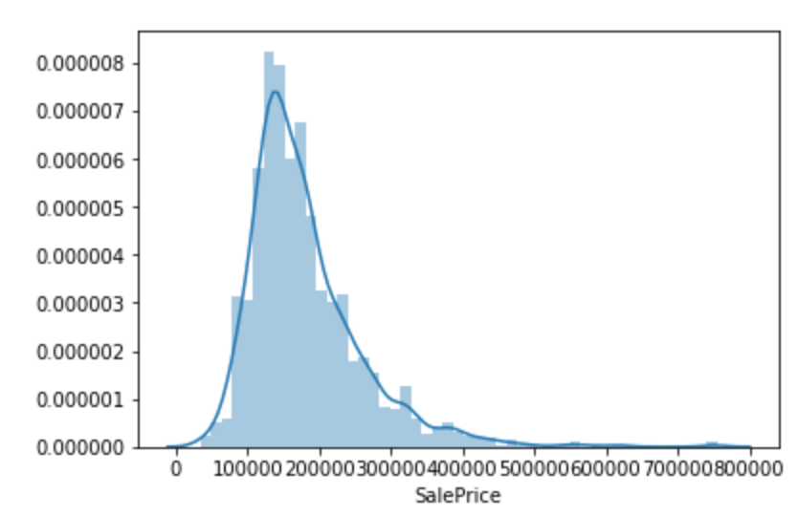
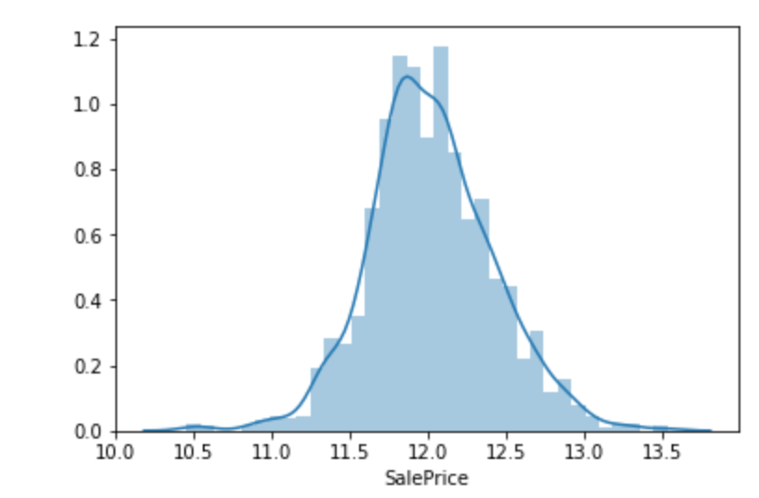
EXAMINING THE DATA
Normalize the data
Log transformation
Avoid uneven variances
Heteroscedasticity
Ability to use parametric statistics
Student’s t-test

Slide 4
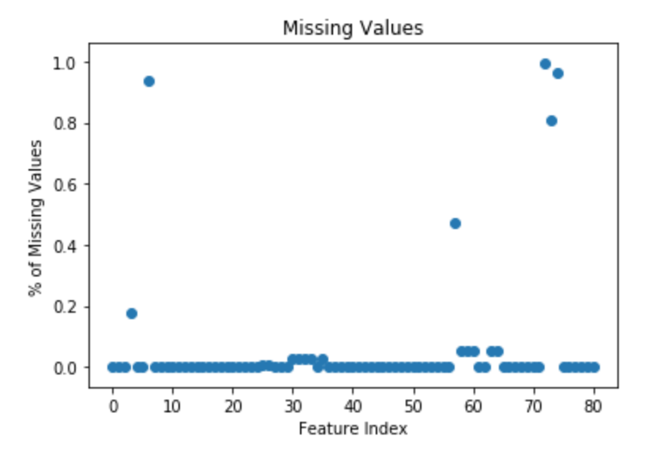
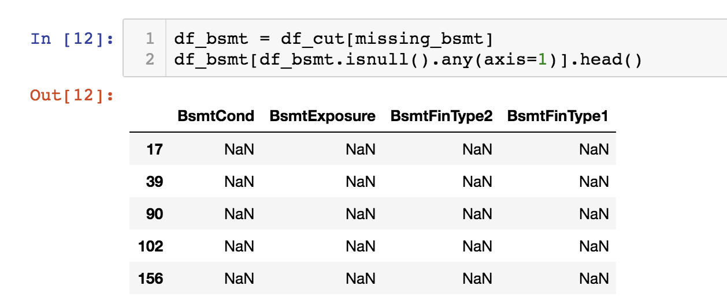
MISSING VALUES
Removed all variables missing more than 10% of rows
Impute/estimate rest of missing values
Numerical values replaced by median
Categorical values - created new values

Slide 5
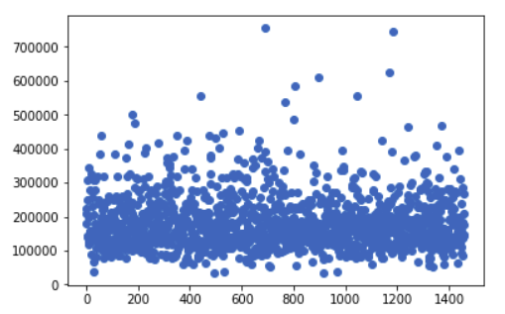
OUTLIERS
Interquartile Range (IQR)
Identified values outside of 1.5*IQR
fence_low = q1-1.5*iqr
fence_high = q3+1.5*iqr
Identified ~30 values
Removed 2

Slide 6
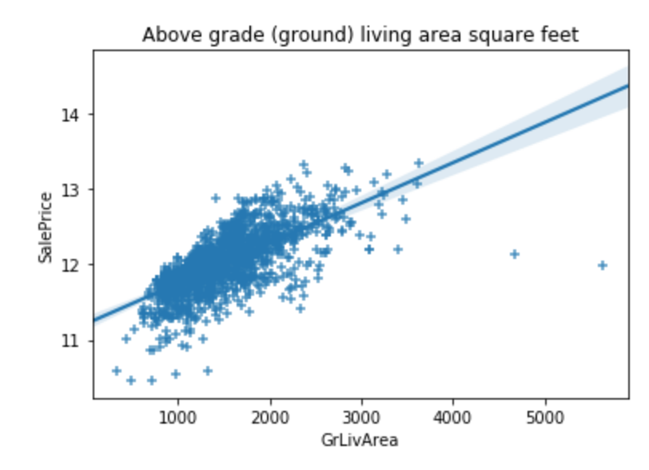
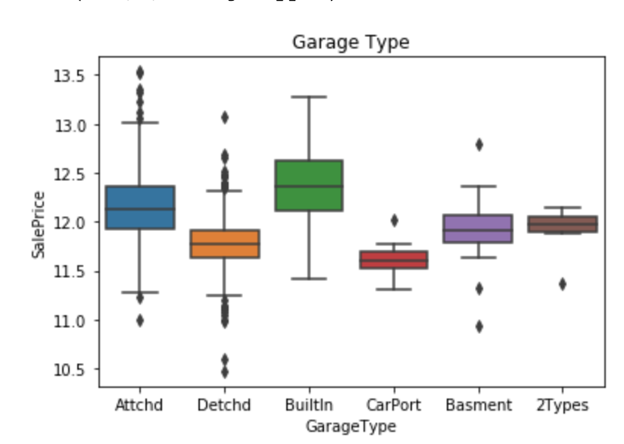
IDENTIFYING VARIABLES
Numerical Features
Categorical Features

Slide 7
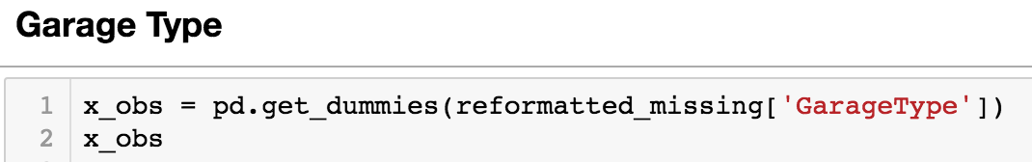
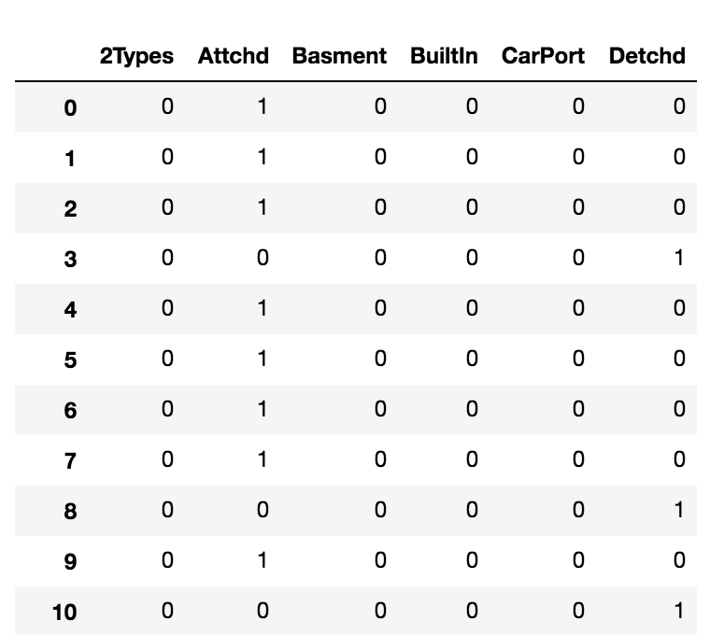
CATEGORICAL FEATURES
Replace words with integers
Now we can use the same statistical tests we used on the numeric features

Slide 8
FINDING PREDICTIVE POWER
Correlation
Maximal Information Coefficient
RandomForest
GOAL: Find the best features to add to our final model

Slide 9
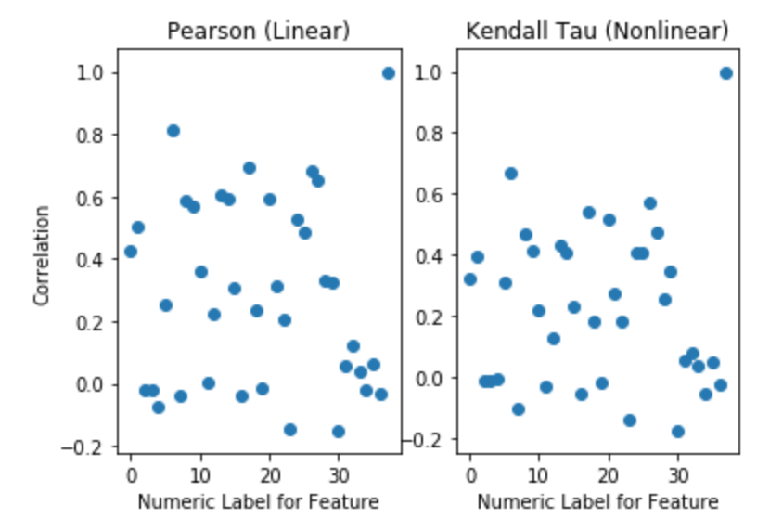
CORRELATION
Linear vs Non-Linear measures
Linear Trends: Pearson’s r
-1 to 1 range
Non-Linear: Kendall’s tau
0 is no relationship
1 is perfect relationship

Slide 10
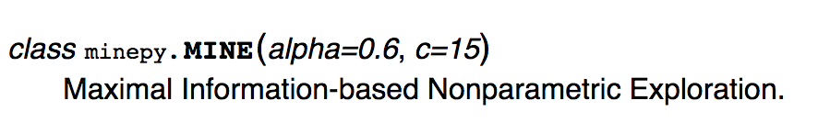
MAXIMAL INFORMATION COEFFICIENT
MIC tests both the linear and non-linear association between two variables
MIC is a “weaker” test that is broader in its ability to capture associations
We used this measure to solidify our selections from our correlation measures (pearson’s r and kendall’s tau)

Slide 11
RANDOMFOREST
Requires very little preparation
Automatically deals with multicollinearity
Collect the features with the highest contributions or weights

Slide 12
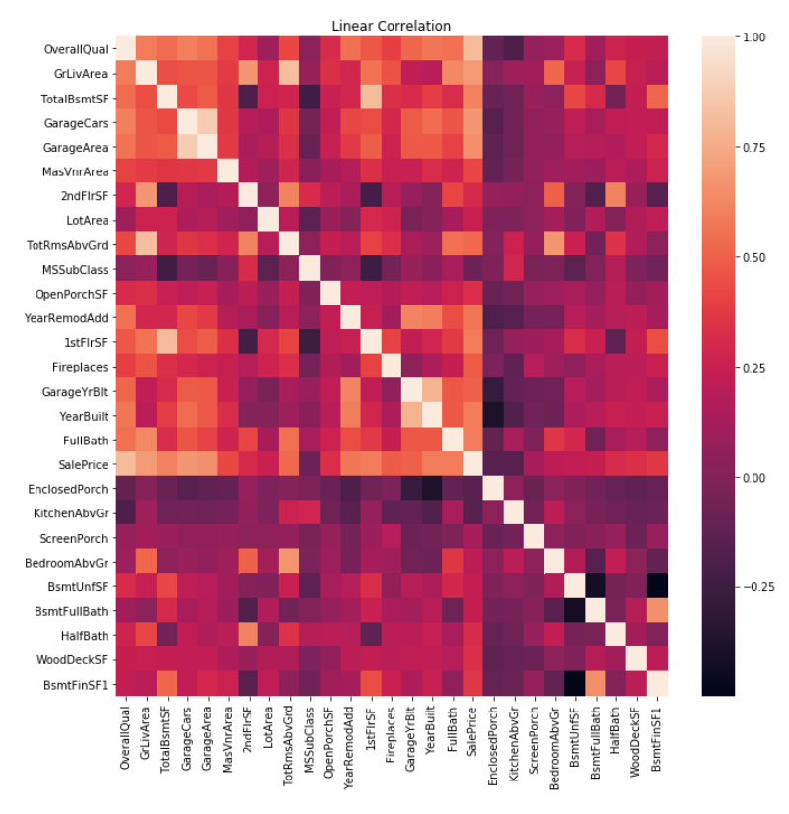
FEATURE EXPLORATION & ENGINEERING
Multicollinearity
Two features are highly correlated
Leads to overfitting
Dropped 3 variables because they were highly correlated

Slide 13
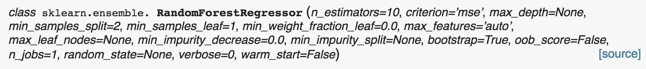
Building A Model
Training vs Testing Data
Grid Search and Hyperparameters
Base Model
Lasso
Ridge
RandomForestRegressor

Slide 14
Model Stacking
Ensemble Method: combining weak learners to make a stronger learner
Stacking
Training, Validation, Testing Sets
Predict on validation using Base Models
Use predictions as features for Meta Model

Slide 15
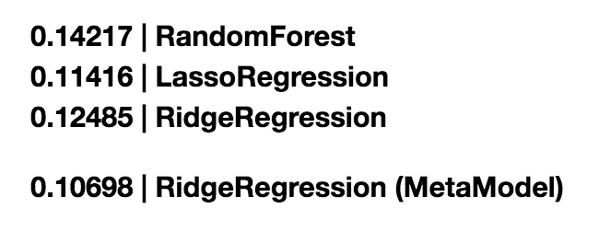
Results
70, 15, 15 (%) split on data
Training on 15% captures information from 70%

