Slide 1
FBLA Quiz
Salil Naik
Notes:
Hi my name is Salil Naik and I’m here to propose to you my solution for the FBLA Quiz, and before I get started I would just like to that you very much for your time and your consideration of my proposal, I have spent a lot of time on this and I hope we can move forward with it in the future. So let’s get into it!

Slide 2
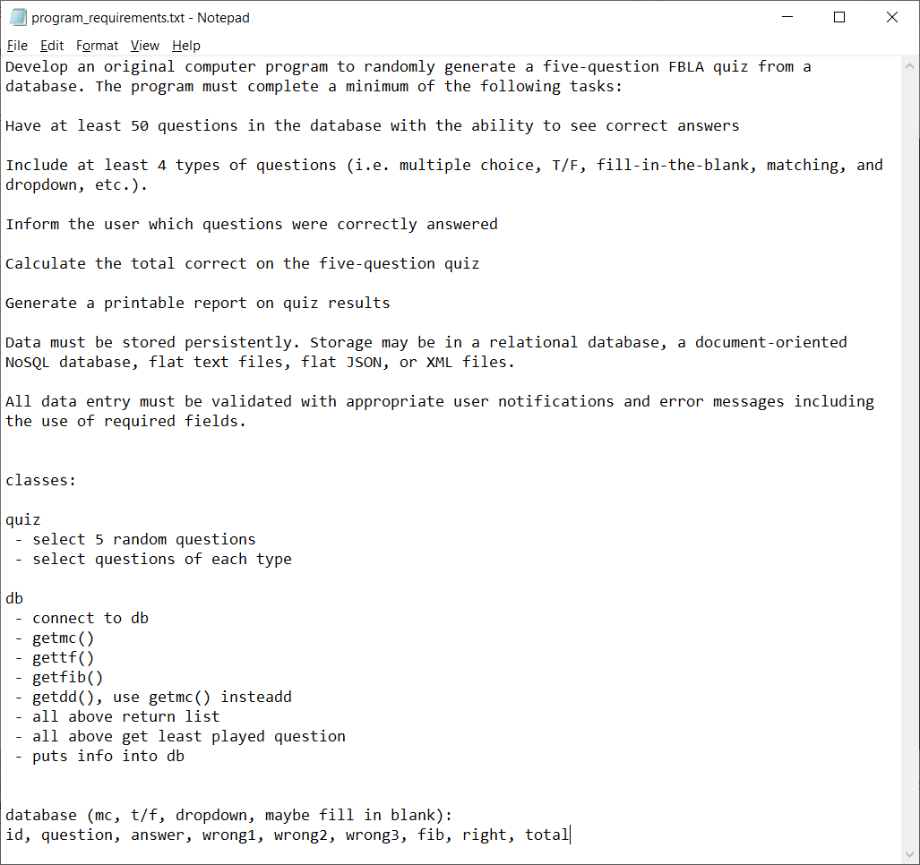
Notepad Planning
Notes:
First I would like to start off with the stage that all great ideas go through: planning. To me, this stage is the most important. If you don’t plan, your code will turn out like a soap opera: where you write everything as you go along until you back yourself into a corner and you have to start bringing characters back from the dead. So clearly, I find planning extremely important which is precisely why I spent so much time on it.
The first thing I did was start off with a simple text document. Here, I layed out all the requirements of the program and a basic vision of what I wanted the classes to look like.

Slide 3
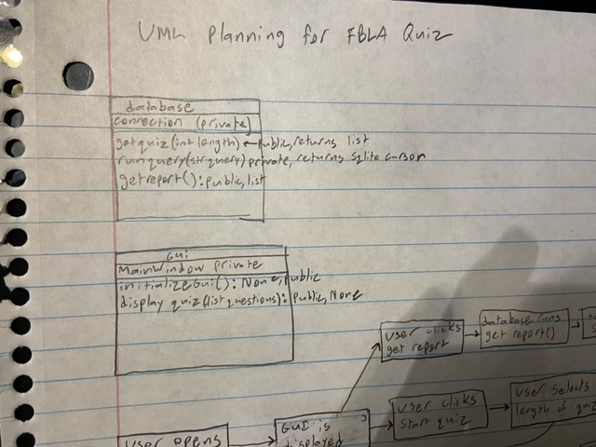
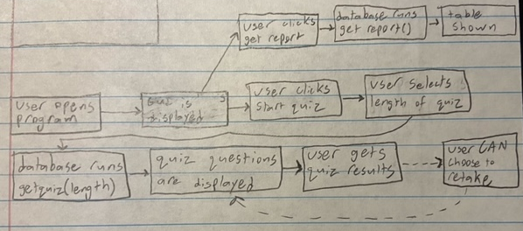
Software Diagramming
Notes:
I then made a basic UML diagram, and you can see two of the classes from that diagram on the right. I also created a flowchart to outline the basic actions the user may take and how the program will respond. Both these diagramming techniques, UML (Unified Modeling Language) and flowcharts, are used professionally by Software Developers. I wanted to keep this production process as professional and unified as possible so I used these techniques as well.

Slide 4
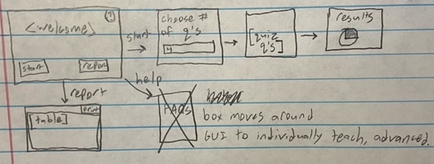
GUI Planning
<?xml version="1.0" encoding="UTF-8"?>
<ui version="4.0">
<class>MainWindow</class>
<widget class="QMainWindow" name="MainWindow">
<property name="geometry">
<rect>
<x>0</x>
<y>0</y>
<width>601</width>
<height>335</height>
</rect>
</property>
<property name="windowTitle">
<string>FBLA Quiz ~ Home</string>
</property>
<widget class="QWidget" name="centralwidget">
<widget class="QLabel" name="welcomeText">
<property name="geometry">
<rect>
<x>10</x>
<y>10</y>
<width>581</width>
<height>141</height>
</rect>
</property>
<property name="font">
<font>
<pointsize>15</pointsize>
</font>
</property>
<property name="text">
<string>Hello! Welcome to the FBLA Quiz! Select the Begin button below to enter the quiz. Or if you have already taken the quiz, select the Report button below to view your question stats.</string>
</property>
Notes:
So then, I began planning the GUI. Above, on the piece of paper, I used a combination of GUI diagramming and flowcharts to show how the GUI will look in different areas of the program. And then, I created a UI file, written in XML, which is once again a professionally used GUI diagramming tool. I included a short excerpt from this file as the entire file is way too big to fit on this slide.
I also want to mention something else: even tho I did so much planning, things still changed. I needed helper methods, I needed to create more variables, these are just examples. For all these additions, I went back to the planning board. I didn’t redo everything, obviously, but I thought for a couple minutes about the proper way to implement these into the existing code. I didn’t simply start writing the code think that I will figure it out later. This is one thing that sets my solution apart from the others you may have seen. Every single line of code in here has been given deliberate thought and planning to be efficient for both the programmers as well as the end user.

Slide 5



Technologies Used
Notes:
SQLite is a relational database, relatively lightweight and fast, built on C language. I didn’t need too heavy queries so SQLite worked fine for simple CRUD operations.

Slide 6
GUI Pros and Cons
PyQt5
Tkinter
Pros:
Variety of widgets
Good looking GUI
Based on Qt
Cons:
More difficult than Tkinter
Pros:
Easy to code
Personal experience
Cons:
Very few widgets
Bad looking GUI
Not as stable
Notes:
C++ is a lower level programming language, works on more platforms, more stable, quicker

Slide 7
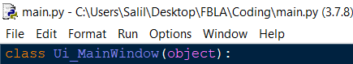
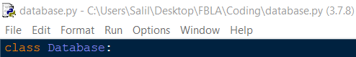
Program Structure and Flow
Notes:
The program contains two different files: main.py and database.py. The names should be pretty self explanatory. The Main.py file defines a class called Ui_MainWindow which creates the GUI of the application. The database.py file defines the database class which, as expected, interfaces with the database and formats the results to feed into the gui. So every time the gui needs to interface the database, it calls the Database class. This separation of powers improves security of the database, prevents corruption of the data, and simply makes interfacing the database simple with higher levels of abstraction.
The Database even includes a dynamic backup feature. This way, your data is safe in the very unlikely event that the GUI crashes.

Slide 8

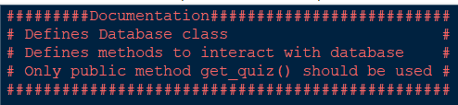
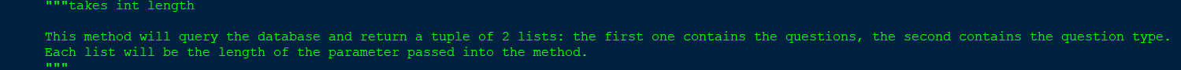
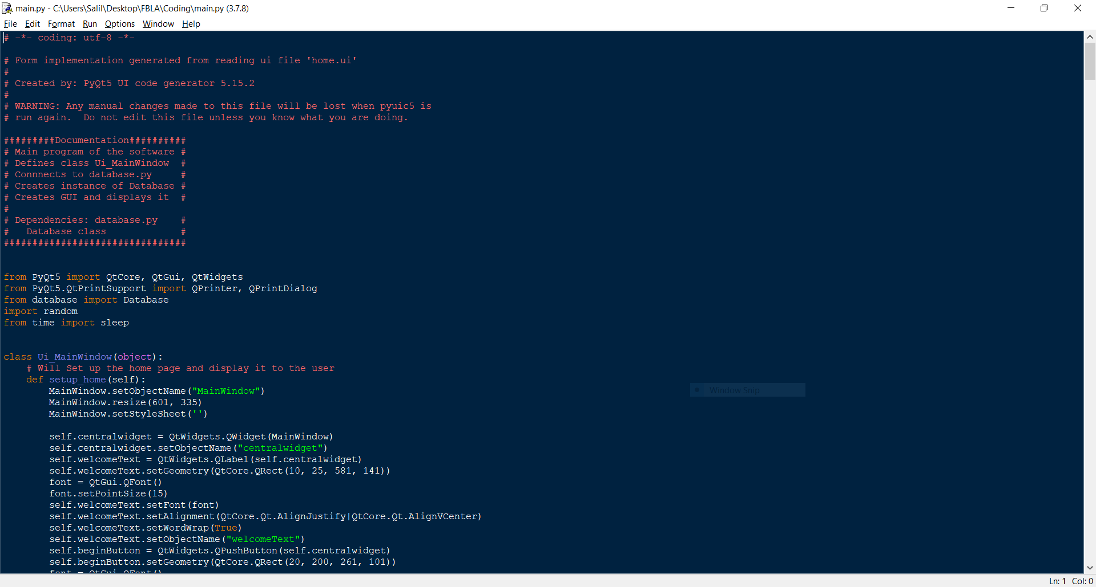
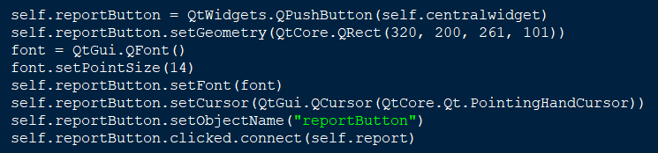
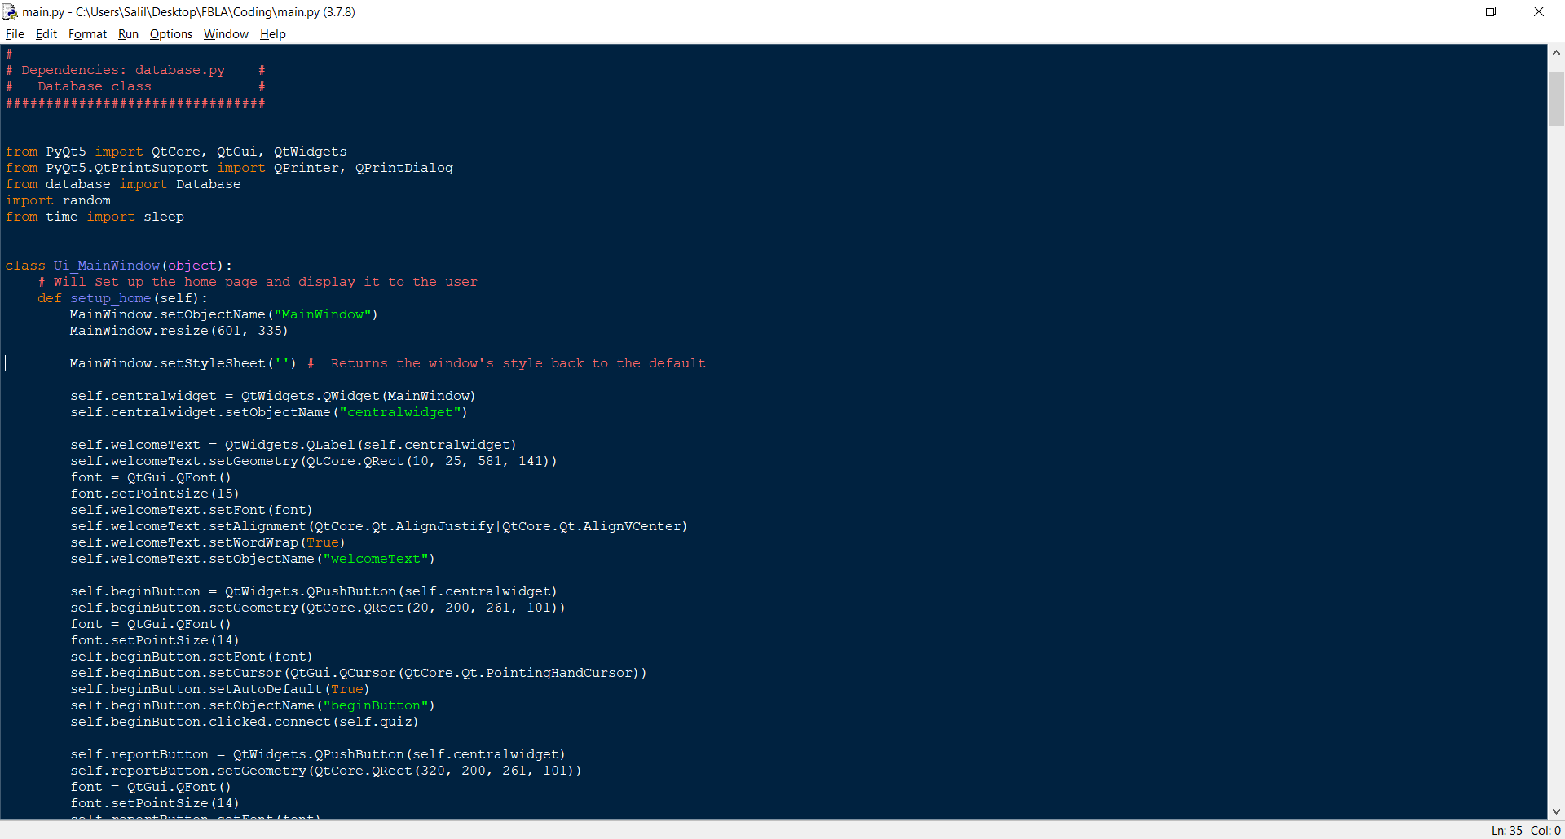
The Code
Notes:
So now, let me get into the actual coding process. Now, I have been coding since the fourth grade, I have a lot of experience in writing bad code. But of course, I maintained professionality by using the PEP 8 standard for Python. This formatting standard in used in many professional environments and encourages collaboration with code. The documentation in the top left corner also encourages this. This tells the programmer what the program will do and how they should implement it. This documentation works in conjuction with the readme file in the program to guide developers as they collaborate to modify and improve this code. I also followed the standards for PyQt5, for example in the camel case in the bottom right picture. This same picture also shows that I appropriately named the identifiers to be intuitive and easy to understand. Finally, I used inline comments, as you can see in the bottom picture, to tell what the program is doing, or to clarify a confusing block of code.

Slide 9
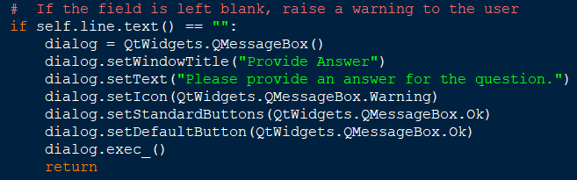
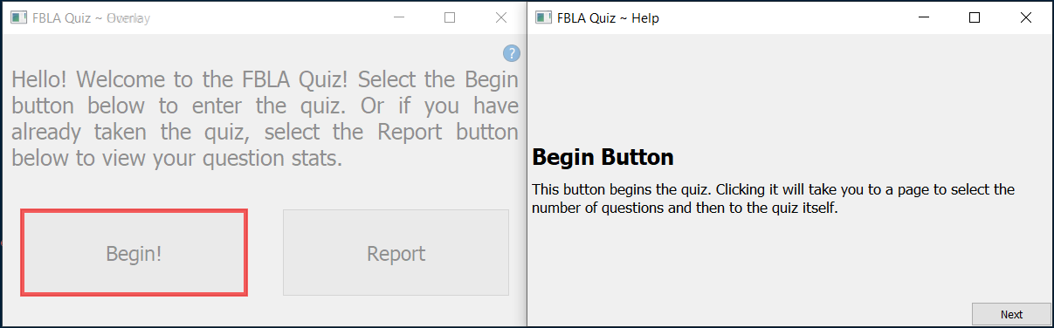
User Experience
Notes:
Through this whole process, I wanted to emphasize the user experience. The if-then statement in the top right saves the user steps by noticing a possible mistake before it occurs. If this block hadn’t been in place, the user may not have gotten the correct results from the quiz and the data may have been corrupted. This data corruption is also mitigated by the aforementioned dynamic backup system, keeping the database safe. Now, I recognize that not everyone is as technologically savvy which is why included an advanced help feature. Rather than a simple FAQ section or a drab block of text, I went above and beyond. This intelligent help menu will guide the user through the program and will explain each and every action they can take.

