Slide 1

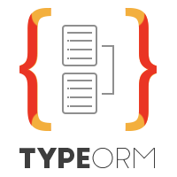
Design Patterns

Slide 2

Hierarchical pattern
Adjacency List
Closure Table
Graph model
1
2
3
4
Id | Username
1 | Bob
2 | Anwar
3 | Aman
Node
from | to | Rel_Type
1 | 2 | Friend
2 | 4 | Blocked
Edge

Slide 3
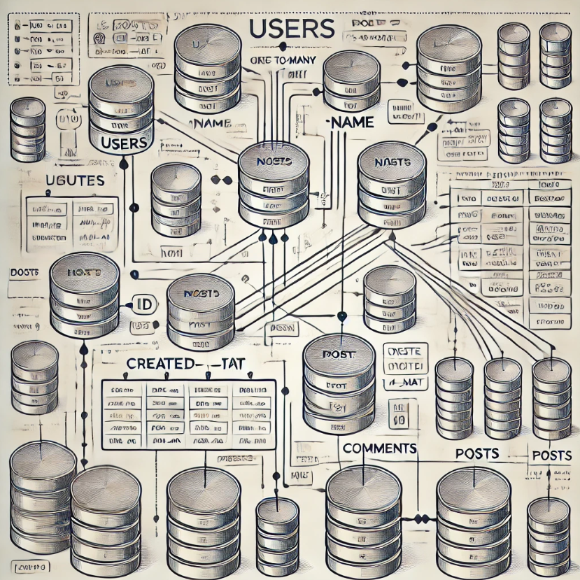
Association pattern
OneToMany
OneToOne
ManyToMany

Slide 4
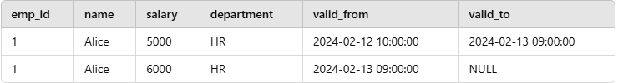
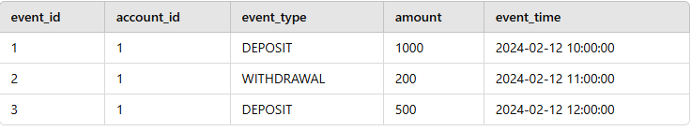
Data Versioning & Auditing Patterns
Temporal Tables – Uses valid_from and valid_to timestamps to track changes.
Event Sourcing – Stores every change as an event.
Soft Deletes – Uses an is_deleted flag instead of deleting records.
Temporal Tables
Event Sourcing – Stores every change as an event.
Concept
Instead of storing only the latest state of a record, we log every change as an event. The system can reconstruct the current state by replaying events.
✅ Use Cases
✔ Financial transactions (ledgers, banking systems) ✔ Order history in e-commerce ✔ IoT data logging

Slide 5
Data Versioning & Auditing Patterns
Temporal Tables – Uses valid_from and valid_to timestamps to track changes.
Event Sourcing – Stores every change as an event.
Soft Deletes – Uses an is_deleted flag instead of deleting records.
Cart:
Id | item
1 | Apple
2 | Oranges
3 | Bananas

Slide 6

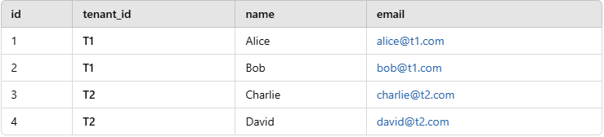
Multi Tenant Pattern
What is Multi-Tenant Architecture?
Multi-tenancy is a software architecture where a single application instance serves multiple tenants (clients, companies, or users), keeping their data logically separated while sharing common infrastructure.
Shared DB, Shared Schema.
Shared DB, separate schema.
Separate DB.

Slide 7
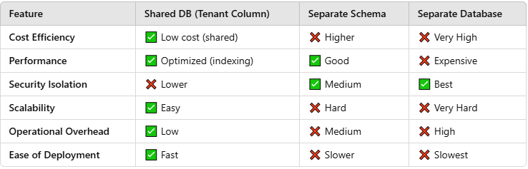
Multi Tenant Pattern
Shared DB, Shared Schema.

Slide 8
Pre requisites
Docker and Docker compose
Basic SQL Script
Type script Basics
Express JS Basics

Slide 9
Introduction to Database Modeling Technique Using Type ORM
Course Introduction
Course Contents
Pre-requisites
Installation
DB Schema Design Patterns and Data Consistency using Locking and Transactions
Hierarchical Pattern: Adjacency List
Hierarchical Pattern: Closure Table
Association Patterns: Bi-Directional One To One
Association Patterns: Bi-Directional One To Many
Association Patterns: Many To Many
Versioning Pattern: Temporal versioning
Versioning Pattern: Event Sourcing
Multi Tenant Pattern: Part-1
Multi Tenant Pattern: Part-2
Multi Tenant Pattern: Part-3
Virtual Table Pattern
Soft Delete Pattern
Graph Table Pattern
SQL Injection Theory and Prevention Practical
Locking
Learn Type ORM Fundamentals
Normalization Topic
Type ORM Manager v/s Repository pattern
Project Folder structuring
All about Type ORM Entities
Saving and Updating Entity
Column Definitions and Transformers
Uni-directional One To One With Inheritance
Query Builders
Bonus: Book Store Project Implementation Using Type ORM

