Slide 1
DNA Polymerases
Vihang Ghalsasi, phd

Slide 2
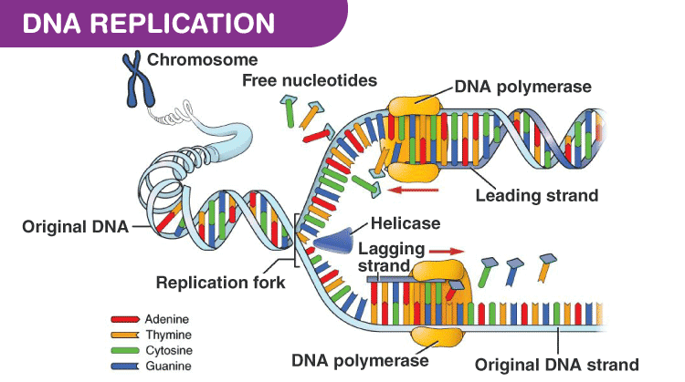
DNA Polymerases
DNA Polymerases are a group of enzymes that catalyze the synthesis of DNA during replication
Functions
Replication
Proofreading
Repair
Prokaryotic polymerases: I, II, III, IV, and V
Eukaryotic polymerases: δ, α, γ, ε
T4 DNA polymerase: obtained from T4 bacteriophage

Slide 3
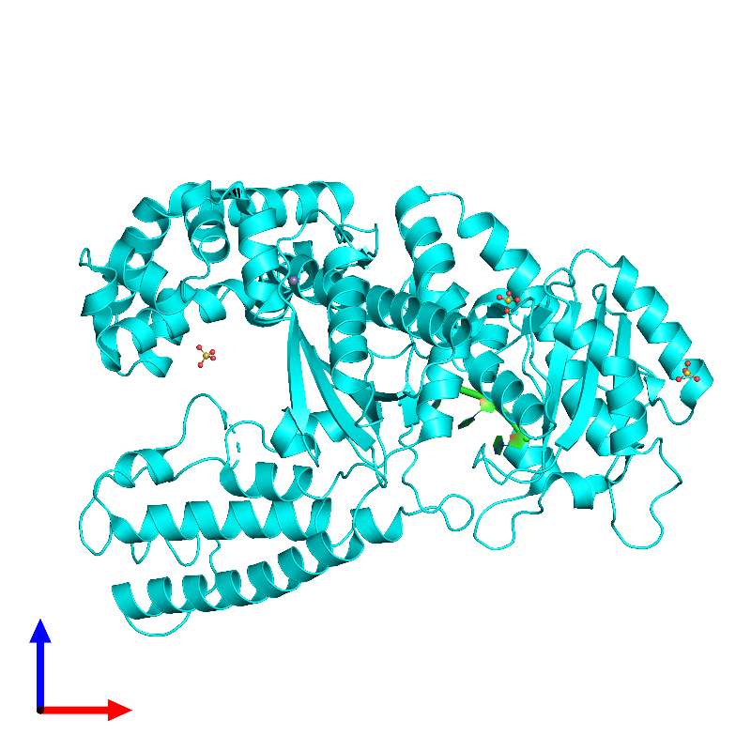
DNA polymerase I
Obtained form E. coli
Activities
5’ → 3’ synthesis/polymerization
3’ → 5’ exonuclease (proofreading)
5’ → 3’ exonuclease (primer removal)
Applications
DNA labelling by nick translation
DNA end blunting of 5'- and 3'-overhangs
cDNA synthesis from RNA template
PDBe › 1d8y

Slide 4
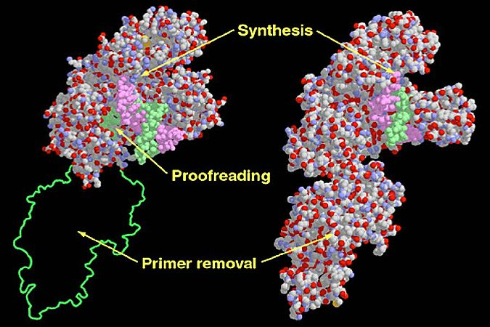
DNA Polymerase I, Klenow Fragment
A large protein fragment produced when DNA polymerase I from E. coli is enzymatically cleaved by the protease subtilisin
Activities
5’ → 3’ synthesis/polymerization
3’ → 5’ exonuclease (proofreading)
Applications
Filling in receded 3' ends of DNA fragments to make 5' overhang blunt
Digesting away protruding 3' overhangs
Preparation of radioactive DNA probes

Slide 5
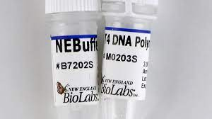
T4 DNA Polymerase
Obtained from T4 bacteriophage
Activities
5’ → 3’ synthesis/polymerization
3’ → 5’ exonuclease (proofreading)
High fidelity
Better processivity
Applications
Large gap filling
Chewing away of 3’ ends
Radiolabeling of ends
Site-directed mutagenesis

Slide 6
Reverse transcriptase
RNA-dependent DNA polymerase involved in the synthesis of DNA using RNA as a template
Obtained from retroviruses such as Avian Myeloblastosis Virus and Moloney Murine Leukemia Virus
Naturally required for
Retroviral integration into the host
Telomere extension
Retro-transposition
Used in molecular biology to synthesize complementary DNA (cDNA) from mRNA
Applications
Gene expression analysis using RT-PCR
Constructing cDNA libraries
Recombinant production of monoclonal antibodies

Slide 7
Taq Polymerase
Klenow fragment was initially used in PCR; however, its optimum temperature is 37 °C and it is not stable at >90 °C
In 1976, Chien et al discovered a thermostable DNA polymerase from hot water springs of Yellowstone National Park and named it as Taq polymerase
Later, Saiki et al demonstrated its use in in-vitro DNA amplification, which is today known as PCR
Properties of Taq polymerase
Optimum temperature 75-80 °C
Half life >2 h at 92.5 °C, 40 min at 95 °C, 9 min at 97.5 °C
Extension rate 1000 bp in less than 10 s at 72 °C
No 3’ → 5’ exonuclease (proofreading), thus low fidelity
Amplified products have A overhangs, enabling TA cloning

Slide 8
Other thermostable polymerases
Pfu DNA polymerase
Isolated from hyperthermophilic archaeon Pyrococcus furiosus
Possesses 3’ → 5’ exonuclease (proofreading), thus higher fidelity than Taq polymerase
Has superior thermostability
Q5 DNA polymerase
Novel polymerase that is fused to the processivity-enhancing Sso7d DNA binding domain
Highest fidelity amplification (~280X higher than Taq) and ultra low error rates
Superior performance for a broad range of amplicons (from high AT to high GC)
Phusion DNA polymerase
Pyrococcus-like enzyme fused with a processivity-enhancing domain
> 50-fold lower error rate than Taq polymerase
Ideal choice for difficult amplicons

Slide 9
Other thermostable polymerases
Hot Start Taq DNA polymerase
mixture of Taq DNA Polymerase and an aptamer-based inhibitor
Inhibits amplification at <45 °C
Deep Vent DNA polymerase
Isolated from Thermococcus litoralis
Extremely high thermostability: half-life of 23 hours at 95°C
5X higher fidelity than Taq
Ideal for GC-rich or looped sequence

