Slide 1
Polymerase Chain Reaction
Vihang Ghalsasi, PHD

Slide 2
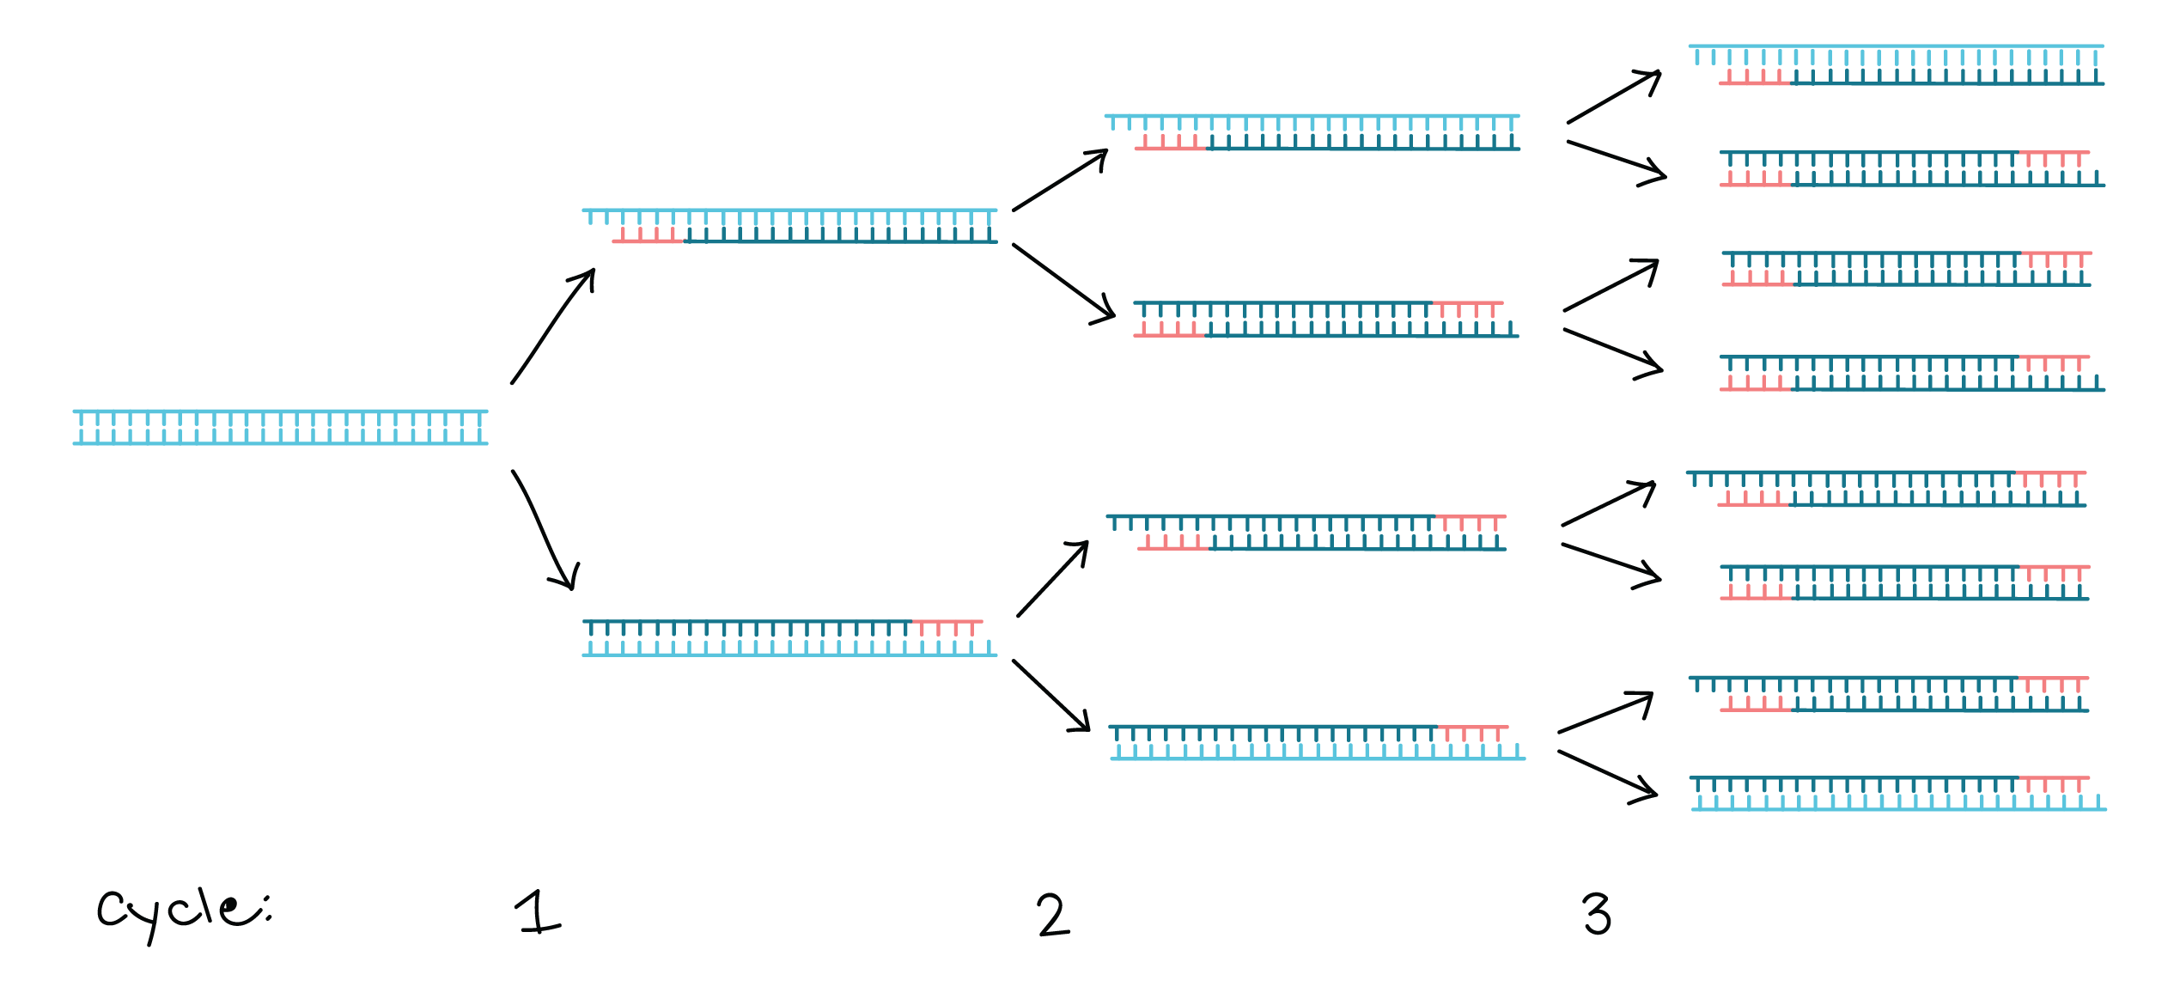
Polymerase chain reaction
A laboratory technique used to make many copies of a specific region of DNA

Slide 3
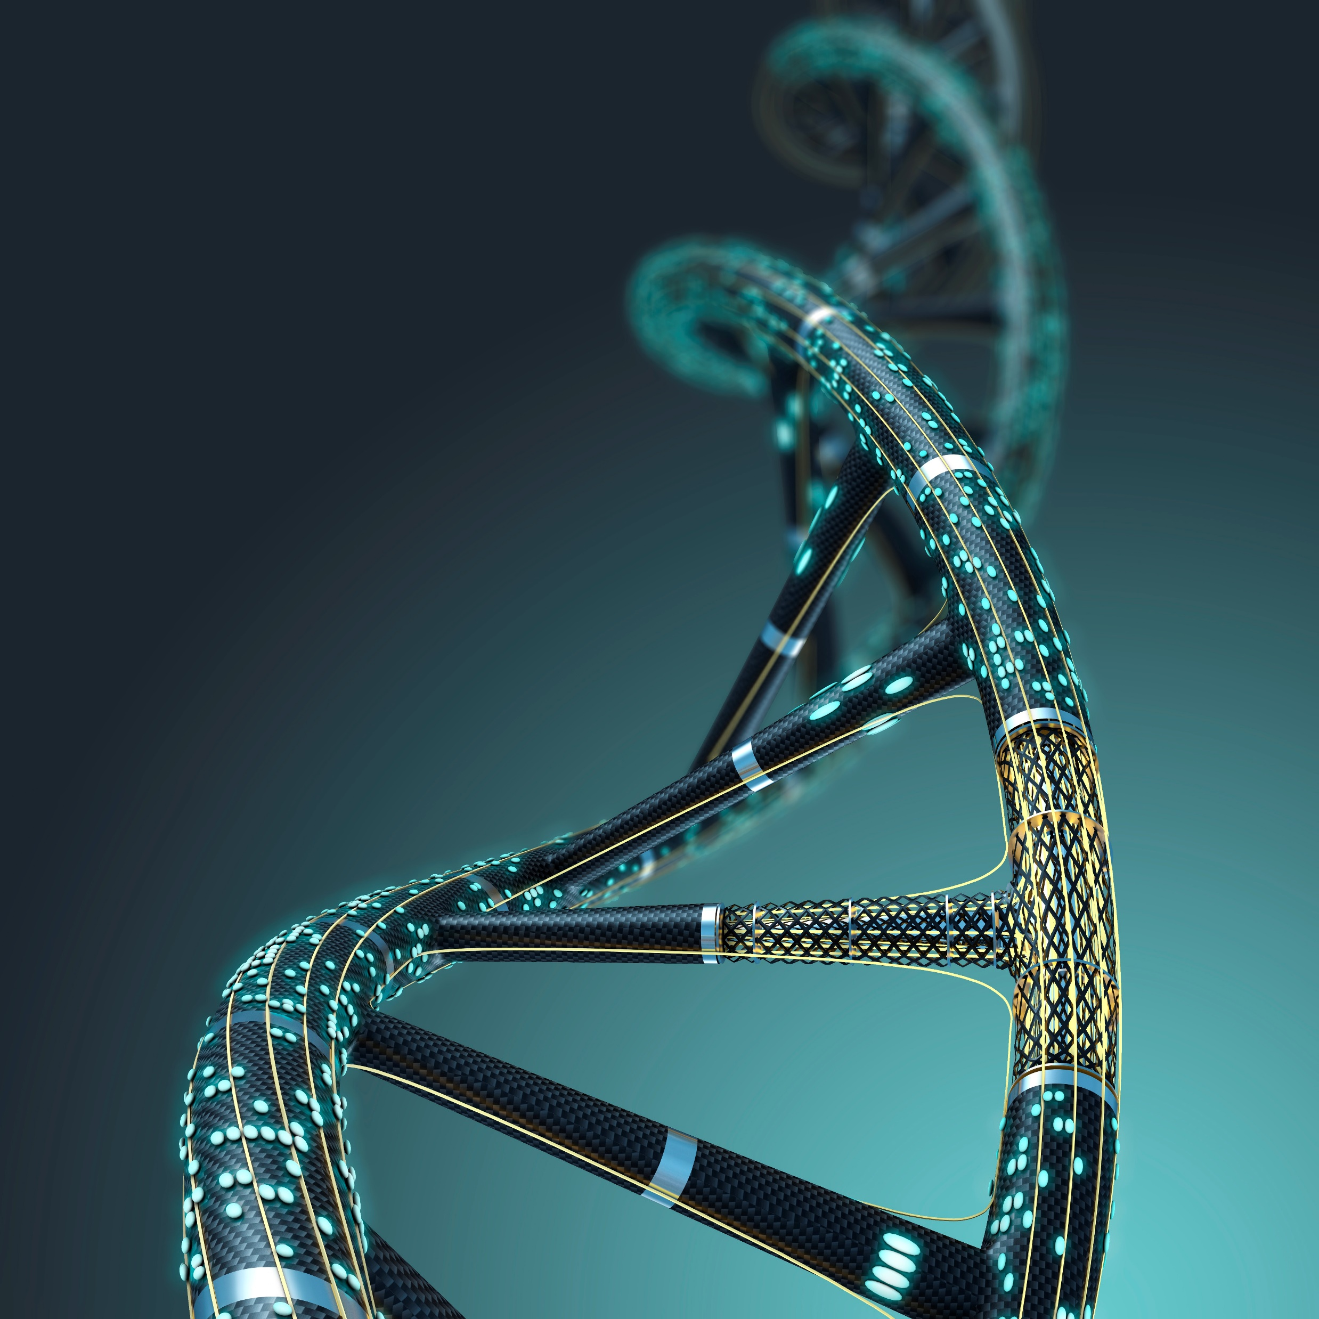
Why amplify DNA?
DNA from source organism is present in very low amounts
The desired sequence of that DNA is present in even lesser amount
Having enough fragments of desired DNA sequence is crucial for further studies

Slide 4
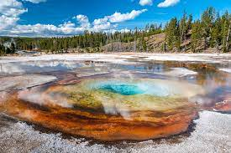
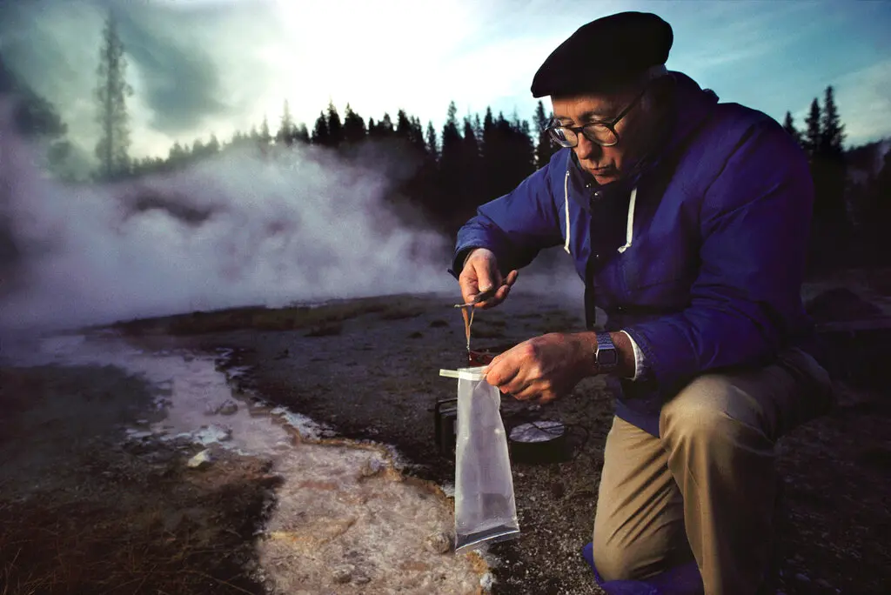
History of PCR
1969: Researchers in the laboratory of Nobel Laureate H. Gobind Khorana made significant advancements in DNA amplification technology using an artificial system of primers and templates to copy DNA segments using a single primer-template complex
1969: Indiana University microbiologists Thomas Brock and Hudson Freeze discovered an extreme species of thermophilic bacterium they named Thermus aquaticus at the Lower Geyser Basin at Yellowstone National Park
Thomas Brock in 1992 at a hot spring in Yellowstone National Park. It was there, 26 years earlier, that he found Thermus aquaticus, a species of bacteria that would be used to develop the chemical process behind PCR testing for the coronavirus.Credit...Peter Menzel/Menzelphoto

Slide 5

History of PCR: important milestones
1971: Kjell Kleppe described a method quite similar to PCR in which a two-primer system might result in replication of a DNA segment in one cycle, which could be repeated by adding a fresh dose of DNA polymerase each cycle
1976: Alice Chien and John Trela from the University of Cincinnati isolated and purified a thermostable DNA polymerase from Thermus aquaticus – very sensibly named Taq polymerase – with a temperature preference of 75-80 degrees Celsius
1977: Frederick Sanger published a novel method for sequencing DNA in 1977 using an oligonucleotide primer, DNA polymerase and modified nucleotide precursors that prevent primer extension in a sequence-dependent manner
1980: Sanger was awarded a Nobel Prize in 1980 for this work

Slide 6
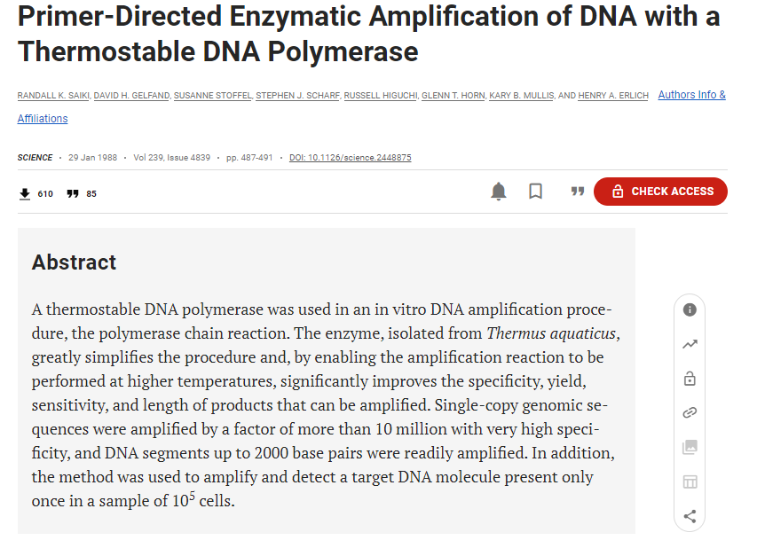
History of PCR: the seminal publication
1983: Kary Mullis, a biochemist at Cetus Corporation, began devising experiments using repeated thermal cycling to amplify small segments of a cloned gene
1985: Mullis and team characterized and honed the process and presented the work at a conference and published in Science
1988: Saiki experimented with polymerase isolated from T. acquaticus and published the work in Science
Discovery turned out to become a game-changer for decades to come!

Slide 7
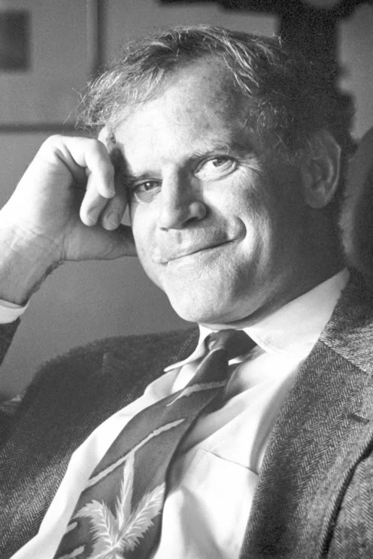
History of PCR: further developments
1988: Cetus Corporation and Perkin Elmer together developed a machine that could rapidly change temperatures; this was the first commercially available Thermal Cycler PCR-1000. This machine along with commercially available Taq polymerase “AmpliTaq Polymerase” became massively successful.
1990s: PCR was adopted for diagnosis, forensic sciences, and fundamental research
1993: Karry Mullis was awarded a Nobel Prize
1991: Another thermostable polymerase Pfu polymerase was derived from a hyperthermophilic archaeon Pyrococcus furiosus. Pfu DNA polymerase, unlike Taq DNA polymerase, has built in 3' to 5' exonuclease proofreading activity, meaning that it could correct nucleotide-incorporation errors, dramatically lower error rate, and offer increased specificity.
2003: Next-generation DNA polymerases called Phusion Polymerases were developed. These were considerably more stable and accurate than Taq polymerases.

Slide 8
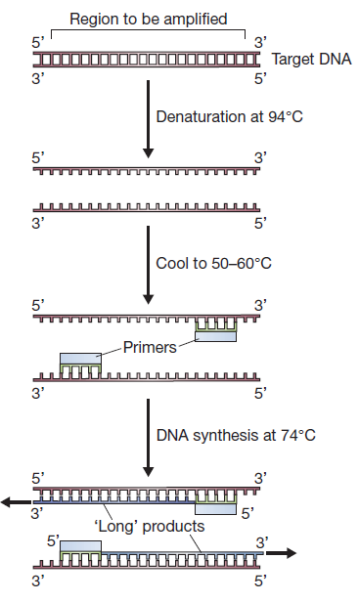
Steps in a PCR
Denaturation
Complete separation of the two strands of double-stranded DNA
Occurs at 94-98 °C
Takes 30 s to 5 min depending on the length of ds DNA
Annealing
Binding of short oligonucleotides called primers to the denatured template DNA
Occurs at 50-65 °C depending on the length and sequence of the primers
Determining the correct annealing temperature is crucial for successful PCR
Extension
Synthesis of a new DNA strand by copying the existing DNA strand with the help of Taq polymerase
Occurs at 72-74 °C
Required time depends on the extension rate of the polymerase and length of DNA sequence to be amplified

Slide 9
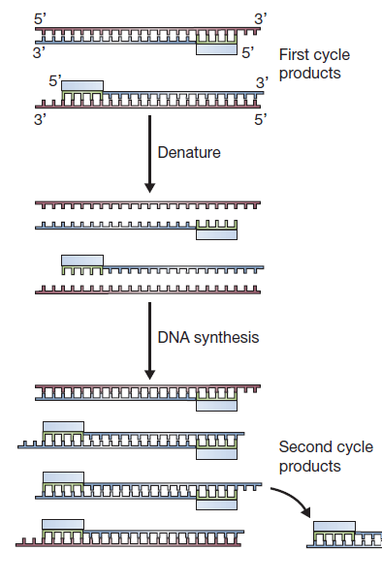
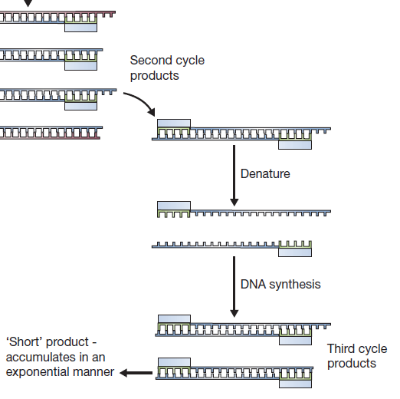
The second and third cycles of a PCR, during which the first short products are synthesized

Slide 10
Components of a PCR
Buffer: Maintains pH, contains salts to maintain the right ionic strength, usually available at 5X or 10X concentrations, provided by the enzyme manufacturer
Template DNA: The DNA that contains the region to be amplified, ideally should be 10-50 ng
Forward and reverse primers: Short oligonucleotides complementary to the ends of the DNA sequence to be amplified
dNTPs: deoxy nucleoside triphosphates, building blocks of DNA, usually 20-500 μM each
Enzyme: Taq polymerase, Phusion polymerase, Pfu polymerase, amount as defined by the manufacturer
Mg²⁺: Required as a cofactor for polymerase at 0.5-5.0 mM, usually included in the buffer
Water: As a solvent for all components
Other optional reagents: DMSO, BSA

Slide 11
Conditions of a PCR
SrNo | Step | Temperature | Time | Purpose
1 | Initial denaturation | 94-98 °C | 5-10 min | To allow complete denaturation of template DNA
2 | Denaturation | 94-98 °C | 30 s | To allow denaturation of template in subsequent cycles
3 | Annealing | As per primer Tm | 15-30 s | To allow binding of primers to template
4 | Extension | 72 °C | As per amplicon length | To allow synthesis of new DNA strand
5 | Final extension | 72 °C | 5-10 min | To allow completion of incompletely synthesized strands
6 | Hold | 4-10 °C | Until stopped | To hold the reaction
Steps 2-4 are repeated 25-35 times in a routine PCR

Slide 12
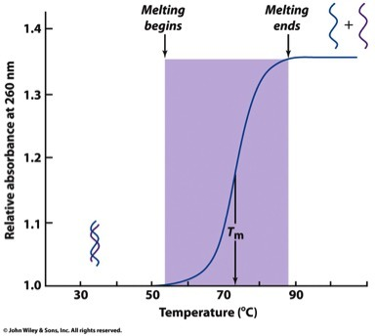
Determining optimum annealing temperature
Melting, i.e., denaturation of DNA, is separation of double stranded DNA into two single strands
Melting starts at ~50 °C and ends at ~90 °C; beyond 94 °C, all of dsDNA is melted
The temperature at which 50% of the dsDNA molecules are melted is known at melting temperature or T_{m}
Tm depends on primer sequence; particularly the proportion of AT and GC
Determined by formula: Tm ≈ 4(G-C) + 2(A-T)
Using online tools is recommended for Tm calculation
Annealing temperature is usually 3-5 °C lesser than the melting temperature of primers

Slide 13
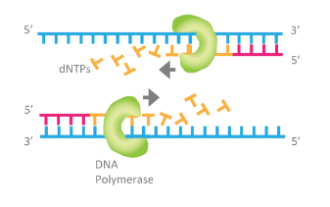
Determining optimum extension time
Extension time depends on the processivity and extension rate of the polymerase
Processivity: the number of base pairs synthesized before falling off
Extension rate: the number of base pairs synthesized per unit time
NEB Taq Polymerase extension rate = 1 min/kb
NEB Phusion High Fidelity DNA Polymerase = 15-30 s/kb
Extension time to be decided based on length and complexity of the amplicon
Manufacturer information must be checked for the respective enzymes

Slide 14
Determining the number of cycles
For a routine PCR, 25 to 35 cycles are performed
If number of cycles is <25, insufficient product will be formed
With increasing number of cycles, dNTPs and primers are exhausted and enzyme is slowly denatured, which results in errors in amplified fragments
Thus, maximum number of cycles for a PCR is 35
Exact number of cycles depends on purpose of PCR: analytical or preparative
Analytical PCR: to detect the presence of certain gene (e.g., diagnosis), requires lesser number of cycles
Preparative PCR: to obtain DNA for cloning, sequencing, or other downstream applications, requires a greater number of cycles
Denaturation
98 °C, 30 s
Initial denaturation
98 °C, 5 min
Extension
72 °C, 40 s
Final extension
72 °C, 5 min
Annealing
58 °C, 30 s
n cycles
Hold
10 °C
until stopped

Slide 15
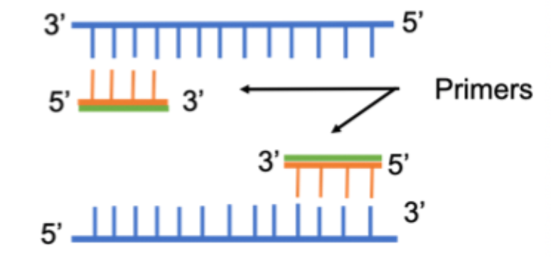
Points to consider while designing primers
Primer length should be 18-25 bp
GC content should be 40-60%
Sequence must be specific to the region to be amplified
Tm difference between forward and reverse primers should not be >5 °C
Should not have self or inter complementary sequences
Should not have homopolymeric regions
Should not form secondary structures
Should not contain internal repeats
Use of online tools such as Primer Blast is recommended

Slide 16
References
Putting the 'P' in PCR: A retrospective on Taq polymerase and the evolution of PCR
Ishino S, Ishino Y. DNA polymerases as useful reagents for biotechnology - the history of developmental research in the field. Front Microbiol. 2014 Aug 29;5:465. doi: 10.3389/fmicb.2014.00465. PMID: 25221550; PMCID: PMC4148896.
Lorenz TC. Polymerase chain reaction: basic protocol plus troubleshooting and optimization strategies. J Vis Exp. 2012 May 22;(63):e3998. doi: 10.3791/3998. PMID: 22664923; PMCID: PMC4846334.
Gene Cloning and DNA Analysis. TA Brown. Chapter 9

