Slide 1
Variants of Polymerase Chain Reaction
Vihang Ghalsasi, PHD

Slide 2
Topic overview
Why use variants?
Hot start PCR
Touchdown PCR
Gradient PCR
Colony PCR
Inverse PCR
Assembly PCR
qPCR and RT-PCR

Slide 3
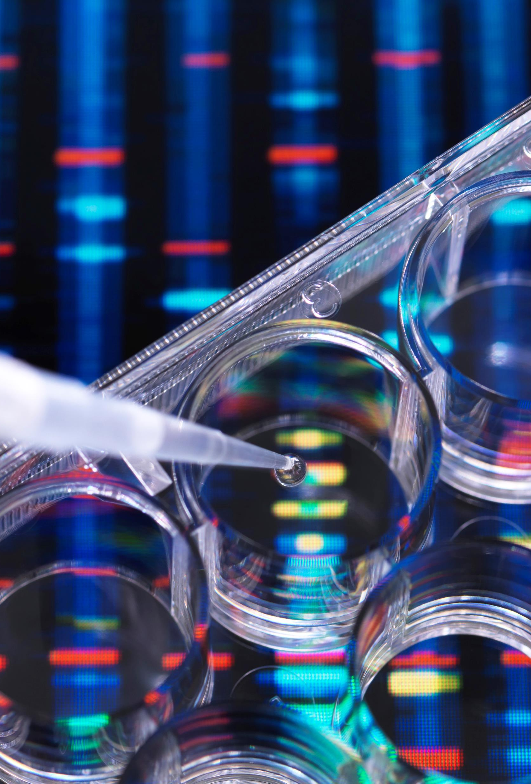
Why use variants?
To improve specificity (hot start PCR, touchdown PCR, gradient PCR)
To expediate analysis (colony PCR)
To achieve combination of genes (assembly PCR, inverse PCR)
To achieve high sensitivity (qPCR)
To perform specialized analysis (digital PCR)

Slide 4
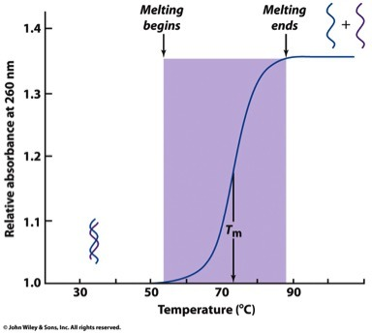
Annealing temperature and amplification specificity
Annealing temperature << Tm
More number of annealed species vs melted species
Low specificity, more yield
Annealing temperature >> Tm
More number of melted species vs annealed species
High specificity, low yield

Slide 5
Hot-start PCR
A technique that reduces non-specific amplification at low temperature
Can be manually performed by adding the polymerase after heating the PCR reaction mixture to template DNA denaturing temperature
Commercially available hot-start PCR polymerase enzymes
Inhibitors that inhibit the activity of the polymerase at ambient temperature
Antibodies that bind the polymerase at ambient temperature
Engineered enzymes that are NOT active at ambient temperatures
Dissociation of inhibitor at high temperature
n cycles
Polymerase-inhibitor complex
Non-specific amplification due to polymerase activity at ambient temperature

Slide 6
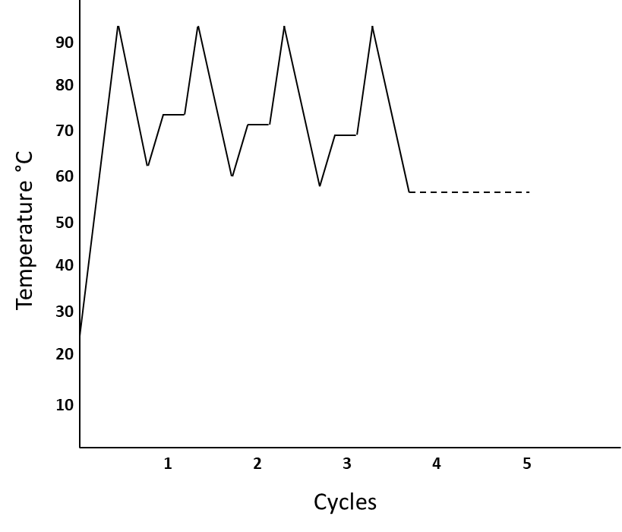
Touchdown PCR
The initial annealing temperature is higher than the T_{m} of the primers
It is lowered over the subsequent cycles to reach slightly below the T_{m}
Higher annealing temperature favours specific annealing but lowers the yield
Stepwise reduction in the annealing temperature improves the yield
Efficient technique to achieve specific amplification when initial results are nonspecific

Slide 7
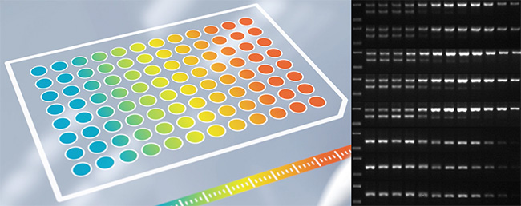
Gradient PCR
Sometimes, theoretically calculated annealing temperature fails to provide optimum yield and specificity
In such cases, optimum annealing temperature needs to be determined empirically
Temperature range of ±10 °C from the theoretical Tm is chosen
Thermocycler program is set
Thermocycler assigns different temperatures to different columns on its block
Reactions are set in different columns and executed
Upon agarose gel electrophoresis, annealing temperature with maximum yield and specificity is determined
https://handling-solutions.eppendorf.com/sample-handling/amplification/detailview-principles/news/gradient-pcr-for-optimization/

Slide 8
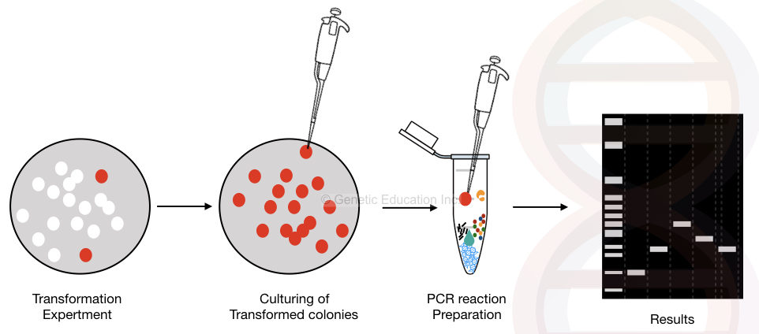
Colony PCR
Bacterial or fungal colonies are picked and added directly to the PCR mixture
Initial denaturation dissolves cell wall and cell membrane and releases DNA into the solution
Released DNA acts as a template
Reactions are analyzed on agarose gel along with appropriate controls
Size of the amplification reveals the presence/absence of gene of interest
Used for rapid screening, as it does not require DNA isolation
https://geneticeducation.co.in/colony-pcr-principle-process-protocol-advantages-and-limitations/

Slide 9
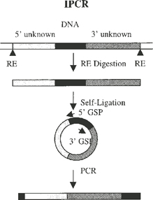
Inverse PCR
Same as routine PCR but with primers oriented in opposite directions
Can be used only circular DNA template
Amplifies DNA region flanking the region of interest
Used for identifying unknown flanking regions
Restriction digestion with a single enzyme
Self ligation
Inverse PCR
Sequencing
Also used for generating linearized vector for cloning

Slide 10
Assembly PCR/overlap extension PCR
Used for assembling/joining two DNA fragments without restriction digestion and ligation
Assembling DNA fragments, A and B
Design primers for amplification of A: Af and Ar
Design primers for amplification of B: Bf and Br
Ar and Bf should have overhangs complementary to each other
Amplify A and B separately
Pool the PCR products and run another PCR with pooled PCR products as templates and Af and Br as primers
Complimentary regions anneal to each other and provide free 3’ OH end for extension
After subsequent cycles, A+B fragment is obtained
Optimization of annealing temperature, number of cycles, and template DNA concentration is required for successful PCR

Slide 11
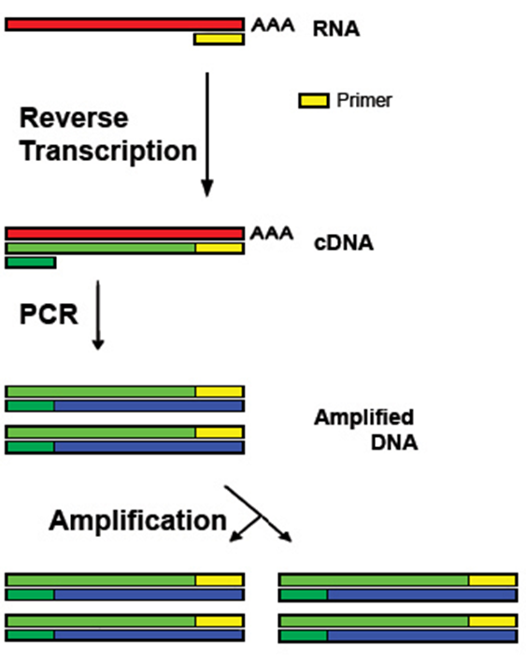
Reverse transcription PCR (RT-PCR)
Reverse transcriptase: an enzyme that can synthesize complimentary DNA (cDNA) from a single-stranded mRNA as a template
Naturally found in viruses that have RNA as genetic material
When reverse transcription is combined with PCR, amplification of mRNA sequence is achieved
Isolated mRNA is used as template
Oligo dT primer binds to poly A tail of eukaryotic mRNA
Reverse transcriptase synthesizes cDNA from mRNA
Taq polymerase synthesizes more copies of cDNA

Slide 12
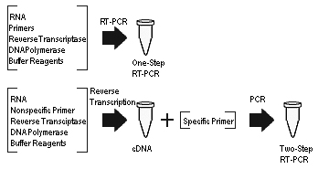
One-step vs two-step RT-PCR
One-step RT-PCR
cDNA synthesis and its amplification performed in a single tube
Contains RT and Taq polymerase in the same reaction mixture
Less laborious and avoids pipetting errors
mRNA is prone to degradation, less accurate
Preferred when multiple samples are to be screened
Two-step PCR
cDNA synthesis occurs in one tube and PCR amplification in another
Laborious and prone to pipetting errors and contamination
More accurate and sensitive
Preferred when fewer samples are to be analyzed

Slide 13
Quantitative PCR/real time PCR
A technique used for monitoring the progress of a PCR reaction in real time
Based on detection of fluorescence produced by a reporter molecule, which increases as the reaction proceeds
Accurate quantification of minimal amounts of template DNA
Advantages
Easy to perform
Highly sensitive, specific, and precise
No need of post-PCR processing
Provides a scope for automation

Slide 14
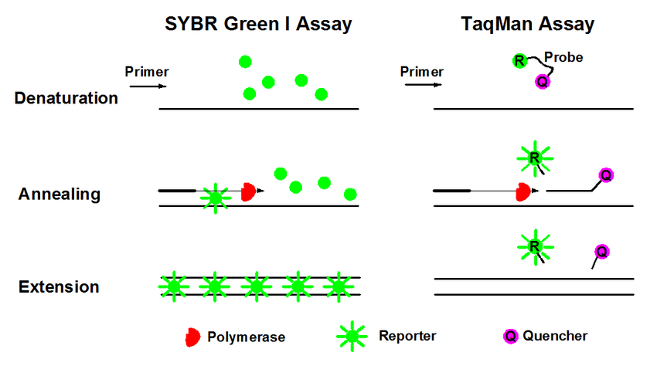
Quantitative PCR/real time PCR
Different chemistries
SYBR Green fluorescent dye
Taq Man probe
Molecular beacons
Scorpion probes
Analysis methods
Standard curve method
Comparative Ct method
Applications
Detection/diagnosis
Understanding expression levels

Slide 15
RT-qPCR
When reverse transcription PCR is performed as a quantitative or real time PCR, it is known as RT-qPCR, commonly written as RT-PCR
RT-PCR to be never used for real time PCR to avoid confusion
Allows direct detection of mRNA in a one-step reaction
Important in diagnosis
Used widely for COVID-19 diagnosis
Technique | Abbreviation
Polymerase chain reaction | PCR
Reverse transcription polymerase chain reaction | RT-PCR
Real-time polymerase chain reaction | qPCR
RT-PCR / qPCR combined technique | qRT-PCR or RT-qPCR

Slide 16
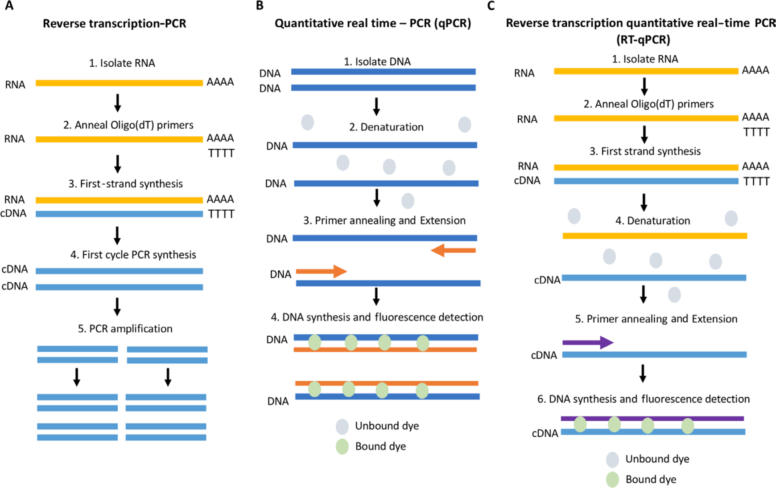

Slide 17
PCR vs qPCR
PCR
qPCR
Results obtained only at the end of the reaction
Requires agarose gel electrophoresis to analyze the reaction products
Does not require specialized instrumentation
Only qualitative
Analytical as well as preparative
Less sensitive and more time-consuming
Low cost
Results can be monitored while the reaction is ongoing
Does not require agarose gel electrophoresis
Requires specialized thermocycler with provision to detect fluorescence
Qualitative as well as quantitative
Only analytical and not preparative
More sensitive and less time-consuming
High cost

Slide 18
References
Gene Cloning and DNA Analysis, TA Brown, Chapter 9
Grace Adams; A beginner’s guide to RT-PCR, qPCR and RT-qPCR. Biochem (Lond) 22 June 2020; 42 (3): 48–53. doi: https://doi.org/10.1042/BIO20200034
Mao X, Liu C, Tong H, Chen Y, Liu K. Principles of digital PCR and its applications in current obstetrical and gynecological diseases. Am J Transl Res. 2019 Dec 15;11(12):7209-7222. PMID: 31934273; PMCID: PMC6943456.
Further reading:
Taylor, S.C., Laperriere, G. & Germain, H. Droplet Digital PCR versus qPCR for gene expression analysis with low abundant targets: from variable nonsense to publication quality data. Sci Rep 7, 2409 (2017). https://doi.org/10.1038/s41598-017-02217-x
Tan, C, Fan, D, Wang, N, et al. Applications of digital PCR in COVID-19 pandemic. VIEW. 2021; 2:20200082. https://doi.org/10.1002/VIW.20200082

