Slide 1
Ligation
Vihang Ghalsasi, phd

Slide 2
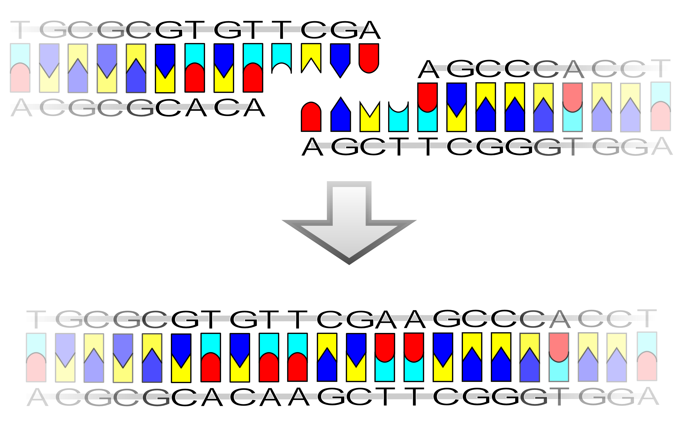
What is ligation?
Joining of two DNA molecules
Formation of a phosphodiester bond between 5’ phosphate of one DNA molecule and 3’ hydroxyl group of another DNA molecule
Mediated by DNA Ligase (EC 6.5.1.1)
Ligases are naturally present in cells to fix double-strand nicks
Crucial in DNA repair
Purified ligase from T4 Bacteriophage is used in molecular biology
By Madprime - Own work, CC BY-SA 3.0, https://commons.wikimedia.org/w/index.php?curid=2161789

Slide 3
Types of ligation
Sticky end ligation
Blunt end ligation
Ends of DNA are cohesive/sticky
Generated through restriction digestion
Hydrogen bonding between sticky ends stabilizes DNA fragments
Ligation is more efficient
More prevalent in conventional cloning
Ends of DNA are blunt – no overhangs
Generated through PCR or gene synthesis
No stabilization involved
Ligation is less efficient – requires more amount of enzyme
Used only under specific circumstances

Slide 4
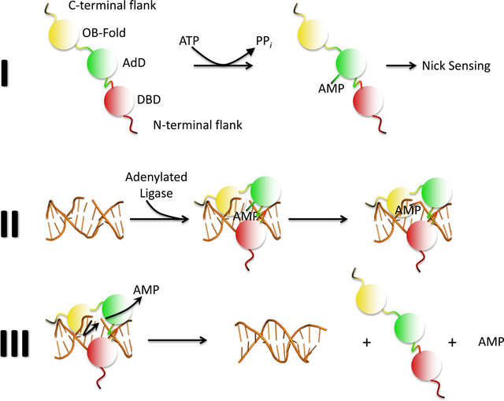
Mechanism of ligation
Adenylation of a Lys residue in the active site of ligase
Binding of adenylated ligase to DNA nick
Transfer of AMP to the 5’ phosphate group
Formation of a phosphodiester bond between 5’ P and 3’ OH
Release of AMP

Slide 5
Components of a ligation reaction
DNA fragments to be joined
Digested and purified
Resuspended in water of TE buffer
Amounts adjusted according to the molar ratio
Buffer
Tris-HCl – to maintain pH
DTT – reducing agent
ATP – to execute ligation
MgCl2 – cofactor for ligase
Ligase
Water

Slide 6

Calculating amounts of DNA fragments
The recommended vector:insert molar ratio is 1:3
$\frac{ng of vector × size of insert in kb}{size of vector in kb}×molar ratio of \frac{insert}{vector}=ng of insert$
Example:
Vector size = 3 kb
Insert size = 0.5 kb
Vector amount = 100 ng
Molar ratio = 1:3

Slide 7
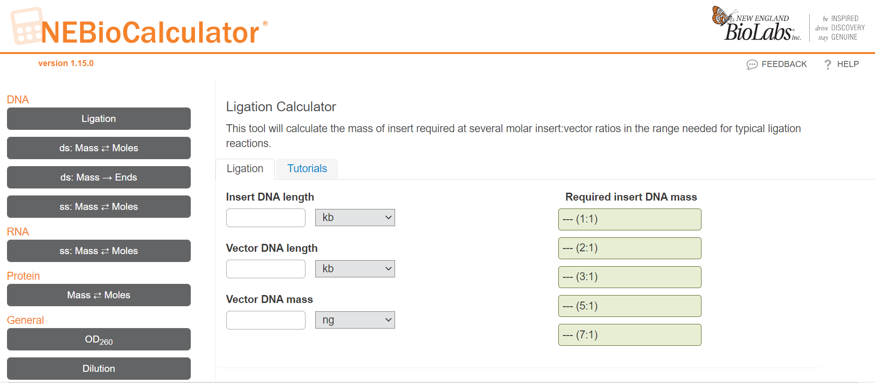
Using a ligation calculator

Slide 8
Factors affecting ligation
DNA concentration
Low DNA concentration → Intramolecular interaction > Intermolecular interaction
High DNA concentration → Intermolecular interaction > Intramolecular interaction
DNA concentration can be artificially increased by adding PEG
Temperature
Bringing together of cohesive DNA ends favored at 4-16 °C
Ligase optimum temperature is 37 °C
Selecting the right temperature for ligation is a trade off between the two
Buffer composition
ATP in ligase buffer tends to degrade after repeated freeze thawing
Aliquoting of ligase buffer is recommended

Slide 9
References
Gene Cloning and DNA Analysis. T. A. Brown. 6th Edition. Chapter 4.
https://www.takarabio.com/products/cloning/modifying-enzymes

