Slide 1
Restriction endonucleases
Vihang Ghalsasi, phd

Slide 2
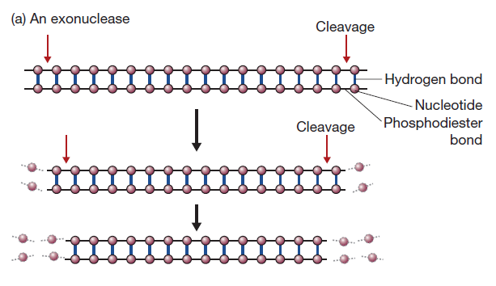
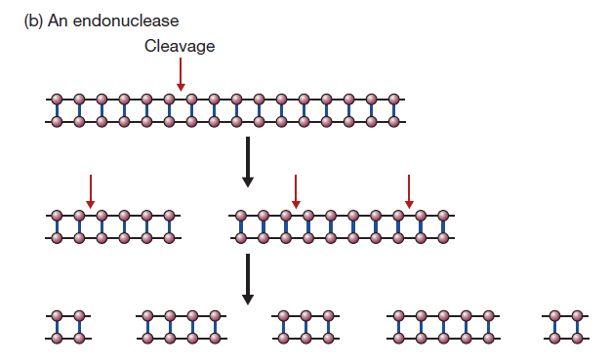
Nucleases
Enzymes that degrade nucleic acids
DNAse: enzyme that degrades DNA; RNAse: enzyme that’s degrades RNA
Exonucleases remove nucleotides one at a time from the end of a DNA molecule
Endonucleases break internal phosphodiester bonds within a DNA molecule

Slide 3
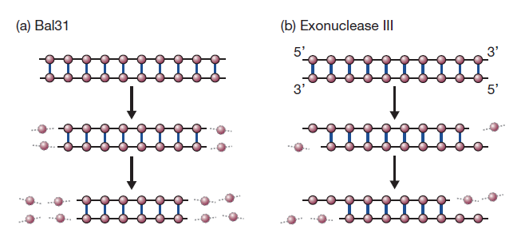
Types of exonucleases
Bal31 from Alteromonas espejiana removes nucleotides from both strands of a double-stranded molecule
Exonuclease III from Escherichia coli degrades just one strand of a double-stranded molecule, leaving single-stranded DNA as the product

Slide 4
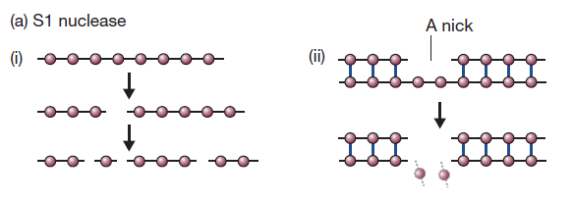
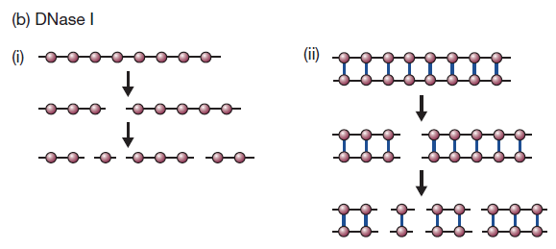
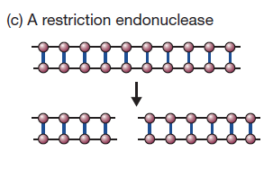
Types of endonucleases
S1 nuclease from Aspergillus oryzae only cleaves single-stranded DNA, can introduce single-stranded nicks in double-stranded DNA
DNAse1 from cow pancreas cuts both single- and double-stranded DNA
Restriction endonucleases cut double-stranded DNA only at specific sites

Slide 5
Restriction endonucleases (REs)
The term “restriction enzyme” originated while studying Lambda phage infection in E. coli
Some E. coli strains were able to “restrict” the growth of phage
Soon, the enzymes responsible for this were identified and purified and termed as “restriction endonucleases”
These enzyme cut double-stranded at specific sites and offer an excellent tool for cutting DNA molecules at desired sites for genetic engineering
Also known as “molecular scissors”
Werner Arber, Daniel Nathans, and Hamilton O. Smith were awarded the Nobel Prize for Physiology or Medicine in 1978 for their discovery and characterization of restriction enzymes, which led to the development of recombinant DNA technology
Over 2500 different REs have been isolated and >300 are available for use in the laboratory

Slide 6
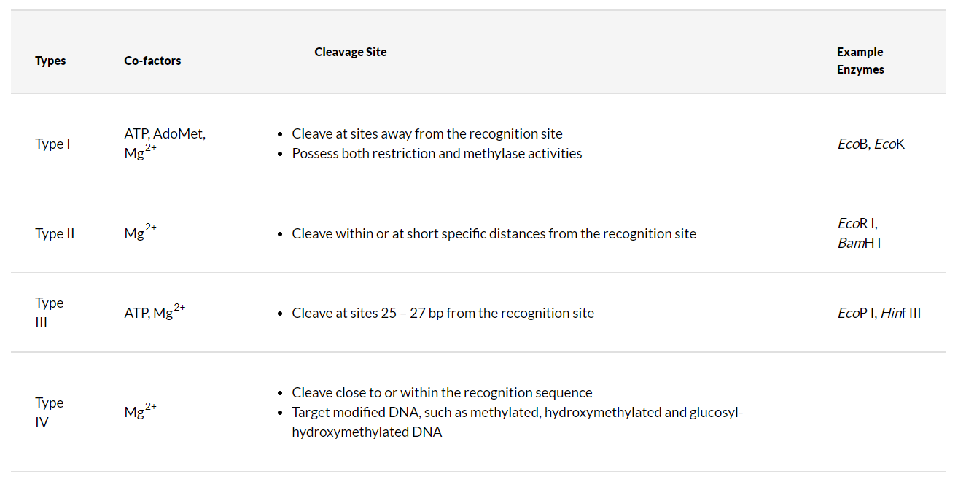
Types of REs

Slide 7
Nomenclature of REs
Suggested by Smith and Nathan in 1973
Name begins with italicized three latter acronym followed by extra letters or numbers
First letter: first letter of the bacterial genus from which the enzyme was isolated
Second and third letter: first two letters of the bacterial species
Last letter: serovar or strain name
Last number: in Roman numerals, indicates chronology or identification
HindIII: Third of the four enzymes isolated from Haemophilus influenzae serotype d
EcoRI: first enzyme isolated from Escherichia coli strain R

Slide 8
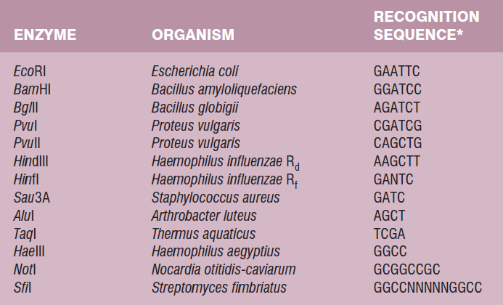
Cleavage sites of type II REs
Most REs cleave DNA at specific sites that are 4-8 bp long
These sites are palindromic sequences
Palindrome: a number, word, phrase, or string of characters that reads the same backward
For example: madam, Malayalam
A DNA sequence is a palindrome when its complimentary sequence reads the same
Examples: GAATTCC, CATATG, CCATGG, CTCGAG, TCTAGA, GCGGCCGC

Slide 9
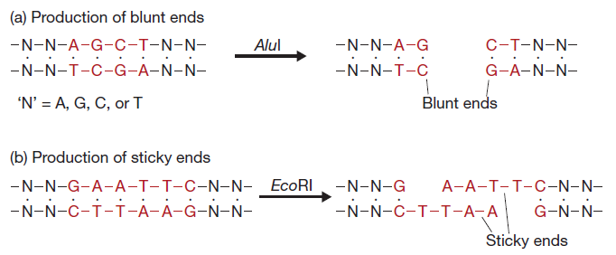
Sticky ends and blunt ends
When an RE cuts DNA at staggered sites, it results in short single-stranded overhangs – called as sticky ends (examples: EcoRI, BamHI)
When an RE cuts DNA exactly in the middle of the site, it results in two double-stranded DNA fragments without any overhangs – called as blunt ends or flush ends (examples: AluI, HaeIII)

Slide 10
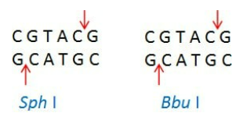
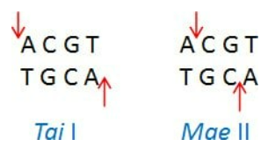
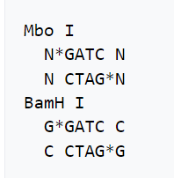
Isoschizomers, neoschizomers, and isocaudomers
Isoschizomers are restriction enzymes with the same recognition sequence and cleavage sites
Examples: SphI and BbuI
Neoschizomers are restriction enzymes with the same recognition sequence but cleave the DNA at a different site within that sequence
Examples: TaiI and MaeII
Isocaudomers are restriction enzymes that have slightly different recognition sequences, but upon cleavage of DNA, generate identical overhangs
Examples: MboI and BamHI

Slide 11
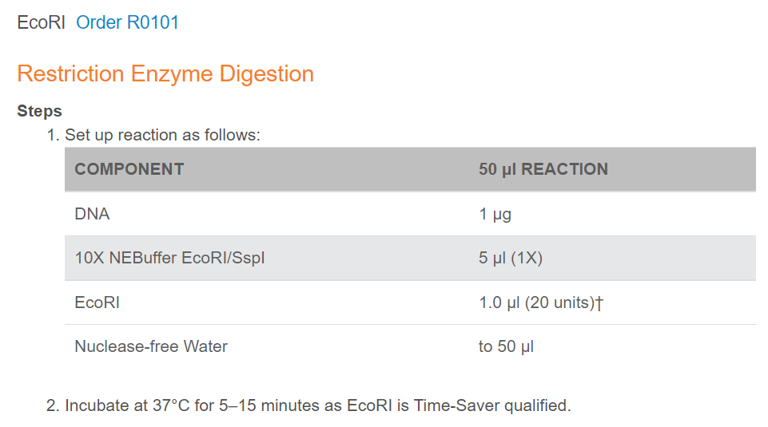
Setting up a restriction reaction
Components of a restriction reaction
Buffer
DNA
Enzyme
Water
Buffers and reaction protocols are provided by the manufacturer
Unit Definition
One unit is defined as the amount of enzyme required to digest 1 µg of λ DNA in 1 hour at 37°C in a total reaction volume of 50 µl.
https://nebcloner.neb.com/#!/protocol/re/single/EcoRI

Slide 12
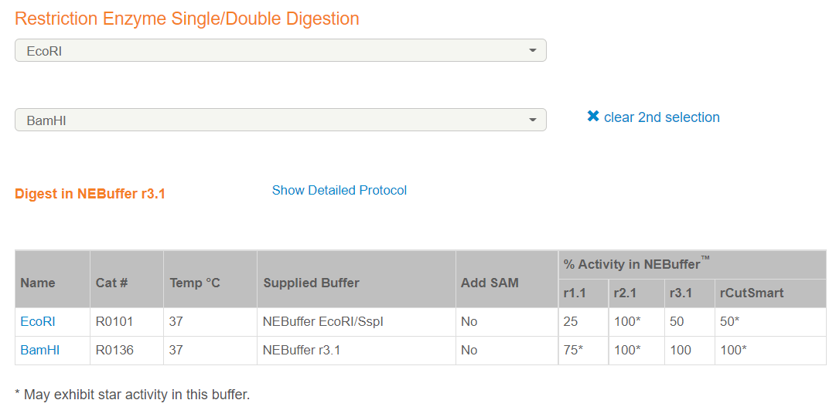
Double digestion

Slide 13
Star Activity
Under sub-optimal reaction conditions, some REs cleave at non-specific sites; this phenomenon is known as star activity
Factors responsible for star activity
High salt concentration
High glycerol concentration
Impurities in DNA prep
Excessive enzyme wrt DNA
Longer incubation time
Absence of cofactors
Manufacturers provide detailed information regarding star activity of a particular enzyme; referring to this information is critical before planning an experiment

Slide 14
Applications of REs
Molecular cloning: The insert and vector can be cut with same enzyme(s) to generate compatible sticky ends. The two fragments can then be combined using a DNA ligase to generate a recombinant DNA molecule.
Restriction mapping: A given DNA fragment can be digested using one or more enzymes and the products can be analyzed on agarose gel. Based on the sizes of digested fragments, the generic nature of the DNA sequence can be determined.
Restriction fragment length polymorphism
Linearization of circular DNA
DNA footprinting

Slide 15
References
Gene Cloning and DNA Analysis. TA Brown. Chapter 4
https://www.sigmaaldrich.com/IN/en/technical-documents/technical-article/genomics/cloning-and-expression/restriction-endonucleases-the-molecular-scissors
https://nebcloner.neb.com/#!/redigest

