Slide 1
Transformation
Vihang Ghalsasi, phd

Slide 2
Transformation and competent cells
Transformation is a process by which an organism acquires external DNA
Natural transformation: natural uptake of exogenous DNA from cell’s microenvironment
Artificial transformation: making cells take up exogenous DNA using different methods
Competent cells: cells capable of taking up exogenous DNA; prepared through artificial means
Types of competent cells: chemical and electrical
Chemical methods:
CaCl₂
Transformation storage solution (TSS)
Electrical method: electroporation

Slide 3
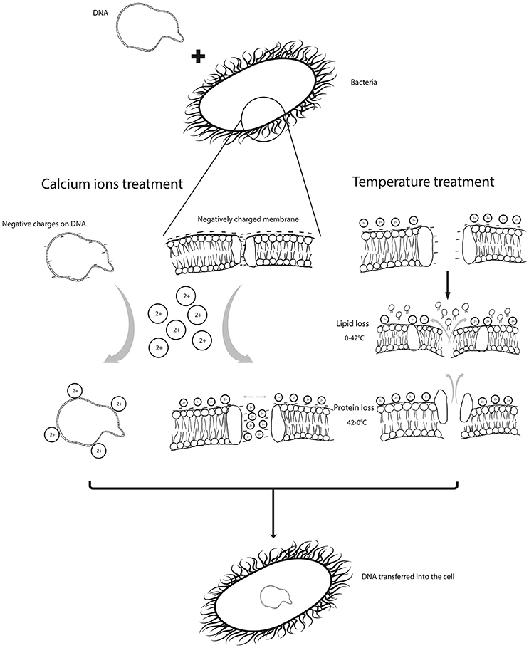
CaCl₂-mediated competent cells
Divalent cations of calcium are positively charged. They make a bridge between negatively charged DNA and negatively charged lipopolysaccharide and allow the DNA to bind to cell membrane. In addition, calcium ions improve the permeability of the cell membrane.
Low temperature incubation reduces the fluidity of outer membrane. Sudden shift to high temperature melts the cell membrane unevenly creating pores and allowing entry of DNA inside the cells.

Slide 4
Method of preparing CaCl₂-mediated competent cells
Streak
Streak the desired strain on LA/NA plate
Primary culture
Inoculate isolated colony in media and grow overnight (primary culture)
Secondary culture
Dilute primary culture 1:100 and grow secondary culture until OD600 reaches ~0.4-0.6
Arrest growth
Chill the cells on ice for 15 min to arrest growth
Ca treatment
Spin down and re-suspend in 0.1 M CaCl₂; incubate for 15 min
Aliquoting
Spin down and re-suspend in 0.1 M CaCl₂ + 15% glycerol, aliquot, and store for further use

Slide 5
TSS-mediated competent cells
Transformation storage solution: single solution for transformation and storage
One-step method of transformation
Avoids centrifugation and washes
TSS: LB broth containing 10% (wt/vol) polyethylene glycol, 5% (vol/vol) dimethyl sulfoxide, and 50 mM Mg²⁺ at pH 6.5
PEG creates microbubbles that hold DNA and cells together
Divalent cations of Mg have similar effect as that of Ca
Heat shock is not required
Overall efficiency is lower than that of CaCl2 method

Slide 6
Method of preparing TSS-mediated competent cells
Streak
Streak the desired strain on LA/NA plate
Primary culture
Inoculate isolated colony in media and grow overnight (primary culture)
Resuspension and aliquoting
Mix the cells with equal volume of 2X TSS, aliquot, and store for further use

Slide 7
Transformation by heat shock
Heat shock refers rapid change in temperature to enable the entry of DNA inside the cells
For E. coli transformation, heat shock is the routinely used method
Thaw the frozen cells on ice
Mix cells and DNA and incubate on ice for ~5 min
Put the cells at 42 °C for 45-90 s
Immediately transfer the cells on ice and incubate for ~2-3 min
Add pre-warmed media (LB or SOC) to the cells and allow them to grow for 1 h
Spin down the cells, resuspend in ~100 uL of medium, and plate on media containing the relevant antibiotic
Observe for colonies after ~18-20 hrs

Slide 8
Electroporation
The use of high-voltage electric shocks to introduce DNA into cells
Electric pulse temporarily disturbs the phospholipid bilayer and allows the entry of DNA
Can be used with most cell types
Fast, easy, convenient
Involves lesser number of steps
Yields high frequency of transformants
Requires specialized instrument called electroporator and specialized cuvettes
More expensive than other techniques

Slide 9
Method of preparing electro-competent cells
Streak
Streak the desired strain on LA/NA plate
Primary culture
Inoculate isolated colony in media and grow overnight (primary culture)
Secondary culture
Dilute primary culture 1:100 and grow secondary culture until OD600 reaches ~0.4-0.6
Arrest growth
Chill the cells on ice for 15 min to arrest growth
Washes
Spin down and wash with sterile, pre-chilled distilled water two-three times, every time reducing the volume by 1/10
Aliquoting
Finally, resuspend in 10% glycerol and aliquot

Slide 10
Transformation by electroporation
For electroporation, the protocol is mostly similar for all cell types
Thaw the frozen electrocompetent cells on ice
Mix cells and DNA and incubate on ice for ~15 min
Transfer the cell+DNA mixture into an electroporation cuvette
Gently tap the cells to ensure that they are within the narrow gap of the cuvette
Immediately put the cuvette in the electroporator and pulse the cells under required settings
Take the cuvette out and immediately add recovery media
Allow the cells to recover and grow for ~1 h
Spin down the cells, resuspend in ~100 uL of medium, and plate on media containing the relevant antibiotic
Observe for colonies after ~18-20 hrs

Slide 11
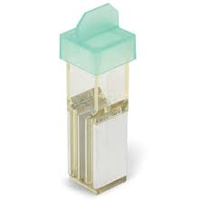
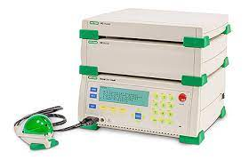
Electroporator and cuvettes

Slide 12
Precautions while preparing competent cells
Keep everything on ice – eppendorfs, falcons, centrifuge bottles, everything you need for competent cell preparation must be pre-chilled and on ice
Never vortex the cells – vortexing causes shear stress, which might affect the efficiency of cells
Handle with care – always transfer and pipette the cells gently
Store the cells at -80 °C after aliquoting
Check the efficiency and contamination of each batch of cells
During transformation, always thaw the cells on ice
Do not refreeze thawed cells – repeated freeze-thawing results in loss of efficiency

