Slide 1
Vectors
Vihang Ghalsasi, phd

Slide 2
Topic overview
What is gene cloning?
Definition of a vector
Plasmids: definition and classification
Plasmids as cloning vectors
E. coli vectors: pBR and pUC

Slide 3
What is gene cloning?
A fragment of DNA, containing the gene to be cloned, is inserted into a circular DNA molecule called a vector, to produce a recombinant DNA molecule
The vector transports the gene into a host cell, which is usually a bacterium, although other types of living cell can be used
Within the host cell the vector multiplies, producing numerous identical copies, not only of itself but also of the gene that it carries
When the host cell divides, copies of the recombinant DNA molecule are passed to the progeny and further vector replication takes place
After a large number of cell divisions, a colony, or clone, of identical host cells is produced. Each cell in the clone contains one or more copies of the recombinant DNA molecule; the gene carried by the recombinant molecule is now said to be cloned.

Slide 4
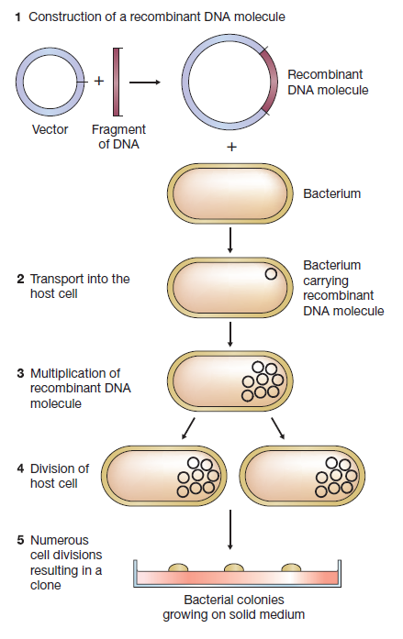

Slide 5
Vector
A DNA molecule that is used as a vehicle to carry a particular DNA segment into a host cell
A random DNA fragment is difficult to introduce into a host cell
Even if introduced it is prone to degradation by intracellular nucleases
Such a fragment can neither replicate independently nor express the gene
Thus, a vector is required to stably replicate and express the gene of interest in a host cells
A vector must possess following properties:
Ability to replicate independently
Presence of a selectable marker (antibiotic-based or auxotrophic)
Relatively small size (ideally less than 10 kb)
Vectors are specific to the kind of host cells
Vectors that can replicate in two or more host cells are known as shuttle vectors

Slide 6
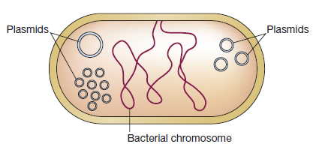
Plasmids
Plasmids are self-replicating extra-chromosomal genetic elements found mostly in bacteria
Plasmids carry one or more genes responsible for specific phenotypes such as antibiotic resistance, conjugation, bacteriocin production, and virulence
Plasmids make use of cell’s replication machinery to replicate and make copies
Plasmids are classified based on
Copy number
Integration
Conjugation
Characteristics coded by genes

Slide 7
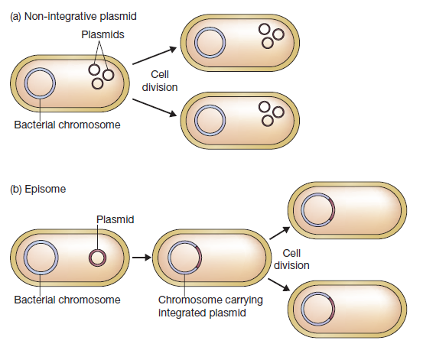
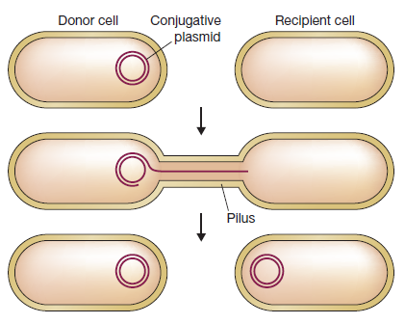
Plasmid classification (1/2)
Copy number: Number of molecules of an individual plasmid present in a single bacterial cell. Large plasmids have low copy number (2-10) and called stringent plasmids. Small plasmids have high copy number (20-50) and called relaxed plasmids.
Integration: Non-integrative plasmids replicate using cell’s replication machinery but independently. Get divided into daughter cells as the cell divides. Integrative plasmids or episomes get integrated into cell’s chromosomal DNA.
Conjugation: Conjugative plasmids promote sexual conjugation in bacterial cells. Contain tra genes to enable transfer of the plasmid from one cell to another. Also known as F plasmids. Non-conjugative plasmids do not enable conjugation.

Slide 8
Plasmid classification (2/2)
Resistance plasmids: Carry genes that confer the host cell resistance to one or more antibacterial agents such as ampicillin and chloramphenicol. Important for cloning as well as clinical microbiology.
Col plasmids: Carry genes encoding colicins, proteins that kill other bacteria. Example, ColE1 plasmid of Escherichia coli.
Degradative plasmids: Allow the host cell to metabolize unusual molecules such as toluene and salicylic acid. Example, TOL plasmid of Pseudomonas putida.
Virulence plasmids: Confer pathogenicity to the host bacterium. Example, Ti plasmid of Agrobacterium tumefaciens.

Slide 9
Plasmid isolation using alkaline lysis method: overview
Cell growth and harvesting
Resuspension in solution I
Lysis using solution II
Neutralization using solution III
Centrifugation to separate plasmid DNA
Ethanol precipitation
Centrifugation and resuspension
First described by Birnboim and Doly in 1979; most widely used method even today with little modifications
Involves lysis of cells under alkaline conditions and separation of plasmid DNA from genomic DNA using three solutions
Solution I (Resuspension solution)
Tris, Glucose, EDTA, RNAse
Solution II (Lysis solution)
SDS and NaOH
Solution III (Neutralization solution)
Potassium acetate

Slide 10
Plasmid isolation using alkaline lysis method: process
Cell growth: Grow plasmid harboring E. coli cells in 3-5 mL LB broth overnight
Harvesting: Spin down the culture and collect the pellet
Resuspension using Solution I: Resuspend the cell pellet in Solution I. Tris maintains pH, glucose maintains osmolarity, EDTA chelates divalent cations, and RNAse degrades RNA
Lysis using Solution II: Add Solution II. SDS denatures proteins and cell membrane. NaOH provides alkaline conditions under which all ds DNA is separated into ss DNA.
Neutralization using Solution III: Add Solution III. Potassium acetate neutralizes the mixture. Plasmid DNA, being small, renatures into ds DNA but genomic DNA being large cannot renature and stays precipitated along with proteins and cell debris.
Centrifugation: Spin down the mixture at high speed for 5-10 min to separate the precipitate from plasmid DNA in solution.

Slide 11
Plasmid isolation using alkaline lysis method: process
Plasmid precipitation using IPA/ethanol: Add pre-chilled isopropyl alcohol or ethanol to the solution and incubate the mixture at -20 °C/-80 °C for ~30 min. IPA/ethanol precipitates DNA in the presence of monovalent cations. Spin down at high speed for 5 min. DNA precipitate can be observed as semi-transparent white pellet.
Washing using 70% ethanol: Add 70% ethanol to the pellet and gently wash the pellet. Spin down at high speed for 5 min. Remove the supernatant. Allow the tube to air dry.
Resuspension using water/TE buffer: Add water/TE buffer and gently resuspend the pellet. Plasmid prep is ready.
Kit-based plasmid prep: Commercially available plasmid isolation kits contain silica-based columns for separation of plasmid DNA from the neutralized cell lysate. This method is fast, efficient, and reproducible, but expensive. Depending the amount of plasmid DNA to be isolated, kits are named as mini (up to 20 μg), midi (up to 200 μg), maxi (up to 1 mg), and giga (up to 10 mg).

Slide 12
Plasmids as vectors
Plasmids all the features necessary for being used as a vector (small size, independent replication, ability to carry genes that render specific characteristics)
A general plasmid vector contains
Origin of replication
Antibiotic resistance gene
Multiple cloning site (MCS)
Promoter
Terminator
Tags for detection/purification/solubilization
A single natural plasmid may not have all these features
Commercially available plasmid vectors are engineered by combining the necessary features present on naturally occurring plasmids
MCS
Terminator
Promoter
Antibiotic resistance gene
Other features
Ori

Slide 13
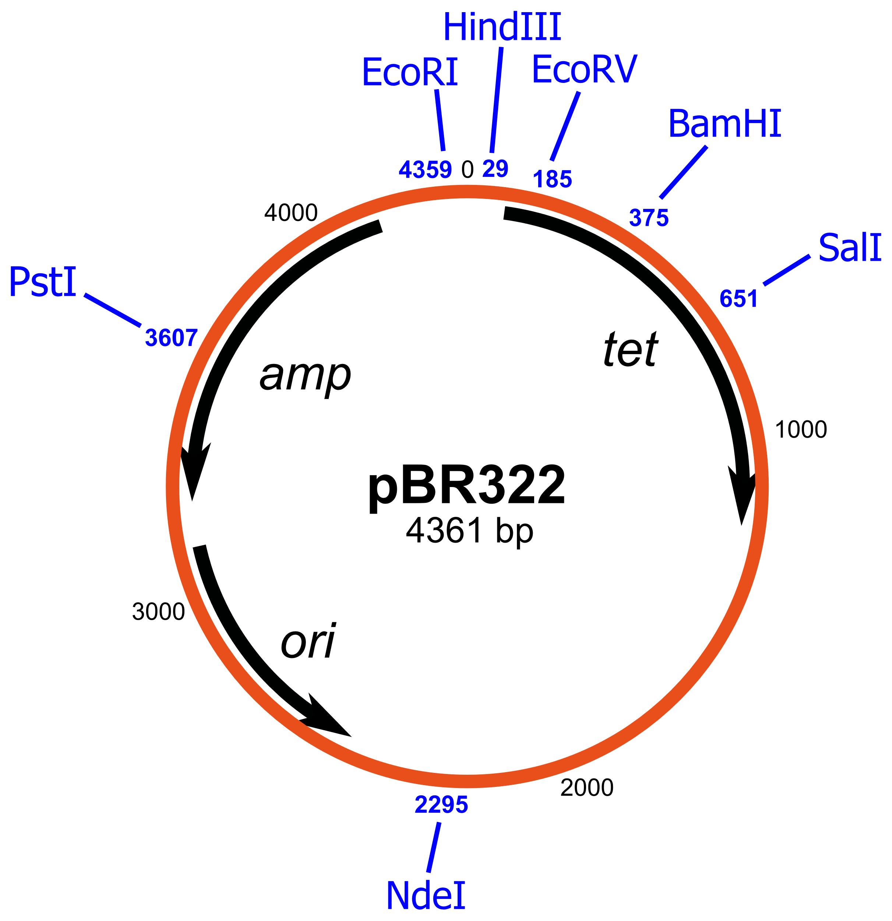
pBR322
First engineered plasmid designed by Bolivar and Rodriguez in 1970
4363 bp in size
Contains two antibiotic resistance genes: AmpR and TetR
AmpR from plasmid R1
TetR from plasmid pSC101
Several unique restriction sites within AmpR and TetR coding sequences
Origin of replication from ColE1, giving high copy number
pBR322 became a template for designing future plasmids
pBR327: higher copy number and loss of conjugative ability
Most plasmids currently in use contain some elements from pBR322

Slide 14
Insertional inactivation
Selection of recombinants by replica plating on antibiotic-containing media
Clone the gene of interest in restriction sites within the TetR gene
Transform the cells with ligated insert and vector
Plate on ampicillin-containing media
Replica-plate the colonies on tetracycline-containing media
Colonies that grow on ampicillin but not on tetracycline are true recombinants
When the gene of interest is successfully cloned, only TetR CDS is disrupted, whereas AmpR CDS is intact
This method, although effective, is laborious and time-consuming
Media with ampicillin
Media with tetracycline

Slide 15
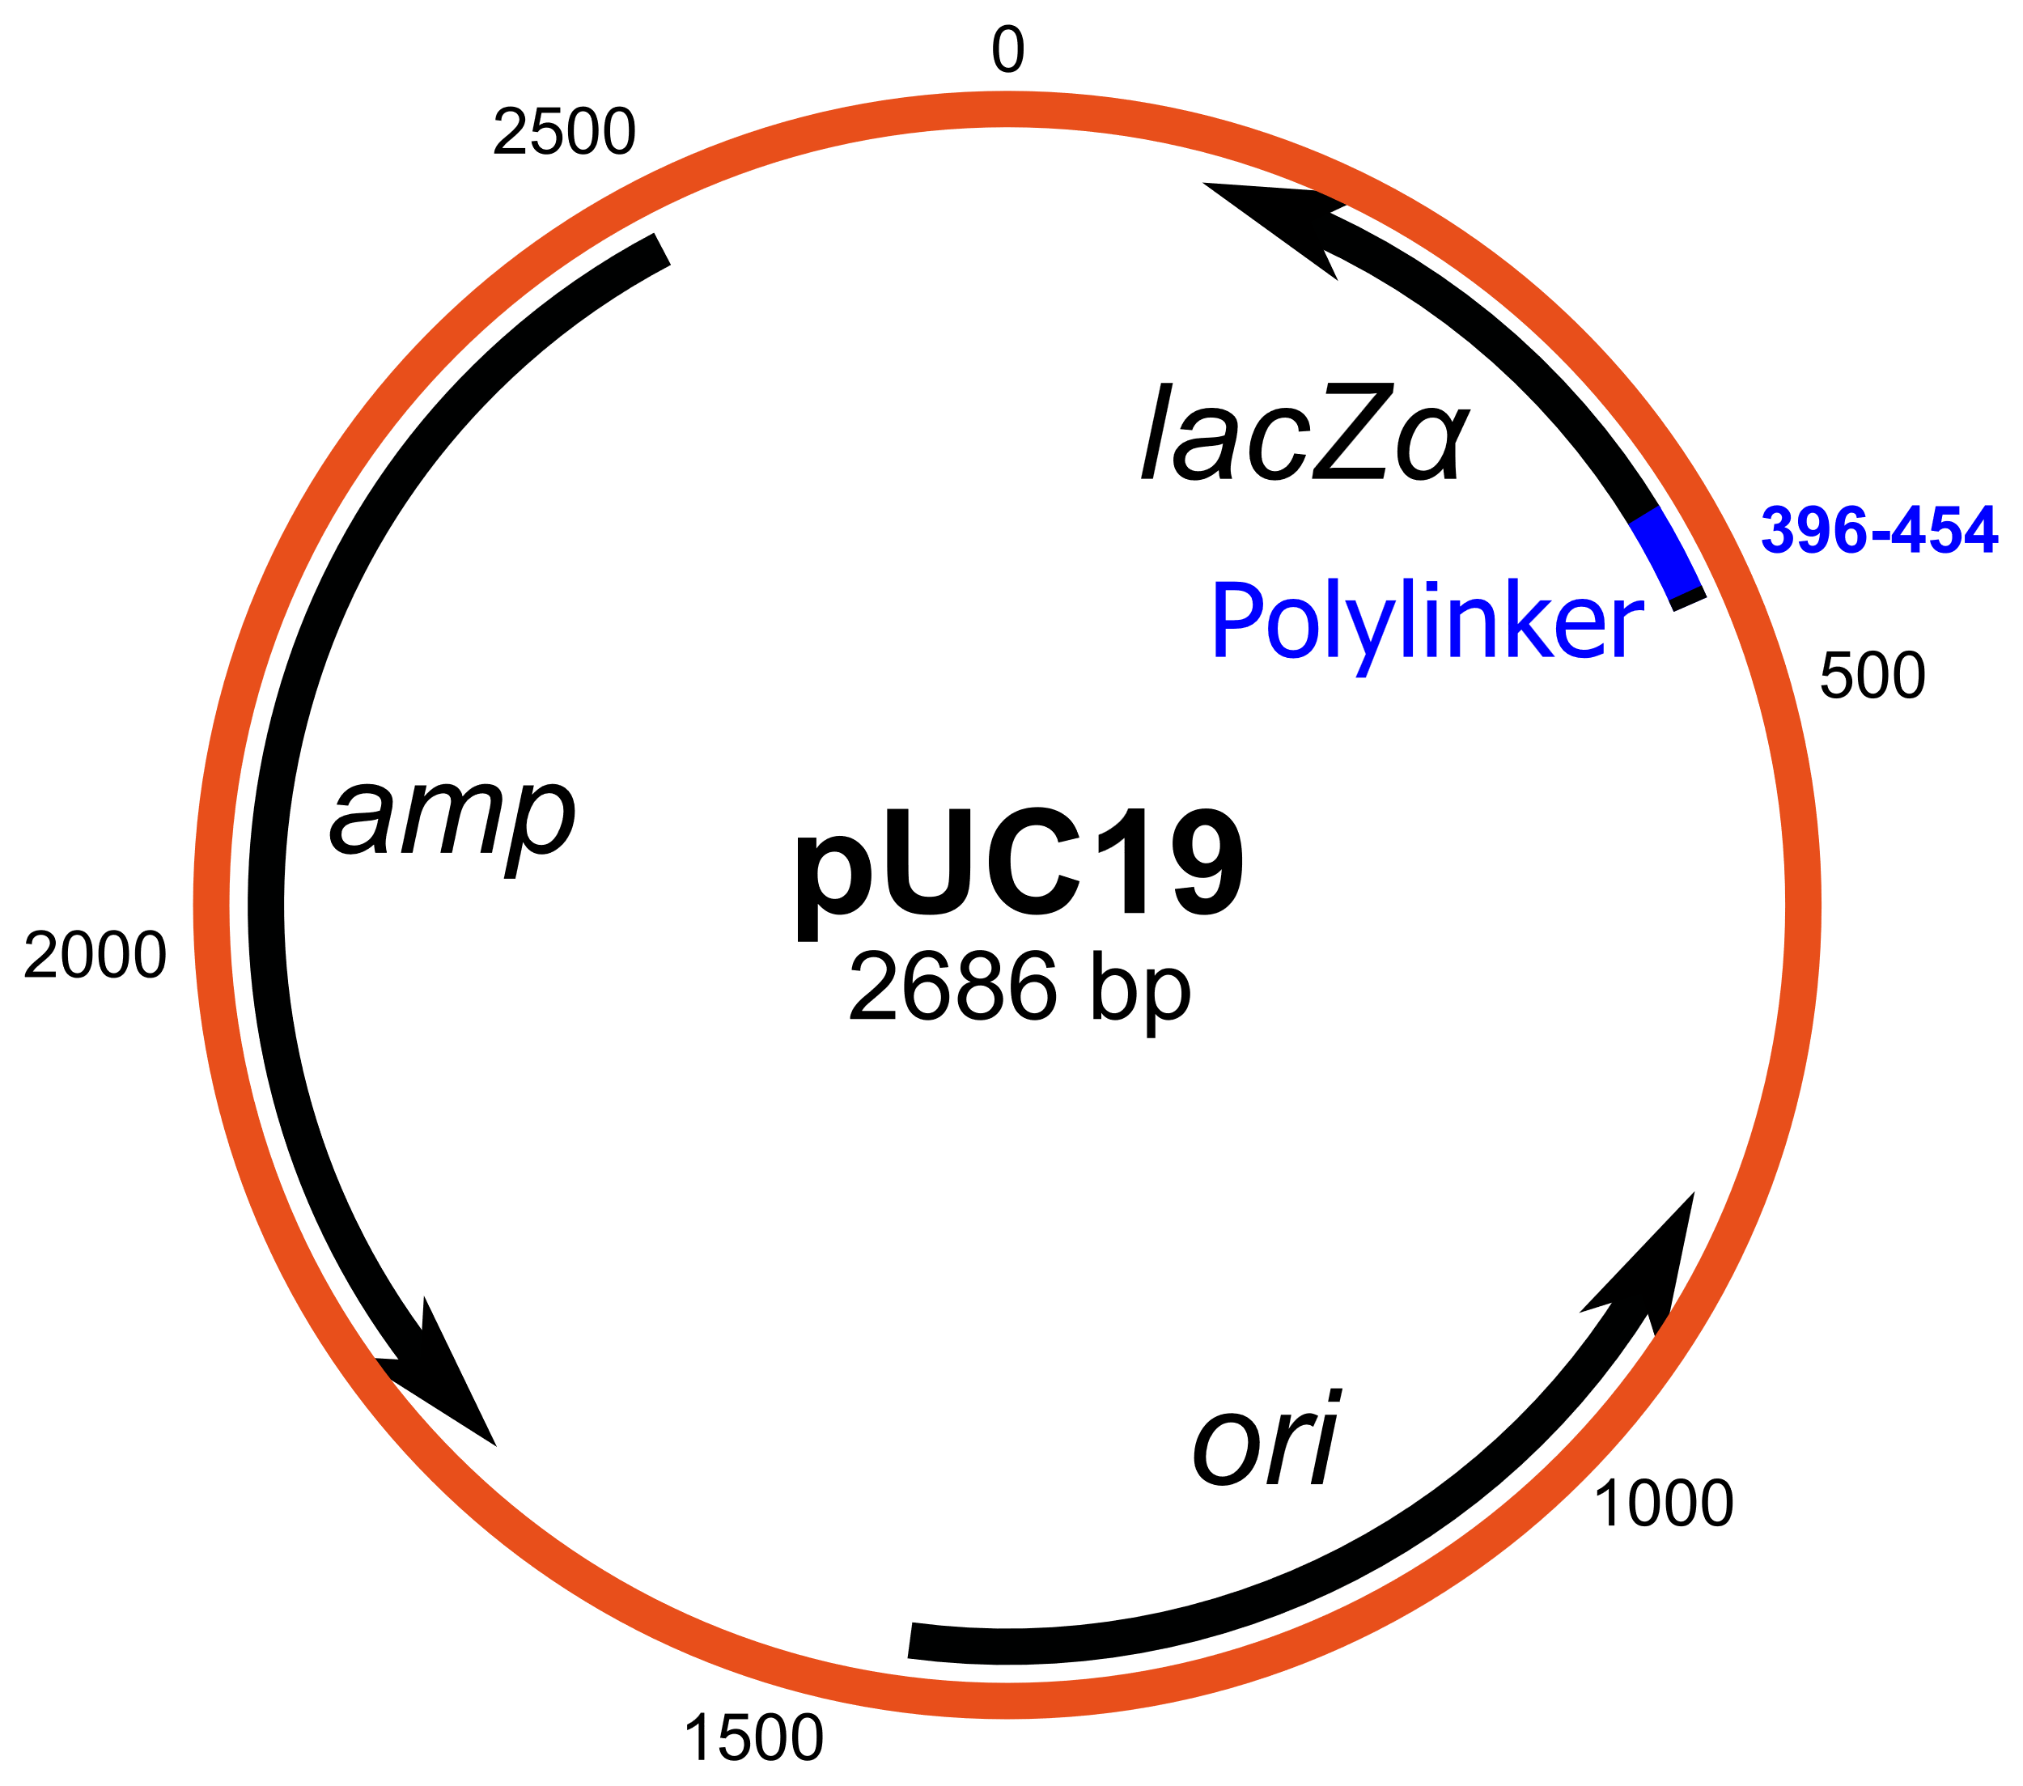
pUC series of vectors
Developed by Joachim Messing at University of California in the 1990s
2686 bp in size
Contains AmpR gene, rendering resistance to ampicillin
Contains a point mutation in Ori region, increasing the copy number to ~500 per cell
Contains lacZ’ CDS that complements lacZΔM15 from the host chromosome
Restriction sites are clubbed together within the lacZ’ CDS
pUC8 was the first vector of the series
Nowadays pUC19 is the most widely used vector for cloning
Advantages: high copy number, chromogenic selection using blue-white screening
Disadvantages: AT-rich inserts are difficult to clone, not suitable for creating libraries

Slide 16
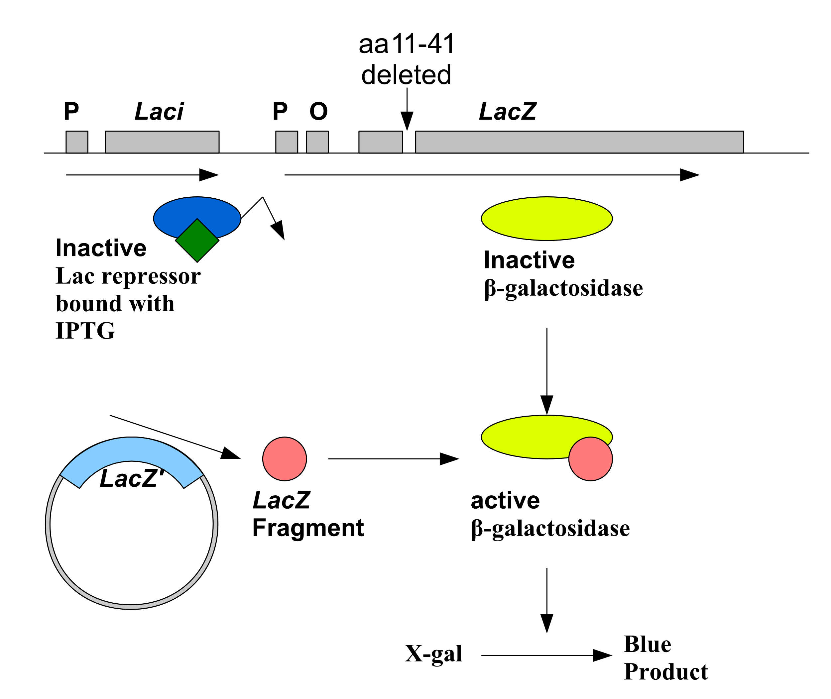
Blue-white screening
Chromogenic selection of recombinants
Clone the gene of interest in the multiple cloning site: restriction sites clustered within the lacZ’ CDS
Transform the cells with ligated insert and vector
Plate on media containing ampicillin, IPTG, and X-gal
When the gene of interest is successfully cloned, lacZ’ CDS is disrupted, resulting in white colonies
When the gene is not cloned, lacZ’ CDS is intact, it encodes beta galactosidase, which degrades X-gal and results in blue colonies
The selection method is simple, fast, and efficient
The host strain must be lacZΔM15 and lacY+

Slide 17
Disadvantages of using plasmids as cloning vectors
Maximum size of the DNA fragment that can be cloned is ~12 kb
Requires preparation of competent cells
Not suitable for generating DNA libraries
Expression of eukaryotic proteins in prokaryotic hosts is not possible

Slide 18
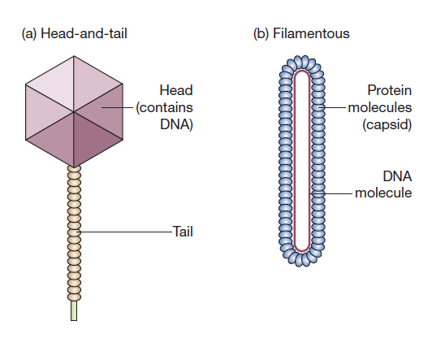
Bacteriophages
Viruses that infect bacteria
Usually have a capsid and a genomic material packaged in the capsid
The phage attaches itself to a bacterial cell and injects its genomic material inside
The phage genome carries genes for encoding the capsid proteins
It highjacks cell’s protein synthesis and replication machinery to make more copies of itself
DNA is packaged into the capsids and released when the cell is lysed; this is known as lytic cycle
Sometimes, phages exhibit lysogenic cycles wherein the phage genome gets integrated into host genome

Slide 19
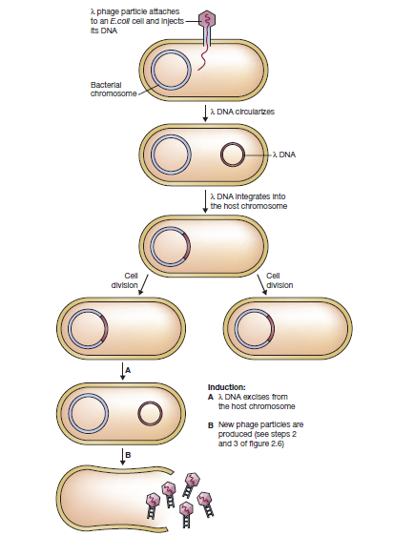
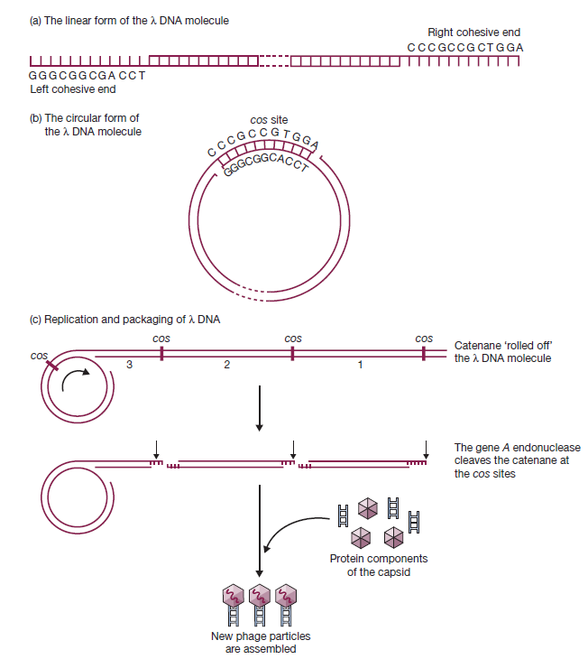
Lambda phage: Life cycle and cos sites

Slide 20
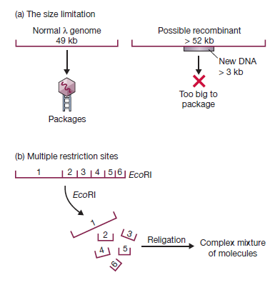
Using Lambda phage as a vector
Lambda genome is 49 kb in size; only up to 3 kb DNA fragments can be inserted into the genome; larger DNA is unable to get packaged into the capsid
Being large, lambda genome contains too many sites of commonly used restriction sites, making it unsuitable for cloning
Large chunk of lambda genome that codes for lysogenic cycle is “non-essential” and can be deleted
Mutants with less or no restriction sites can be obtained through natural selection
Two types of lambda vectors engineered: insertion and replacement

Slide 21
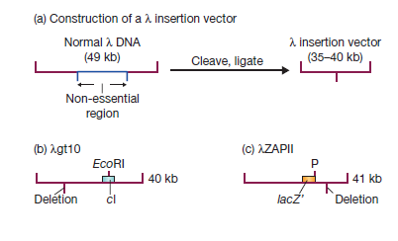
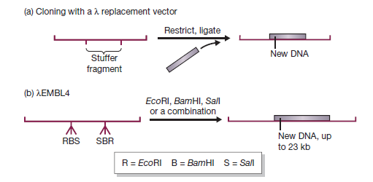
Insertion and replacement vectors
Examples: λgt10 and λZAPII
Example: λEMBL4

Slide 22
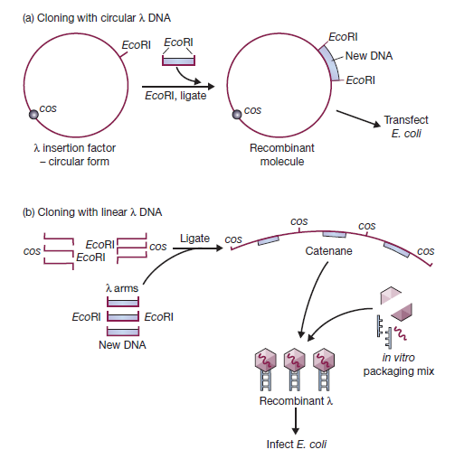
Cloning using λ vectors

Slide 23
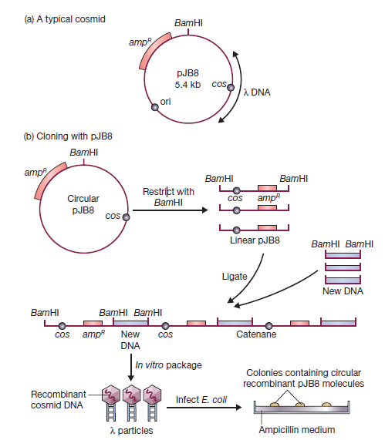
Cosmid
Combination of plasmid and λ DNA
Relies on the principle that capsid packaging requires only cos sites and no other genes of the phage
A cosmid contains cos sites and no other elements of λ DNA
It contains a plasmid origin of replication, selectable marker, and multiple cloning site

Slide 24
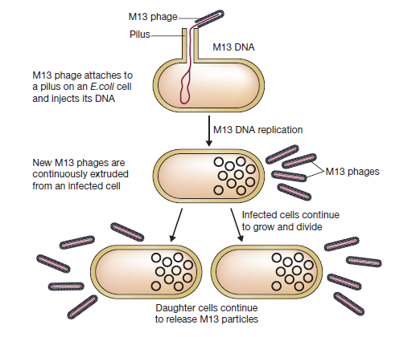
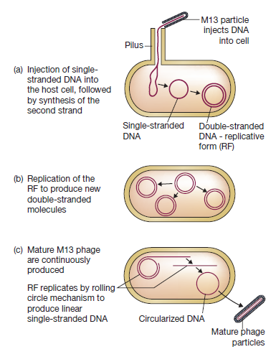
M13 Phage: life cycle

Slide 25
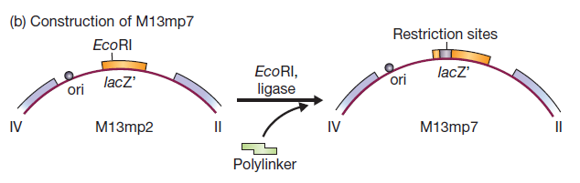
Using M13 phage as a vector
M13 genome is 6.4 kb in length
Contains ten closely packed genes
A single 507 bp intergenic region into which new DNA fragments can be introduced
M13mp7: contains lacZ’ CDS along with a polylinker introduced in it
Selection is done based on the formation of blue plaques
Generation of single-stranded DNA fragments is the most important advantage

Slide 26
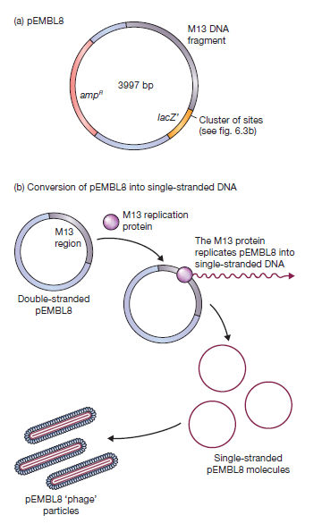
Phagemid
M13 vectors can be used to clone fragments of up to 1500 bp
Hybrid vectors called phagemids that combine the properties of a plasmid and M13 phage have been engineered
Phagemid contains 1300 bp region from M13 phage genome introduced into the pUC8 plasmid vector
This region allows the expression of enzymes that convert dsDNA into ssDNA for packaging to M13 capsids
The region functions even without other M13 genes being absent
Normal M13 phage is needed as helper phage
Example: pEMBL8

Slide 27
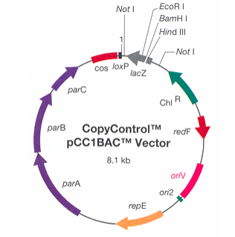
Bacterial Artificial Chromosome (BAC)
A large, circular DNA based on the F plasmid of bacteria
Contains origin of replication, selectable marker, and MCS
Exists as only one copy per cell, which stably maintains large DNA fragments
Contains Par genes, which allow partitioning of the chromosome into daughter cells
Allows cloning of huge fragments of DNA up to 100-300 kb
Useful in constructing genomic DNA libraries
Was crucial in sequencing the human genome
Another variant of BAC is PAC (P1-derived artificial chromosome)
Example: pCCBAC

Slide 28
Cloning vectors: summary
Cloning vector | Type | Features
pBR322 | Plasmid | Insertional inactivation
pUC18/19 | Plasmid | Blue-white screening
Λ Phage | Phage-based vector | Allows cloning of large DNA fragments
Cosmid | Plasmid with cos sites | Allows packaging of cloned fragments into capsid
M13 phage (M13mp7) | Phage-based vector | Generates ssDNA fragments
Phagemid | Plasmid with M13 region | Allows cloning of large DNA fragments in ssDNA form
BAC | F plasmid vector | Allows cloning of ~100 kb fragments
PAC | P1 phage-based vector | Allows cloning of ~300 kb fragments

