Slide 1

Hangman Game using Artificial Intelligence
Project Members : Nikshita Harmalkar 23CE241
Salim Khan 23CE256
Course: Artificial Intelligence
Notes:
1

Slide 2

Introduction to Hangman
Hangman is a classic word-guessing game where players attempt to discover a hidden word by guessing individual letters. The player has a limited number of incorrect guesses before the hangman is drawn.
Traditional Gameplay: A word is selected and represented by blank spaces. Players guess letters one at a time. Correct guesses reveal letter positions, while incorrect guesses bring the player closer to losing.
Notes:
2

Slide 3
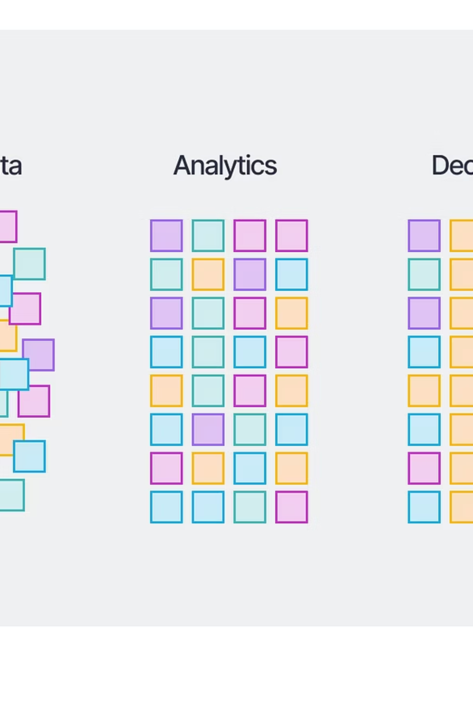

Project Overview
Objective
Intelligent Guessing
Develop an AI system that intelligently guesses letters in Hangman using heuristic search algorithms rather than random selection
The AI analyzes letter frequencies, word patterns, and remaining possibilities to make statistically optimal guesses
Improved Performance
Compared to random guessing, the AI achieves higher success rates and solves words more efficiently
Notes:
3

Slide 4
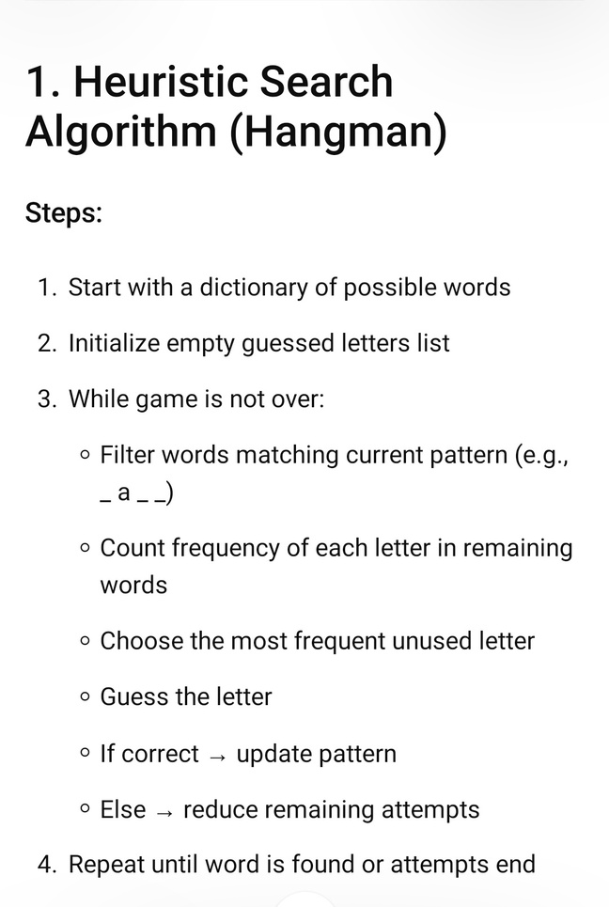
AI Algorithms Used
AI Algorithm (Single Slide)
1. Filter candidates by word length, revealed letters, and excluded wrong letters.
2. Easy: choose the most frequent unguessed letter from candidates, with slight randomness.
3. Medium: compute score = 0.5*frequency + 0.3*positionalProbability + 0.2*eliminationPower.
4. Hard: evaluate each letter by Shannon entropy over partitions of candidate patterns.
5. Returns the best next letter guess and the current candidate count.
Notes:
4

Slide 5
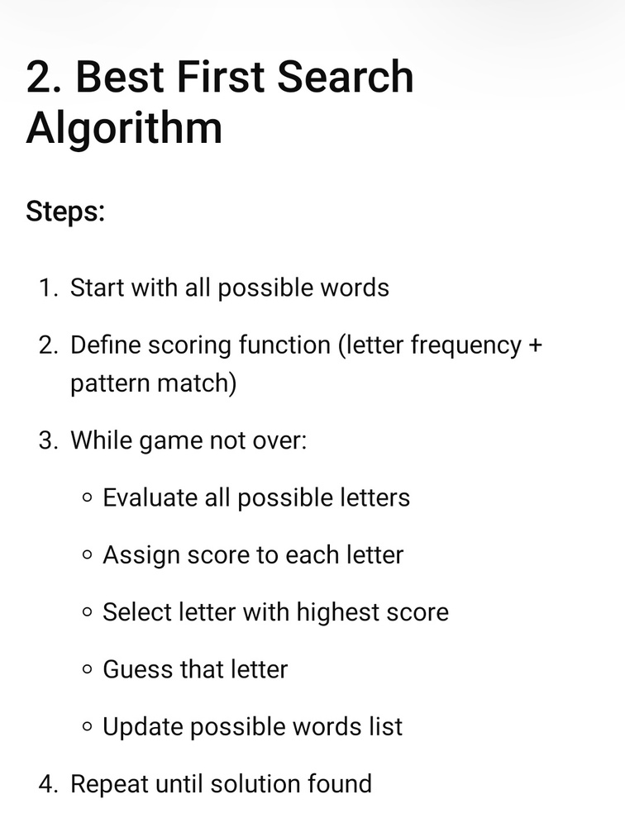
AI Algorithms Used
AI algorithm details are consolidated on the previous slide.
Notes:
5

Slide 6





Algorithm Workflow
Notes:
6

Slide 7




Why the AI Does Not Always Win
Limited Wrong Guesses
Similar Dictionary Words
The game restricts the number of allowed incorrect guesses. Even when following an optimal strategy, the AI can reach this limit and fail if it encounters an unlucky sequence of hidden letters early in the game.
When multiple candidate words fit the same revealed letter pattern, the AI's frequency analysis may struggle to narrow down the choices effectively, leading to ambiguous guesses that do not eliminate enough possibilities.
Adversarial Word Selection
Shared Word Patterns
If the word chooser deliberately picks rare or low-frequency words, the heuristic's statistical assumptions break down, leading to suboptimal guesses.
Certain words share identical structural patterns, which can cause significant confusion for the algorithm. This similarity makes it difficult for the AI to differentiate between words during the matching process.
Notes:
7

Slide 8




Technology Stack
MongoDB
Express.js
Database for storing game data, user profiles, and game history
Backend framework for building RESTful APIs and handling game logic
Stores game sessions, move history, and player statistics for all three game modes.
React
Node.js
Frontend library for building interactive user interface and real-time game updates
JavaScript runtime for server-side execution and managing concurrent game sessions
Notes:
8

Slide 9
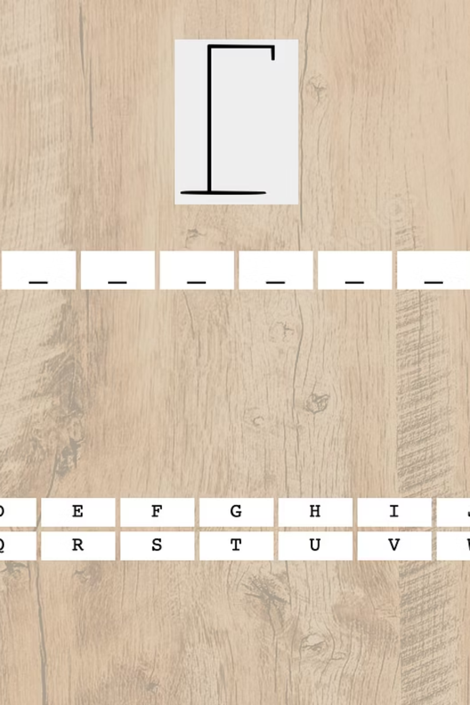
Game Interface Design
Word Display
Letter Tracking
Hidden word shown as underscores representing each letter position
Displayed list of attempted letters with visual indicators for correct and incorrect guesses
Attempt Counter
Visual representation of remaining incorrect guess attempts before game ends
Notes:
9

Slide 10
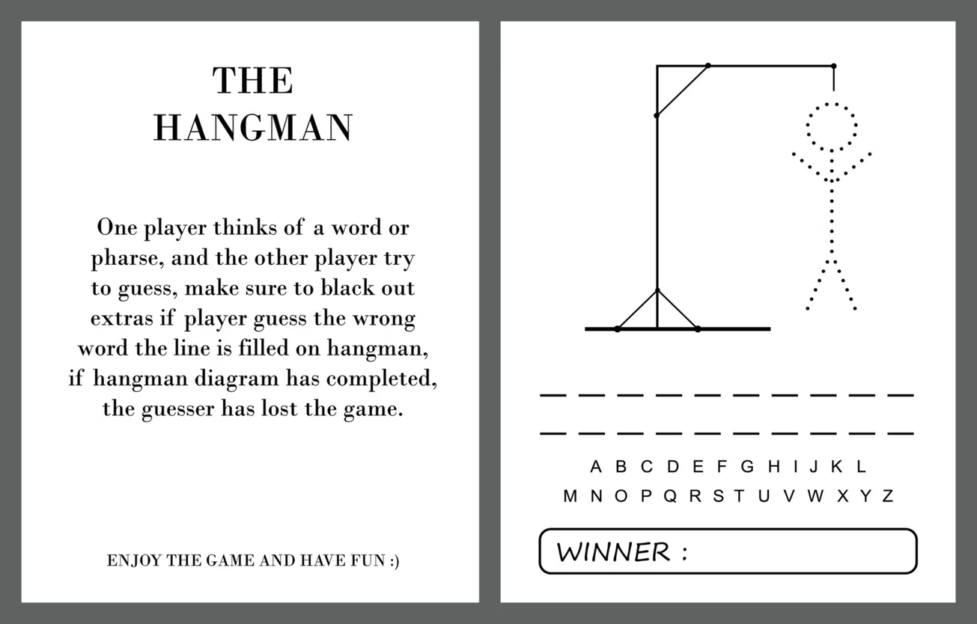
Example Execution
Target Word: "APPLE"
Step 1: AI guesses 'E' (highest frequency) ✓ reveals position 5
Step 2: AI guesses 'A' (pattern match) ✓ reveals position 1
Step 3: AI guesses 'L' (position analysis) ✓ reveals position 4
Step 4: AI guesses 'P' (remaining letters) ✓ reveals positions 2 and 3
Result: Word solved in 4 guesses with 0 incorrect attempts remaining
Notes:
10

Slide 11
Challenges Encountered
Designing an effective heuristic function
Managing large word dictionaries
Determining optimal weighting between letter frequency, word position, and remaining possibilities required extensive testing and refinement
Efficiently filtering thousands of possible words after each guess while maintaining accuracy demanded careful algorithm optimization
Implementing multiplayer gameplay
Maintaining game balance between AI and player
Handling multiple game modes and player interactions while maintaining game state consistency
Ensuring the AI is challenging but not unbeatable, and that all game modes provide engaging experiences
Notes:
11

Slide 12



Game Modes
Player vs AI
AI vs Player
Player vs Player (Multiplayer)
Player chooses a word and the AI attempts to guess it using the heuristic search algorithm. The AI's performance is measured by the number of guesses needed and incorrect attempts made. This mode demonstrates the AI's effectiveness against human-selected words.
The AI selects a word from its dictionary and the player attempts to guess it. This mode allows players to experience the challenge of guessing against a computer-generated word. The difficulty can be adjusted by varying word length and complexity.
One player enters a secret word while another player attempts to guess it. This classic mode provides competitive gameplay without AI involvement, allowing players to test their word-guessing skills against each other.
Notes:
12

Slide 13
Conclusion
Key Achievements
AI Advantages
Successfully implemented heuristic search for intelligent letter guessing
Achieved significantly better performance than random guessing
Demonstrated practical application of AI search techniques
Created extensible framework for word game AI
The AI approach transforms Hangman from a game of chance into a demonstration of informed decision-making. By leveraging letter frequency analysis and pattern matching, the system achieves higher success rates while providing insights into algorithmic problem-solving.
Future improvements: Machine learning integration, difficulty adaptation, and multi-language support
Notes:
13

