Slide 1
World Cup 2018 Predictions
Using the Monte Carlo method

Slide 2

World Cup
World Cup is an event that takes place every 4 years.
Largest international soccer tournament.
Largest sport event in the world.
32 teams from all continents compete.
A total of 64 games are played.

Slide 3
Structure
Teams are split into a 4 different categories based on their FIFA ranking.
Each team is randomly placed in one of the 8 letter groups.
48 games in the group stage, 6 per group.
The best two teams in each group get selected to move to the round of 16. At this point the team that loses a game is eliminated.
After winning 3 games the team makes it to the World Cup final.

Slide 4
Monte Carlo Method
Monte Carlo methods are a broad class of computational algorithms that rely on repeated random sampling to obtain numerical results.
Used for optimization, numerical integration, and generating draws from a probability distribution.
A better team is still more likely to win and move on than its lower ranked opponent.
Run 10,000 simulations and count how many times each team made it to the different stages.

Slide 5
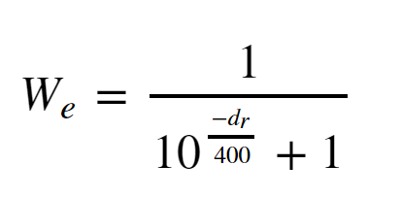
Elo rating system
The Elo rating system is a method for calculating the relative skill levels of players in zero-sum games such as chess.
It has gained popularity as a rating system and now is used in competitive video games and sports.
The difference in the ratings between two players serves as a predictor of the outcome of a match.
Δ100 points → expected score for the stronger player is 64%
Δ 200 points → expected score for the stronger player is 76%.

Slide 6
Assumptions/Simplifications
No tied games allowed in the group stage.
No goals, teams win or lose.
At the end of the group stage, if more than two teams end up tied for the top two positions, two will get randomly selected to move forward.
Elo rating is enough to predict the win rate between two teams.

Slide 7
Code..

Slide 8
Results
 | Second_Group_Stage | Winner_Group_Stage | Quater-Finalist | Semi-Finalist | Finalist | Winner
Country
Brazil | 19.27% | 74.08% | 70.26% | 55.46% | 40.23% | 26.76%
Germany | 20.73% | 69.95% | 64.20% | 48.17% | 32.34% | 19.51%
Spain | 31.02% | 53.95% | 70.75% | 47.27% | 26.63% | 14.68%
Portugal | 39.84% | 33.41% | 55.03% | 32.17% | 14.27% | 6.48%
Argentina | 26.52% | 56.39% | 50.52% | 27.52% | 13.17% | 6.27%
France | 29.67% | 48.51% | 50.74% | 28.41% | 13.19% | 6.01%

Slide 9
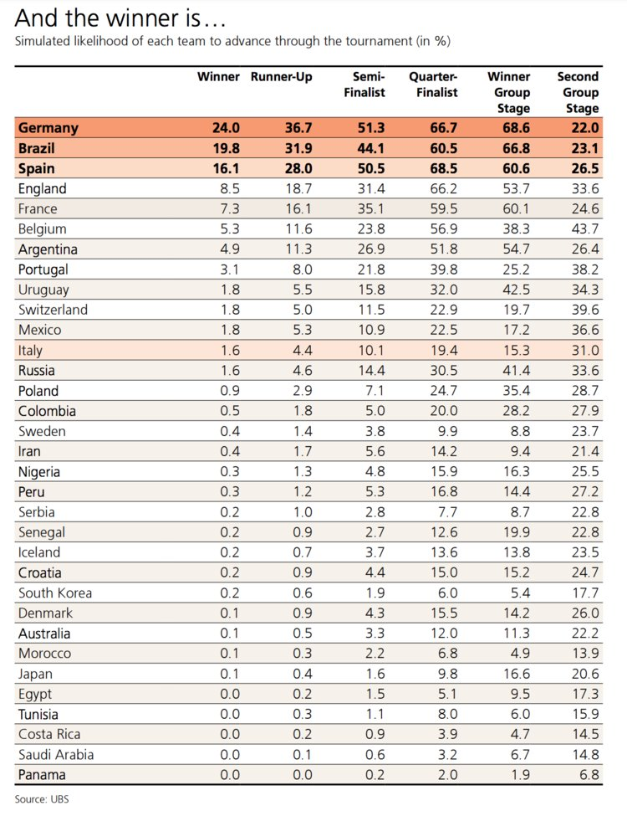
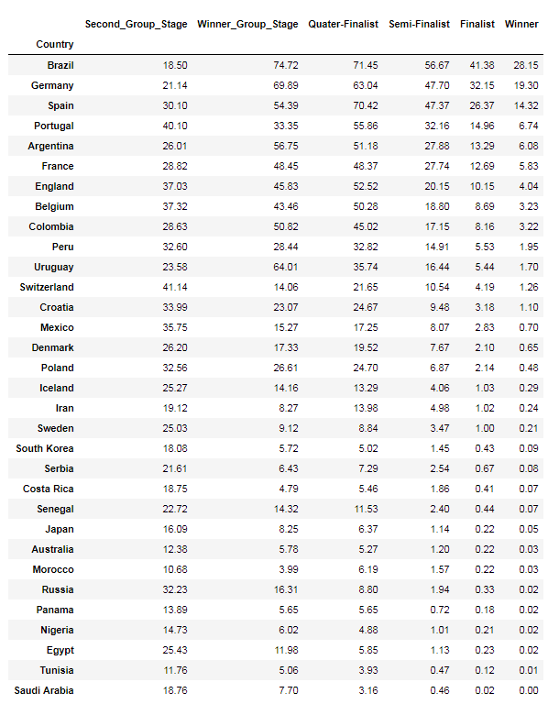

Slide 10
Conclusion
Germany, Brazil, and Spain have a combined 60% win rate.
Elo rating is not enough to predict win rate in a game like soccer.
“Rock, paper, scissors” syndrome.
Other important factors to take into consideration are:
Past games played between teams, players involved, goals scored, home vs visiting.
This is sport, and upsets DO happen. Many models for the 2014 World Cup gave Brazil as the most likely winner.

