Slide 1
EE 586 – ARTIFICIAL INTELLIGENCE
Simultaneous Localization and Mapping Implementation on Khepera Robot Simulator
by
Bengi Koç , Barış Tanrıverdi , Salim Sırtkaya
(Group 5)
METU – EE Spring 2006

Slide 2
Outline
Problem Definition
Basic Theory of chosen SLAM algorithm, fastSLAM
Algorithmic Details of fastSLAM
Results
Discussions
Demo

Slide 3
Problem Definition
SLAM - the ability of a robot to build a map of its environment while localizing itself in that map to reach true autonomy
“Is it possible for an autonomous vehicle starting at an uncertain location in an unknown environment to incrementally build a map of the environment while simultaneously using this map to compute the vehicle’s location?”

Slide 4
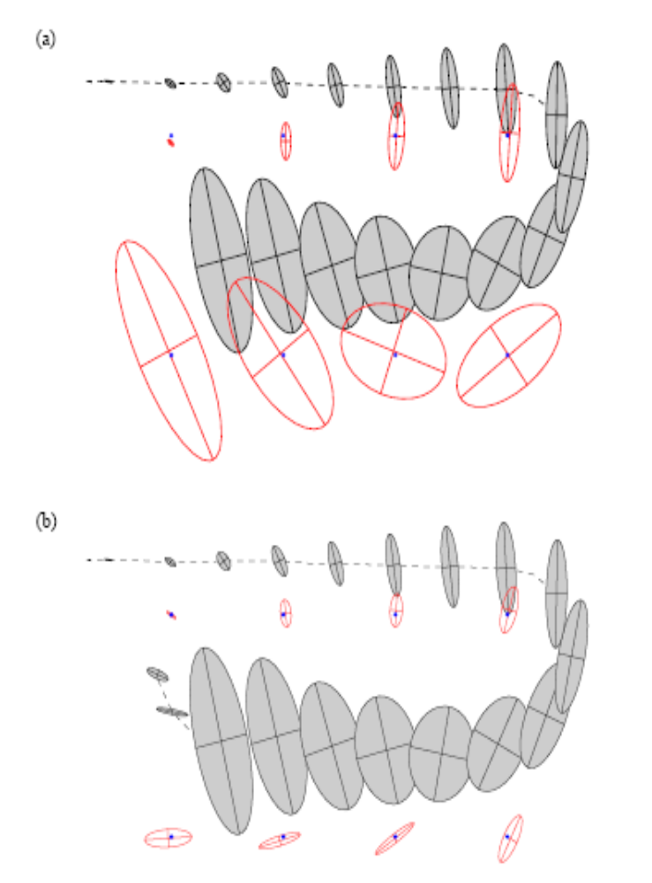
Problem Definition

Slide 5
Basic Theory of fastSLAM
Bayesian Approach to SLAM
  Motion model : p(s_{t}|u_{t},s_{t-1})
  Measurement Model : p(z_{t}|s_{t},θ,n_{t})
  Recover the posterior distribution p(s^{t}, θ₁, …, θ_{K}|z^{t},u^{t})
Contribution of Conditional Independence
  Observation : given a known robot path, measurements corresponding to different landmarks are independent of each other
  Bayesian Network

Slide 6
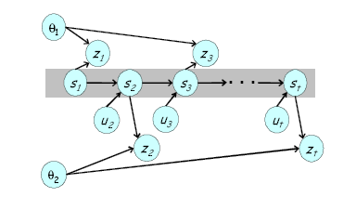
Basic Theory of fastSLAM
Observe that measurements corresponding to the landmark locations
θ₁ and θ₂ are only linked together through their joint dependence on
the robot path s^{t}

Slide 7
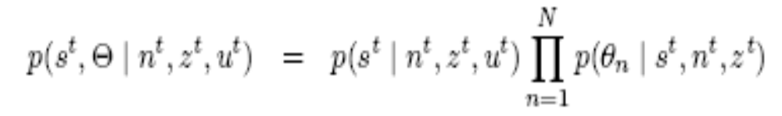
Basic Theory of fastSLAM
Factored representation of fastSLAM for known correspondence
The problem can be decomposed into K+1 estimation problems, one problem of estimating a posterior over robot paths s^{t}, and K problems of estimating the locations of the K landmarks conditioned on the path estimate

Slide 8
Basic Theory of fastSLAM
Pose Estimation – Particle Filtering
  Estimate the path posterior by p(s^{t}|z^{t},u^{t},n^{t}), HOW?
  Use particles to represent the path posterior
  Each Particle possesses k Kalman filters that estimate the k landmarks location conditioned on the path estimate
  Update particles in each step using weights assigned by the filter
  good approximation of the posterior even under non-linear motion kinematics
Landmark (MAP) Estimation – Extended Kalman Filtering

Slide 9
Basic Theory of fastSLAM
Landmark (MAP) Estimation – Extended Kalman Filtering
  If a measurement from a previously seen landmark is taken, apply EKF update for estimating the landmark position
  EKF can handle non-linear motion and measurement models
Based on the control u_{t}, measurement z_{t} and its data association n_{t}, fastSLAM is performed as follows.
  For a particle m, update the local pose estimate s_{t}^{[m]} by sampling the motion model.
  Use measurement z_{t} and data association n_{t} to update the appropriate local landmark location estimate θ_{nt}^{[m]} using the standard EKF
  Assign an importance weight to each particle proportional to the likelihood of the measurement given the estimated robot pose.
  Generate a new particle set through importance sampling

Slide 10
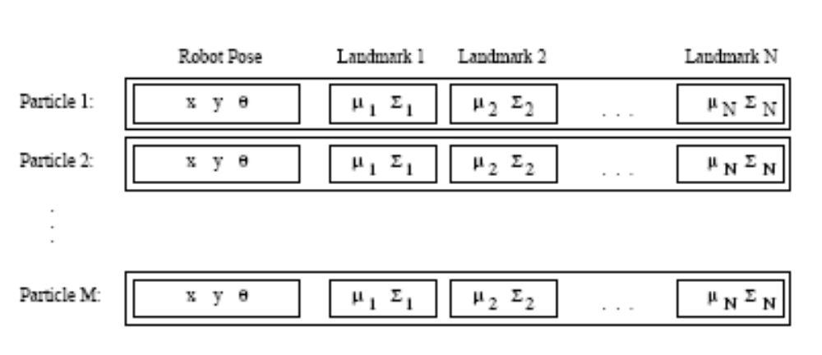
Algorithmic Details of fastSLAM
Particle Structure

Slide 11
Algorithmic Details of fastSLAM
How to generate a new particle set from the previous one:
  Extending the path posterior by sampling new poses
  Updating the observed landmark estimate
  Re-sampling

Slide 12
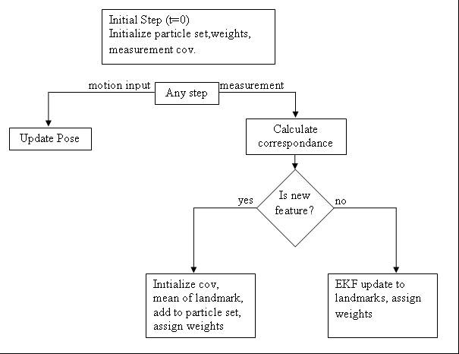
Algorithmic Details of fastSLAM

Slide 13
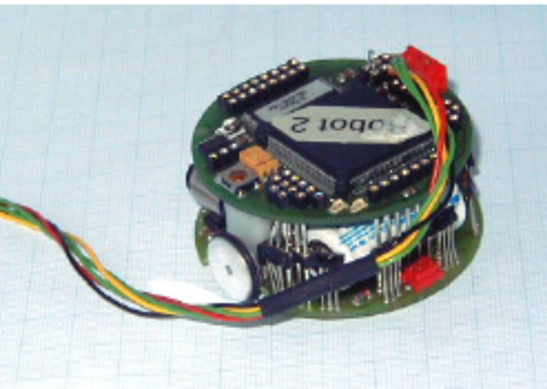
Algorithmic Details of fastSLAM
Basics of Khepera
  designed as a research and teaching tool in the framework of a Swiss Research Priority Program.
  A Khepera robot has two DC motors with incremental encoders and 8 infrared proximity/light sensors.

Slide 14
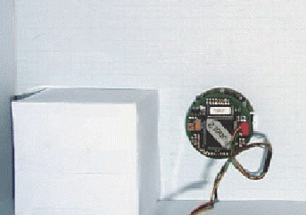
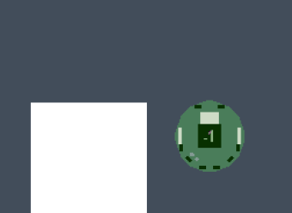
Algorithmic Details of fastSLAM
KiKS (Khepera Simulator in MatLab)
  A Matlab application that simulates a Khepera robot connected to the computer in a very realistic way

Slide 15
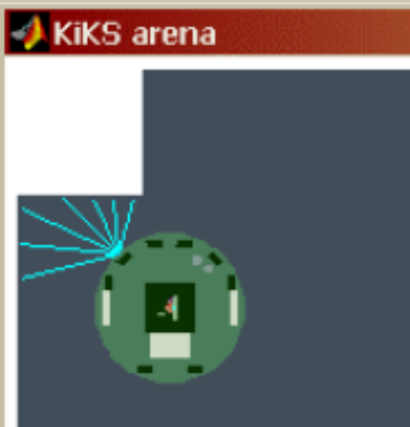
Algorithmic Details of fastSLAM
Interpreting Sensor Data
  Each sensor has a field-of-view of about 120°.
  Look up table
  Weighted average

Slide 16
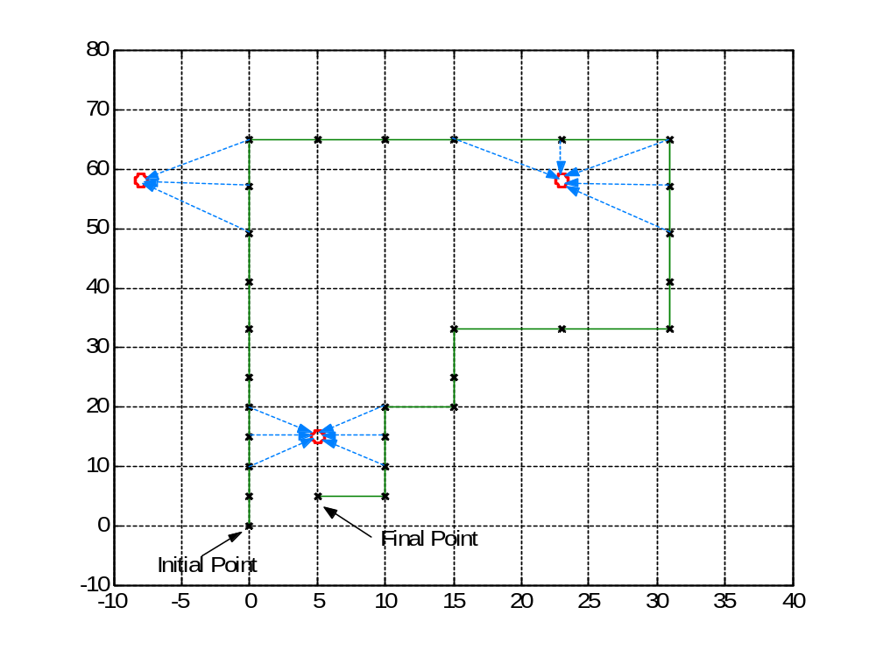
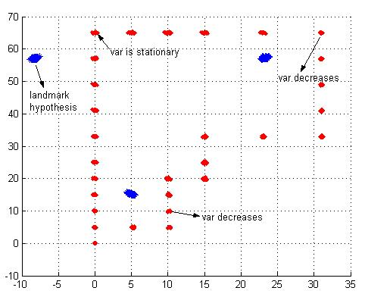
Results for Synthetic Data
Original path and map of the
synthetic data
Result of the fastSLAM

Slide 17
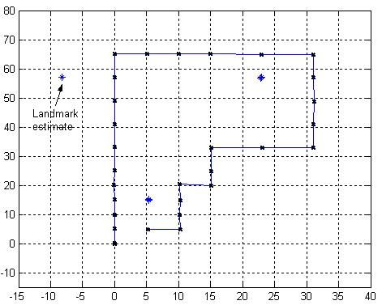
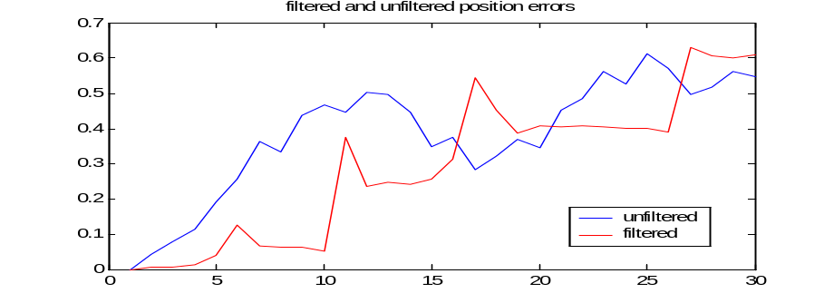
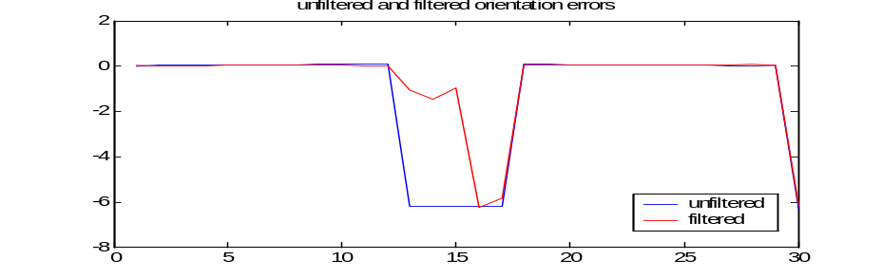
Results for Synthetic Data
Weighted average of the particles
Pose and orientation errors for filtered and un-filtered cases
MSE orientation filtered = 1.9627
MSE orientation un-filtered = 2.7855
MSE position filtered = 0.3558
MSE position un-filtered = 0.4181

Slide 18
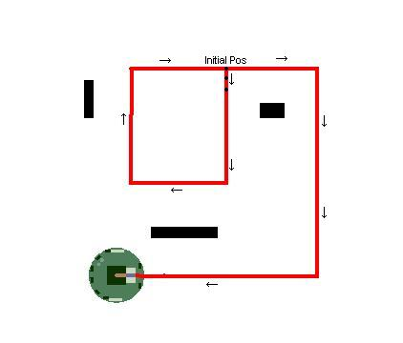
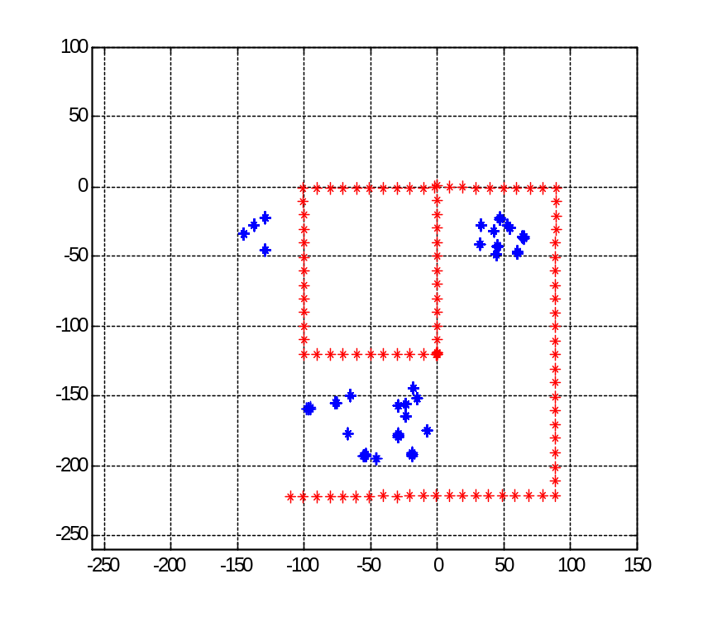
Results for Khepera
(averaged measurements)
Original path and map
Weighted average of the particles

Slide 19
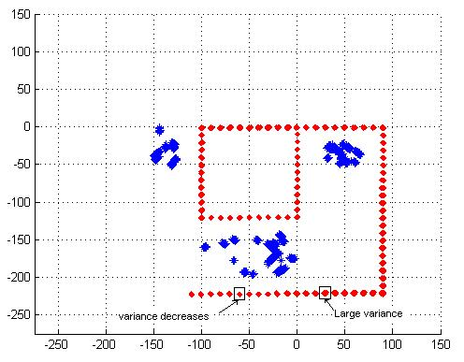
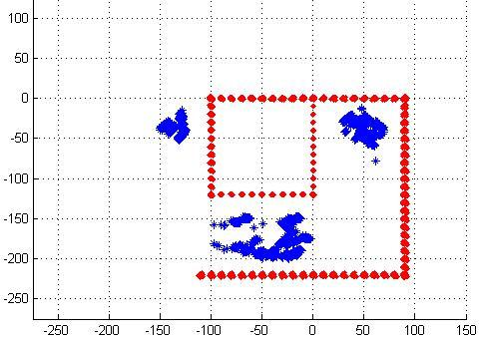
Results for Khepera
(averaged measurements)
fastSLAM result with resampling
fastSLAM result without resampling

Slide 20
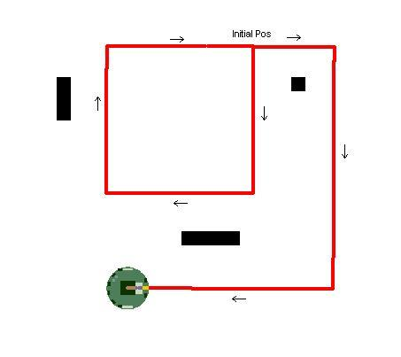
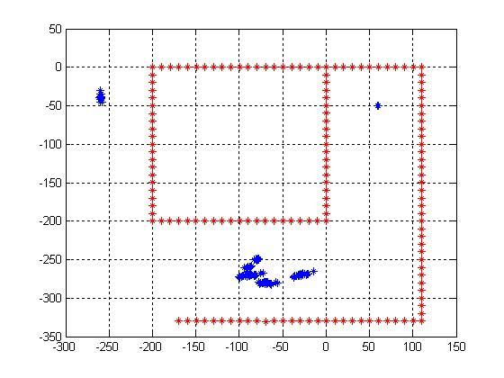
Results for Khepera
(look-up table)
Original path and map
Weighted average of the particles

Slide 21
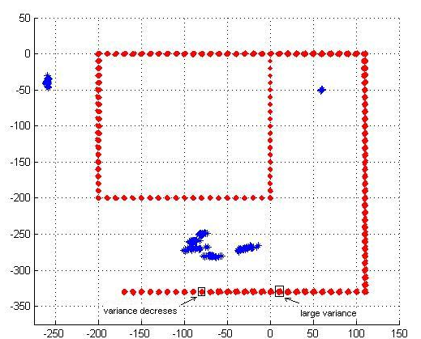
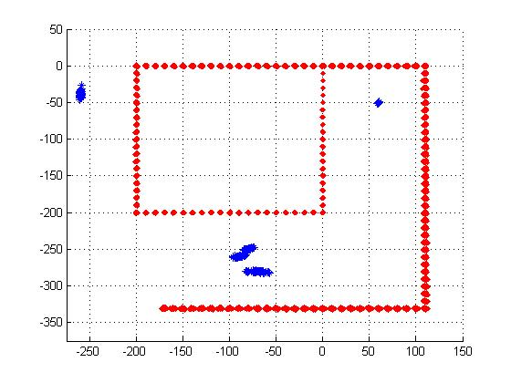
Results for Khepera
(look-up table)
fastSLAM result with resampling
fastSLAM result without resampling

Slide 22
Discussions
Performance depends on
  proper motion and measurement model
  sufficient number of particles
  proper initial covariance matrices
Better results can be achieved with more proper and accurate sensors like laser range finders.

