Slide 1
Matlab Simulation of Obstacle Avoidance
Presented by Jonathan Deming
Sept 10th, 2004

Slide 2
Presentation Overview
Real World Representation
Simulation Capabilities
Simulation Environment
Current Focus
Behavior Hierarchy
Simulation Plots
Known Bugs
Future Plans

Slide 3
Real World Representation
NxM Matrix, each element represents elevation
Scalable to larger maps but Matlab becomes unstable when plotting
Maps measuring 100x100 works best
Obstacles are assumed to be part of terrain
1 element = 0.1m

Slide 4
Simulation Variables
Dimensions of the “world”:
  Overall Map Size
  Globally defined Obstacle size for 2.5D
Robot:
  Speed (represented as step size)
4 Ultrasonic Detectors with:
  Independently defined:
    3-d Offset from origin of robot
    Azimuth + Elevation Skew
    Max Range

Slide 5
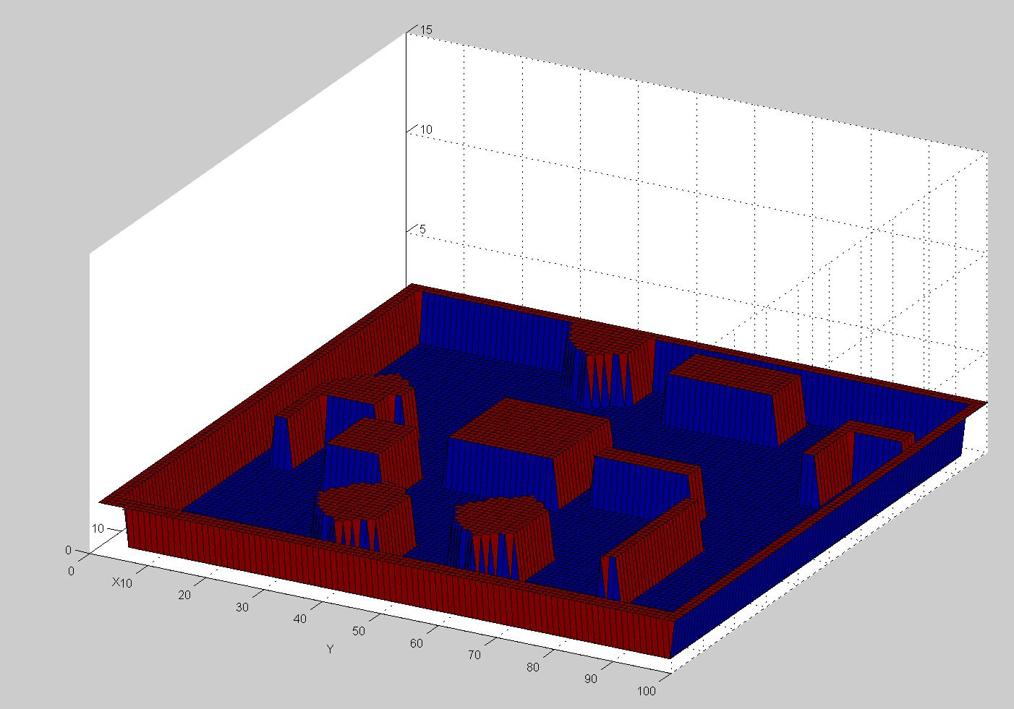
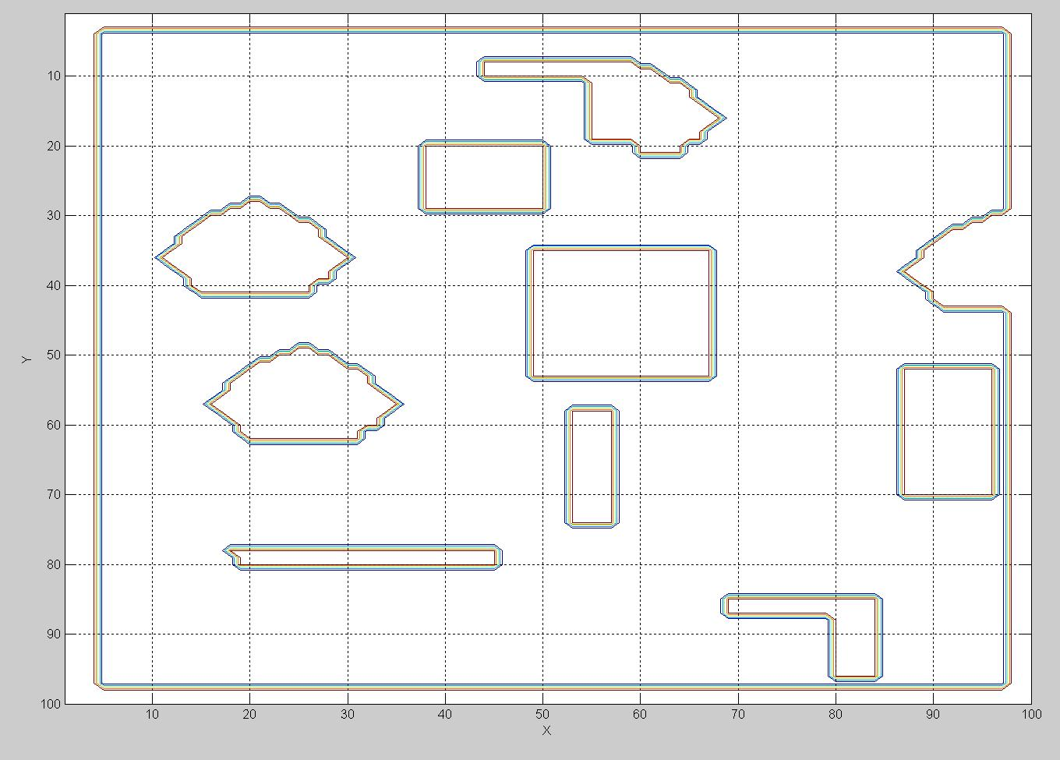
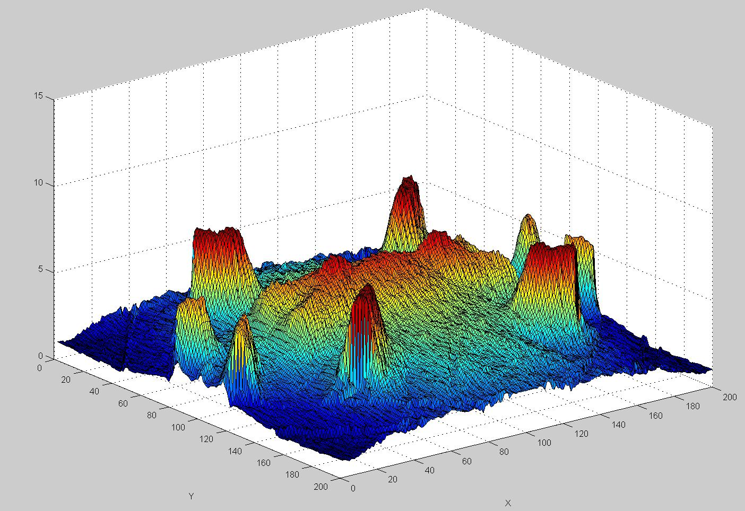
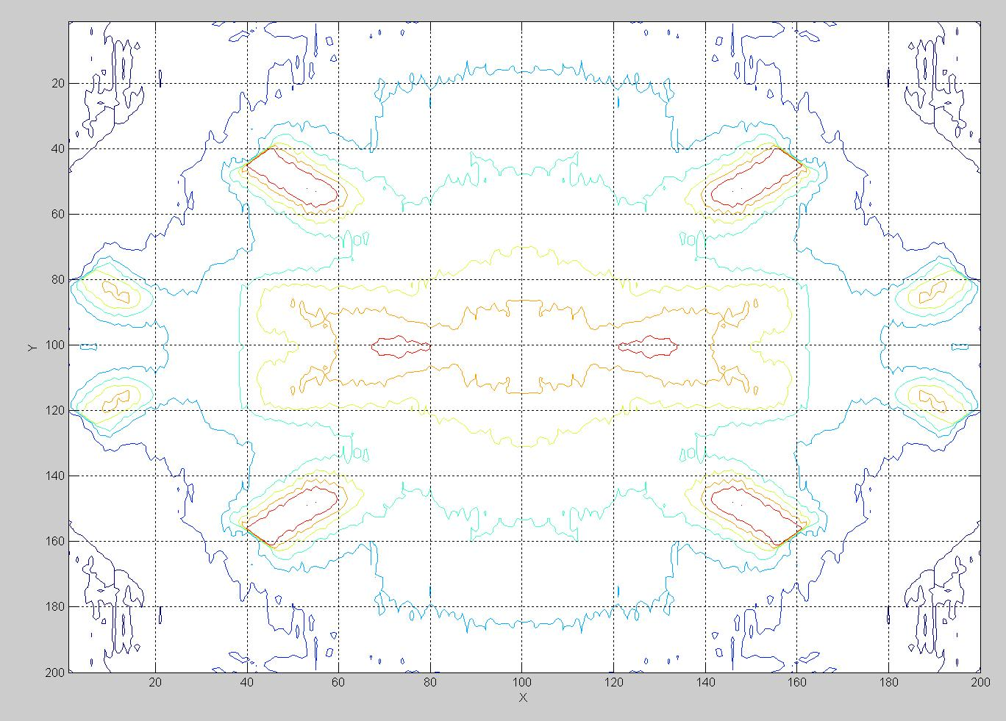
Simulation Environments

Slide 6
Current Focus
2.5D Enviornment
Robot with 4 Ultrasonic Detectors
Utilizes global offsets configuration used for the Matilda Bot
Point-to-point obstacle avoidance
Look ahead planning
Pseudo-goal (PG) completion when looking for waypoint

Slide 7
Behavior Hierarchy
Caclulate pseudo-waypoint
Direct Traversal to pseudo-waypoint
Trivial Avoidance
  90º Search for path, wall-follow
    Additional 270º scan
    Weighted Decision, wallfollow
Repeat until pseudo-goal is reached

Slide 8
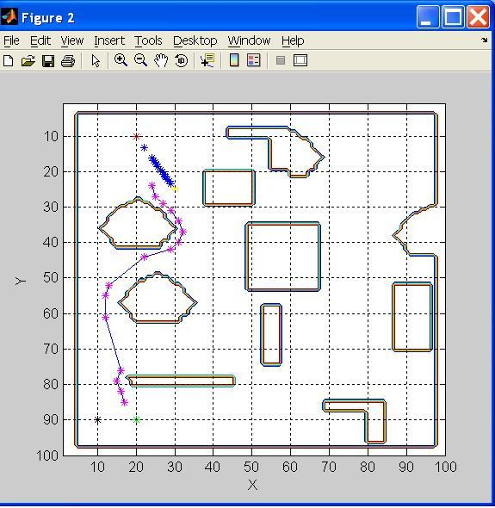
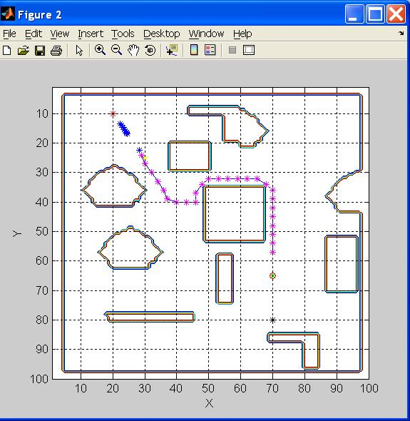
Simulation Plots

Slide 9
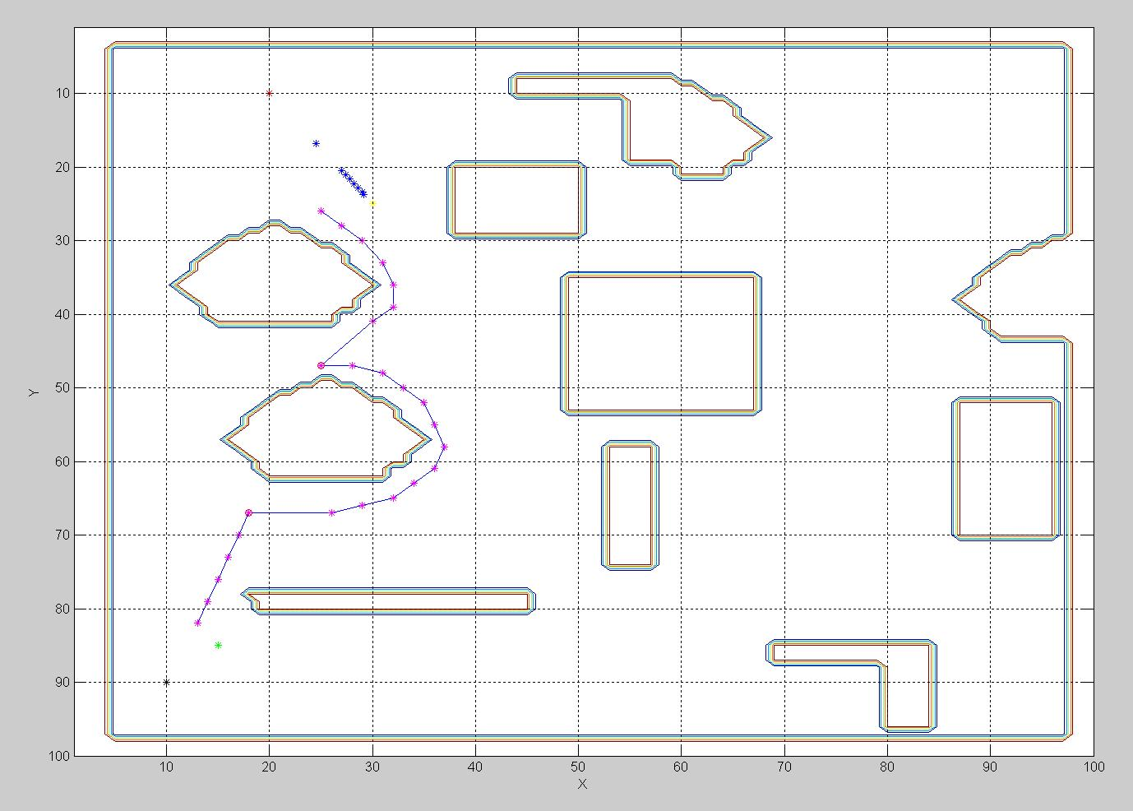
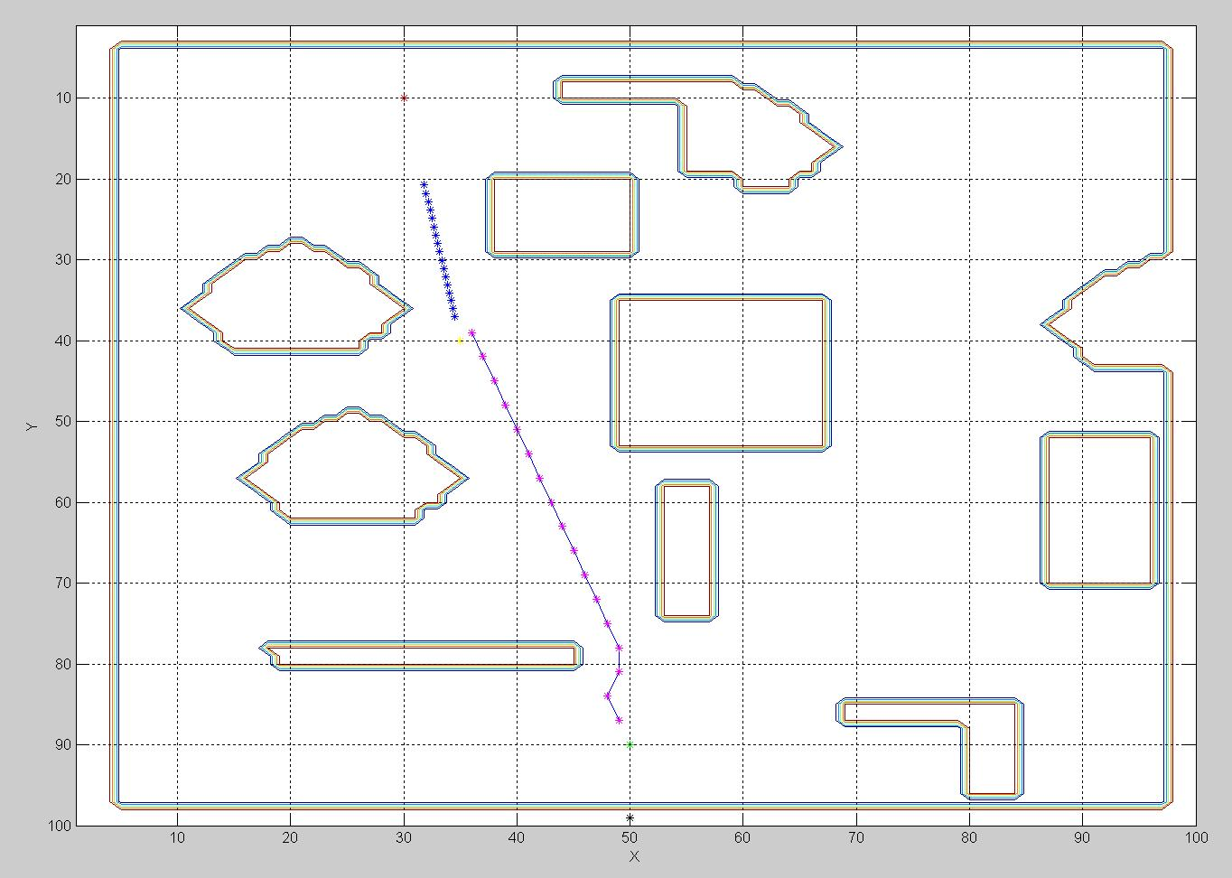
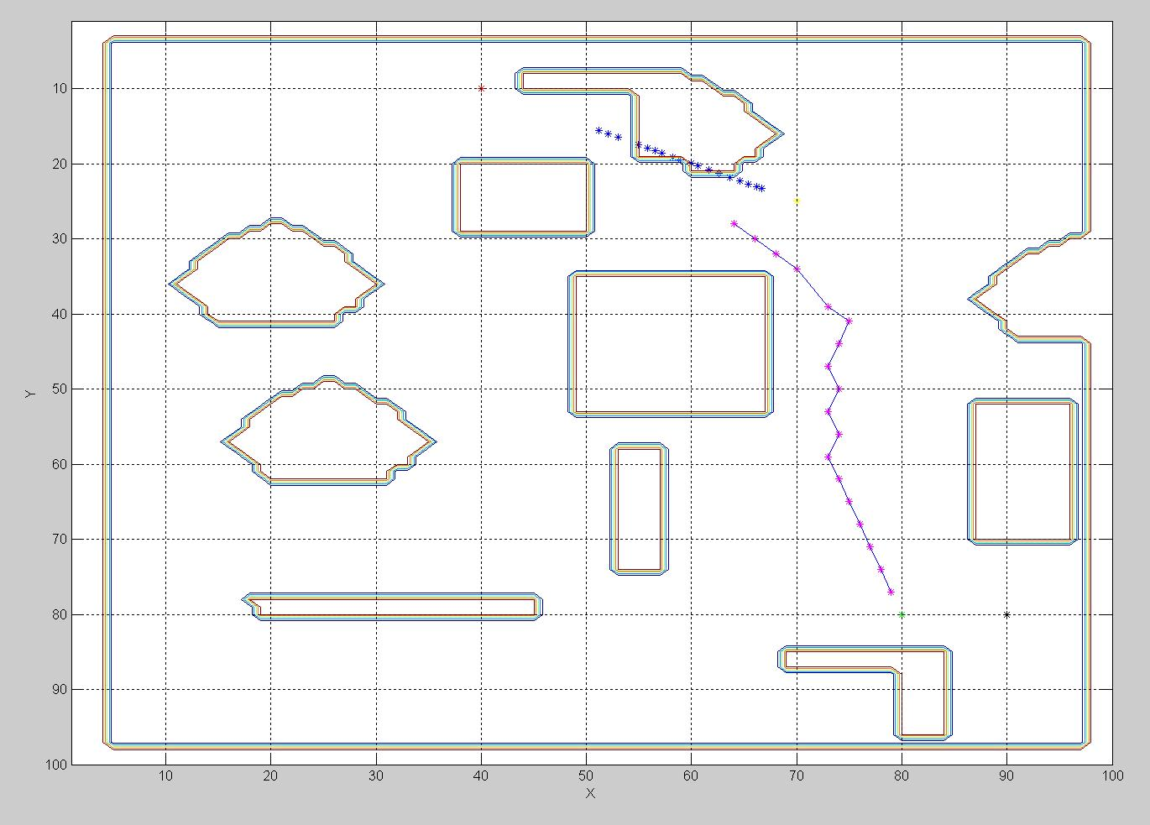
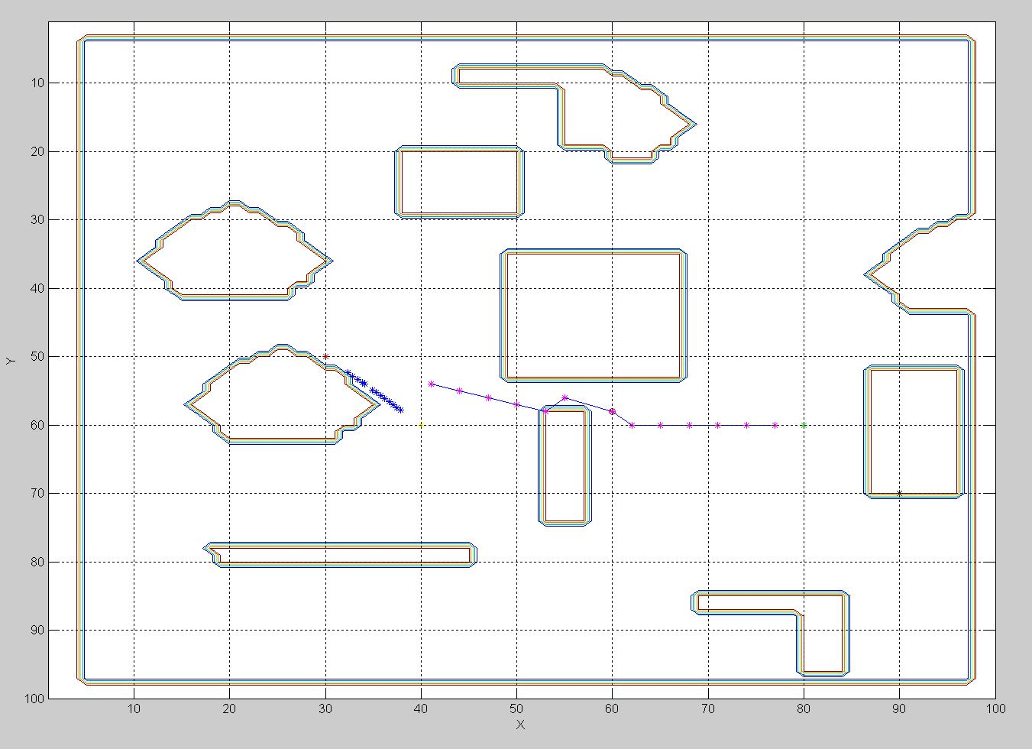
More Simulation Plots

Slide 10
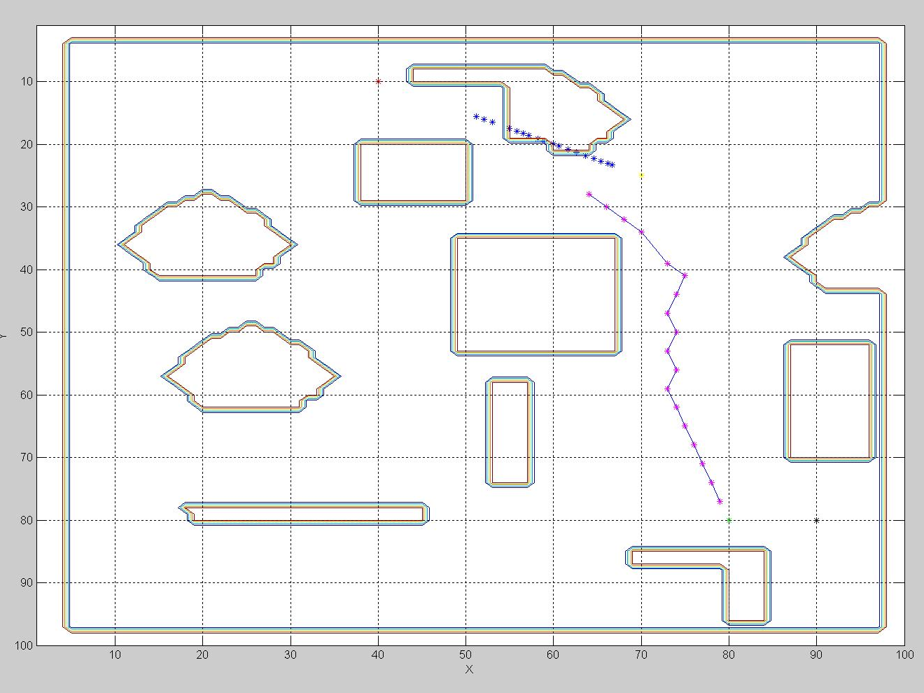
Known Bugs

Slide 11
Future Plans
Implement these behaviors in the black bots
Use this environment to develop LIDAR algorithm
Create an integrated approach using LIDAR and SONAR

Slide 12
Questions?

