Slide 1
A General Algorithm for Output-Sensitive Visibility Preprocessing
Samuli Laine
Helsinki University of Technology / TML
Hybrid Graphics, Ltd.

Slide 2
Visibility Preprocessing
Goal: avoid rendering hidden objects
Utilize static occlusion
Pre-process = compute visible sets (VS)
  Divide accessible space into viewcells
  Find visible objects for each viewcell
Run-time = use VS
  Identify viewcell of the camera
  Draw objects in the VS of the viewcell
    Use VS of the viewcell as the PVS for the camera
Notes:
VS = objects visible to any point inside the cell

Slide 3
Basic Properties of Visibility
Sightlines are straight
The VS of a viewcell is the union of
  Objects that overlap the viewcell
  Objects visible from the boundary of the viewcell
Object 1
Viewcell
Object 2
Notes:
Forget about reflection and refraction, too complicated!
That’s because every sightline from the interior must either
terminate at an object inside the cell
pass through the boundary of the cell

Slide 4
Computing the VS of a viewcell
Rasterization [Nirenstein & Blake 2004]
  Pick a viewpoint on the viewcell’s boundary
  Render the scene
  Add objects in the image to the VS of the cell
  Repeat until happy
Exact [Bittner 2002, Nirenstein et al. 2002]
  Complicated, works in 6D dual space
  Slow
Many conservative methods

Slide 5
What About Multiple Viewcells?
Computing the VS of each viewcell separately is inefficient
  Does not utilize coherence of visibility
Previous solution: Hierarchical refinement
[Cohen-Or et al. 1998, Gotsman et al. 1999, Durand et al. 2000, Bittner 2002, Nirenstein & Blake 2004]
Notes:
Utilizing coherence: use previous results during computation to save work later

Slide 6
Hierarchical Refinement
Construct a hierarchy of viewcells
First compute VS of root cell
Split the cell into two child cells
Recurse to the children
Stop recursion when leaf cells (= final viewcells) are reached

Slide 7
Hierarchical Refinement, cont’d
The VS of parent cell bounds the VS of child cell
  Not visible to the parent cell → not visible to the child cell
Good: hierarchical pruning of objects
Bad: still redundant work in internal cells
  We only need the VS of the leaf cells
  But we find the VS of the internal cells too
  Let’s remove this redundancy

Slide 8
Removing the Hierarchy
The parent cell is not the only possible source for VS bounds
Idea: use the VS of the neighbor cells
  Consider cell C and the set of its neighbors N
  Not visible to any N → not visible to C either
    Except if inside C, which is a trivial case
  Cells must cover the entire world
No hierarchy required

Slide 9
Removing the Hierarchy, cont’d
N₁
N₂
C
N₄
N₃
N₅
Major trouble: nowhere to start!
  All cells depend on their neighbors
  Cyclic dependencies ☹
Notes:
Kuva: selitä suhde uudestaan, ei muuta

Slide 10
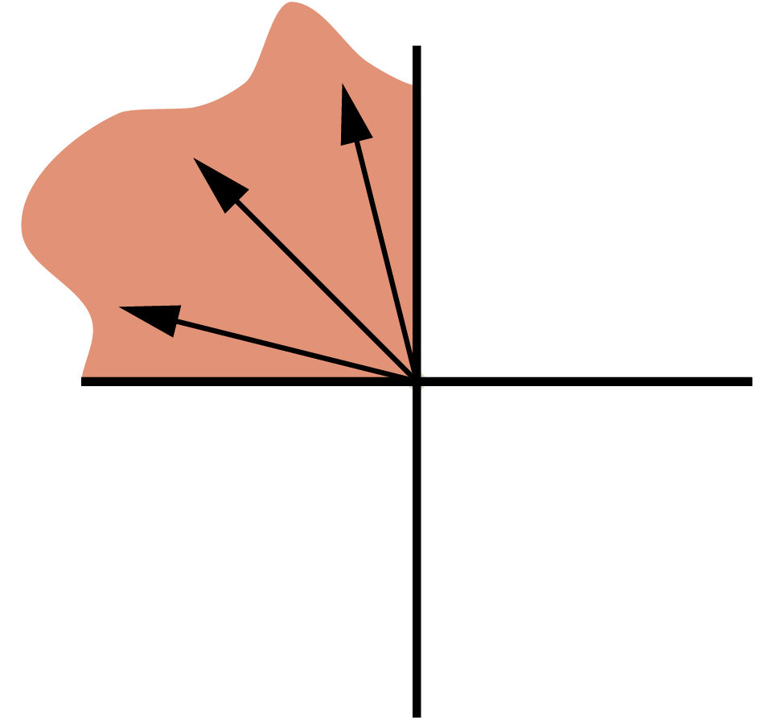
Removing the Cyclic Dependencies
Assumption: viewcells are axis-aligned
Let’s constrain the sightline directions
  Divide direction space into 2^{dim} partitions
    4 quadrants in 2D
    8 octants in 3D
Define directed visible set (DVS) as the set of objects visible to a viewcell, but with constrained sightline directions
  This is the key idea of the algorithm
Notes:
union of dvs is vs

Slide 11
Bounding the DVS
Similar to bounding the VS with neighbors
But now we may use only a subset of N
  Because we have constrained the sightline directions
No more cyclic dependencies ☺
  Except in funny situations, see paper
N₁
N₂
C
N₃

Slide 12
Example: Regular Grid
Sightline directions constrained to top left quadrant
Cell C depends on A and B
Cell X depends on nothing → start there
X
A
B
C
Notes:
TODO: fix quadrant figure

Slide 13
Ordering the Computation
Construct a dependence graph
  Nodes are viewcells, edges are dependencies
  Edge from A to B, if A depends on B
Sort the graph topologically
  Linear-time operation
  Always possible if the graph contains no cycles
Process cells in sorted order → can always get DVS bounds

Slide 14
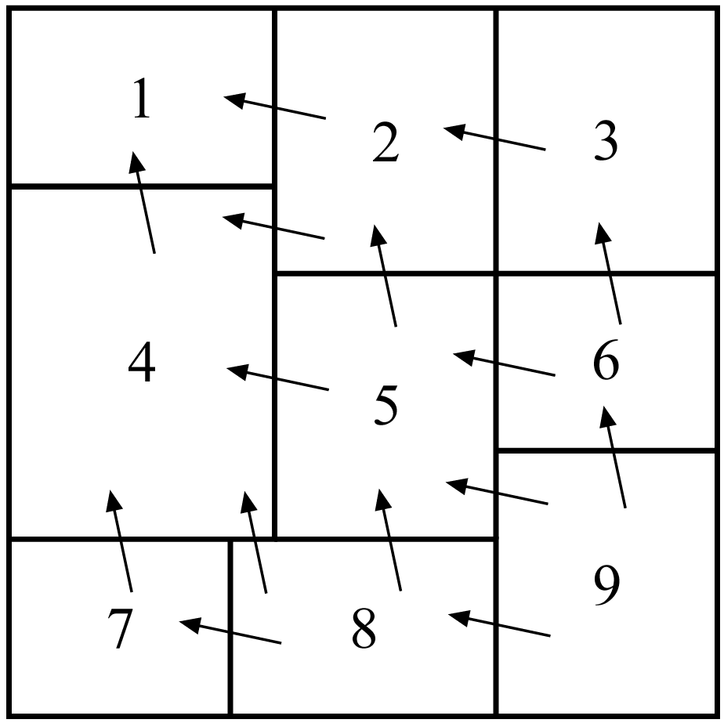
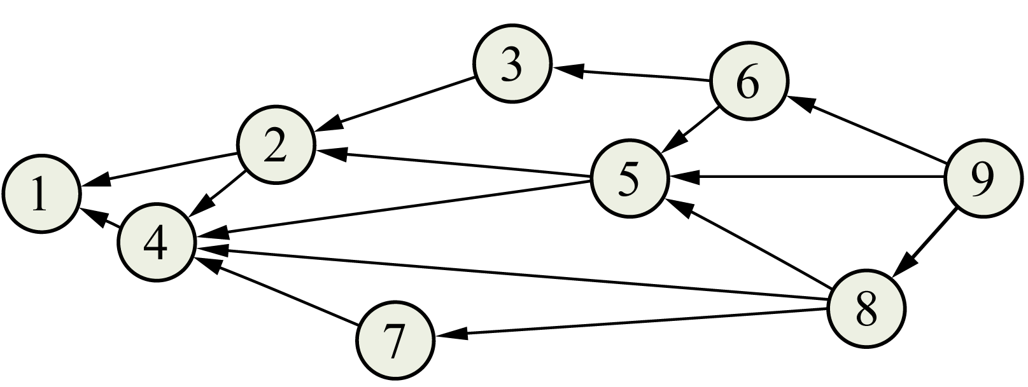
Dependence Graph: Example
Cells and dependencies
Sorted dependence graph

Slide 15
The Full Algorithm
For each quadrant / octant
  Construct dependence graph
  Process cells in sorted order
  For each cell:
    Compute the bounds for DVS
    Call visibility solver with the bounds to obtain DVS
    Add objects in DVS to VS

Slide 16
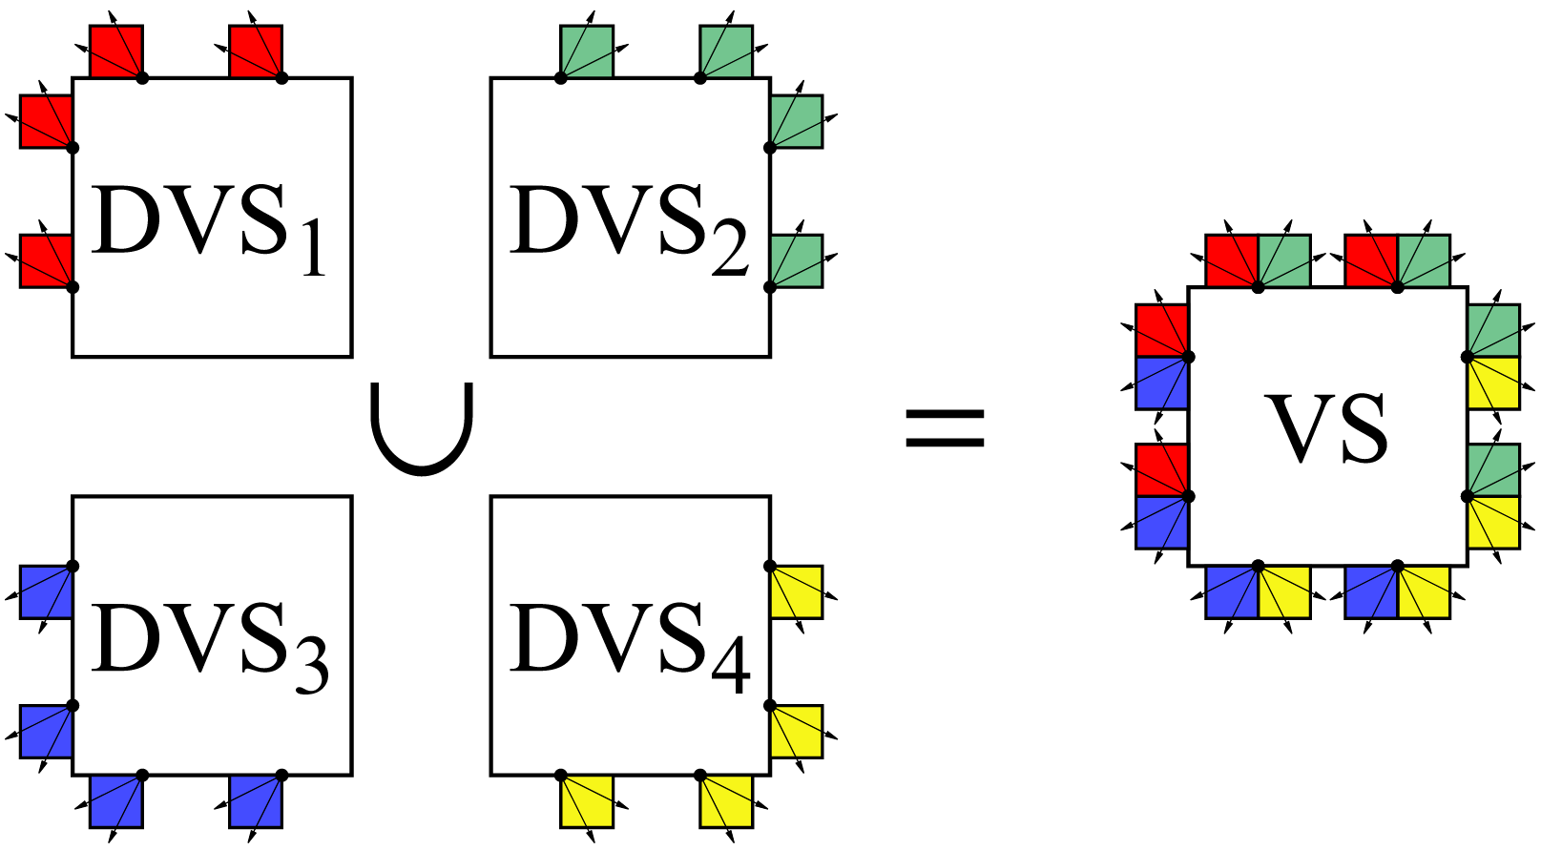
Constraining the Visibility Solver
Rasterization-based method
  Render images that correspond to casting rays to the allowed directions
Notes:
Exact method: See paper
Same number of pixels

Slide 17
Experimental Results
Synthetic scene
  Control over the amount of visibility
Compare against hierarchical refinement
  With point caching [Nirenstein & Blake 2004]
    Re-uses visibility samples taken at internal cells
Use rasterization for solving the visibility
Measure the average number of objects rasterized by the visibility solver

Slide 18
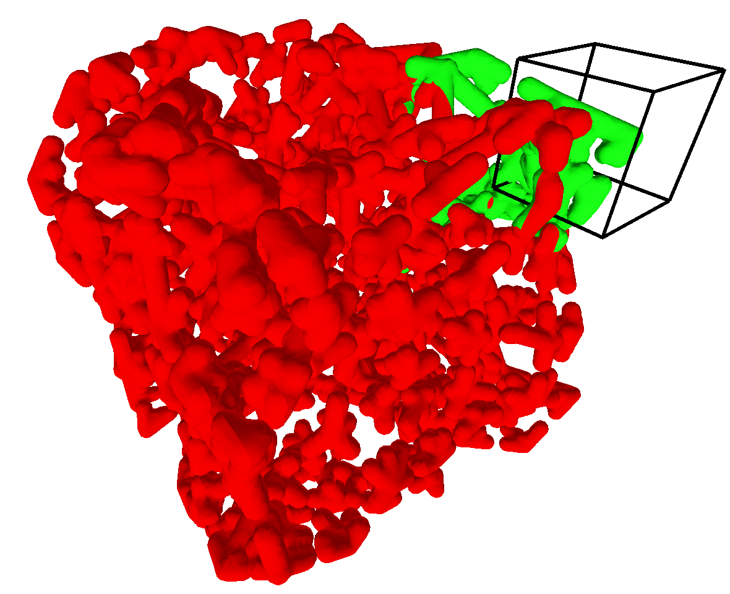
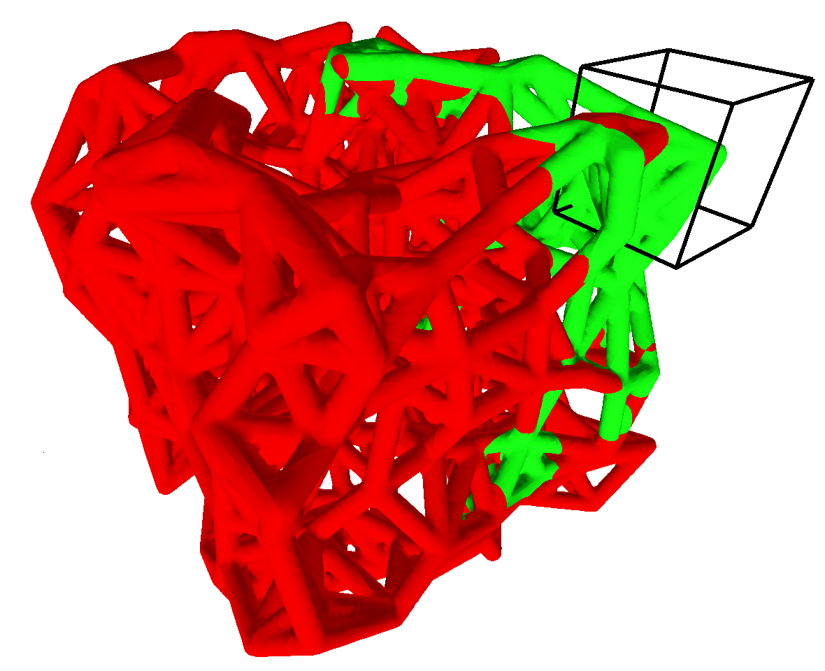
Experimental Results: Scenes
10% of tunnels open
→ small visible sets
100% of tunnels open
→ large visible sets

Slide 19
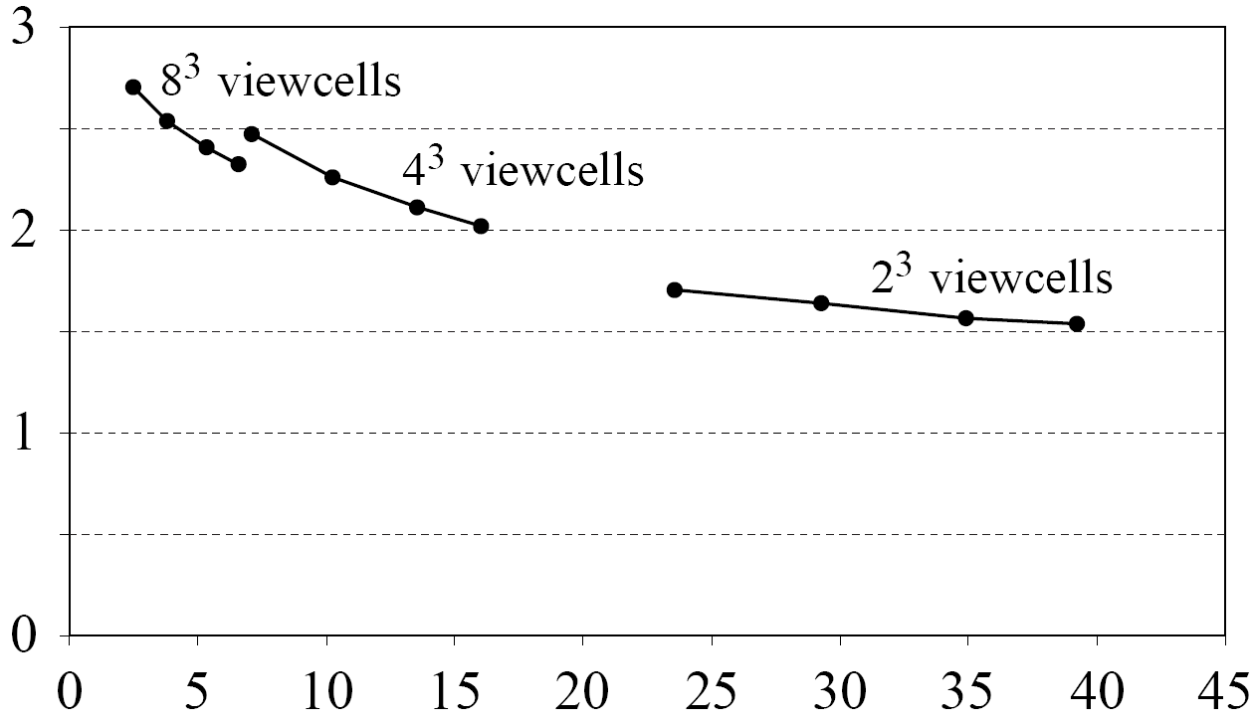
Experimental Results, cont’d
Improvement over hierarchical refinement
Average VS size, % of objects

Slide 20
Summary
Output-Sensitive
  The workload is only affected by the number of visible objects
    Proof in the paper
No need to consider the entire scene at any time
  We always have a subset of objects to process
  Nice property if we have massive worlds
Straightforward to implement
Notes:
In effect, we have a PVS while computing PVS

Slide 21
That’s It
Questions
Thanks
  Discussions: Timo Aila, Lauri Savioja
  Funding: National Technology Agency of Finland, Bitboys, Hybrid Graphics, Nokia, Remedy Entertainment

