Slide 1
EE 706-DIGITAL VIDEO PROCESSING
Digital Video Stabilization and Augmented Ego-motion Estimation of a Moving Camera
by
Salim Sırtkaya & Gökhan GÖKSÜGÜR
METU – EE Spring 2005

Slide 2
Outline
Project Description
Description of Camera Motion Estimation Algorithm
Results
Demo
References
Notes:
Let me first talk about the outline of the presentation..
I will first describe the project, then I will talk about the work load o each member
Then I will go into details of my part, camera motion estimation.
After that I will talk about my project plan and finish my presentation.
Gökhan will continue with the stabilization part

Slide 3
Project Description
Digital video stabilization and augmented ego-motion estimation of a camera+imu system mounted on a 6 degree of freedom moving platform
Our aim will be estimating the motion of the platform using Image Based Motion Estimation (IBME) and Inertial Measurements using Kalman Filter. And then removing the jittering motion (stabilization) while preserving the global motion.
The Kalman Filtering part will be omitted

Slide 4
Work Load Of Members
Salim SIRTKAYA
  Augmented Ego-motion Estimation of a Moving Camera
  Unification with Digital Video Stabilization
Gökhan GÖKSÜGÜR
  Digital Video Stabilization
  Unification with Ego-motion Estimation

Slide 5
Camera Motion Estimation
Based on optimal fusion of two different estimation sources via Kalman Filtering
    Source 1 : Image Based Motion Estimation
    Source 2 : Inertial Measurement Unit
    ( 3 accelerometers + 3 gyroscopes )
Focus : Image Based Motion Estimation
IBME has found application areas:
Optical Navigation in unmanned and space vehicles
Automatic and safe descent/ascent of UAV’s
Platform Stabilization
Geo-referencing Systems
Alternative aiding for Inertial Navigation Systems
Notes:
The camera motion estimation framework is based on fusion of two motion estimation sources with Kalman Filtering.
The first source is “Image Based Motion Estimation” and we will primarily focus on this source due to the scope of this course.
The second source is the IMU. The principles of inertial navigation is beyond the scope of this course, therefore I will not go into details. But questions are welcome.

Slide 6
Camera Motion Estimation
Image Based Motion Estimation (IBME)
3D Camera Motion is estimated between two camera views
Assumption: The 2D image motion is only due to camera motion.
The algorithm is based on feature extraction, Optical Flow Estimation of the extracted features, Essential Matrix Estimation and Levenberg-Marquardt Minimization for 3D motion Estimation
The translational motion of the camera can be estimated up to a scale. Therefore a scale estimation algorithm using range finder is presented for complete motion estimation

Slide 7
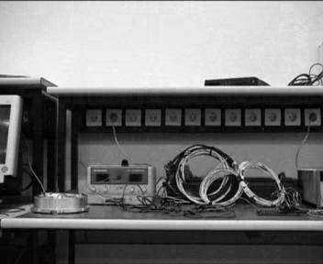
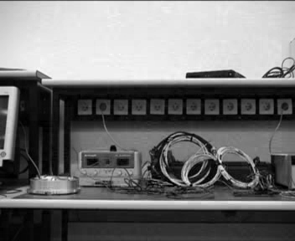
Camera Motion Estimation
Given two consecutive frames
Image Based Motion Estimation – The algorithm
Harris Corner Detector or Intensity Gradient Matrix analysis
Extract Features
Optical Flow Estimation based tracking (Kanade Lucas Tracker)
Track Features
Stabilization
Modified 8-point Algorithm
Calculate Essential Matrix
Direct Minimization of Epipolar Constraint equation
Linear Motion Estimation
Non-linear Motion Estimation
Levenberg-Marquardt Algorithm
Scale estimation of translational motion
Using Range Finders (a-priori in test case)

Slide 8
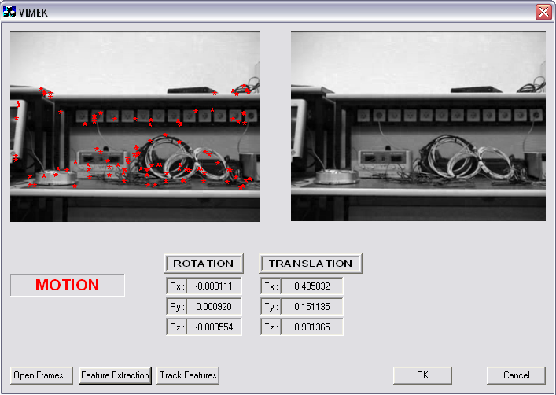
Camera Motion Estimation
Image Based Motion Estimation – Feature Extraction

Slide 9
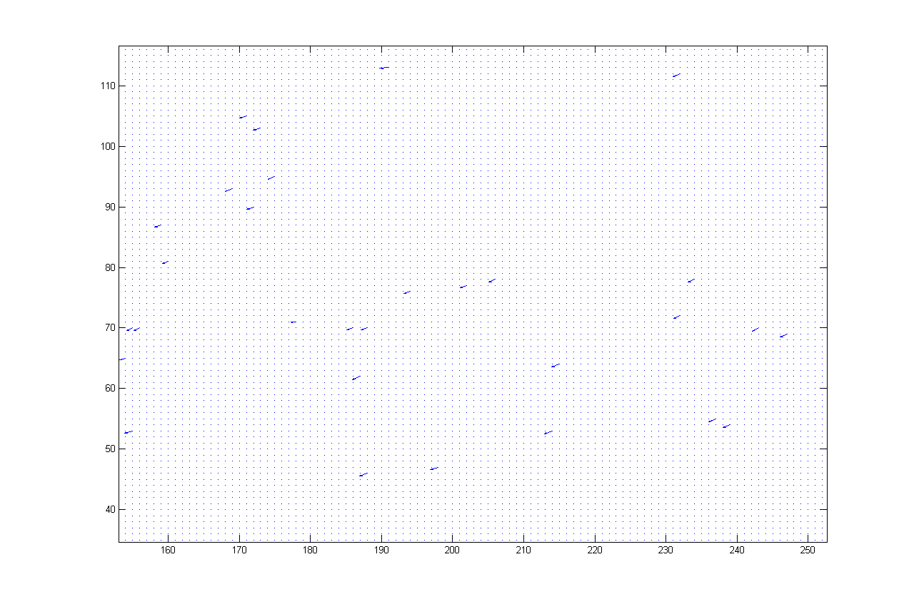
Camera Motion Estimation
Image Based Motion Estimation – Feature Tracking (KLT)

Slide 10
Camera Motion Estimation
Image Based Motion Estimation – Essential Matrix Method
! What is Essential Matrix? Why do we need it?
Given 2-D correspondences (conjugate pairs) on two image planes, find the relative orientation between these image planes.
X₂ = R. X₁ + T R = Rotation, T = Translation
Note that X₂ , R.X₁ and T are coplanar
Therefore (T x R.X₁) is perpendicular to X₂ => X₂ . (T x R.X1) = 0
E Matrix = T x R
X₂. E . X₁ = 0 E Matrix is estimated by manipulating this equation
8 point correspondences are enough to solve this equation. Due to noisy measurements, a linear minimization is more appropriate. Therefore
min Σ (x₁. E. x₂) will yield a more accurate result.
Next step is to decompose E matrix into R and T

Slide 11
Camera Motion Estimation
Image Based Motion Estimation – Essential Matrix Method
Decompose E Matrix into R and T
T is the unit eigenvector with the smallest eigenvalue of the matrix E.E^{T}
Remember E = R x T => E^{T} = R x (-T)
R can be found by solving min |R x (-T) - E^{T}|
This estimation algorithm is a linear algorithm and is not precise. We may use this linear estimation as an initial starting point of a more complicated non-linear estimation algorithm : Levenberg-Marquardt Minimization
Represent the Rotation+Translation unknown vector as a = [q₀ q₁ q₂ q₃ T_{x} T_{y} T_{z}]
Nonlinear motion estimation attempts to minimize the image plane error between the features in the second view and the projection of the features in the first view into the second view given the motion between the frames. Image plane error is,
C(a) = Σ |x₂ – f(x₁,a)|²
where f represents the projection of the features x1 on image J given the motion a.

Slide 12
Camera Motion Estimation
Image Based Motion Estimation – Levenberg-Marquardt
Correct image projection requires knowledge of the depth to a feature and a perspective camera model. Solve this problem with triangulation...
Find the minimum of C(a) by iteratively solving (A+λI).δa = -b
where A = Σ(∆f(x₁,a))^{T} (∆f(x₁,a)) and b = Σ(∆f(x₁,a))(x₂-f(x₁,a))
And λ is a scalar whose value is changed at each iteration depending on the solution to the minimization equation. The algorithm is as follows:
1- Compute C(a)
2- Set λ = 0.001 (start with a small λ )
3- Compute A,b and solve (A+λI).δa = -b for δa
4- Evaluate C(a +δa) with ||q+δq||=1 & ||T+δT||=1
5- If C(a +δa) ≥C(a) then λ ← 10λ and go to 3
Else λ ← 0.1λ ; q ← (q+δq)/||(q+δq)|| ; T ← (T+δT)/||(T+δT)|| ;
a ← (a+δa) solve for new feature depths and go to 3
6- Stop when (C(a+δa) – C(a))/C(a) < 0.001

Slide 13
Camera Motion Estimation
Kalman Filtering of IBME with Inertial Measurements
Image Based Motion Estimates
( R , T )
KALMAN FILTER
Optimal Estimates
( R , T)
Inertial Measurements
(ax,ay,az,Ω_{x},Ω_{y},Ω_{z})

Slide 14
Experimental Results
The algorithm is experimented on real data taken from a moving platform (VIMEK Testbed). The moving platform consists of following items:
  A camera
  An Inertial Navigation System
  A precise surfaced mechanical mount
  Two computers
  Test cables
  Moving four wheel carriage
The experiment is conducted in a close environment.
The experiment durations are short (at most 1 minute)
The motion capability of the carriage was limited, therefore the motion is dominantly translational.

Slide 15
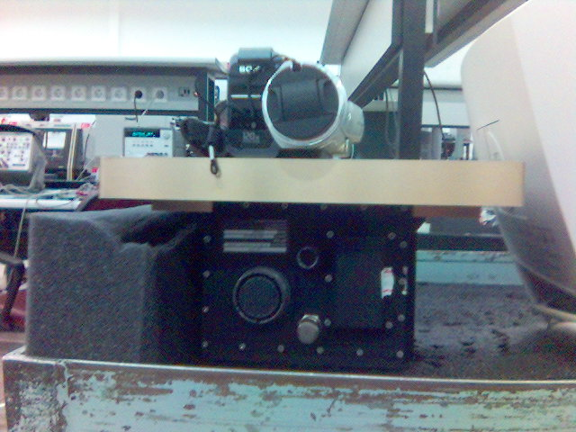
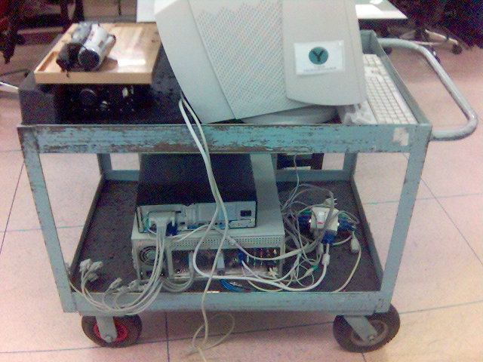
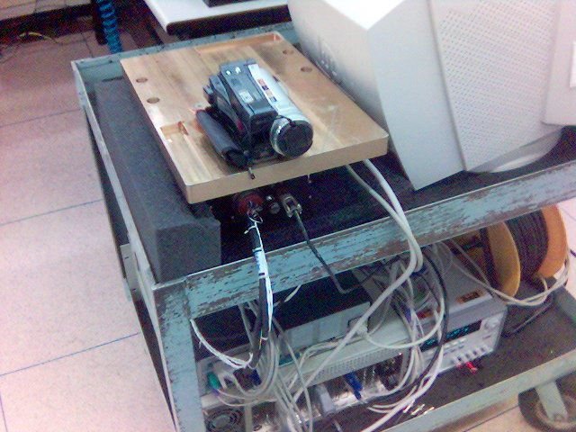
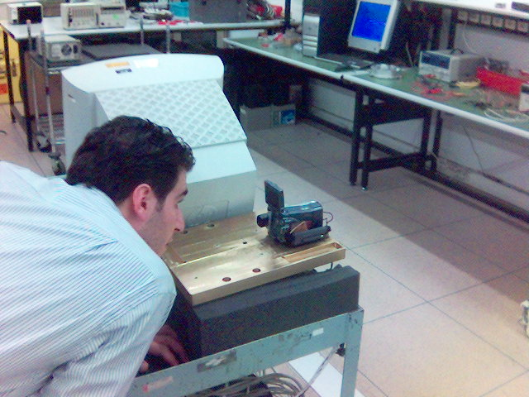
Experimental Results

Slide 16
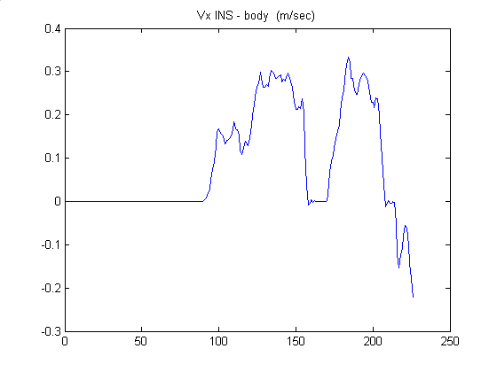
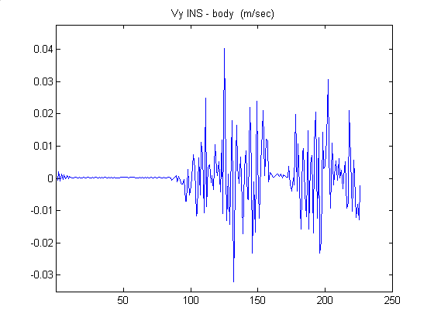
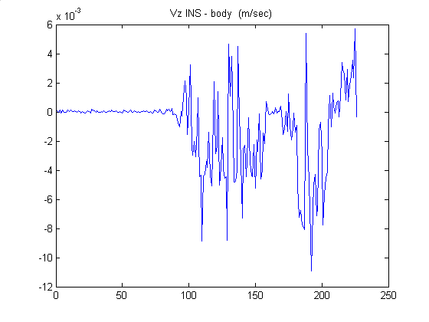
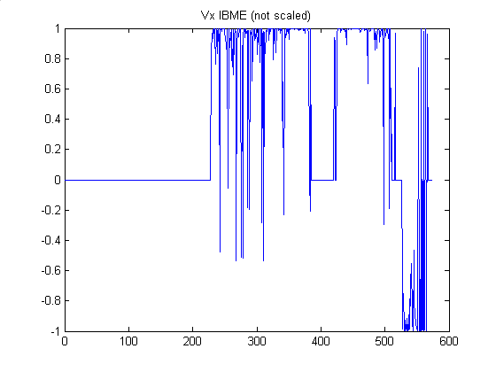
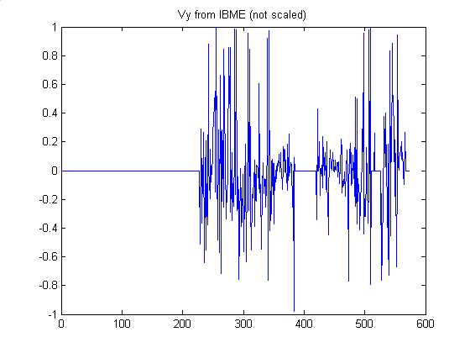
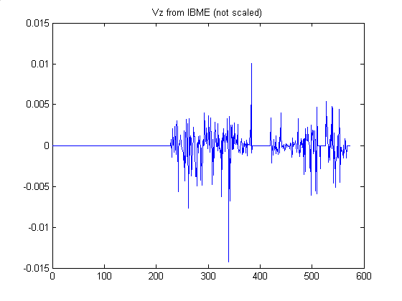
Experimental Results
Inertial Navigation System Results of a 45 second experiment

Slide 17
References
Software:
GDIPlusWrapper Class, DirectShowWrapper Class, MATLAB API, RANSAC
Papers:
‘Precise Image Based Motion Estimation for Autonomous Small Body Exploration’, Andrew E. Johnson, Larry H. Matthius
‘Lecture Notes of EE-701 Robot Vision’, Aydın ALATAN, 2002, METU
‘Pyramidal Implementation of the Lucas Kanade Feature Tracker Description of the algorithm’, Jean-Yves Bouguet
‘Optimal motion estimation from visual and inertial measurements’, Dennis Strelow and Sanjiv Singh

Slide 18
Thanks for listening

