Slide 1
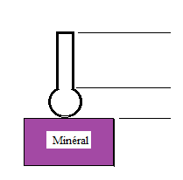
flottation
A separation of minerals by exploiting difference of surface properties (hydrophobicity) is called flotation. The reverse cationic flotation is commonly used to separate iron from silica. By adjusting the 'chemistry' of the pulp by adding various chemical reagents, iron minerals remain in the water and create sediment with a high concentration of iron (valuable minerals). At the same time, silica particles (gangue) attach to air bubbles and float to the surface.

Slide 2
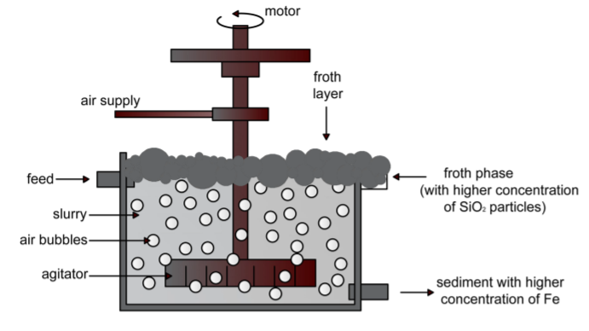
Process of the flottation

Slide 3
GOAL
The main goal is to use this data to predict how much impurity is in the ore concentrate. As this impurity is measured every hour, if we can predict how much silica (impurity) is in the ore concentrate, we can help the engineers, giving them early information to take actions (empowering!). Hence, they will be able to take corrective actions in advance (reduce impurity, if it is the case) and also help the environment (reducing the amount of ore that goes to tailings as we reduce silica in the ore concentrate

