Slide 1
Welcome to the DataPower Course Instructor: Steve Edwards
While you’re waiting, do some preparation to allow the course to run more smoothly for you …

Slide 2
Course Booklets – Make Ready
Ensure you already have these available, either as hard-copy or eBook
If you do not have these:
if hard-copy: contact your own local coordinator
if eBook: contact Technical Support guy (James)
Bookmark (as appropriate):
Course Guide / Unit 1.
Course Exercises Guide / Exercise 1.
If eBook being used, a single document will have:
Course Guide at the front
Course Exercises Guide at the back

Slide 3
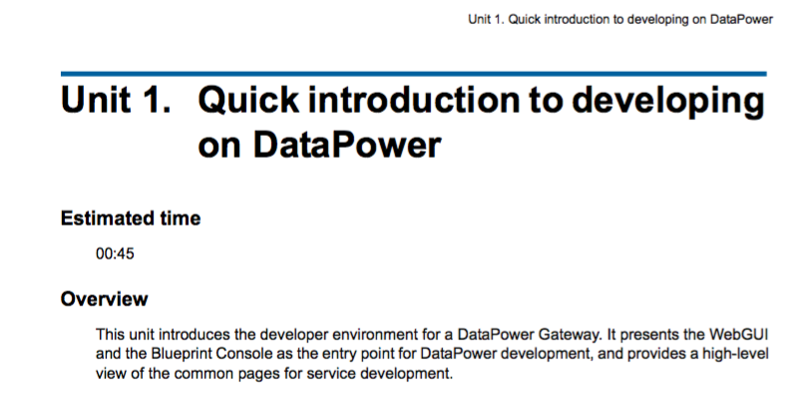
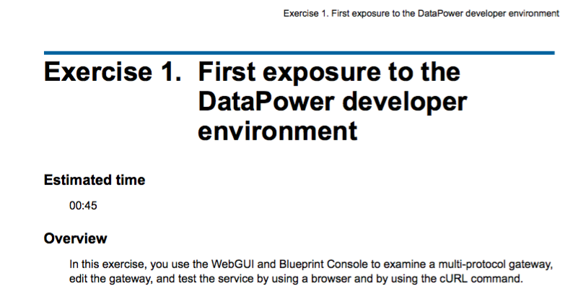

Slide 4
Course Support - Bookmarks
github.com/steve-a-edwards/course-support
entry point to course support pages
datapower.md
has links to information needed for this course
bookmark this page
A - WE751 student remote lab links
find lab link in this page and bookmark yours
B - Variables, Ports, Users, Passwords
open this page and bookmark this

Slide 5
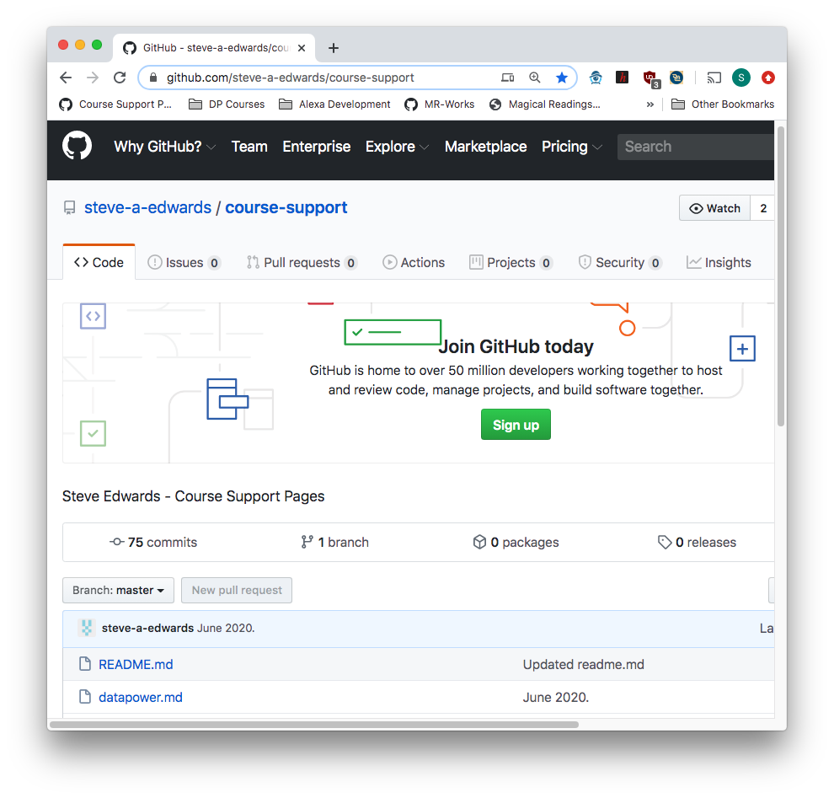
github.com/steve-a-edwards/course-support

Slide 6
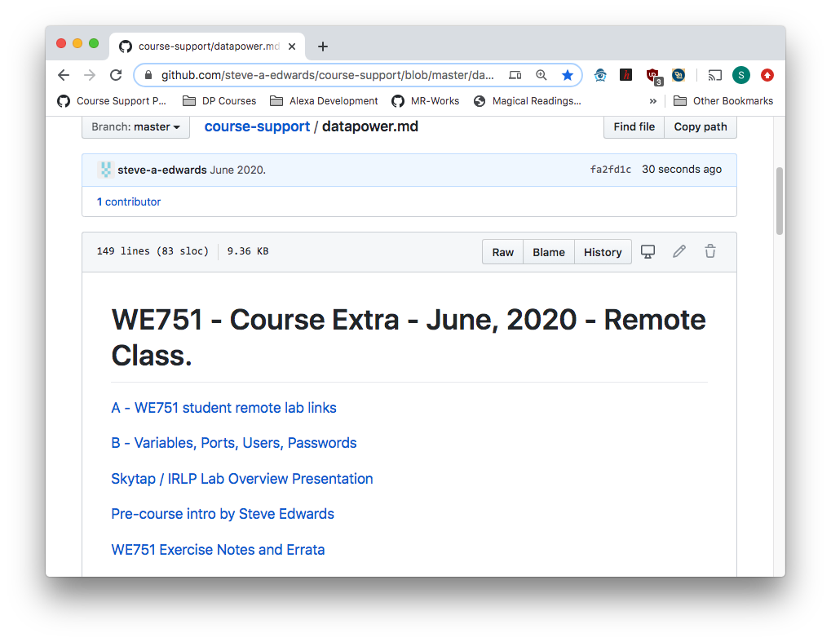
datapower.md
Open, find link to your
remote lab, bookmark that
Open and bookmark this

Slide 7
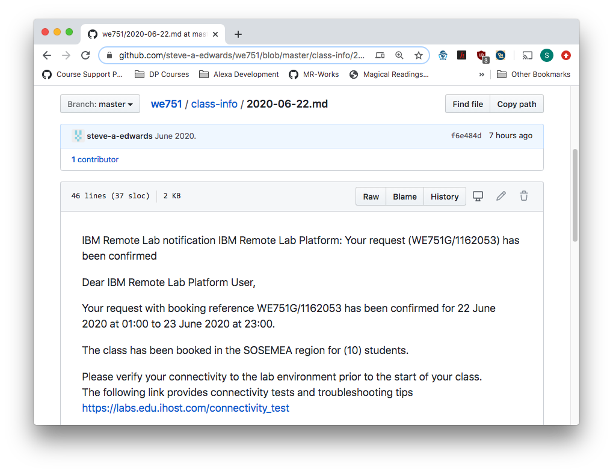
IBM Remote Lab notification IBM Remote Lab Platform
Within this page
you will find a
link to your labs,
find this and bookmark it

