Slide 1







Phase 2: Data Understanding & Exploratory Analysis
Empirical inspection, statistical distributions, correlation modeling, and preprocessing of gym workout records.
Gym Exercise Tracking Dataset
AVG BPM
CALORIES
DURATION
WATER
FREQUENCY
Notes:
[As the heartbeat line draws across the screen]
Hi everyone. This is Phase 2 of our project: Data Understanding and Exploratory Analysis.
We're working with a gym exercise tracking dataset. Before building any models, we looked closely at the data to see what's in it, how clean it is, and which attributes matter.
[As the five icons appear] These icons are the attributes you'll hear about most today: heart rate, calories burned, session duration, water intake, and workout frequency.

Slide 2


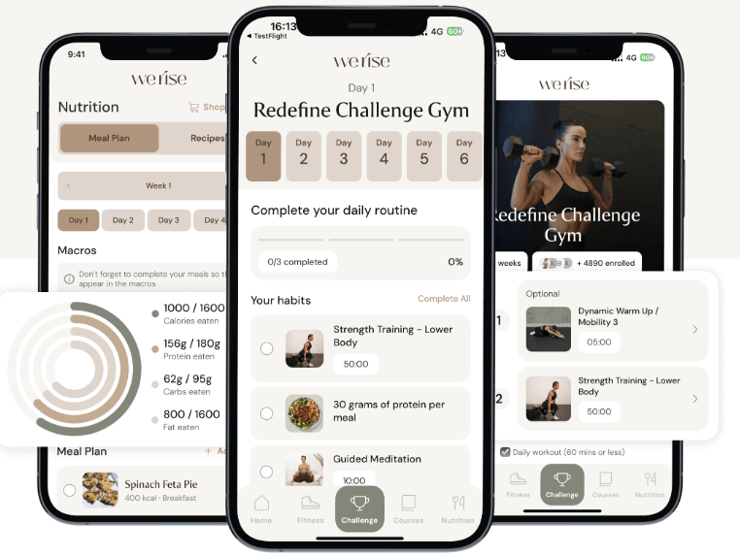
Dataset Provenance & Scope
DATA SOURCE
Kaggle / GitHub Repository
https://www.kaggle.com/datasets/valakhorasani/gym-members-exercise-dataset
COLLECTION CONTEXT
Fitness Center Member Tracking
Aggregated biometric and physiological workout metrics.
CORE OBJECTIVE
Energy Expenditure Prediction
Exploratory baselining for caloric burn modeling and training patterns.
Notes:
This slide shows where our data comes from.
[Cards slide in] The dataset comes from Kaggle and GitHub. It was collected from fitness center members and combines biometric and workout measurements.
Our main goal is to predict energy expenditure, meaning how many calories a member burns in a session, and to understand the training patterns behind it.
The app screens on the right show the kind of tracking tool that produces data like this.

Slide 3


Structural Profile & Target Variable
973
15
13 / 2
Total Member Records
Observed Features
Numeric vs. Categorical
TARGET CLASS IDENTIFICATION
CATEGORICAL DATA
Calories_Burned
Gender & Workout_Type
Continuous numerical regression target indicating total energy output per exercise session.
Gender (Male / Female) and Workout Type (Cardio, HIIT, Strength, Yoga) serve as key groupings.
NUMERICAL DATA
Age, Weight, Height, Max_BPM, Avg_BPM,Resting_BPM, Session_Duration, Fat_Percentage, Water_Intake, Workout_Frequency, Experience_Level, BMI
Notes:
Here's the shape of the dataset.
[Numbers pop in] We have 973 member records and 15 features. 13 are numeric and 2 are categorical.
Our target is Calories_Burned, a continuous number, which makes this a regression problem.
The two categorical features, Gender and Workout_Type, let us compare groups. Workout_Type covers Cardio, HIIT, Strength, and Yoga.
Everything else, like age, weight, heart rate, and session duration, is numeric.

Slide 4






Detected Anomalies & Cleansing Steps
Zero Missing Values
Zero Duplicates
Unit Transformation
Z-Score Outliers
Zero null entries across all 15 columns.
973 unique tracking records confirmed.
Converted pounds and inches for modeling.
Identified extreme points exceeding |Z| > 3.
Result: a clean, duplicate-free dataset of 973 records × 15 features — ready to train on.
Notes:
Before analysis, we checked data quality.
[Cards appear one by one] There are zero missing values across all 15 columns, and zero duplicates, so all 973 records are unique.
We converted pound and inch values for modeling, and we used Z-scores to flag extreme points beyond 3 standard deviations.
[Result bar] The result: a clean dataset that's ready to work with.

Slide 5
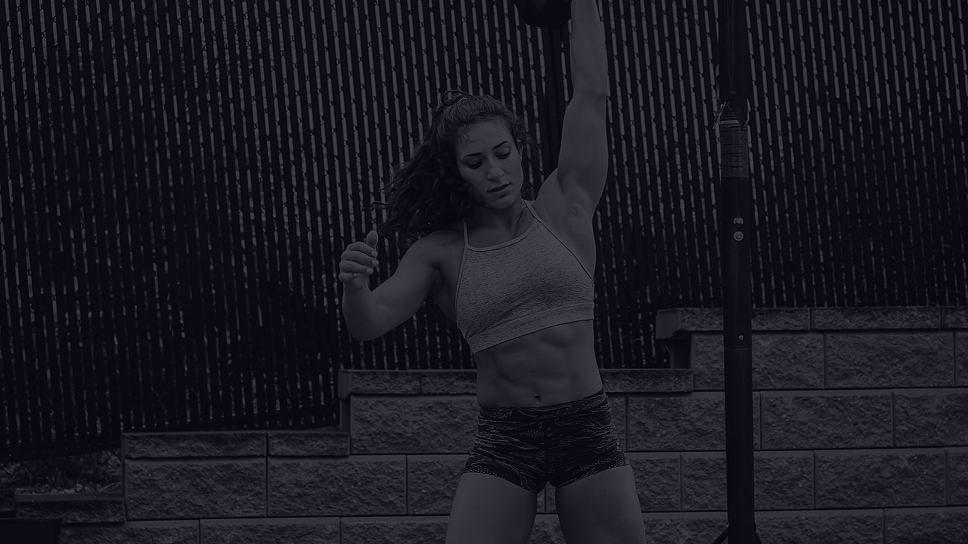

Numerical Attribute Outlier Distribution
Natural Physiological Spread
IQR Dispersion across 13 Numerical Dimensions
No negative, corrupt, or truncated values exist. Features like Water_Intake and Workout_Frequency sit entirely within plausible real-world ranges.
Age (18–59)
Heart Rates
Duration (0.5–2h)
Zero fliers • Symmetric
Zero fliers • Bounded
Zero fliers • Uniform
Weight (kg)
BMI (12.3–49.9)
Calories Burned
Right-Tail Outlier Drivers
1 flier at 130 kg
Dense right fliers (>41)
Upper fliers (>1600)
Upper fliers in Calories_Burned correspond strictly to maximum 2.0-hour workout sessions by high-mass individuals rather than random measurement noise.
Notes:
Next, we looked for outliers using the interquartile range.
[Top row] Age, heart rates, and session duration have no outliers. They sit in natural, realistic ranges.
[Bottom row] Weight, BMI, and calories burned do have some high values on the right tail.
[Right side] The key point: these aren't errors. The highest calorie values come from heavier members doing the longest, two-hour sessions, so they're real and worth keeping.

Slide 6
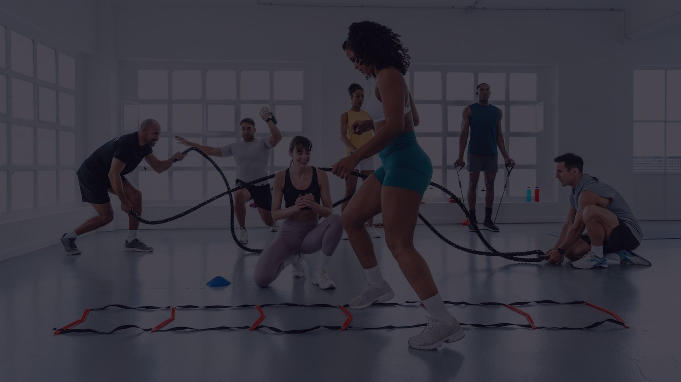

Parametric Summary of Key Attributes
Feature Attribute | Data Type | Min | Max | Mean ± Std | Observed Spread
Calories_Burned (Target) | Float64 | 303.00 | 1783.00 | 905.42 ± 272.64 | Broad continuous range
Session_Duration (hours) | Float64 | 0.50 | 2.00 | 1.26 ± 0.34 | Uniform exercise window
Avg_BPM | Int64 | 120 | 169 | 143.77 ± 14.35 | Cardiovascular exertion
Fat_Percentage | Float64 | 10.0% | 35.0% | 24.98% ± 6.26% | Realistic body composition
Workout_Frequency | Int64 | 2 days | 5 days | 3.32 ± 0.91 | Days logged per week
Notes:
This table summarizes five key attributes.
[Table wipes down] Calories burned, highlighted at the top, ranges from about 300 to 1,783, with an average of around 905.
Sessions run from half an hour to two hours, averaging about 1.26 hours.
Average heart rate is about 144 BPM, body fat averages about 25 percent, and members work out about 3 days a week.
All of these values are realistic for gym members.

Slide 7

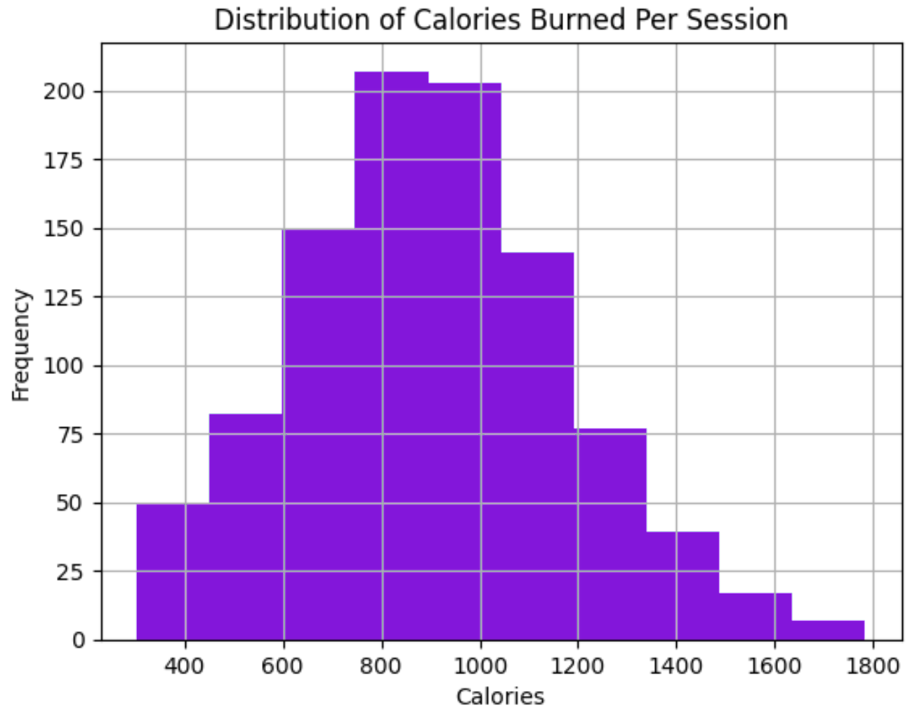

Target Distribution: Calories Burned
Binned histogram of Calories Burned across 10 intervals (200 kcal to 1,800 kcal).
Normal distribution shape centered near 900 kcal
Slight positive right skew toward endurance workouts
Notes:
Now let's look at our target, calories burned.
[Bars rise] The histogram is roughly bell-shaped and centered near 900 calories, so most sessions land in the middle.
There's a slight tail to the right: a smaller group of sessions burns a lot more, usually long endurance workouts.
This shape matters later when we split calories into groups.

Slide 8
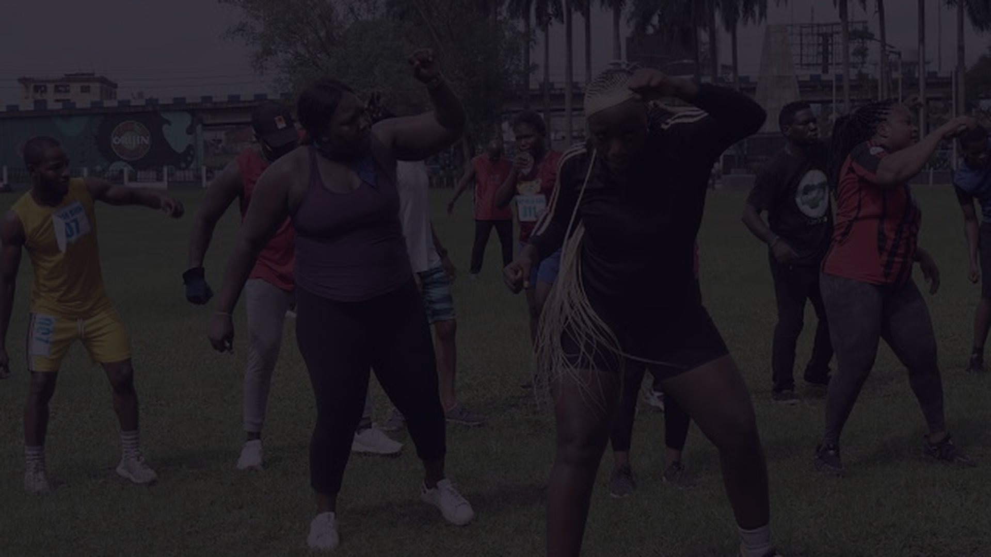

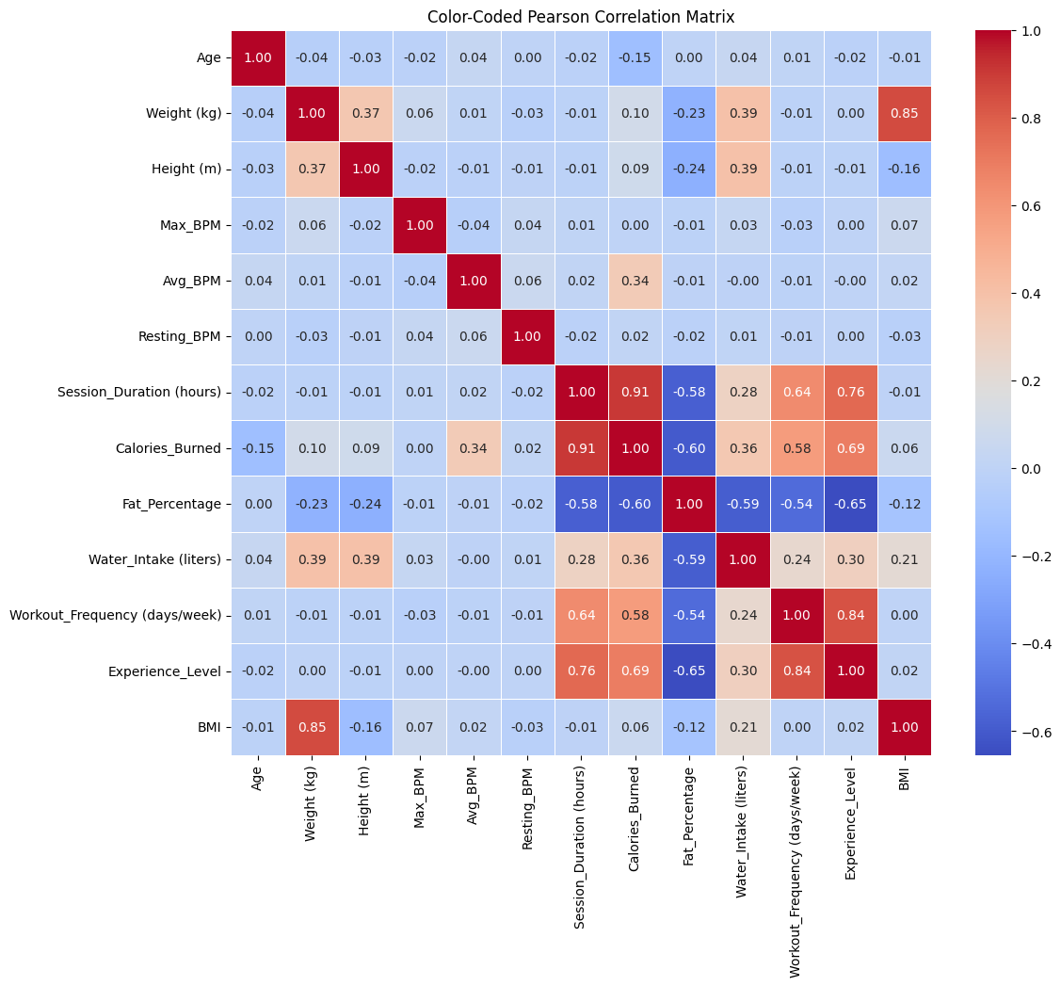
Pearson Correlation with Target (Calories Burned)
STRONGEST LINKS TO CALORIES BURNED
Session_Duration
+0.91
Experience_level
+0.69
Workout_frequency
+0.58
Average_BPM
+0.34
Fat_Percentage
-0.60
Key Takeaway: Workout duration is the primary linear predictor (r = 0.91), followed by member experience level (Experience_level = 0.69).
Notes:
This slide shows which attributes move with calories burned.
[Heatmap appears] On the left is the full correlation matrix. Red means two features rise together, and blue means one rises while the other falls.
[Bars fill one at a time] On the right are the strongest links to calories. Session duration is by far the strongest at plus 0.91: the longer you train, the more you burn. Experience level follows at 0.69, then workout frequency and average heart rate.
Body fat percentage is negative at minus 0.60, so members with lower body fat tend to burn more.

Slide 9


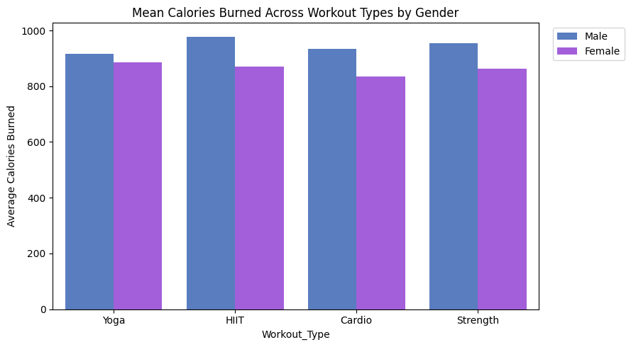
Workout Type & Gender Interactions
KEY TAKEAWAYS:
Category Ranking: HIIT (~980 kcal) and Strength (~970 kcal) yield the highest average caloric expenditure, followed by Cardio (~960 kcal) and Yoga (~900 kcal)
Gender Expenditure Differential:
  Male records average higher caloric output across all categories (~100–120 kcal delta)
Notes:
Here we compare calories by workout type and gender.
[Bars rise] HIIT and Strength burn the most, at around 980 and 970 calories, followed by Cardio and then Yoga.
Across every workout type, male members burn about 100 to 120 more calories on average than female members.
So both the type of workout and who is doing it make a difference.

Slide 10

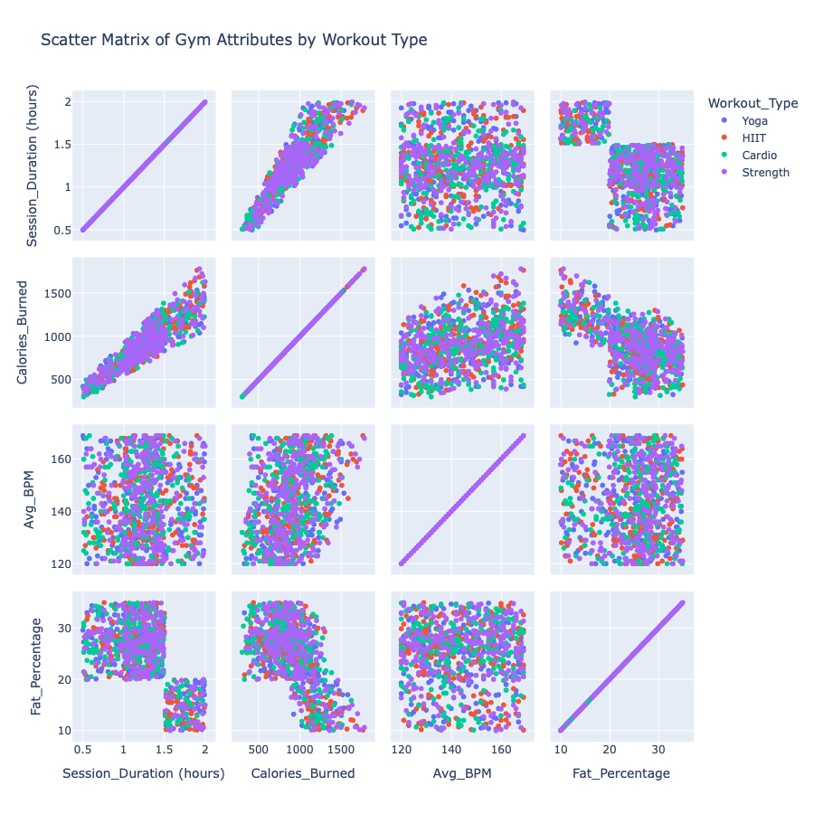
Workout Type Vs (Session_Duration, Calories_Burned, Avg_BPM, Fat_Percentage)
Scatter Matrix: Duration, Calories, Heart Rate & Fat Percentage
PRIMARY PREDICTOR ALIGNMENT: Session duration and calories burned form a direct, deterministic linear path across all four workout types
TWO DISTINCT TRAINING SUBGROUPS: Data separates cleanly into two discrete rectangular clusters when pairing session length against body fat percentage (sessions > 1.5 hrs strictly map to body fat < 20%)
EQUAL INTENSITY SPREAD: Average heart rate shows uniform distribution (120–170 BPM) without distinct separation between yoga, cardio, HIIT, or strength training
Notes:
This scatter matrix compares duration, calories, heart rate, and body fat, colored by workout type.
[Insights slide in] First, duration and calories form an almost straight line, which confirms duration is our best predictor.
Second, duration against body fat splits into two clear clusters: members who train longer than 1.5 hours all have body fat under 20 percent.
Third, heart rate is spread evenly from 120 to 170 BPM, with no workout type standing out.

Slide 11


Equal-Width and Frequency Binning for Calories Burned
Equal-Width (pd.cut) Calories Burned
Equal-Frequency (pd.qcut) Calories Burned
Divides in equal width.
Divides into 4 quartiles with equal record counts.
W1: 301 - 673
188 members
Q1: 302 - 720
245 members
W2: 673 - 1043
506 members
Q2: 720 - 893
242 members
W3: 1043 - 1413
240 members
Q3: 893 - 1076
243 members
W4: 1413 - 1783
39 members
Q4: 1076 - 1783
243 members
Right-skewed (positively skewed) Severe class size imbalance
Equal class size (Low, Moderate, High, Very High)
Notes:
To prepare for classification, we tried two ways of splitting calories into four groups.
[Left column] Equal-width binning cuts the range into equal-sized intervals. Because most sessions sit in the middle, one bin gets 506 members and another gets only 39, which is badly unbalanced.
[Right column] Equal-frequency binning uses quartiles, so each group has about 243 members.
We'll use the equal-frequency version for our four intensity tiers: Low, Moderate, High, and Very High.

Slide 12

Supervised Learning Roadmap
REGRESSION MODELING (Predicting Exact Calories)
Goal: Predict the exact number of calories a member burns during their workout session.
Simple Baseline: Linear Regression (tests how much calorie burn increases simply as workout duration gets longer).
Advanced Models: Decision Trees, k-NN, and Neural Networks (capture complex patterns when duration, heart rate, and body fat work together).
How We Measure Success: Look at the average prediction error (how many calories off our model is on average).
CLASSIFICATION MODELING (Predicting Workout Intensity Tier)
Goal: Sort each workout into 4 clear levels: Low, Moderate, High, or Very High calorie burn.
Models to Test: Decision Trees (if/then rules), Naïve Bayes (probability), and k-Nearest Neighbors (grouping similar workouts).
How We Measure Success: Accuracy score and a confusion matrix (checking how often the model confuses adjacent tiers, like "Moderate" vs. "High").
TWO TRAINING TRACKS
Regression
→ exact kcal per session
Classification
→ Low · Moderate · High · Very High
Key signal
Session_Duration (r = 0.91)
Notes:
Here's our plan for supervised learning, which has two tracks.
First, regression, to predict the exact number of calories. We'll start with simple linear regression on duration, then try decision trees, k-nearest neighbors, and neural networks. We'll measure success by average prediction error.
Second, classification, to sort each workout into the four intensity tiers. We'll test decision trees, Naive Bayes, and k-nearest neighbors, and check accuracy and a confusion matrix.

Slide 13
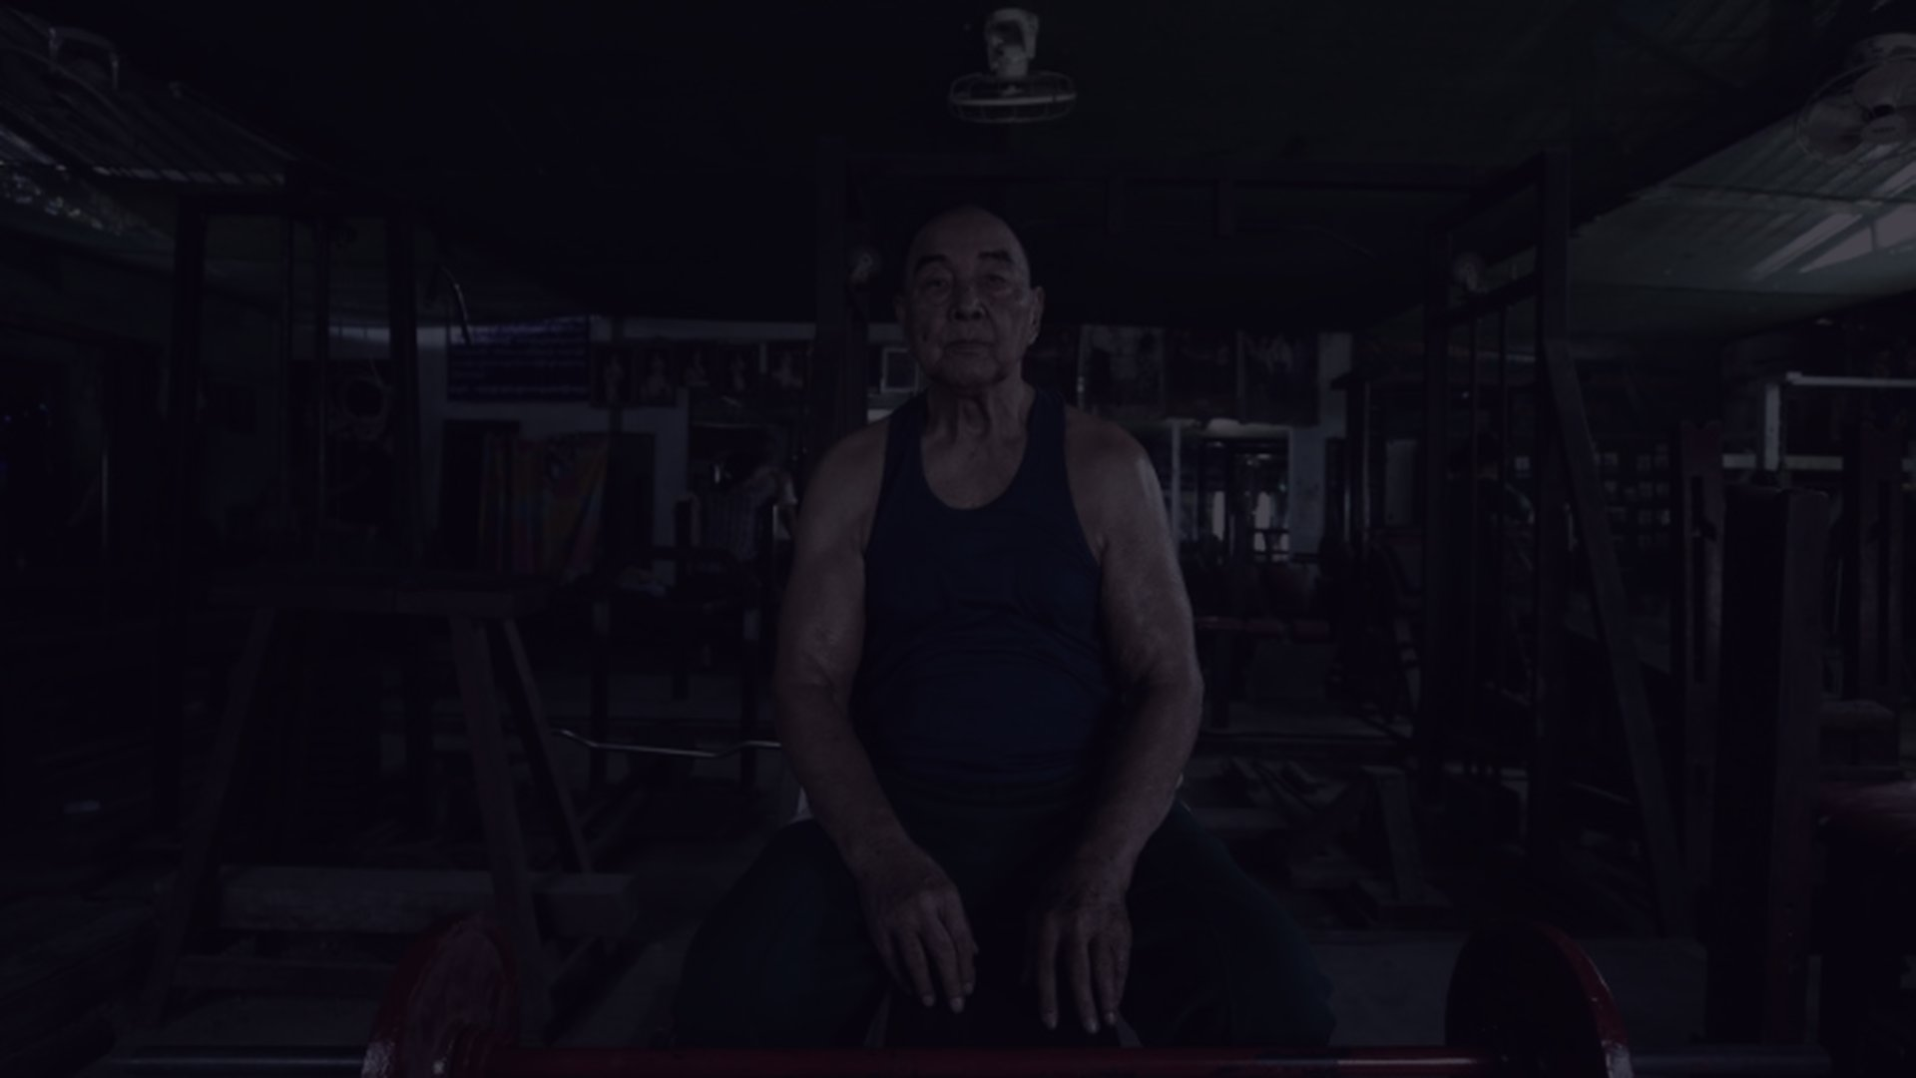



Unsupervised Learning Roadmap
1
ASSOCIATION ANALYSIS
2
CLUSTERING & ANOMALIES
Finding hidden workout habits
Grouping similar members & spotting outliers
Goal: Discover co-occurring training habits across workout modalities, member experience levels, and physiological demands.
Goal
Group members into natural "fitness profiles" (e.g., endurance athletes vs. casual beginners) without pre-set labels.
Algorithm: Apriori — finds frequent itemsets meeting minimum support, then extracts directional IF → THEN rules.
CANDIDATE ASSOCIATION RULES
Models to Test
k-Means and Hierarchical Clustering, grouping members by body stats and heart rates.
Energy Expenditure
{Workout_Type = HIIT, Duration = High} → {Calories_Burned = Very_High}
Cardiovascular Strain
{Workout_Type = HIIT, Experience_Level = Advanced} → {Avg_BPM = High}
Anomaly Check
Pinpoint extreme sessions (like workouts burning over 1,600 kcal) so they don't distort findings.
Member Progression
{Fat_Percentage = Low, Workout_Frequency = High} → {Experience_Level = Advanced}
Hydration Demands
{Duration = High, Avg_BPM = High} → {Water_Intake = High}
How We Measure Success
Cluster quality scores: members inside the same group are genuinely similar.
Support ≥ 0.10
Confidence ≥ 0.70
Lift > 1.0
Notes:
Finally, unsupervised learning, which also has two parts.
[Left card] With association analysis, we use the Apriori algorithm to find habits that occur together. For example: HIIT plus long duration leads to very high calorie burn. A rule counts only if it meets our thresholds: support at least 0.10, confidence at least 0.70, and lift above 1.
[Right card] With clustering, we use k-Means and hierarchical clustering to group members into fitness profiles, like endurance athletes versus beginners. We'll also flag extreme sessions over 1,600 calories so they don't skew the results.

Slide 14
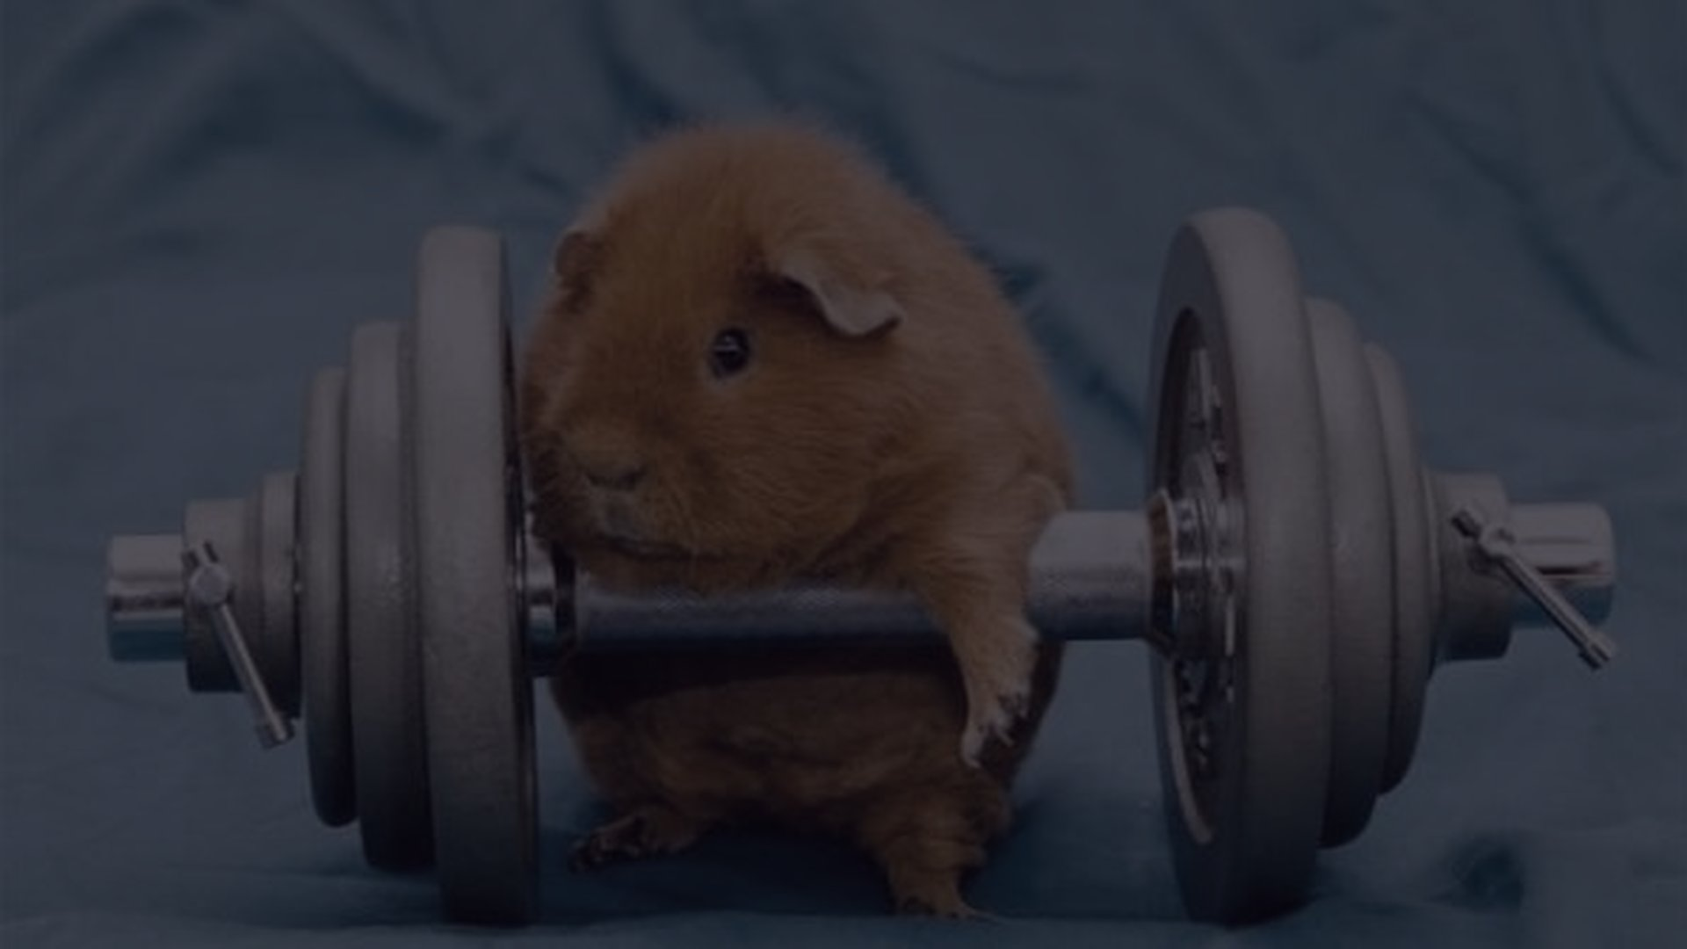


Questions?
Phase 2 · Data Understanding & Exploratory Analysis
Reference: https://healthyhabitsexplorer.com/my-one-year-journey-with-the-werise-app-by-senada-greca/
Notes:
[Heartbeat line draws in]
To sum up: our data is clean, 973 records with 15 features, and session duration is the strongest driver of calories burned.
Thank you. We're happy to take any questions.

