Slide 1
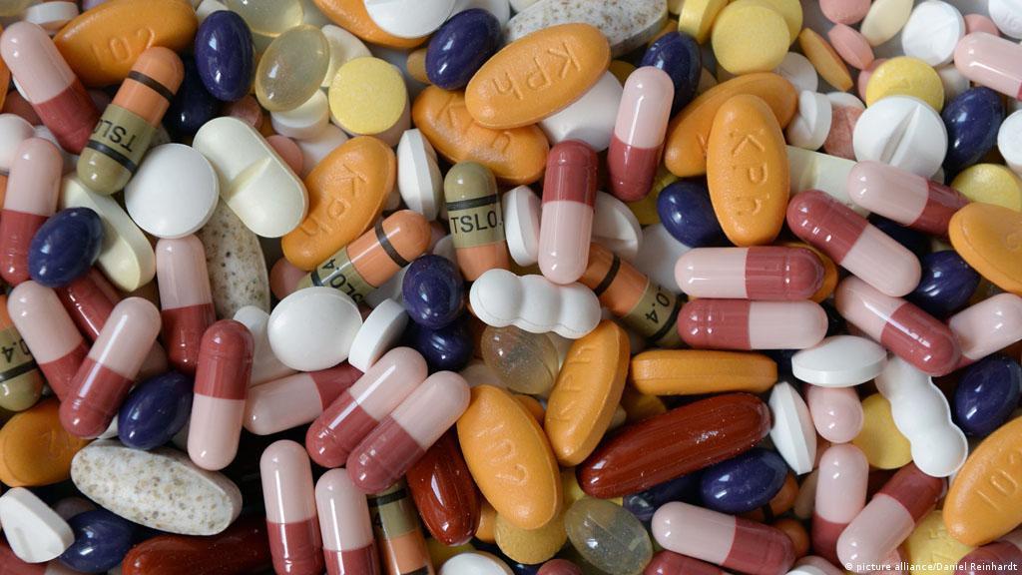
HACKTECH 2022
PharmAssist
Salisu Ali
5th Year Medical Student
Bayero University Kano
Nigeria

Slide 2
Introduction
There are tons of drugs combinations, more than a doctor can cram
There is always a side effect to a drug, the best thing a doctor can do is to avoid drugs with serious side effect to a patient
It’s a routine procedure to ask patient about drugs they are reactive too and document if any. Majority of patient fail to identify those drugs
It is usually devastating for a doctor to see his patient develop a serious pathology as a result administering a particular drug e.g a patient developing diabetes when placed on steroids
Some patients abandon their medications as a result of side effect, leading to failure in pharmacotherapy
As the world moves toward personalized medicine and new drugs are continuously developed, data science will be a great tool to help health care providers improve their service delivery.
Patients might have similar medical condition, but different reactions to similar drug based on different health status/parameters.

Slide 3
Problem Statement
How can data science help doctors, patients and pharmacologist understand drugs side effects for developing, selecting and administering drugs for personalized care.

Slide 4
Solution
Solution will require data on drug components, patient health parameters in order to predict likely side effect based on trial data
Solution drawback is lack of public availability of such data.
MEDDRA has a data with frequency of a particular side effect of a drug based on trial data
MEDDRA was used in this project to predict likelihood(frequency) of side effect occurring in a patient.

Slide 5
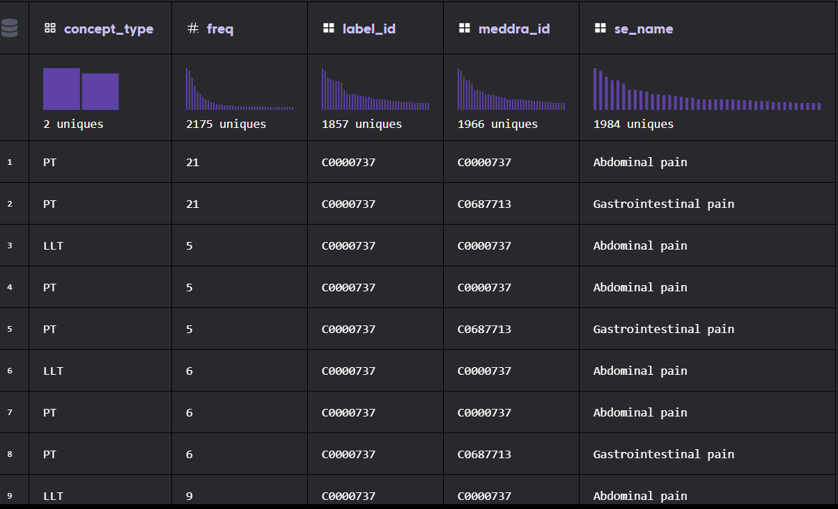
MEDDRA DATA
Poor data for machine learning application
Only drug id(label_id), side effect name and frequency of side effect occurrence during trial
No patient health parameters

Slide 6
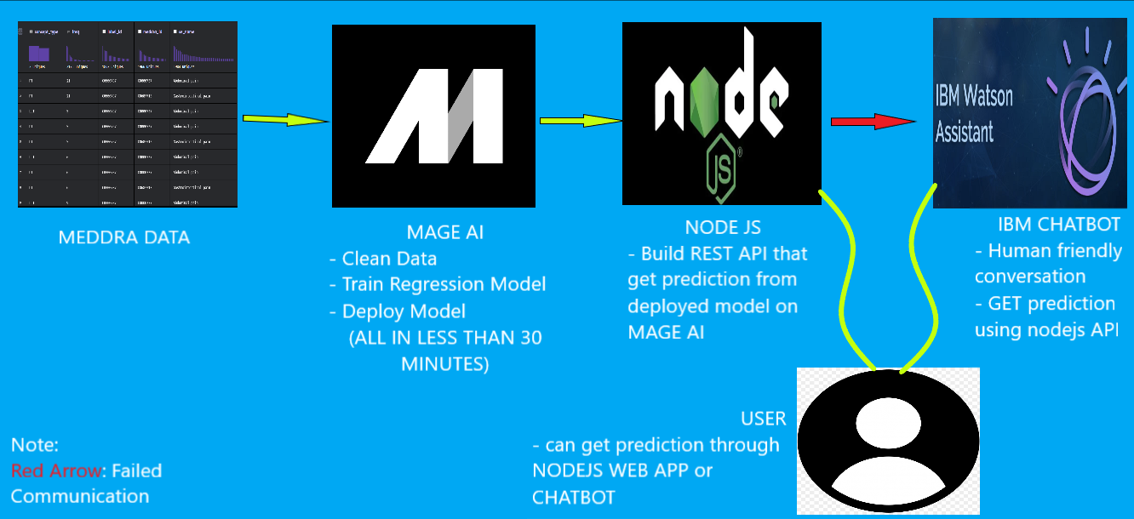
Architecture

Slide 7
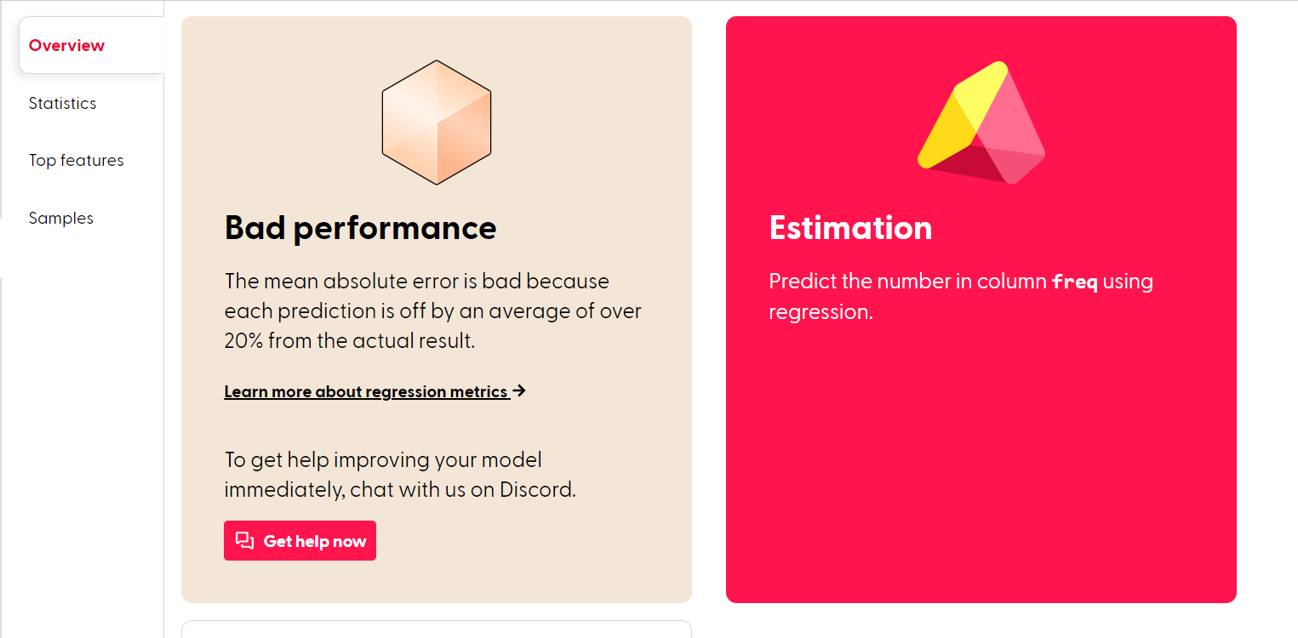
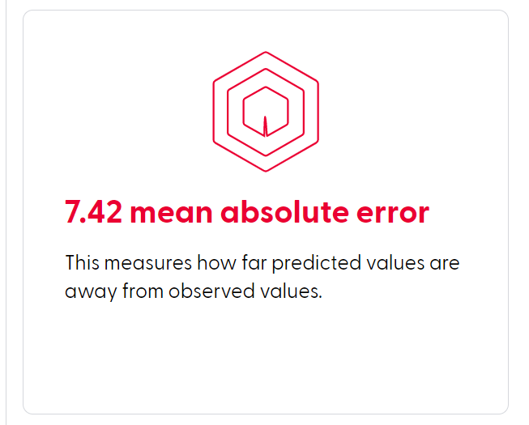
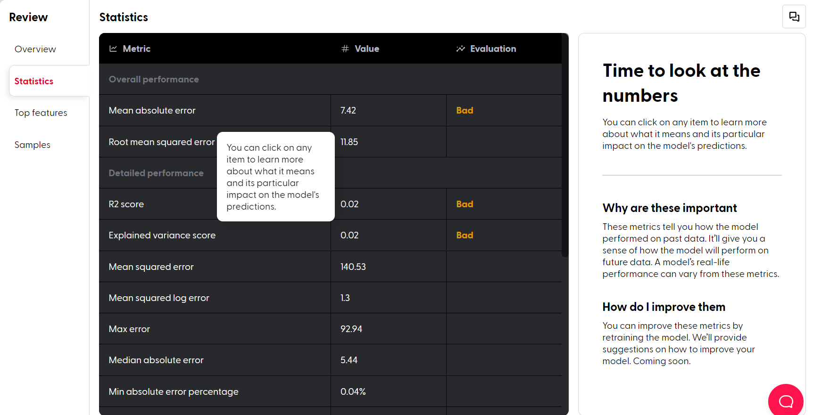
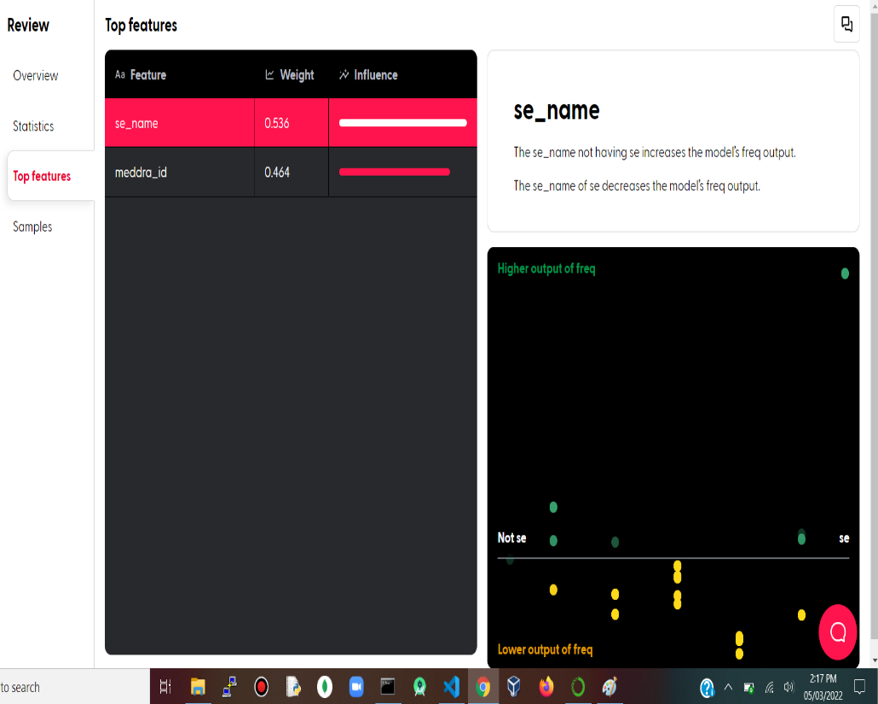
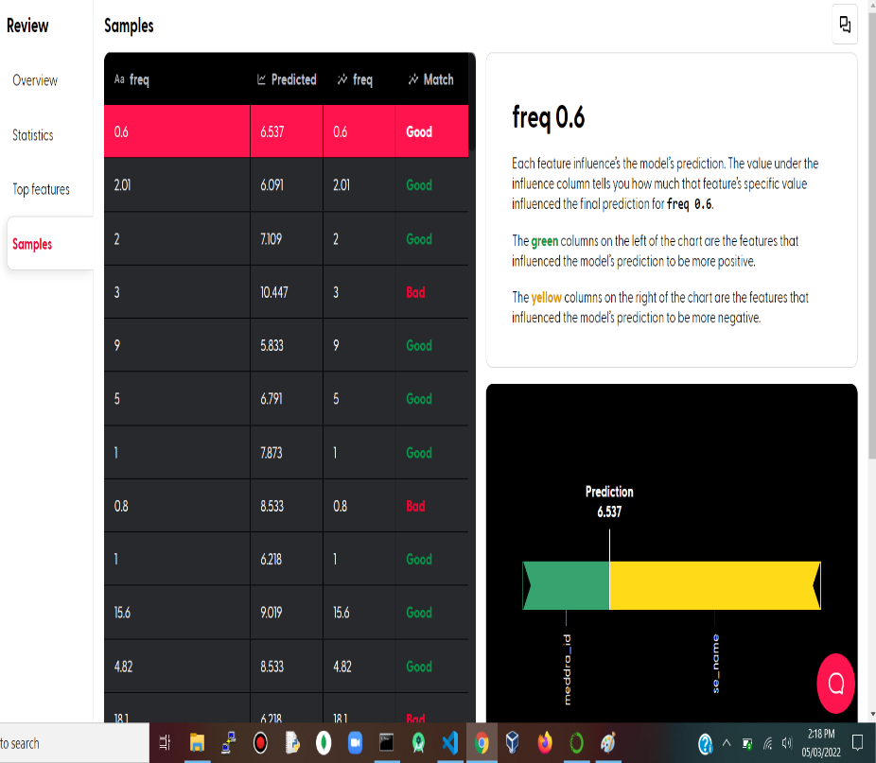

Slide 8
DEMO

Slide 9
Observation
Developing a good solution will take more than what I’m thinking right now
The model was based, predictions inaccurate and patient health parameters not taken into consideration

Slide 10
With A Good Solution
Doctors can have a solution that can predict a serious drug side effect in a patient, hence, making a better drug decision
Also, a solution that can weight in on the numerous drugs brands and suggest the best one for the patient based on his health parameters
Availability of data from patient experiment can help shape drug production for pharmacologist.
Patients will have little to worry about and pharmacotherapy adherence and success rate will improve.

