Slide 1
Azure Event grid
Sean Alisea

Slide 2

Content
Setting up a Topic
Configuration
Creating a Reciver

Slide 3

Introduction
Azure Event Grid is a low-cost service that allows disparate systems to communicate using events.
A “Publisher” sends events to a “Topic”, from which there can be many subscribers. The event contains data that is of interest to subscribers. The usual scenario is data updates in a system of record, that are of interest to other systems, which either need to respond to data updates in some way, or store a local copy of that data (event-driven replication).
The “Receiver” subscribes to the “Topic”, and can receive notifications via webhook api calls posting a standard event grid message schema.

Slide 4
Benefits
Event-based messaging is asynchronous and disconnected. NO SYNCRONOUS API CALLS.
Guaranteed “at-least-once” delivery of message.
Configurable re-try protocol spanning time period and number of attempts to deliver message to receiver.
Dead-letter option. Non-delivered events can be saved in Azure Blob Storage and reprocessed later…no data is lost.
Cost-effective. Azure Event Grid costs very little in comparison to Azure Service Bus or Azure Event Hub.

Slide 5
Event Grid
The Set-up

Slide 6

Topic

Slide 7
Setting up a Topic
In the Azure Portal, create a resource of type “Event Grid Topic”.
An endpoint url, and access keys, will be created. You will need these items to configure your sender and receiver applications. These values will be stored in configuration, and the key value should be stored in an Azure Key Vault instance.

Slide 8
Subscription

Slide 9
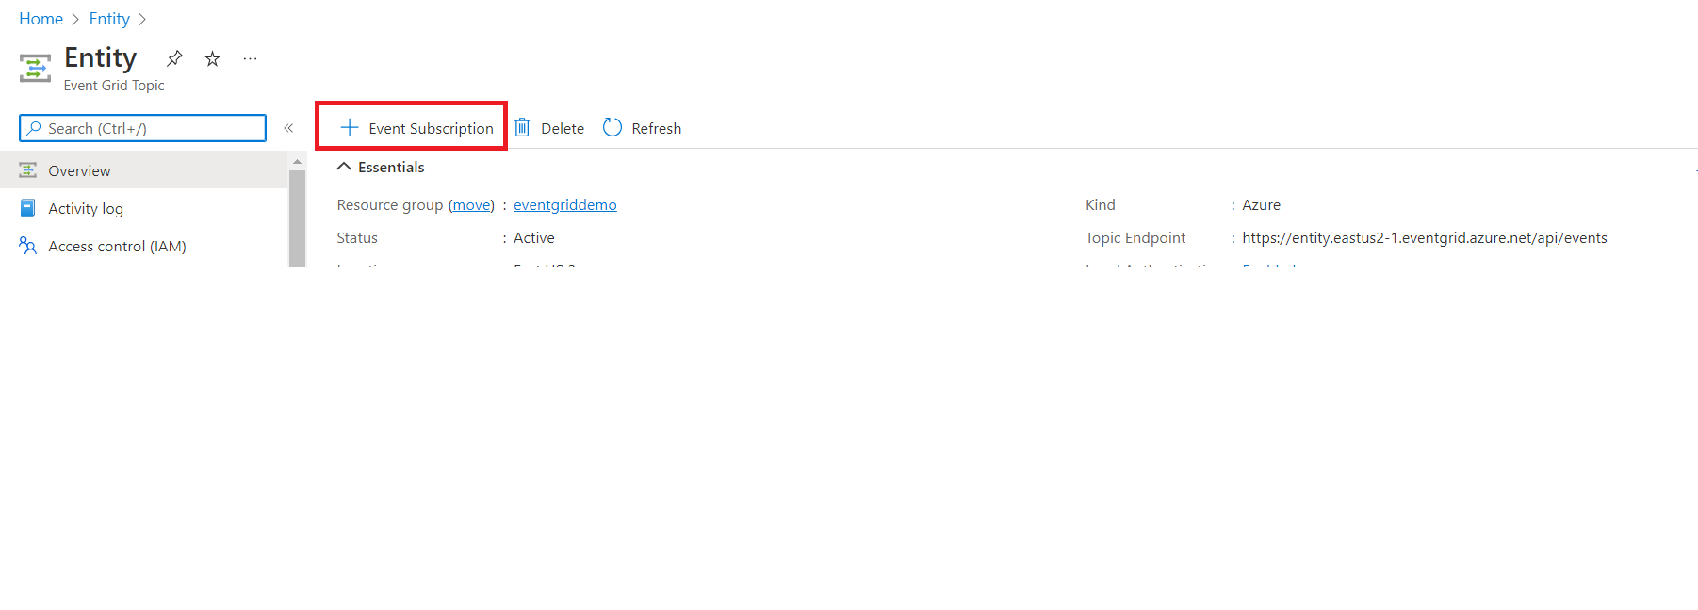
Setting up a Subscription
In your topic, you can create many subscriptions. A “subscription” causes an event receiver to be notified of a particular event.
To create a subscription in the Azure Portal, navigate to the Event Grid Topic, and then click the “+ Event Subscription” option on the overview blade.

Slide 10
Setting up a Subscription
Set the “Event Schema” option value to “Event Grid Schema”. This is a JSON schema that is easy to replicate, and you can create a local DTO/POCO object in your receiver to de-serialize the event information easily.

Slide 11
Setting up a Subscription
Add an “Endpoint Detail”, which is basically the manner in which your event will be delivered to your subscriber. There are many types. The most common-ly used options are “Webhook” and “Azure Function”.
You will need to expose an endpoint in an API, or Azure Function, to receive the event.

Slide 12
Setting up a Subscription
Under “Additional Features”, you can configure some high-value features in your service.
“Dead-Lettering”: this causes non-deliverable event messages to get written into a Blob Storage container.
“Retry Policies”: this allows you to specify a re-try protocol in the case an event cannot be delivered to a receiving application. You can configure “Max Delivery Attempts”, and “Event Time to Live”, so that the framework will keep attempting to deliver the event message to all subscribers during that configured window.

