Slide 1

CCS 206 - Introduction to Linux for Security and Forensics
Federal University Dutse
Lecture Note 4
By
Muhammad S. Ali

Slide 2

Manipulating Files & Directories
The following commands are used for manipulating files and directories in Linux.
cp – copy files and directories
mv – move/rename files and directories
mkdir – create directories
rm – remove files and directories
rmdir - remove the directory (ies), if they are empty.

Slide 3
While it is easy to perform simple file manipulations with a GUI manager, complicated tasks can be easier with the command-line programs. For example, how could we copy all the HTML files one directory to another – but those that do not exist in the destination directory or are newer than the versions in the destination directory?
Wildcards
Wildcards are shell features that make these commands powerful. Because the shell uses file names so much, it provides special characters to help you rapidly specify groups of files.
Using wildcards aka globbing allows you to select filenames based on patterns of characters. The following table list wildcards and what they select:

Slide 4
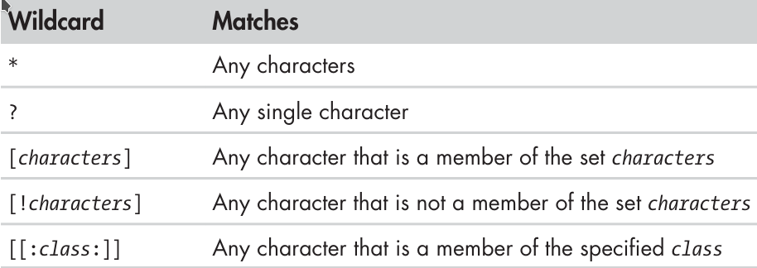
Table: Wildcards
Common Wildcard character classes
The following table list the mostly command used wildcard character classes. Using wildcards makes it possible to construct very sophisticated selection criteria for filenames.

Slide 5
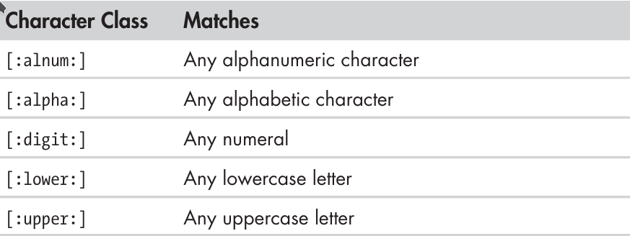
Common Wildcard character classes
Wildcards can be used with any command that accepts filenames as arguments

Slide 6
Pattern | Matches
* | All files
g* | Any file beginning with g
b*.txt | Any file beginning with b followed by any characters and ending with .txt
Data??? | Any file beginning with Data followed by exactly three characters
[abc]* | Any file beginning with either a, b, or c
BACKUP.[0-9][0-9][0-9] | Any file beginning with BACKUP. followed by exactly three numerals
[[:upper:]]* | Any file beginning with an uppercase letter
[![:digit:]]* | Any file not beginning with a numeral
*[[:lower:]123] | Any file ending with a lowercase letter or the numerals 1, 2, or 3

Slide 7
mkdir – Create Directories
The mkdir command is used to create directories. It works like this:
mkdir directory...
The dots in the syntax means that the argument can be repeated to create multiple directories as shown below:
$ mkdir dir1 # creates one directory (dir1)
$ mkdir dir1 dir2 dir3 # creates three directories (dir1, dir2 and dir3)
When given the option -p, then mkdir will create parent directories as needed.
$ mkdir -p mydir2/mysubdir2/threedirsdeep # creates two subdirectories in mydir2

Slide 8
cp – Copy Files and Directories
The cp command copies files or directories. It can be used in two different ways:
To copy single file or directory item1 to file or directory item2
cp item1 item2
To copy multiple items (either files or directories) into a directory
cp item… directory
The following table list cp commonly used options:

Slide 9
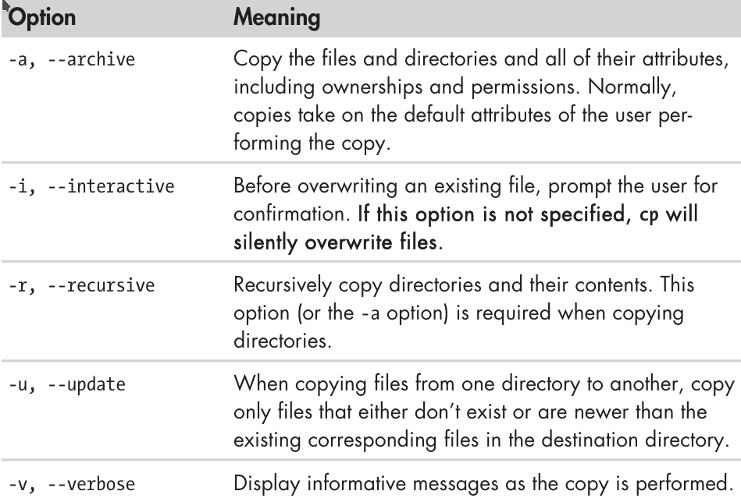

Slide 10
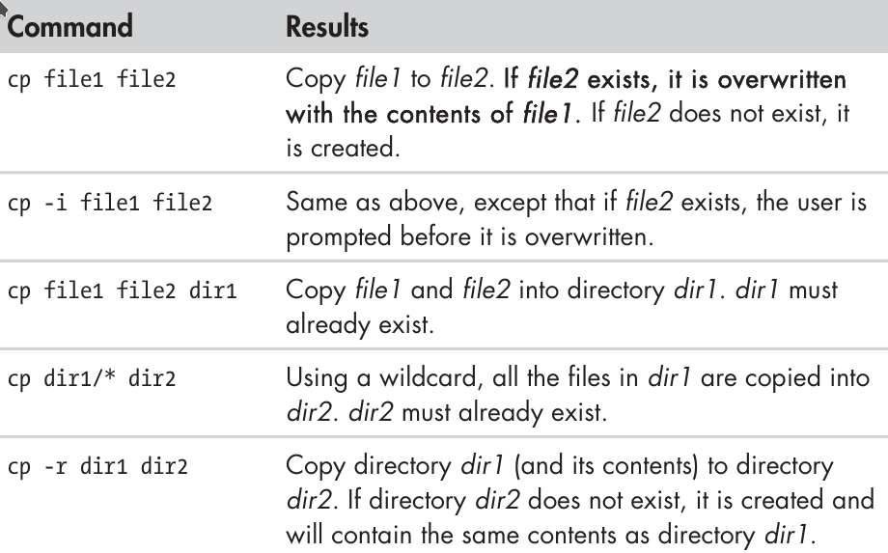
cp – examples

Slide 11
mv – Move and Rename Files
The mv command performs both file moving and file renaming, depending on how it is used. In either case, the original filename no longer exists after the operation. mv is used in much the same way as cp:
To move or rename file or directory item1 to item2
mv item1 item
To move one or items from one directory to another
mv item… directory
mv shares many of the options as cp as shown in table below:

Slide 12
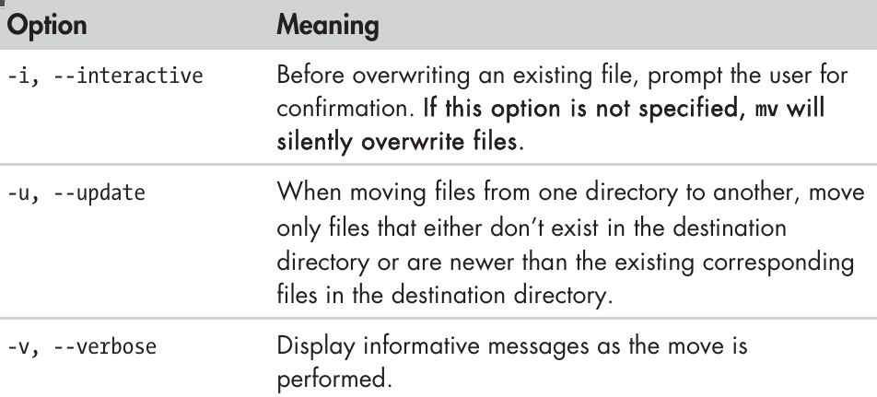
mv – options
See the table below for example how to work with mv command:

Slide 13
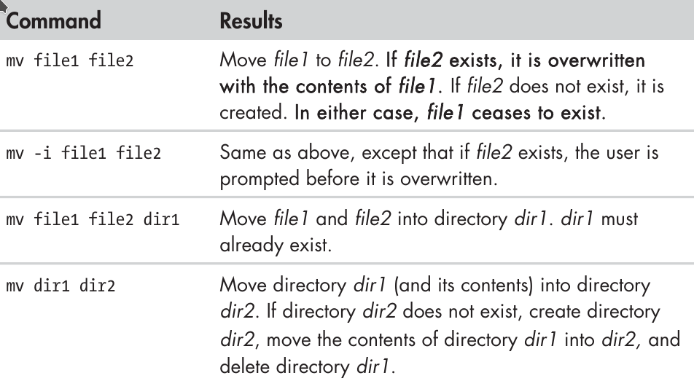
mv – examples

Slide 14
rm – Remove Files and Directories
The rm command is used to remove (delete) files and directories, like this:
rm item…
Where item is the name of one or more files or directories.
Be careful using rm command particularly with wildcard characters, once you delete something it is gone, and you cannot undo it.
Suppose you want delete just the HTML files in a directory. To do this, you type: rm *.html which is correct, but if you accidentally place a space between the * and the .html as: rm * .html the rm command will delete all the files in the directory and then complain that there is not file called .html
The table below lists some options used with rm command:

Slide 15
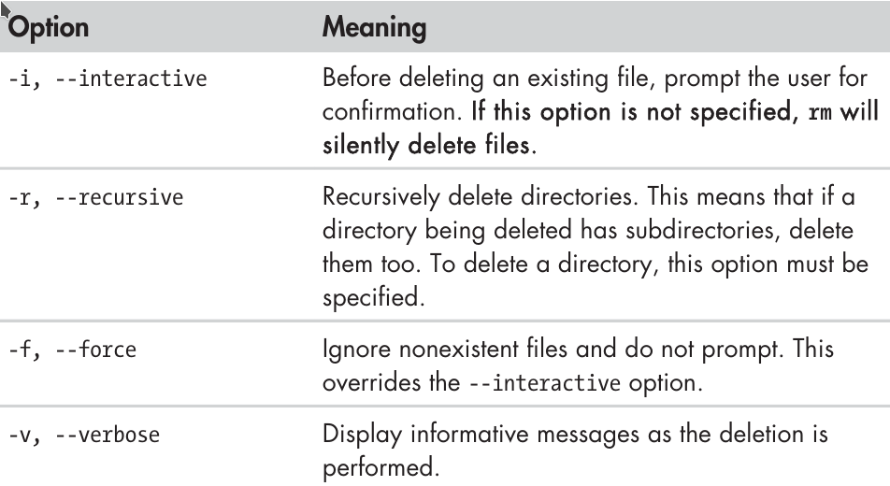
rm – options

Slide 16
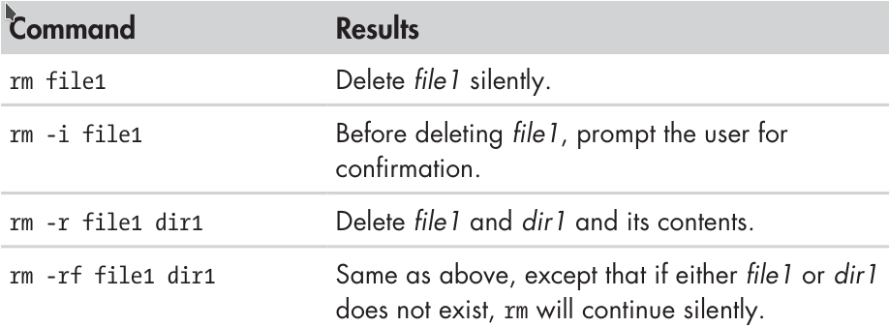
rm – examples

Slide 17
Working with Commands
A command can be one of four things:
An executable program – like all those files we saw in /usr/bin. Within this category, programs can be compiled binaries, such as programs written in C or C++, or programs written in scripting languages, such as the shell, Perl, Python, Ruby, etc.
A command built into the shell – bash supports a number of commands internally called shell builtins. The cd command, for instance, is a shell built in.
A shell function – Shell functions are miniature shell scripts incorporated into the environment.
An alias – An alias is a command that we can defined ourselves, build from other commands.

Slide 18
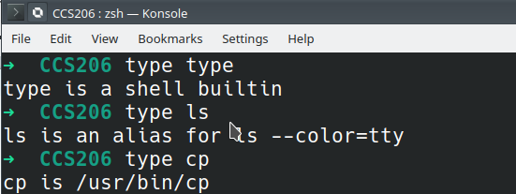
Identifying commands
It is often useful to know exactly which of the four kinds of commands is being used, and Linux provides a couple of ways to find out.
type – display a command’s type
The type command is a shell builtin that displays the kind of command the shell will execute, given a particular command name. It works like this:
type command
Where command is the name of the command you want examine. Examples are:

Slide 19
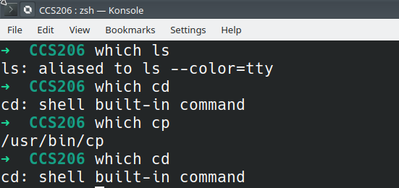
which – Display an Executable’s Location
Sometimes more than version of an executable program is installed on a system. While this is not very common on desktop systems, it is not unusual on large servers. Toe determine the exact location of a given executable, which command is used as follows:
which command
Where command is usually an executable programs. Some Linux machines may display an error or no response when you used which on builtin or alias programs.

Slide 20
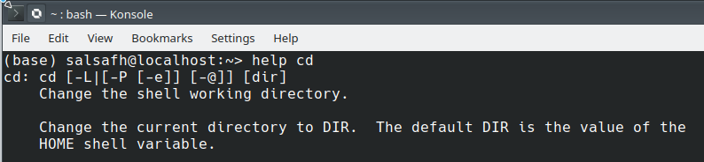
help – Get Help for Shell Builtins
Bash has a builtin help facility for each of the shell builtins. To use it, type
help command
When a square brackets appear in the description of a command’s syntax, they indicate optional items.
A vertical bar character indicates mutually exclusive items. For example, help cd display something like cd [-L |-P] [dir].
This notation says that the command cd may be followed optionally by either a -L or a -P and further, optionally followed by the the argument dir.

Slide 21
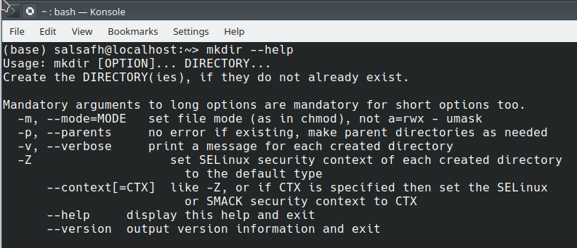
--help – Display Usage Information
Many executable programs supports a –help option that displays a description of the command’s supported syntax and options. For example:
Some programs may not support the –help option. It often results in an error message that reveals the same usage information.

Slide 22
man – Display a Program’s Manual Page
Most executable programs intended for command-line use provide a formal piece of documentation called a manual or man page. A special paging program called man is used to view them like this:
man program
Where program is the name of the command to view.
Man pages may generally contain a title, a synopsis of the command’s syntax, a description of the command’s purpose, and a listing and description of each of the command’s options.
Man pages do not usually include examples, and they are intended as a reference, not a tutorial.
On most Linux systems, man uses less to display manual page, so all of the familiar less commands work while displaying the page.
The following table describes the layout of the manual page.

Slide 23
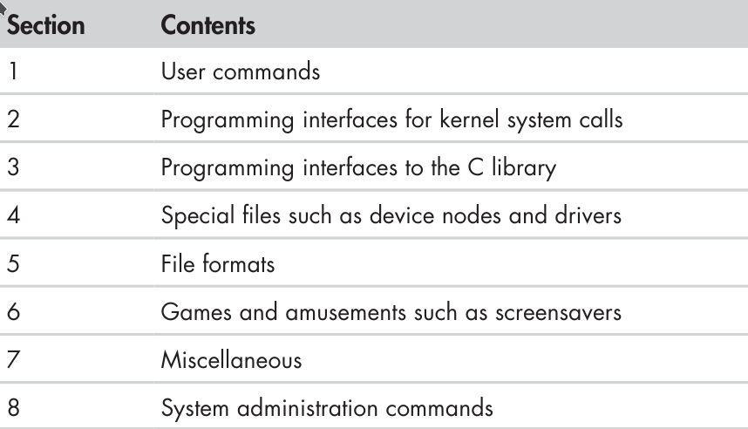
man page organization
Sometimes we need to look in a specific section of the manual to find what we are looking for. This is particularly true if we are looking for a file format that is also the name of a command. To specify a section number we use: man 5 passwd

Slide 24
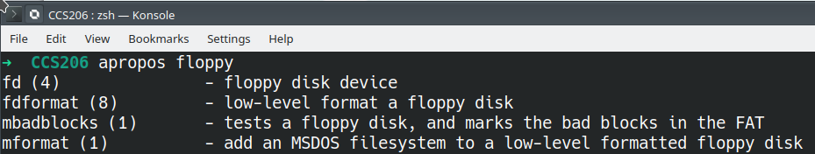
apropos – Display Appropriate Commands
It is not possible to search the list of man pages for possible matches based on a search term. Though crude, this approach is sometimes helpful.
The first field in each line of output is the name of the man page, and the second field shows the section. So, now you can use the command and the section number with man to get manual page for the section. For example – $ man 8 fdformat

Slide 25
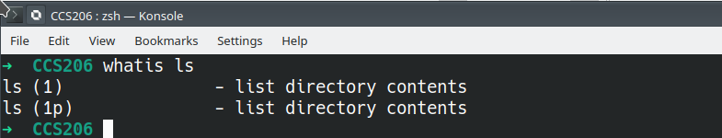
whatis – Display a Very Brief Description of a Command
The whatis program displays the name and a one-line description of a man page matching a specified keyword:
Each manual page has short description available within it. It searches the manual pages names and displays the manual page descriptions of any name matched.
name may contain wildcards (-w) or be a regular expression (-r). Using these options, it may be necessary to quote the name or escape (\) the special characters to stop the shell from interpreting them.

Slide 26
info – Display a Program’s Info Entry
The GNU Project provides an alternative to man pages called info pages. Info pages are displayed with a reader program named, appropriately enough, info. Info pages are hyperlinked much like web pages. info is used as follows:
info [OPTION]... [MENU-ITEM...]
The first non-option argument, if present, is the menu entry to start from; it is searched for in all ‘dir’ files along INFOPATH. If is not present, info merges all ‘dir’ files and shows the result.
Any remaining arguments are treated as the names of menu items relative to the initial node visited.
The info program reads info files, which are tree-structured into individual nodes, each containing a single topic. Info files contain hyperlinks that can move you from node to node. A hyperlink can be identified by its leading asterisk and is activated by placing the cursor upon it and pressing the ENTER key.

Slide 27
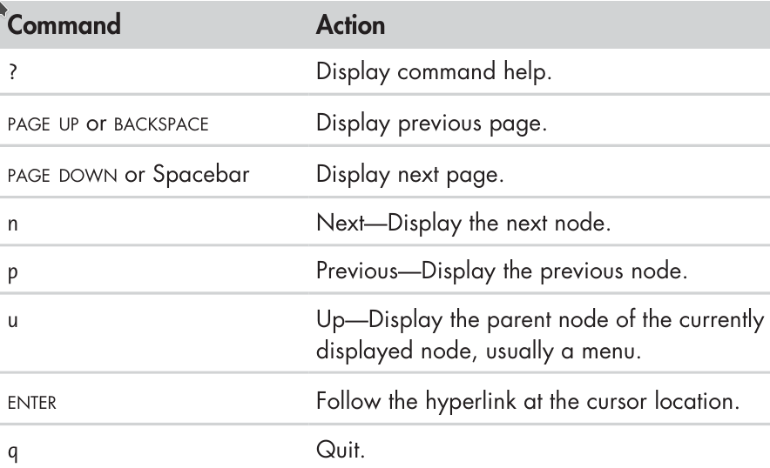
A hyperlink can be identified by its leading asterisk and is activated by placing by placing the cursor upon it and pressing the ENTER key.
Some info commands

