Slide 1
Explore Zomato restaurants dataset of Colombo

Slide 2
Introduction
Colombo is the commercial capital and largest city of Sri Lanka by population. According to the Brookings Institution, Colombo metropolitan area has a population of 5.6 million and 752,993 in the city proper.
It is also the administrative capital of the Western Province and the district capital of Colombo District. Colombo is a busy and vibrant city with a mixture of modern life, colonial buildings and monuments.
With it’s diverse culture , comes diverse food items. There are many restaurants in Colombo City, each belonging to different categories like Chinese , Italian , French etc.
This project will find out the best Chinese restaurants in Colombo and analyze the entire Colombo city to find out best venues.

Slide 3
Objectives
Questions that can be asked using the above mentioned datasets
What is best location in Colombo City for Chinese Cuisines ?
Which areas have large number of Chinese restaurants ?
Which all areas have less number of restaurants ?
Which is the best place to stay if you prefer Chinese Cuisines ?
What places are have best restaurants in Colombo?

Slide 4
Data
For this project we need the following data :
Colombo Restaurants data that contains list Locality, Restaurant name, Rating along with their latitude and longitude.
Data source : Zomato kaggel dataset
Description : This data set contains the required information. And we will use this data set to explore various locality of Colombo city.
Nearby places in each locality of Colombo city.
Data source : Fousquare API
Description : By using this API we will get all the venues in each neighborhood.

Slide 5
Approach
Collect the Colombo city data from Zomato kaggel dataset
Using FourSquare API we will find all venues for each neighborhood.
Filter out all venues that are nearby by locality.
Using aggregative rating for each resturant to find the best places.
Visualize the Ranking of neighborhoods using folium library(python)

Slide 6

RESULTS

Slide 7
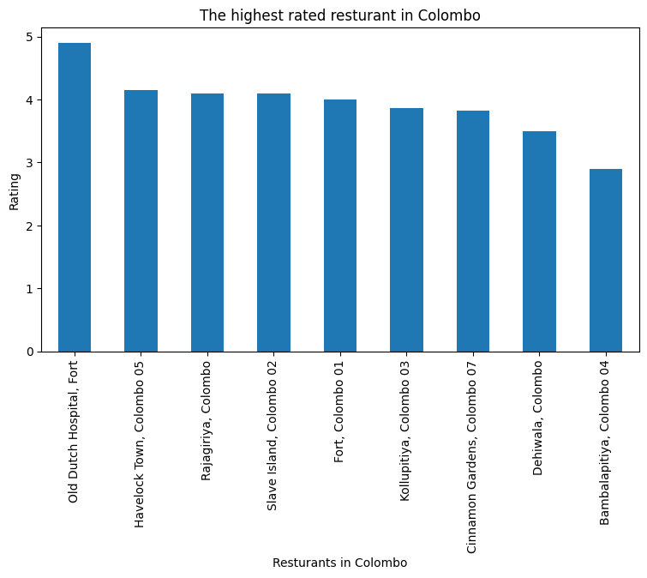

Slide 8
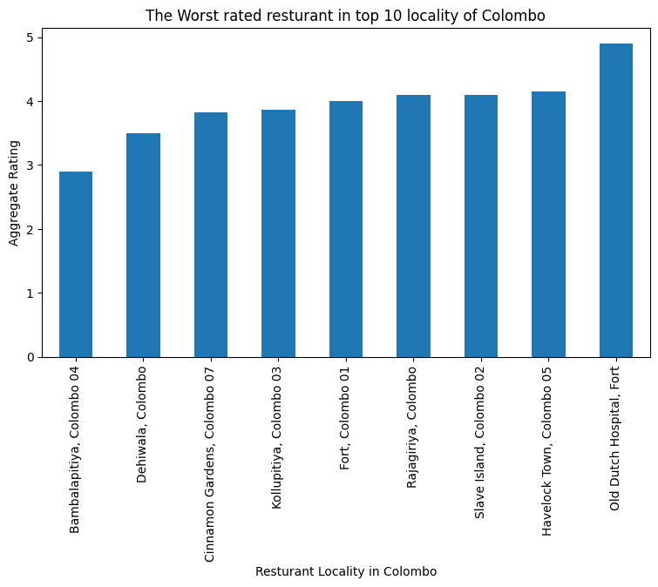

Slide 9
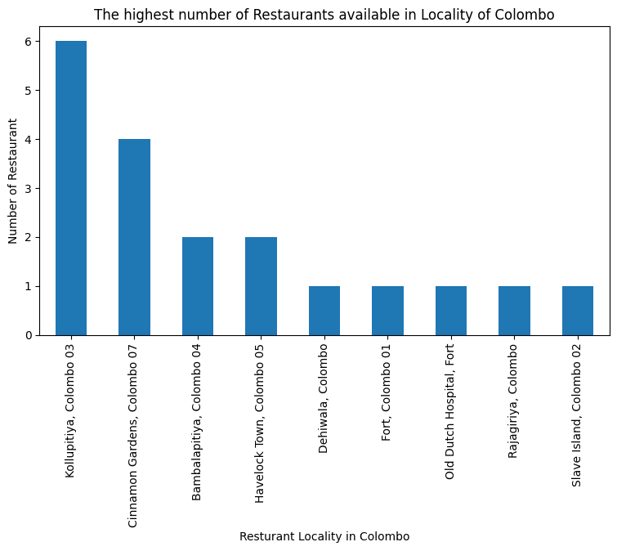

Slide 10
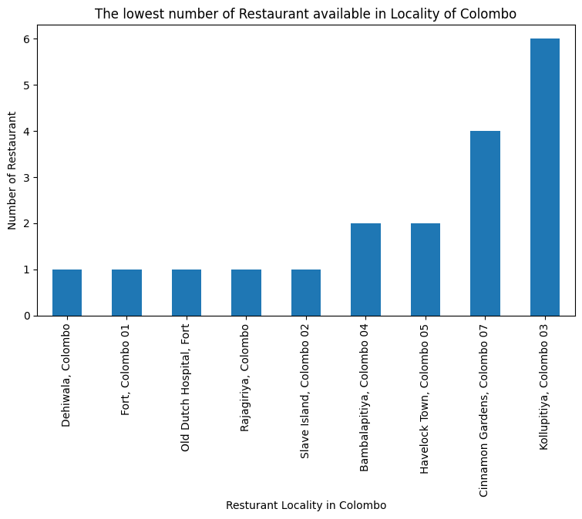

Slide 11
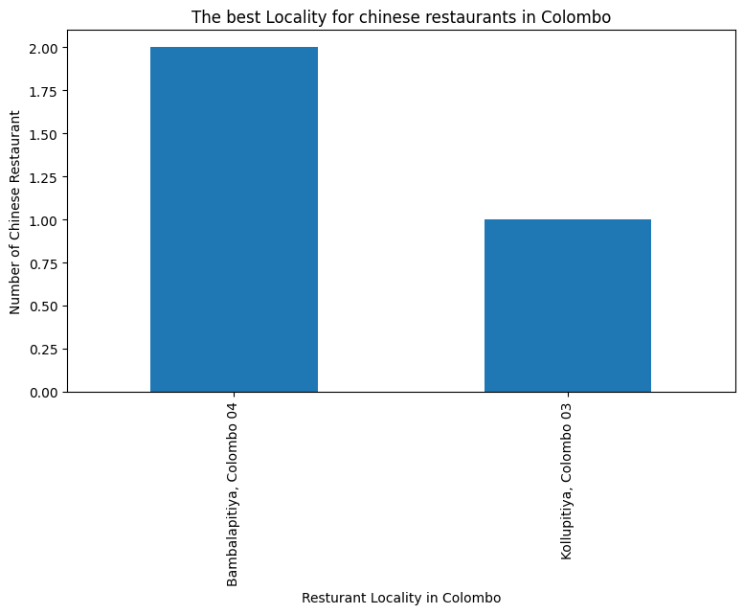

Slide 12
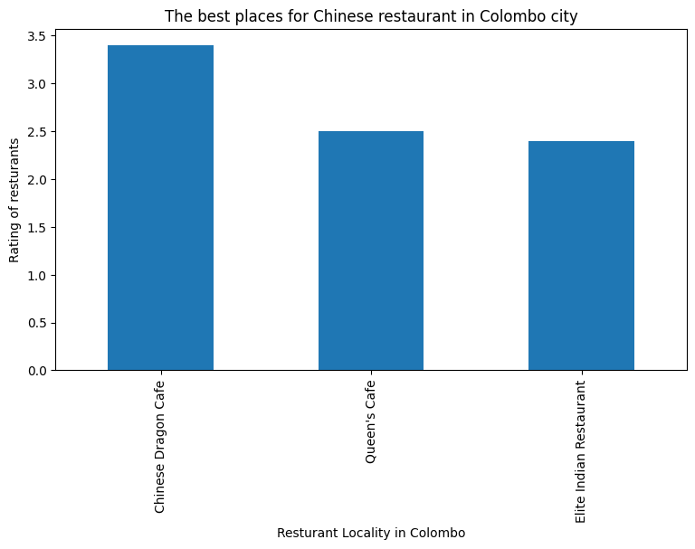

Slide 13
Conclusions
The best restarants are available in Old Dutch Hospital, Fort.
The worst restarants are available in Bambalapitiya, Colombo 4.
Kollupitiya, Colombo 3 is the best place to dine in Colombo.
Bambalapitiya is the best place for Chinese restaurants.
Chinese Dragon Cafe is the best Chinese resturant in Colombo.

