Slide 1
Computers are Stupid
Sal Skare

Slide 2
“The trouble with computers, of course, is that they're very sophisticated idiots. They do exactly what you tell them at amazing speed.”
-The 4th Doctor

Slide 3
Artificial intelligence (AI) is the intelligence exhibited by machines or software. It is an academic field of study which generally studies the goal of emulating human-like intelligence. John McCarthy, who coined the term in 1955, defines it as "the science and engineering of making intelligent machines".
Wikipedia

Slide 4
Agents
An AI program is known as an agent
Agents operate in environments
Agents progress toward a goal state
Agents can be perfectly rational, or solve problems in a more heuristic way

Slide 5
Environments
Observability: partially observable or fully
Deterministic or stochastic
Episodic or sequential
Static or dynamic
Discrete or continuous
Known or unknown

Slide 6
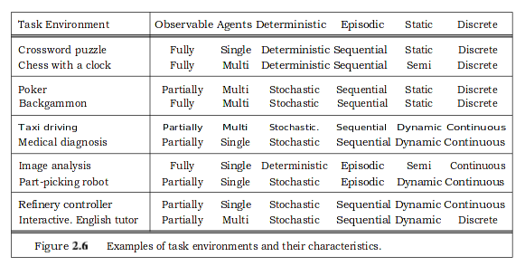
Environments – cont .
Artificial Intelligence: a modern approach 3rd edition

Slide 7
the -”knowledge bottleneck” in Al—the problem of how to express all the knowledge that a system needs—may be solved in many applications by learning methods rather than hand-coded knowledge engineering
Artificial Intelligence: a modern approach 3rd edition

Slide 8
Ways to store data
Atomic
Value pairs
Structured representation

Slide 9
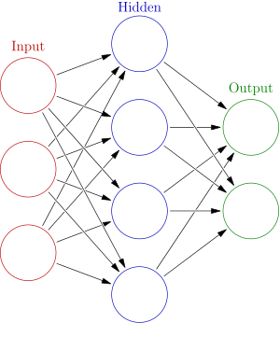
Neural Nets

Slide 10
Neural Network learning
Example by Milo Spencer-Harper

Slide 11
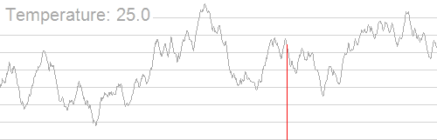
Simulated annealing

