Slide 1
AutoML
Will data scientists become redundant?

Slide 2
Table of Contents
Motivation
Scope
Limitations
Notebook Example
Take-Home Message
References

Slide 3
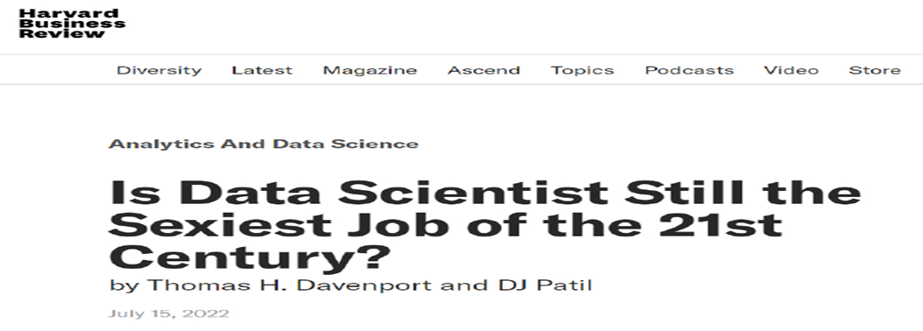
Motivation
Executives, product managers
Reduces tedious work
More time on insights
Continued job growth
More data being created
“the field is projected to experience more growth than almost any other by 2029. ”
https://hbr.org/2022/07/is-data-scientist-still-the-sexiest-job-of-the-21st-century

Slide 4
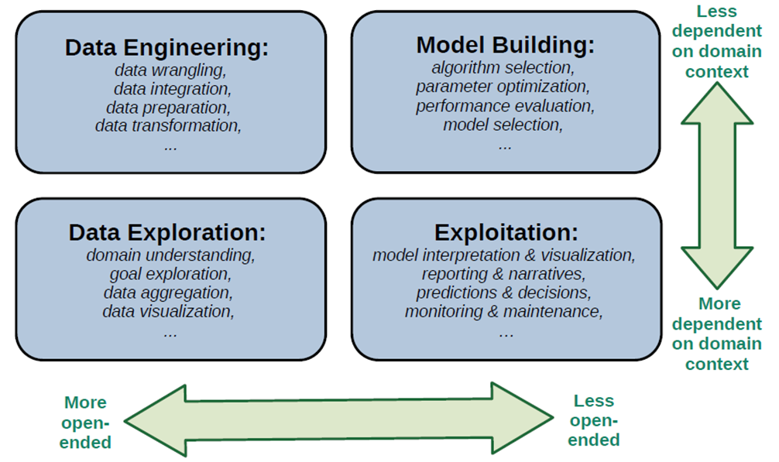
Scope
Difficulty spectrum
Iterative (left)
Domain knowledge (down)
De Bie, 2022

Slide 5
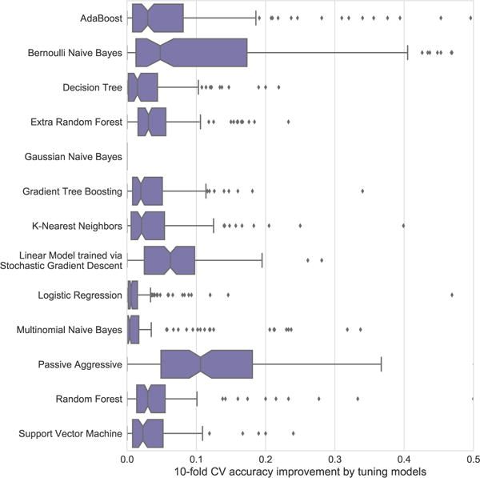
Hyperparameter Optimization
Usually re-run
Execution time and accuracy
Critically impacts performance
In AutoML, these can be set automatically
Individual methods compared fairly with each other
Olson, 2018

Slide 6
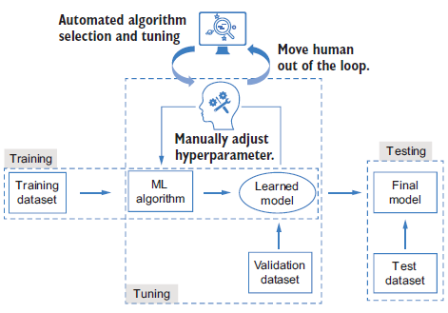
Definitions
Grid Search
Does not scale to high dimensions.
Random Search
Computationally expensive.
Bayesian Optimization
Instantiation of hyperparameters better than random.
Learns from past datasets
Select meta-features of new dataset
Song, 2022

Slide 7
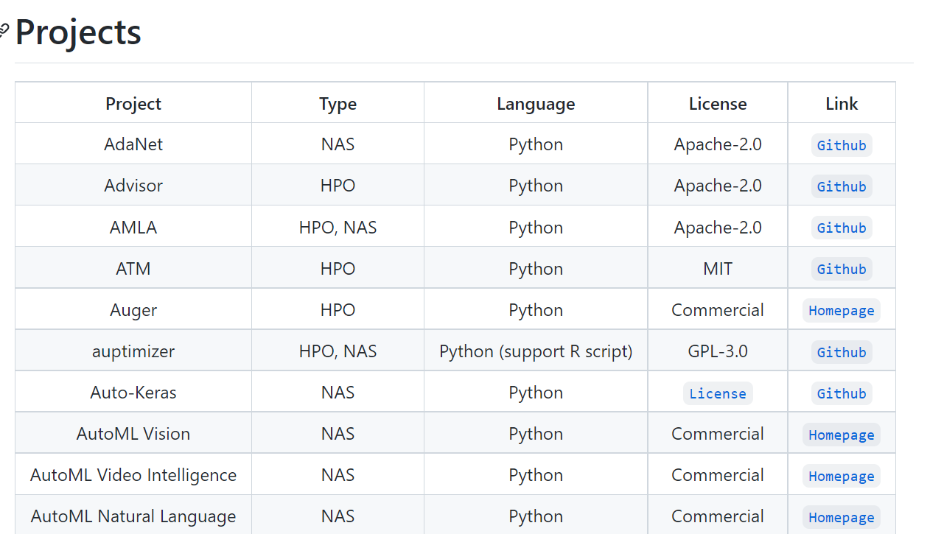
Tools
Mostly after 2017 (Voller, 2021)
Auto-WEKA (2014)
Built on Java
Support GUI
Auto-sklearn (2015)
Python
Sklearn syntax
Many more (>50)
Types:
AutoFE, NAS, or HPO
https://github.com/hibayesian/awesome-automl-papers

Slide 8
Notebook example
Google Colab

Slide 9
Limitations
Unsupervised learning
Unstructured data
Cleaning
Complex datasets
Package conflicts
AutoML Hyperparameters

Slide 10
Take-Home Message
Existing automation:
Programming
Functions and packages
Software
Data scientists still needed
Domain specific feature engineering
Communication with stakeholders
Building hypotheses
Manage package environments

Slide 11
References
Automated Machine Learning in Action, Qingquan Song, Haifeng Jin, Xia Hu, 2022
Automating Data Science: Prospects and Challenges, Tijl De Bie, Luc De Raedt, José Hernández-Orallo, Holger H. Hoos, Padhraic Smyth, Christopher K. I. Williams, 2022
Data-driven advice for applying machine learning to bioinformatics problems, Randal S. Olson, William La Cava, Zairah Mustahsan, Akshay Varik, and Jason H. Moore, 2018
Literature Review on Automated Machine Learning (Automl), Voller, Luisa, Fachhochschule Wedel, Wedel, 2021

Slide 12
Thank you
Q&A…

