Slide 1


Implementing a virtual guitar using ultrasonic sensors
By
Vatsal H. Salla
(110570111018)
Mihir N. Malaviya
(110570111019)
Project Guide
Prof. Kaushal J. Doshi

Slide 2
Project Definition
Definition –
Virtual guitar is a concept in which a conventional guitar is virtualized by using ultrasonic sensors

Slide 3
Literature survey and Motivation
Gathering information on –
Distance measuring sensors
-Infrared sensors.
-Ultrasonic sensors.
Development boards.
-Arduino.
-TI.
Controllers

Slide 4
Ultrasonic vs Infrared sensors
Infrared sensors | Ultrasonic sensors
They depend on external entities. | Such problems are not faced.
Depends on surface. | Surface dependence is not a big problem.
Less accurate | More accurate.
Sunlight can affect the operate. | Works in any light.
Narrow beam width. | Wide beam width.
Low cost. | High cost.
No Echo problem. | Echo problem.

Slide 5
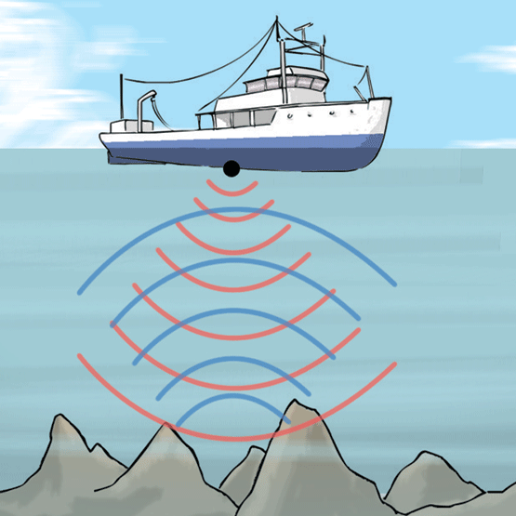
What is Ultrasonic sensor?
Basic understanding of ultrasonic sensor using SONAR –

Slide 6
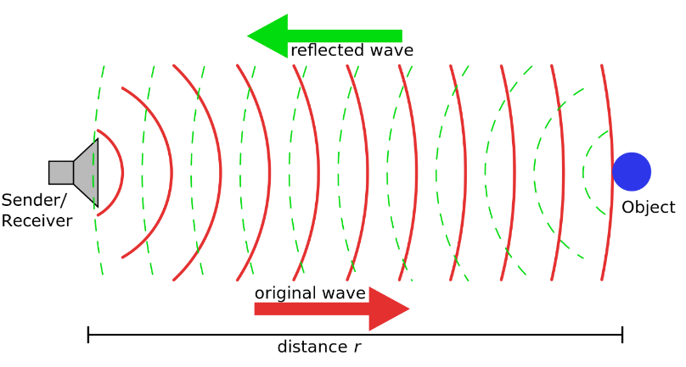
Working Principle of Ultrasonic sensor
Flow –
Generate high frequency sound waves.
Echo detection.
Distance measurement.
Frequency generation.

Slide 7
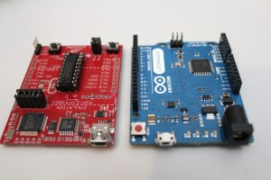
Arduino and TI boards

Slide 8
Arduino Vs TI
Area of concern –
I/O pins
Cost
Programming
Facility

Slide 9
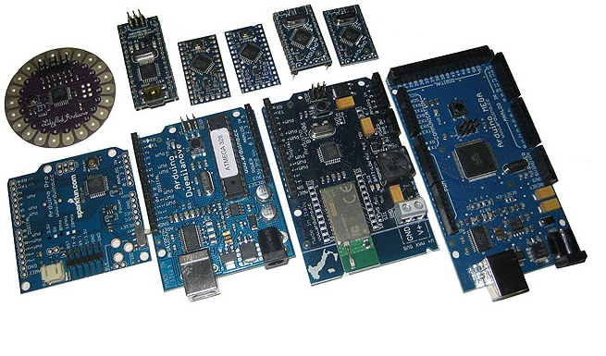
Arduino family

Slide 10
Controller family
Available controllers (Familiar)–
ARM(RISC)
PIC(RISC)
AVR(RISC) – ATMEGA
8051(CISC)
MSP430(RISC)

Slide 11
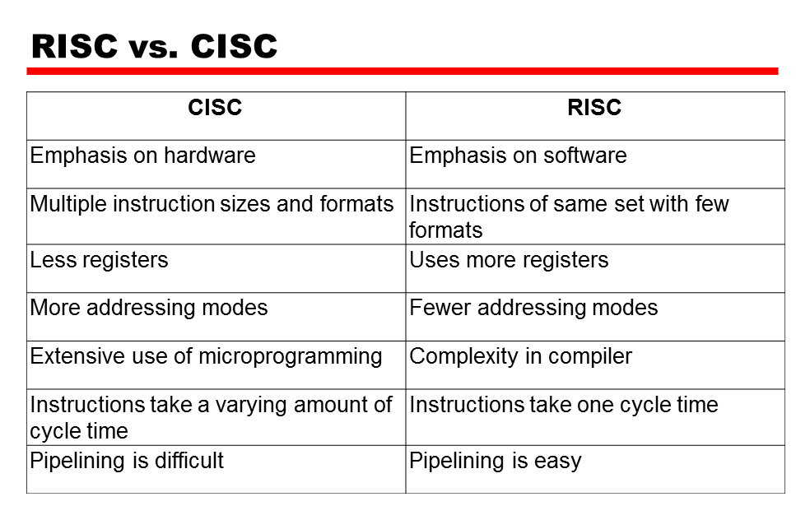
RISC Vs CISC

Slide 12
Controller selected
AVR better than other controllers
AVR comparison with other other controllers.
ARM | High end controller.
8051 | 8051 are CISC controllers.
PIC | PIC are not widely used, not an open source, free C compiler.
MSP430 | More expensive compared to AVR.

Slide 13
Development environment
Selection on the basis of boards
Software provided by Arduino.
Energia.
CCS.

Slide 14
Identification of major components…
Arduino :
- Arduino UNO.
- Arduino Lilypad.
Ultrasonic Sensor HC-SR04.
Controller – ATMEGAxx
A loudspeaker

Slide 15
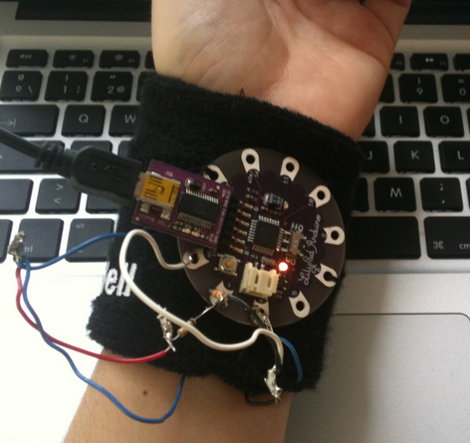
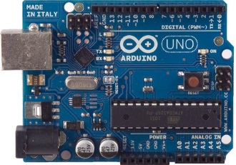
Arduino UNO Vs Arduino Lilypad
ARDUINO boards selected –
Arduino Lilypad
Arduino UNO

Slide 16
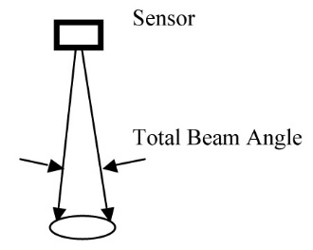
Selected Ultrasonic sensor : HC-SR04
Specifications
Working Voltage : 5V(DC)
Static current: Less than 2mA.
Output signal : Electric frequency signal, high level 5V, low level 0V.
Sensor angle : Not more than 15 degrees.
Detection distance : 2cm-450cm.
High precision : Up to 2mm.
Input trigger signal : 10us TTL impulse.
Echo signal : output TTL PWL signal.

Slide 17
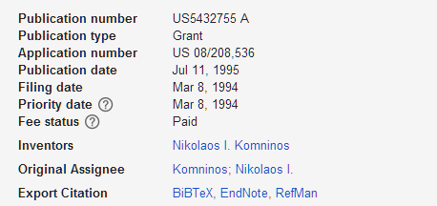
Ultrasonic signal detector US 5432755 A (Patent 1)
Abstract –
Ultrasonic sensor
Frequency generation
Filters

Slide 18
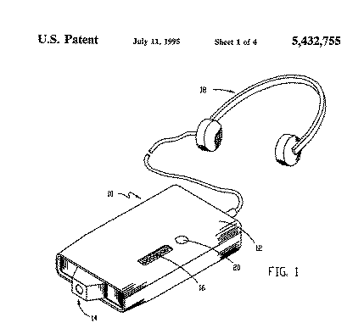
Description on US 5432755 A

Slide 19
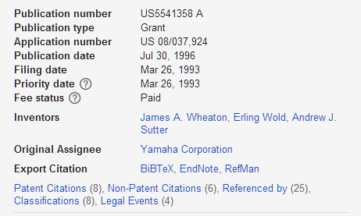
Position-based controller for electronic musical instrument US 5541358 A (Patent 2)
Abstract –
Object
Position detection
Position signal generation
Musical tone generation

Slide 20
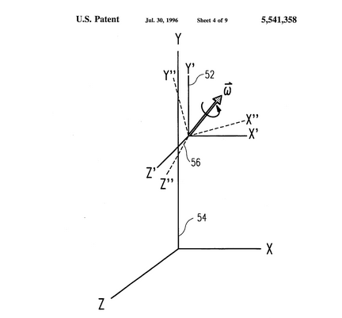
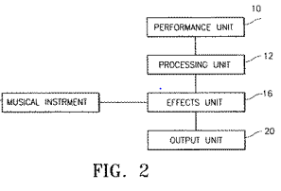
Description on US 5541358 A

Slide 21
Virtual music system US 5393926 A (Patent 3)
Abstract :
Lead storage
Musical tone storage
Connection with the device
Plays the stored notes w.r.t. the music generated by the user automatically

Slide 22
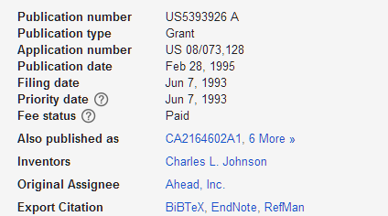
Description on US 5393926 A

Slide 23
Tentative plan
WORK | DURATION
Information gathering | September end 2014
Hardware & Software Development | December End 2014
Combining | By January End 2015
Testing
Debugging | Mid – February 2015
Report generation | March 2015
GANTT CHART

Slide 24
Reference
[1] (2014) Instructables website Online Available at http://www.instructables.com/id/Use-Arduino-code-on-a-TI-Launchpad-MSP430/
[2] (2014) Engineer’s garage website Online Available at http://www.engineersgarage.com/ insight/how-ultrasonic-sensors-work
[3] (2014) teacher’s engineering website Online Available at http://www.teachengineering.org/ view_lesson.php?url=collection/umo_/lessons/umo_sensorswork/umo_sensorswork_lesson06.xml
[4] (2014) Spark fun website Online Available at https://learn.sparkfun.com/ tutorials/arduino-comparison-guide

Slide 25
Reference
[5] (2014) Stanford website Online Available at http://cs.stanford.edu/ people/eroberts/ courses/soco/projects/risc/risccisc/
[6] (2014) Instructables website Online Available at http://en.wikipedia.org/ wiki/Guitar_Center
[7] (2014) Sewelectric website [Online] Available at http://sewelectric.org/diy-projects
[8] (2014) Arduino main website [Online] Available at http://arduino.cc/en/Main/ arduinoBoardLilyPad

Slide 26
Thank You

