Slide 1




CHINOOK DATABASE ANALYSIS

Slide 2
PROJECT INTRODUCTION
The Chinook Database is a sample relational database designed to simulate a digital music store, akin to platforms like iTunes. It contains comprehensive data on customers, invoices, albums, artists, tracks, and genres, making it a valuable resource for analyzing various business scenarios within the digital media industry.

Slide 3
SCOPE OF THE PROJECT
Utilizing SQL to retrieve data from multiple tables within the Chinook Database, including Customer, Invoice, Track, Album, Artist, and Genre tables.
01 - DATA EXTRACTION
Using data preprocessing techniques to ensure accuracy and consistency, which includes handling missing values ,and removing duplicates.
02 - DATA CLEANING
performed exploratory data analysis to extract meaningful insights, including customer segmentation, sales performance evaluation by genre and artist, and trend analysis over time.
03 - DATA ANALYSIS
04 - DATA VISUALIZATION
Creating visual representations of the findings using Python libraries

Slide 4
DATA SOURCE
The project utilizes the Chinook Database, which contains various tables representing the operations of a music store, including customers, employees, invoices, tracks, and genres.
DATA CLEANING
We performed extensive data cleaning, including:
01 -REMOVING DUPLICATES.
02 - HANDLING MISSING VALUES.
04 - FILTERING UNNECESSARY RECORDS
03 -STANDARDIZING FORMATS
05 -CREATING NEW COLUMNS FOR ANALYSIS

Slide 5


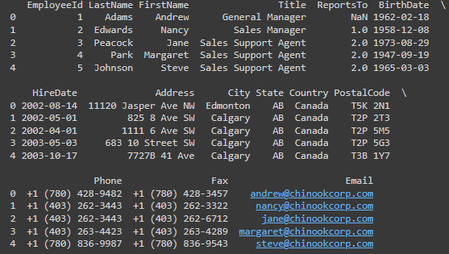
REMOVING DUPLICATES
Used drop_duplicates() method on DataFrames for Employee and Customer tables.
EMPLOYEE TABLE CLEANING
Fill Missing Values:
Replaced missing supervisor IDs with 0.
Standardizing Phone Numbers
Ensured consistent phone number format.
Standardizing Fax Numbers
Standardized fax numbers for uniformity.

Slide 6
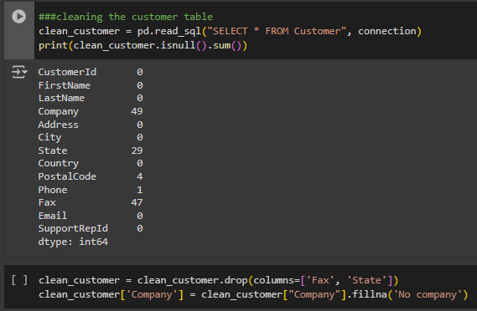
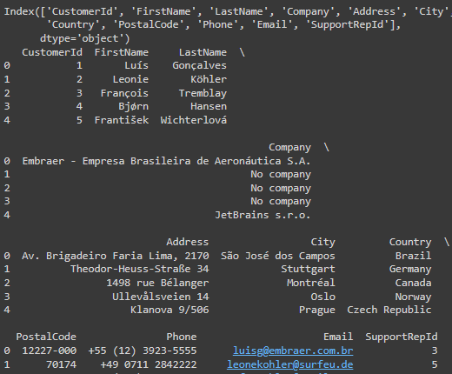
CUSTOMER TABLE CLEANING STEPS
Identified missing values in the Customer table
using : print(clean_customer.isnull().sum())
Dropping Unnecessary Columns
using : clean_customer = clean_customer.drop(columns=['Fax', 'State'])
Handling Missing Values in Company
clean_customer['Company'] = clean_customer["Company"].fillna('No company')
Replaced missing company names with a placeholder

Slide 7
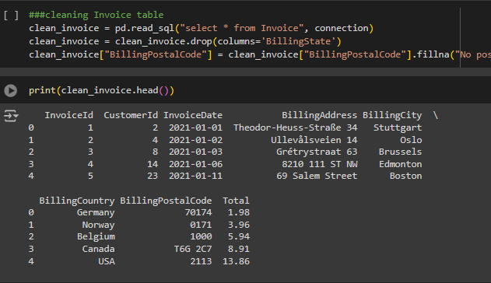
INVOICE TABLE CLEANING STEPS
Data Extraction
using : clean_invoice = pd.read_sql("SELECT * FROM Invoice", connection)
Dropping Unnecessary Columns
using : clean_invoice = clean_invoice.drop(columns='BillingState')
Handling Missing Values
Replaced missing postal codes with a placeholder

Slide 8
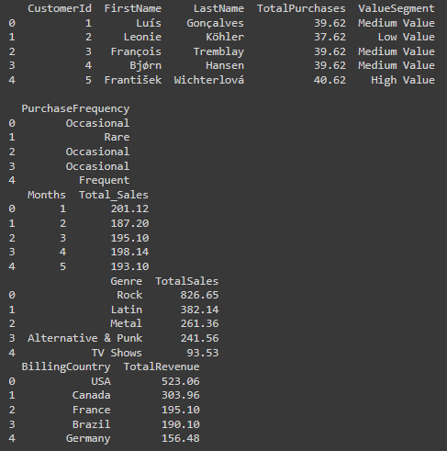
SALES DATA INSIGHTS
Aggregated sales data to identify total revenue by country
CUSTOMER SEGMENTATION
Categorized customers based on total purchases:
MONTHLY SALES TRENDS
Aggregated sales data by month

Slide 9
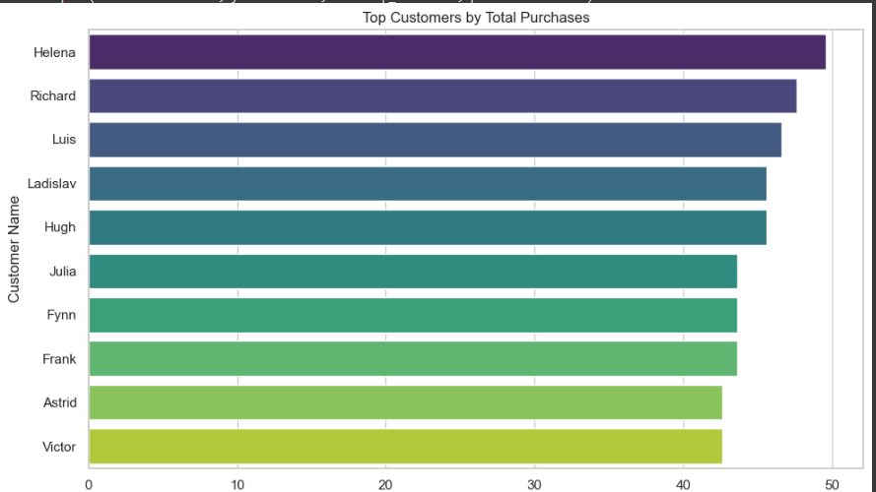
TOP CUSTOMERS BY TOTAL PURCHASES
Here is the top 10 customers bt their total purchase
The top customer is Helena

Slide 10
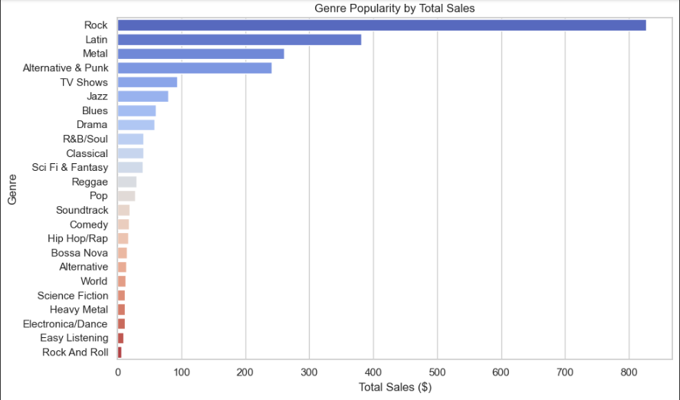
GENRE POPULARITY BY TOTAL SALES
Understanding genre popularity can help in inventory decisions and marketing strategies for new releases.
The most popular genre is Rock

Slide 11
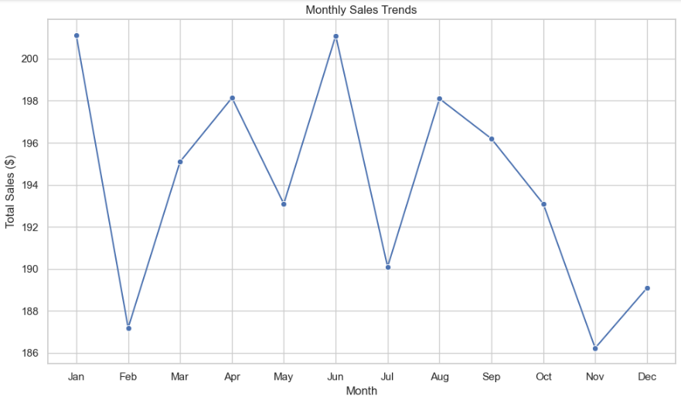
MONTHLY SALES TRENDS
The highest sales are in JAN and JUN This suggests a peak during holiday shopping.
January often benefits from post-holiday sales, while June may reflect summer promotions or activities.
Consider targeted marketing campaigns during the identified peak months to further enhance sales.

Slide 12
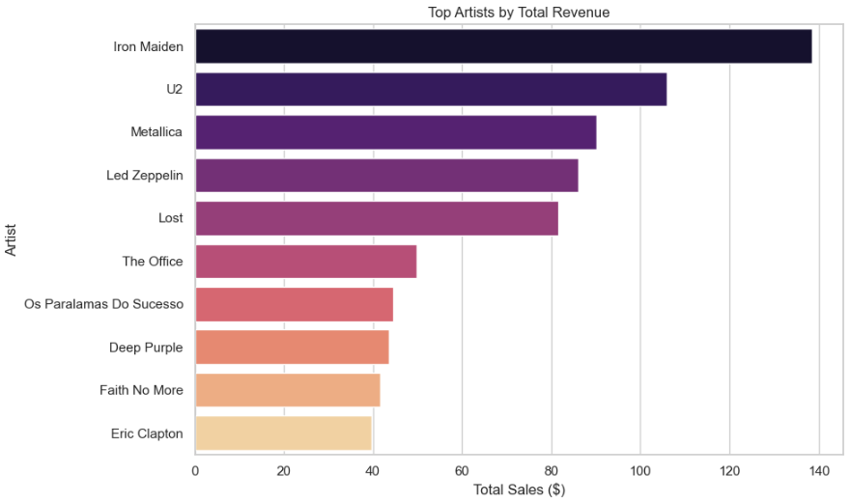
TOP ARTISTS BY TOTAL REVENUE
The top three artists collectively account for a significant portion of the total revenue, highlighting the potential focus on these key contributors.

Slide 13
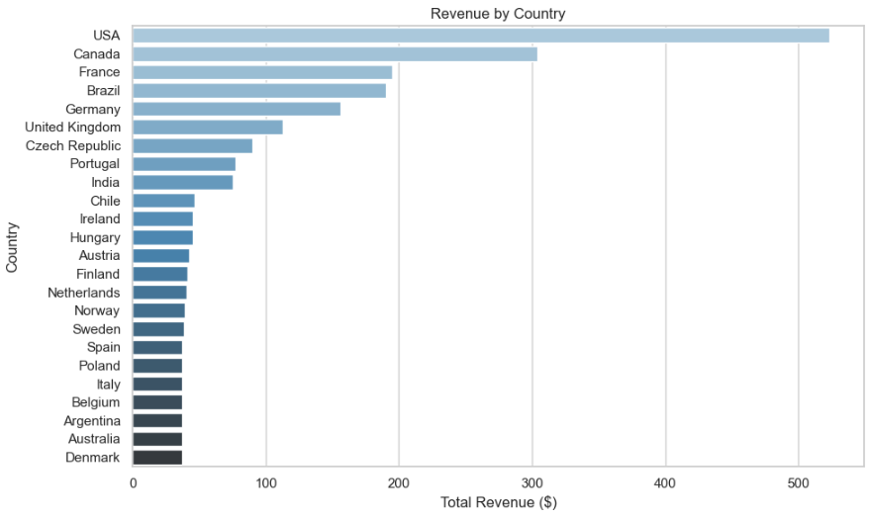
REVENUE BY COUNTRY
The United States is the leading market
There is a noticeable revenue drop in countries outside the top Five, suggesting potential for targeted marketing campaigns in these regions.

Slide 14
SUMMARY REPORT
We identified and addressed issues such as missing values, unnecessary columns, and inconsistent formats in the employee, customer, and invoice tables.
We implemented solutions like filling in missing data, dropping irrelevant columns, and standardizing phone and fax formats.
We analyzed sales by genre to identify our most profitable categories, which helps inform our inventory and marketing decisions.
We discovered that our peak sales months are January and June, along with insights into revenue distribution across countries, guiding us in focused marketing efforts and potential growth strategies.
We highlighted key customers contributing significantly to our total revenue, enabling us to develop targeted retention strategies.

Slide 15
THANK YOU

