Slide 1
An efficient way to learn deep generative models
Geoffrey Hinton
Canadian Institute for Advanced Research
&
Department of Computer Science
University of Toronto
Joint work with: Ruslan Salakhutdinov, Yee-Whye Teh, Simon Osindero, Ilya Sutskever, Graham Taylor, Andriy Mnih

Slide 2
Belief Nets
A belief net is a directed acyclic graph composed of stochastic variables.
We get to observe some of the variables and we would like to solve two problems:
The inference problem: Infer the states of the unobserved variables.
The learning problem: Adjust the interactions between variables to make the network more likely to generate the observed data.
stochastic
hidden cause
visible
effect
We will use nets composed of stochastic binary variables with weighted connections

Slide 3
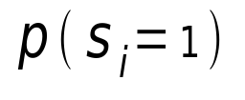
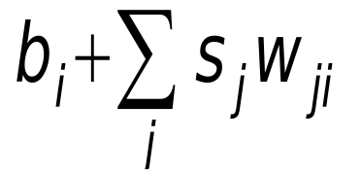
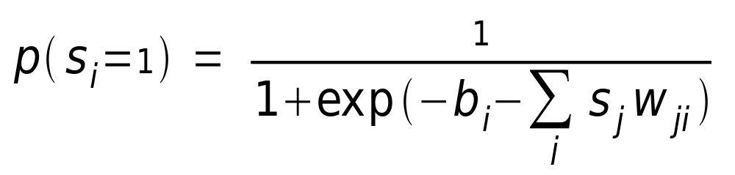
Stochastic binary neurons
These have a state of 1 or 0.
The probability of turning on is determined by the weighted input from other neurons (plus a bias)‏
1
0
0

Slide 4
Learning Belief Nets
It is easy to generate an unbiased example at the leaf nodes, so we can see what kinds of data the network believes in.
It is hard to infer the posterior distribution over all possible configurations of hidden causes.
It is hard to even get a sample from the posterior.
So how can we learn deep belief nets that have millions of parameters?
stochastic
hidden cause
visible
effect

Slide 5
Explaining away (Judea Pearl)‏
Even if two hidden causes are independent, they can become dependent when we observe an effect that they can both influence.
  If we learn that there was an earthquake it reduces the probability that the house jumped because of a truck.
-10
-10
truck hits house
earthquake
20
20
-20
house jumps

Slide 6
Why it is usually very hard to learn sigmoid belief nets one layer at a time
To learn W, we need the posterior distribution in the first hidden layer.
Problem 1: The posterior is typically intractable because of “explaining away”.
Problem 2: The posterior depends on the prior as well as the likelihood.
  So to learn W, we need to know the weights in higher layers, even if we are only approximating the posterior. All the weights interact.
Problem 3: We need to integrate over all possible configurations of the higher variables to get the prior for first hidden layer. Yuk!
hidden variables
hidden variables
prior
hidden variables
likelihood
W
data

Slide 7
Two types of generative neural network
If we connect binary stochastic neurons in a directed acyclic graph we get a Sigmoid Belief Net (Radford Neal 1992).
If we connect binary stochastic neurons using symmetric connections we get a Boltzmann Machine (Hinton & Sejnowski, 1983).
  If we restrict the connectivity in a special way, it is easy to learn a Boltzmann machine.

Slide 8
Restricted Boltzmann Machines
We restrict the connectivity to make learning easier.
  Only one layer of hidden units.
    We will deal with more layers later
  No connections between hidden units.
In an RBM, the hidden units are conditionally independent given the visible states.
  So we can quickly get an unbiased sample from the posterior distribution when given a data-vector.
  This is a big advantage over directed belief nets
hidden
j
i
visible

Slide 9
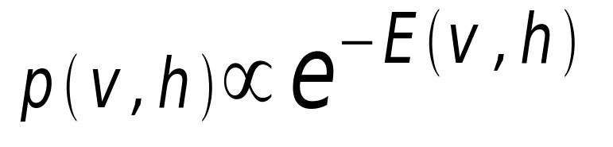
Weights → Energies → Probabilities
Each possible joint configuration of the visible and hidden units has an energy
  The energy is determined by the weights and biases (as in a Hopfield net).
The energy of a joint configuration of the visible and hidden units determines its probability:
The probability of a configuration over the visible units is found by summing the probabilities of all the joint configurations that contain it.

Slide 10
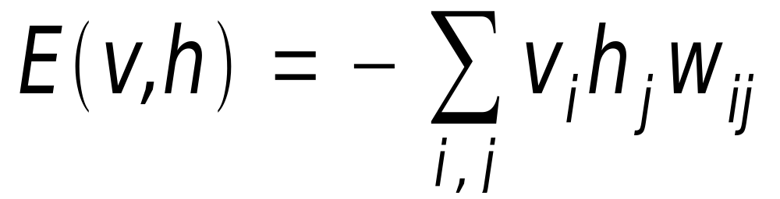
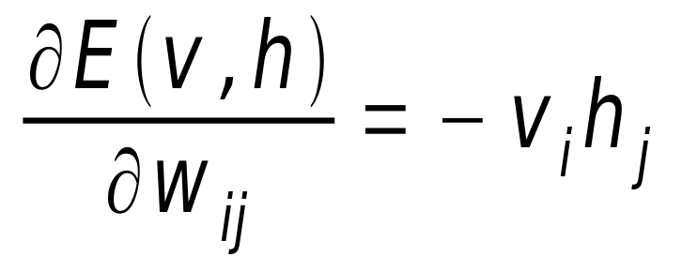
The Energy of a joint configuration
(ignoring terms to do with biases)‏
binary state of visible unit i
binary state of hidden unit j
Energy with configuration v on the visible units and h on the hidden units
weight between units i and j

Slide 11
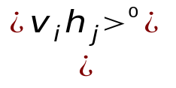
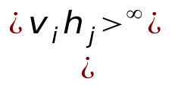
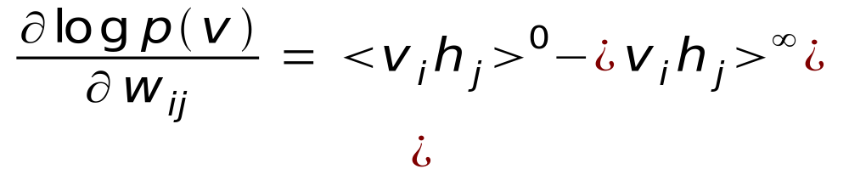
A picture of the maximum likelihood learning algorithm for an RBM
j
j
j
j
a fantasy
i
i
i
i
t = 0 t = 1 t = 2 t = infinity
Start with a training vector on the visible units.
Then alternate between updating all the hidden units in parallel and updating all the visible units in parallel.

Slide 12

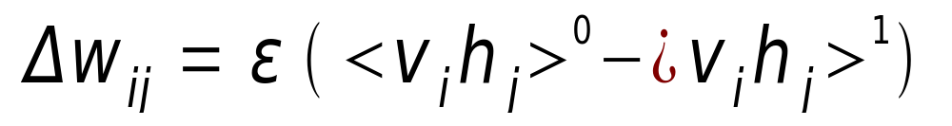
A quick way to learn an RBM
j
j
Start with a training vector on the visible units.
Update all the hidden units in parallel
Update the all the visible units in parallel to get a “reconstruction”.
Update the hidden units again.
i
i
t = 0 t = 1
data
reconstruction
This is not following the gradient of the log likelihood. But it works well.
It is approximately following the gradient of another objective function.

Slide 13
How to learn a set of features that are good for reconstructing images of the digit 2
50 binary feature neurons
50 binary feature neurons
Increment weights between an active pixel and an active feature
Decrement weights between an active pixel and an active feature
16 x 16 pixel image
16 x 16 pixel image
data (reality)‏
reconstruction (better than reality)‏

Slide 14
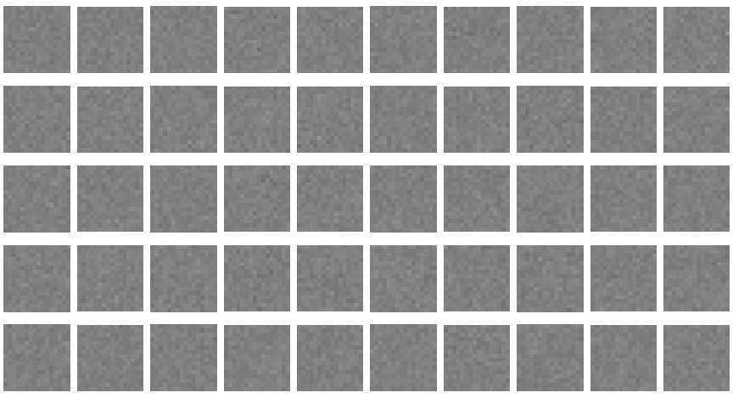
The weights of the 50 feature detectors
We start with small random weights to break symmetry

Slide 15
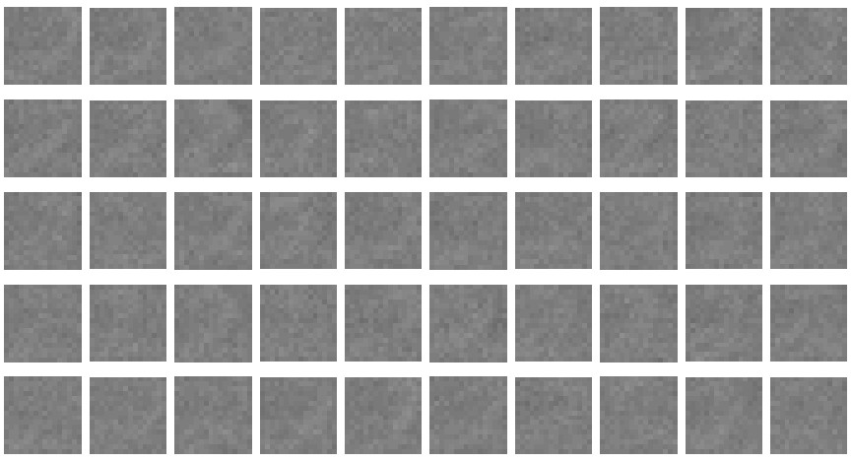

Slide 16
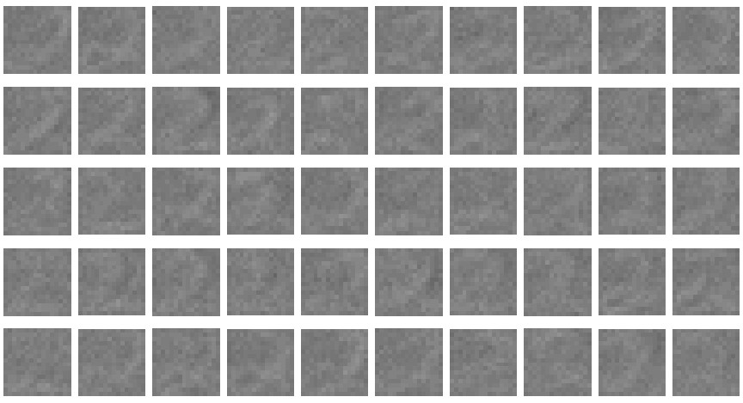

Slide 17
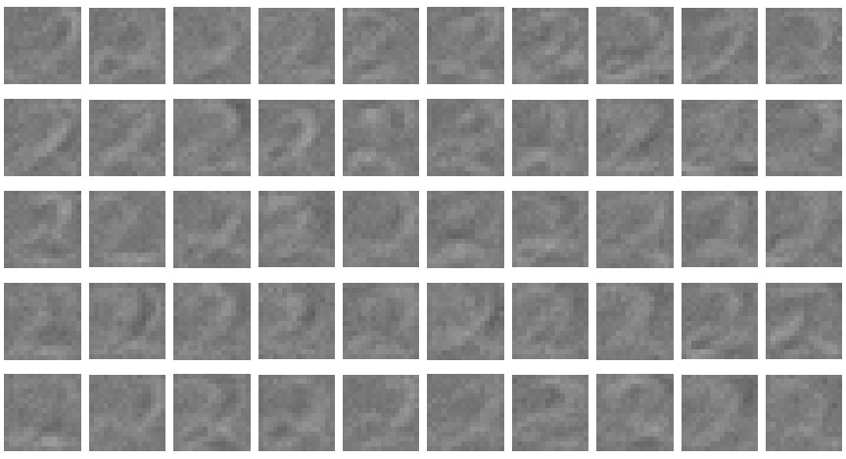

Slide 18
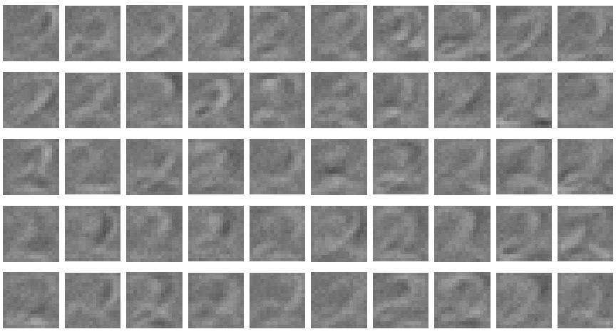

Slide 19
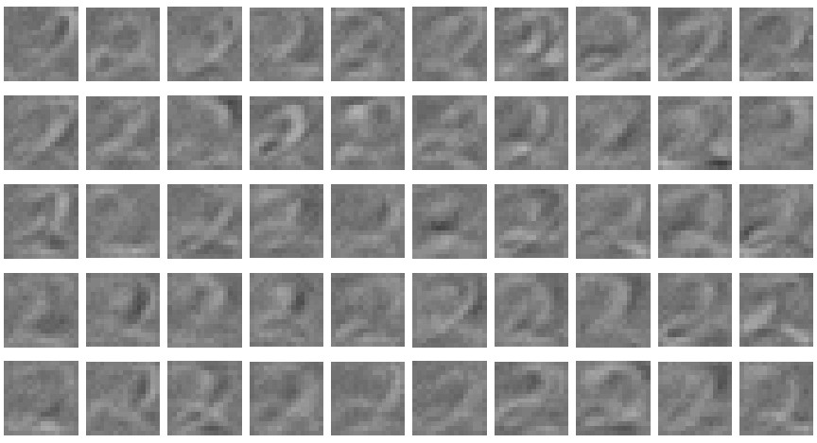

Slide 20
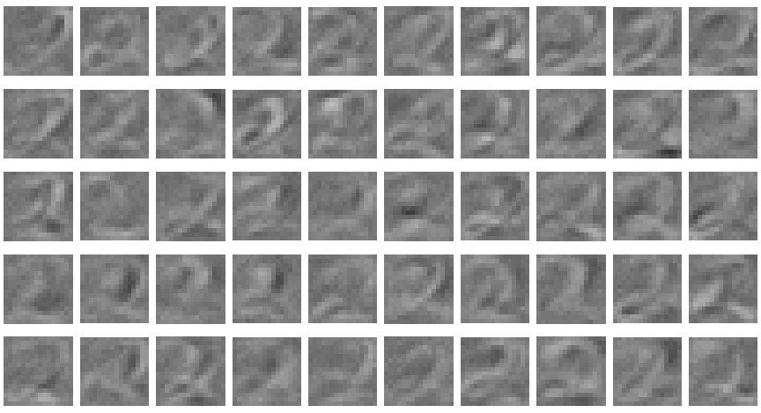

Slide 21
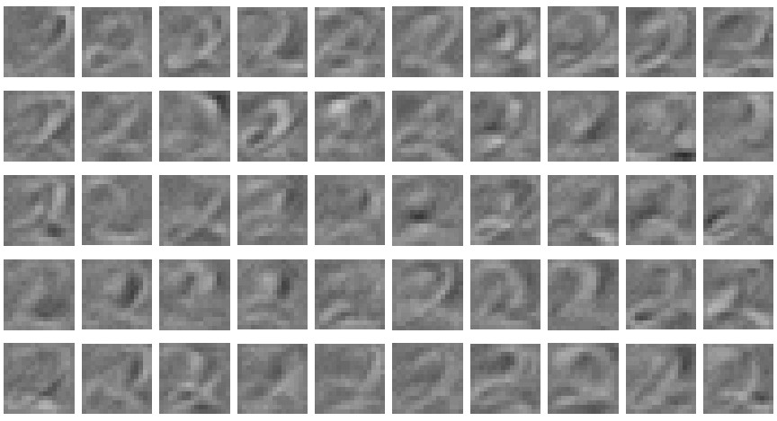

Slide 22
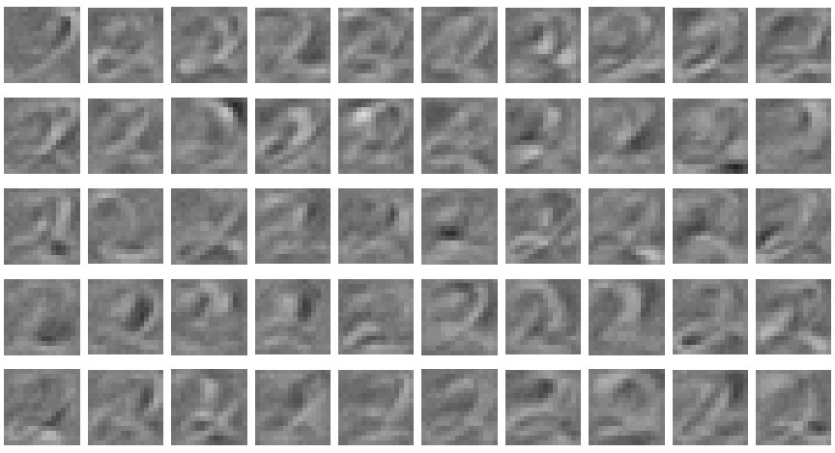

Slide 23
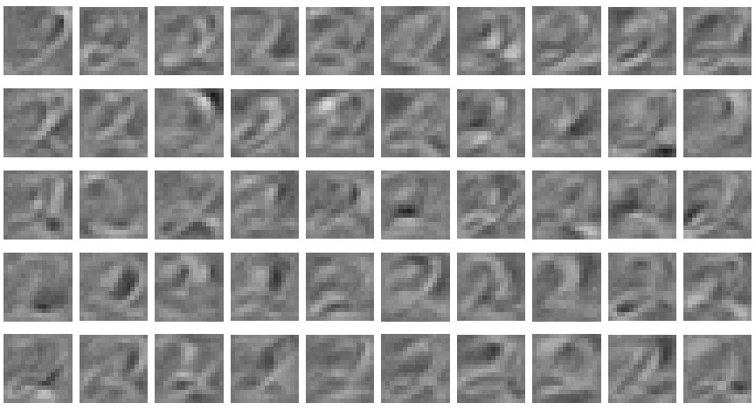

Slide 24
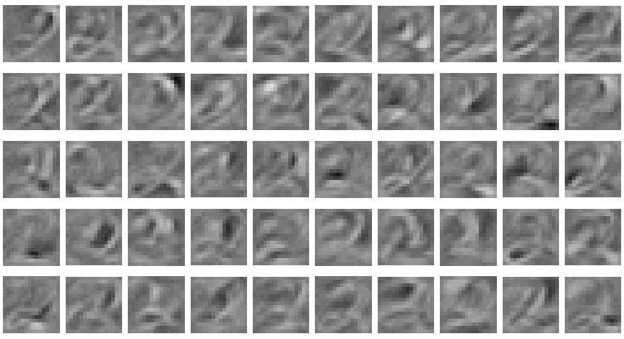

Slide 25
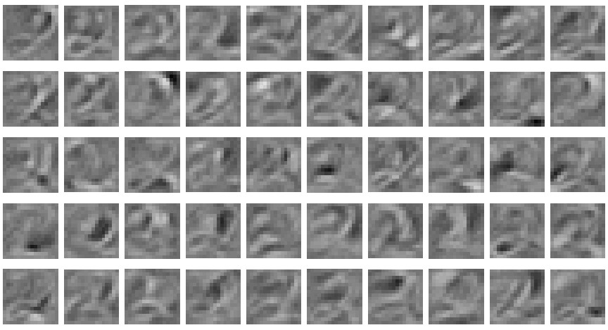

Slide 26
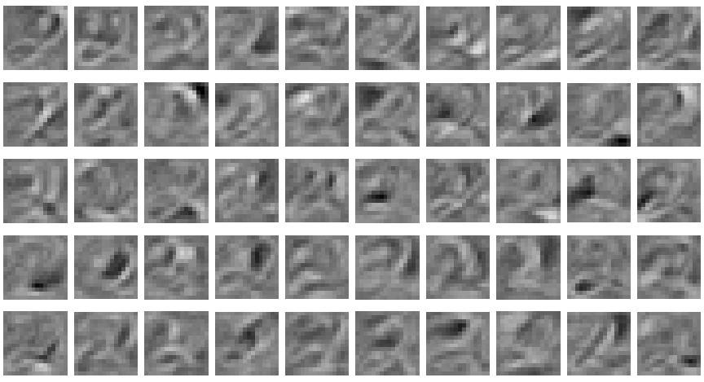

Slide 27
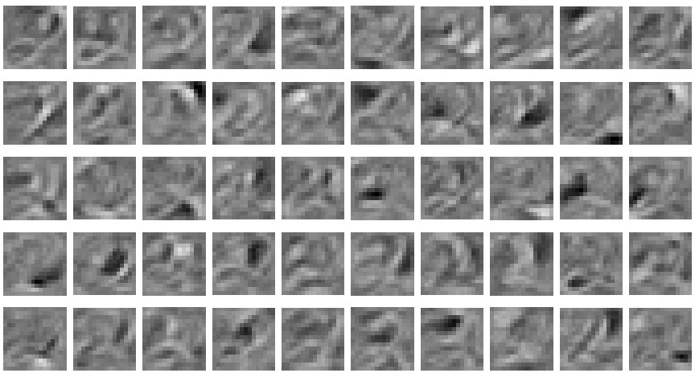

Slide 28
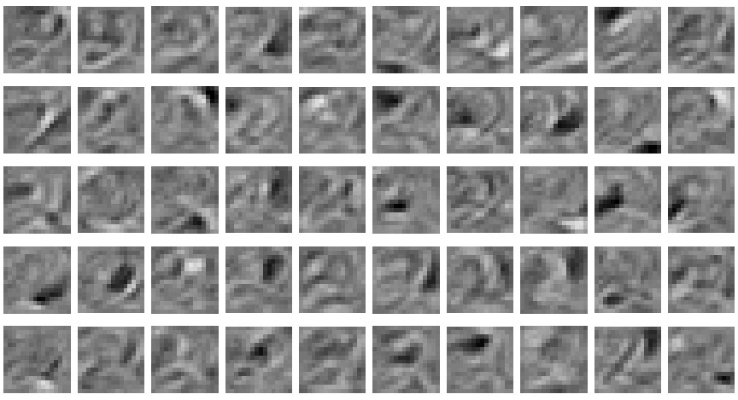

Slide 29
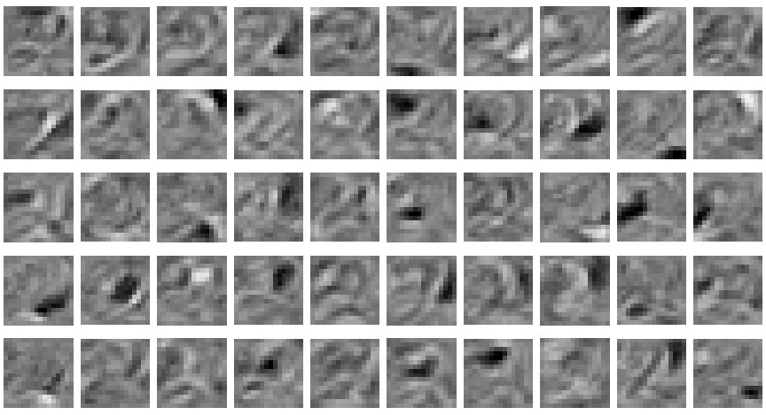

Slide 30
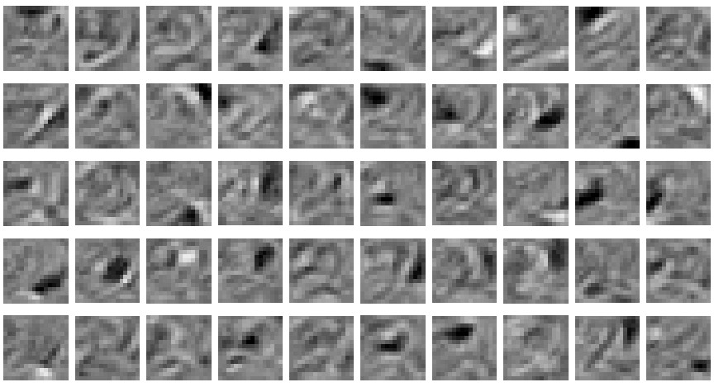

Slide 31
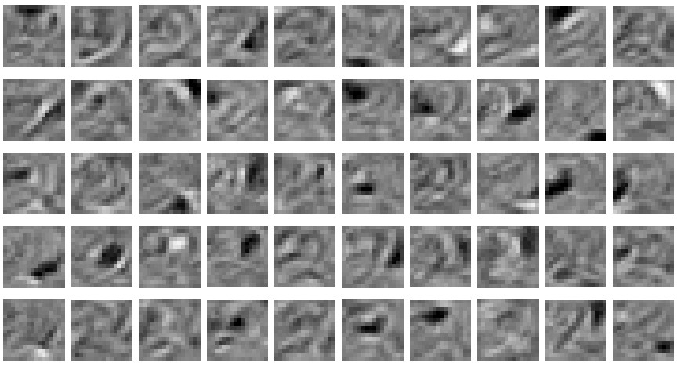
The final 50 x 256 weights
Each neuron grabs a different feature.

Slide 32
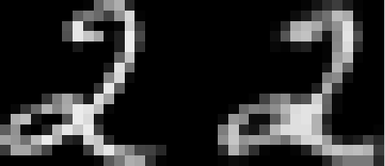
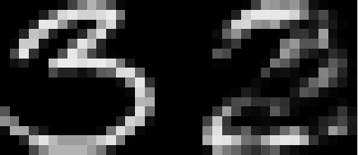
How well can we reconstruct the digit images from the binary feature activations?
Reconstruction from activated binary features
Reconstruction from activated binary features
Data
Data
New test images from the digit class that the model was trained on
Images from an unfamiliar digit class (the network tries to see every image as a 2)‏

Slide 33
Training a deep network
First train a layer of features that receive input directly from the pixels.
Then treat the activations of the trained features as if they were pixels and learn features of features in a second hidden layer.
It can be proved that each time we add another layer of features we get a better model of the set of training images.
  The proof is complicated. It uses variational free energy, a method that physicists use for analyzing non-equilibrium systems.
  But it is based on a neat equivalence (described later)‏

Slide 34
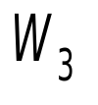


The generative model after learning 3 layers
To generate data:
  Get an equilibrium sample from the top-level RBM by performing alternating Gibbs sampling.
  Perform a top-down pass to get states for all the other layers.
So the lower level bottom-up connections are not part of the generative model. They are just used for inference.
h3
h2
h1
data

Slide 35
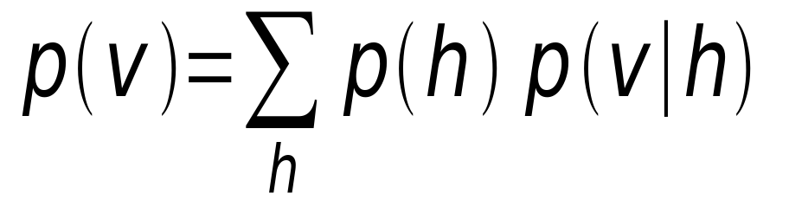
Why does greedy learning work?
The weights, W, in the bottom level RBM define p(v|h) and they also, indirectly, define p(h).
So we can express the RBM model as
If we leave p(v|h) alone and build a better model of p(h), we will improve p(v).
We need a better model of the aggregated posterior distribution over hidden vectors produced by applying W to the data.

Slide 36

What does each RBM achieve?
It divides the task of modeling the data into two tasks and leaves the second task to the next RBM
  Task 1: Learn generative weights that can convert the posterior distribution over the hidden units into the data.
  Task 2: Learn to model the posterior distribution over the hidden units that is produced by applying the transpose of the generative weights to the data
    Task 2 is guaranteed to be easier (for the next RBM) than modeling the original data.
h
v

Slide 37
A neural model of digit recognition
The top two layers form an associative memory whose energy landscape models the low dimensional manifolds of the digits.
The energy valleys have names
2000 top-level neurons
10 label neurons
500 neurons
The model learns to generate combinations of labels and images.
To perform recognition we start with a neutral state of the label units and do an up-pass from the image followed by a few iterations of the top-level associative memory.
500 neurons
28 x 28 pixel image

Slide 38
Fine-tuning with a contrastive divergence version of the wake-sleep algorithm
After learning many layers of features, we can fine-tune the features to improve generation.
1. Do a stochastic bottom-up pass
  Adjust the top-down weights to be good at reconstructing the feature activities in the layer below.
2. Do a few iterations of sampling in the top level RBM
  Use CD learning to improve the RBM
3. Do a stochastic top-down pass
  Adjust the bottom-up weights to be good at reconstructing the feature activities in the layer above.

Slide 39
Show the movie of the network generating digits
(available at www.cs.toronto/~hinton)‏

Slide 40
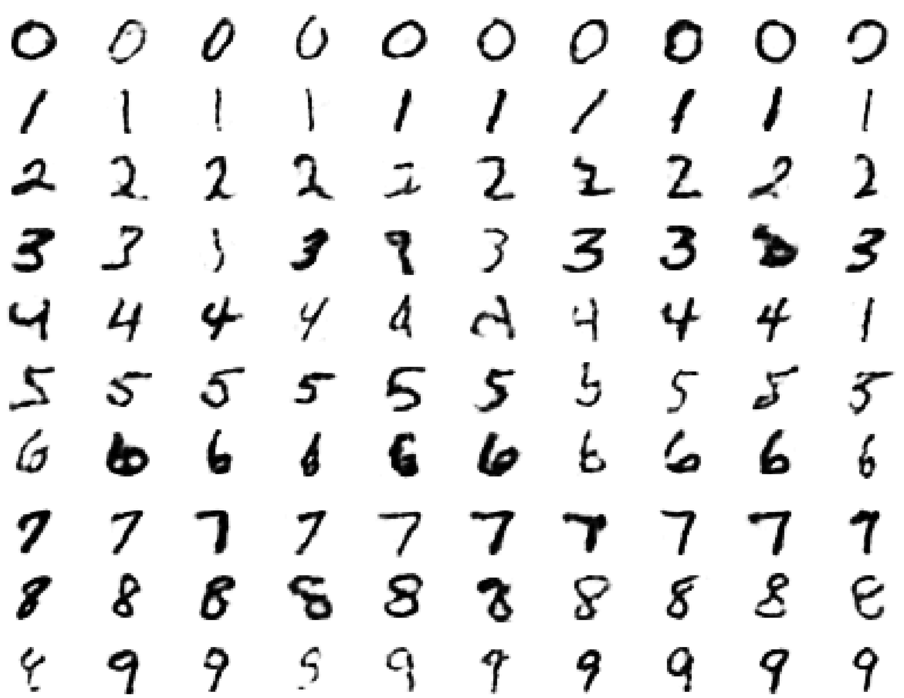
Samples generated by letting the associative memory run with one label clamped. There are 1000 iterations of alternating Gibbs sampling between samples.

Slide 41



What goes on in its mind if we show it an image composed of random pixels and ask it to fantasize from there?
mind brain
2000 top-level neurons
10 label neurons
500 neurons
mind brain
500 neurons
mind brain
28 x 28 pixel image

Slide 42
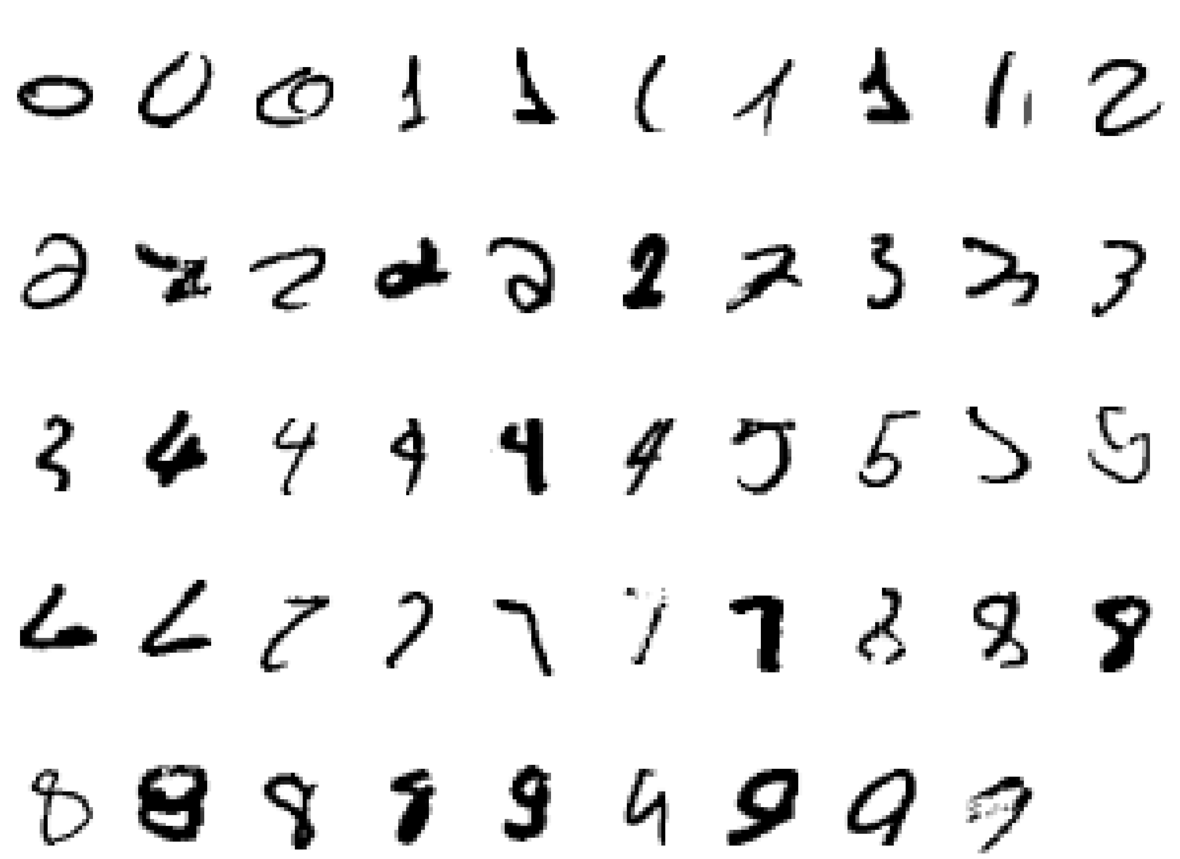
Examples of correctly recognized handwritten digits that the neural network had never seen before
Its very good

Slide 43
How well does it discriminate on MNIST test set with no extra information about geometric distortions?
Generative model based on RBM’s 1.25%
Support Vector Machine (Decoste et. al.) 1.4%
Backprop with 1000 hiddens (Platt) ~1.6%
Backprop with 500 -->300 hiddens ~1.6%
K-Nearest Neighbor ~ 3.3%
Its better than backprop and much more neurally plausible because the neurons only need to send one kind of signal, and the teacher can be another sensory input.

Slide 44
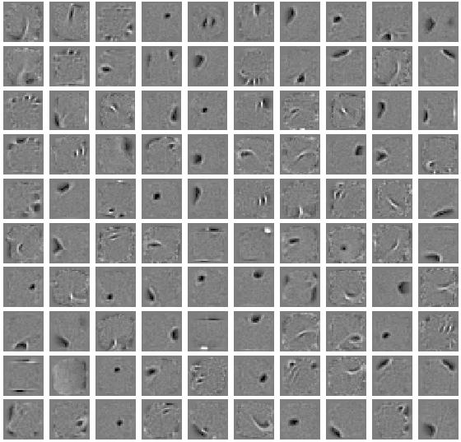
The features learned in the first hidden layer

Slide 45
Show the faces demo
(available at www.cs.toronto/~hinton)‏

Slide 46
Another view of why layer-by-layer learning works
There is an unexpected equivalence between RBM’s and directed networks with many layers that all use the same weights.
  This equivalence also gives insight into why contrastive divergence learning works.

Slide 47

An infinite sigmoid belief net that is equivalent to an RBM
etc.
h2
The distribution generated by this infinite directed net with replicated weights is the equilibrium distribution for a compatible pair of conditional distributions: p(v|h) and p(h|v) that are both defined by W
  A top-down pass of the directed net is exactly equivalent to letting a Restricted Boltzmann Machine settle to equilibrium.
  So this infinite directed net defines the same distribution as an RBM.
v2
h1
v1
h0
v0

Slide 48
Inference in a directed net with replicated weights
etc.
h2
The variables in h0 are conditionally independent given v0.
  Inference is trivial. We just multiply v0 by W transpose.
  The model above h0 implements a complementary prior.
  Multiplying v0 by W transpose gives the product of the likelihood term and the prior term.
Inference in the directed net is exactly equivalent to letting a Restricted Boltzmann Machine settle to equilibrium starting at the data.
v2
h1
v1
+
+
h0
+
+
v0

Slide 49
Learning a deep directed network
etc.
First learn with all the weights tied
  This is exactly equivalent to learning an RBM
  Contrastive divergence learning is equivalent to ignoring the small derivatives contributed by the tied weights between deeper layers.
h2
v2
h1
v1
h0
h0
v0
v0

Slide 50
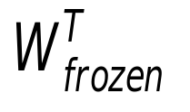
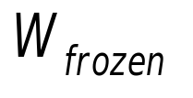
Then freeze the first layer of weights in both directions and learn the remaining weights (still tied together).
  This is equivalent to learning another RBM, using the aggregated posterior distribution of h0 as the data.
etc.
h2
v2
h1
v1
v1
h0
h0
v0

Slide 51
What happens when the weights in higher layers become different from the weights in the first layer?
The higher layers no longer implement a complementary prior.
  So performing inference using the frozen weights in the first layer is no longer correct.
  Using this incorrect inference procedure gives a variational lower bound on the log probability of the data.
    We lose by the slackness of the bound.
The higher layers learn a prior that is closer to the aggregated posterior distribution of the first hidden layer.
  This improves the network’s model of the data.
    Hinton, Osindero and Teh (2006) prove that this improvement is always bigger than the loss.

Slide 52
Using backpropagation for fine-tuning
Greedily learning one layer at a time scales well to really big networks, especially if we have locality in each layer.
We do not start backpropagation until we already have sensible weights that already do well at the task.
  So the initial gradients are sensible and backprop only needs to perform a local search.
Most of the information in the final weights comes from modeling the distribution of input vectors.
  The precious information in the labels is only used for the final fine-tuning. It slightly modifies the features. It does not need to discover features.

Slide 53
First, model the distribution of digit images
The top two layers form a restricted Boltzmann machine whose free energy landscape should model the low dimensional manifolds of the digits.
2000 units
500 units
The network learns a density model for unlabeled digit images. When we generate from the model we often get things that look like real digits of all classes.
But do the hidden features really help with digit discrimination?
Add 10 softmaxed units to the top and do backpropagation.
500 units
28 x 28 pixel image

Slide 54
Results on permutation-invariant MNIST task
Very carefully trained backprop net with 1.6% one or two hidden layers (Platt; Hinton)‏
SVM (Decoste & Schoelkopf) 1.4%
Generative model of joint density of 1.25% images and labels (+ generative fine-tuning)‏
Generative model of unlabelled digits 1.15% followed by gentle backpropagation

Slide 55
Time series models
Inference is difficult in directed models of time series if they are non-linear and they use distributed representations.
So people tend to avoid distributed representations and use exponentially weaker methods (HMM’s) that are based on the idea that each visible frame of data has a single hidden cause
  During generation from an HMM, each frame comes from one hidden state of the HMM

Slide 56

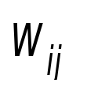

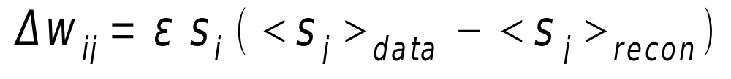
A conditional RBM model (Sutskever, Taylor)
Given the current and previous data, the hidden units at time t are conditionally independent.
  So online inference is very easy.
  Generation from a learned model requires alternating Gibbs sampling but typically converges rapidly.
Learning can be done by using contrastive divergence.
  Reconstruct the data at time t from the inferred states of the hidden units.
  The temporal connections between hiddens can be learned as if they were additional biases
t
t-2 t-1 t

Slide 57
A hierarchical version
Hierarchical versions can be trained one layer at a time.
  This is a major advantage of CRBM’s.
The hierarchical versions are directed at all but the top two layers.
They work well for generation and for filtering out nasty noise from image sequences.

Slide 58
An application to modeling motion capture data
Human motion can be captured by placing reflective markers on the joints and then using lots of infrared cameras to track the 3-D positions of the markers.
The 3-D positions of the markers can be converted into a frame of data containing:
  all the joint angles
  3 variables for the translation of the pelvis
  3 variables for the orientation of the pelvis

Slide 59
Modeling multiple types of motion
We can easily learn to model walking and running in a single model.
This means we can share a lot of knowledge.
It also makes it much easier to learn nice transitions between walking and running.

Slide 60
Show Graham Taylor’s movies
(available via www.cs.toronto/~hinton)‏

Slide 61
Summary so far
Restricted Boltzmann Machines provide a simple way to learn a layer of features without any supervision.
Many layers of representation can be learned by treating the hidden states of one RBM as the visible data for training the next RBM (a composition of experts).
This creates good generative models that can then be fine-tuned.
  Backpropagation can fine-tune discrimination.
  Contrastive wake-sleep can fine-tune generation.
The same ideas can be applied to high-dimensional sequential data.

Slide 62
Deep Autoencoders
(Ruslan Salakhutdinov)‏
28x28
1000 neurons
They always looked like a really nice way to do non-linear dimensionality reduction:
  But it is very difficult to optimize deep autoencoders using backpropagation.
We now have a much better way to optimize them:
  First train a stack of 4 RBM’s
  Then “unroll” them.
  Then fine-tune with backprop.
500 neurons
250 neurons
30
250 neurons
500 neurons
1000 neurons
28x28

Slide 63
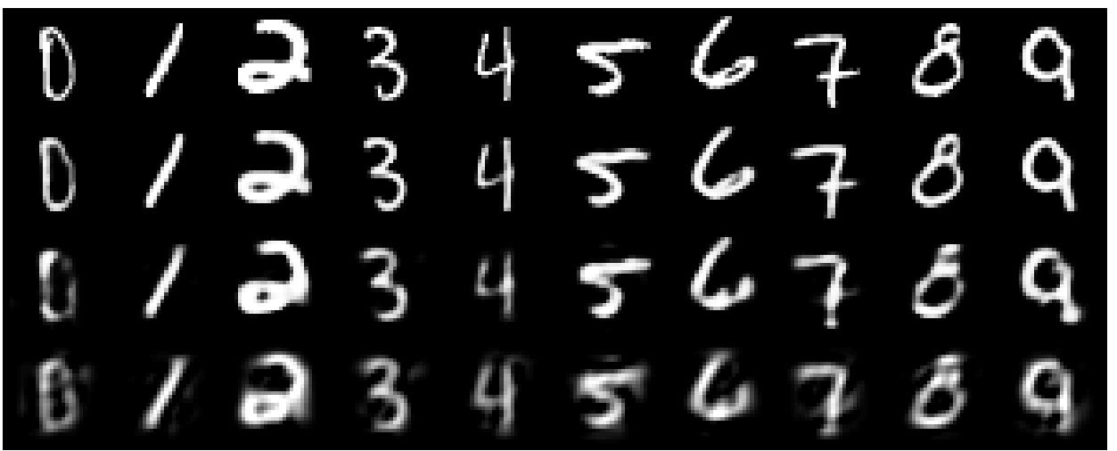
A comparison of methods for compressing digit images to 30 real numbers.
real data
30-D deep auto
30-D logistic PCA
30-D PCA

Slide 64
Do the 30-D codes found by the autoencoder preserve the class structure of the data?
Take the 30-D activity patterns in the code layer and display them in 2-D using a new form of non-linear multi-dimensional scaling (UNI-SNE)‏
Will the learning find the natural classes?

Slide 65
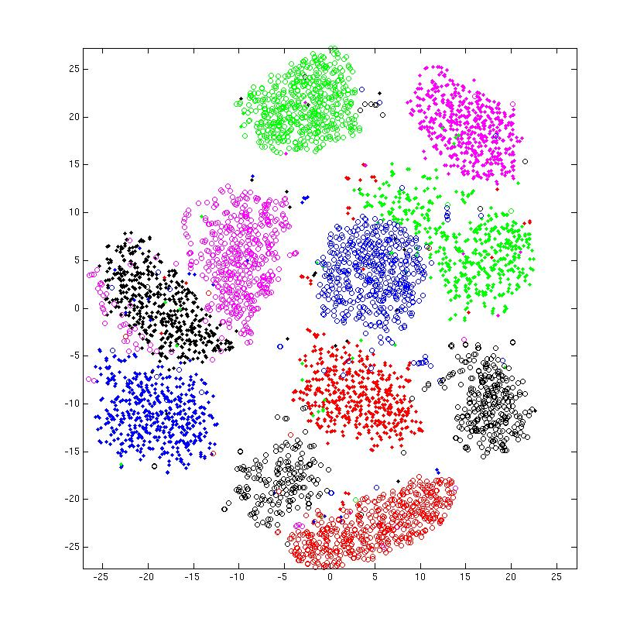
entirely unsupervised except for the colors

Slide 66
How to compress document count vectors
output vector
2000 reconstructed counts
500 neurons
We train the autoencoder to reproduce its input vector as its output
This forces it to compress as much information as possible into the 2 real numbers in the central bottleneck.
These 2 numbers are then a good way to visualize documents.
250 neurons
2
250 neurons
500 neurons
2000 word counts
Input vector uses Poisson units

Slide 67
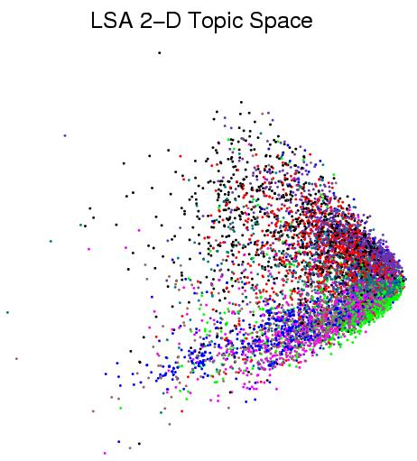
First compress all documents to 2 numbers using a type of PCA Then use different colors for different document categories

Slide 68
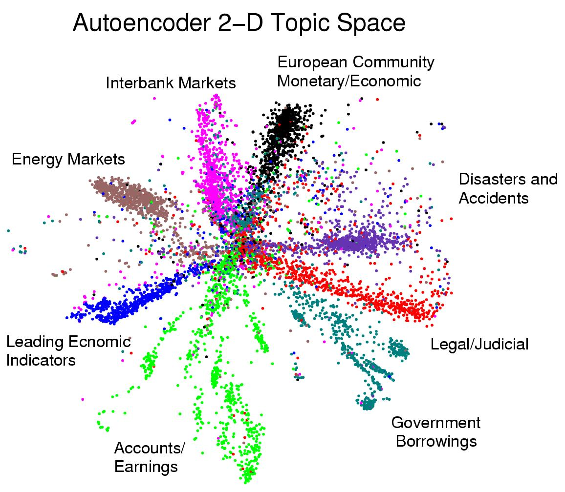
First compress all documents to 2 numbers. Then use different colors for different document categories

Slide 69
The fastest possible way to find similar documents
Given a query document, how long does it take to find a shortlist of 10,000 similar documents in a set of one billion documents?
  Would you be happy with one millesecond?

Slide 70
Finding binary codes for documents
2000 reconstructed counts
Train an auto-encoder using 30 logistic units for the code layer.
During the fine-tuning stage, add noise to the inputs to the code units.
  The “noise” vector for each training case is fixed. So we still get a deterministic gradient.
  The noise forces their activities to become bimodal in order to resist the effects of the noise.
  Then we simply round the activities of the 30 code units to 1 or 0.
500 neurons
250 neurons
30
noise
250 neurons
500 neurons
2000 word counts

Slide 71
Making address space semantic
At each 30-bit address, put a pointer to all the documents that have that address.
Given the 30-bit code of a query document, we can perform bit-operations to find all similar binary codes.
  Then we can just look at those addresses to get the similar documents.
  The “search” time is independent of the size of the document set and linear in the size of the shortlist.
Using an autoencoder we can design a hash-function that finds approximate matches

Slide 72
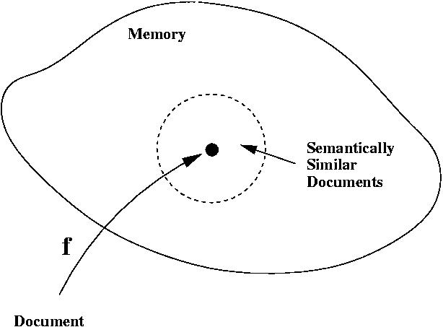
A hash-function for finding approximate matches
hash function

Slide 73
How good is a shortlist found this way?
We have only implemented it for a million documents with 20-bit codes --- but what could possibly go wrong?
  A 20-D hypercube allows us to capture enough of the similarity structure of our document set.
The shortlist found using binary codes actually improves the precision-recall curves of TF-IDF.
  Locality sensitive hashing (the fastest other method) is 50 times slower and always performs worse than TF-IDF alone.

Slide 74
THE END

Slide 75
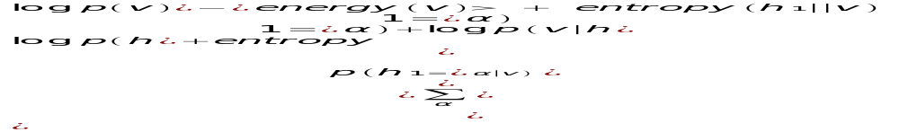
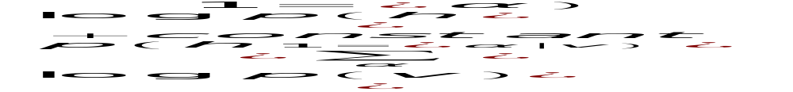


Why the hidden configurations should be treated as data when learning the next layer of weights
After learning the first layer of weights:
If we freeze the generative weights that define the likelihood term and the recognition weights that define the distribution over hidden configurations, we get:
Maximizing the RHS is equivalent to maximizing the log prob of “data” that occurs with probability
If we start the second level RBM at the learned weights of the first level RBM we cannot lose.

Slide 76
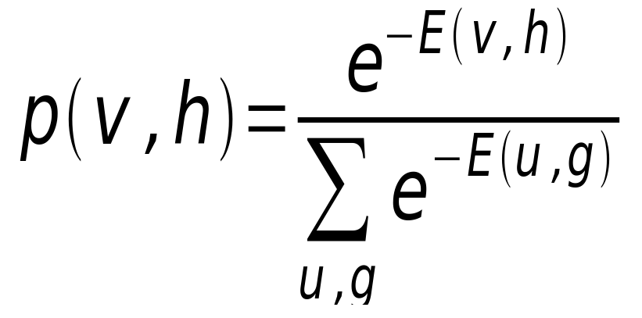
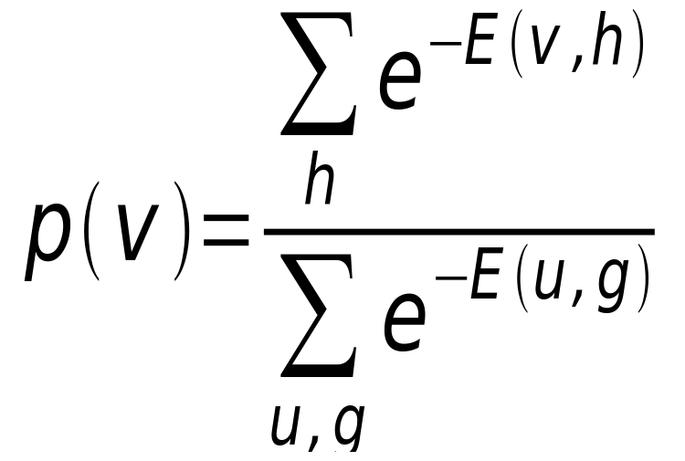
Using energies to define probabilities
The probability of a joint configuration over both visible and hidden units depends on the energy of that joint configuration compared with the energy of all other joint configurations.
The probability of a configuration of the visible units is the sum of the probabilities of all the joint configurations that contain it.
partition function

Slide 77
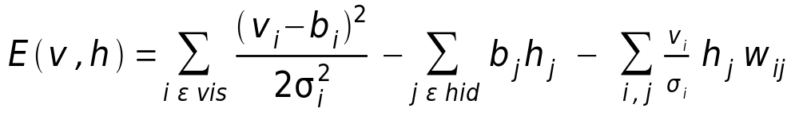
An RBM with real-valued visible units
In a mean-field logistic unit, the total input provides a linear energy-gradient and the negative entropy provides a containment function with fixed curvature. So it is impossible for the value 0.7 to have much lower free energy than both 0.8 and 0.6. This is no good for modeling real-valued data.
Using Gaussian visible units we can get much sharper predictions and alternating Gibbs sampling is still easy, though learning is slower.
F→
energy
- entropy
0 output-> 1

Slide 78
The non-linearity used for reconstructing bags of words
Divide the counts in a bag of words vector by N, where N is the total number of non-stop words in the document.
  The resulting probability vector gives the probability of getting a particular word if we pick a non-stop word at random from the document.
At the output of the autoencoder, we use a softmax.
  The probability vector defines the desired outputs of the softmax.
When we train the first RBM in the stack we use the same trick.
  We treat the word counts as probabilities, but we make the visible to hidden weights N times bigger than the hidden to visible because we have N observations from the probability distribution.

Slide 79
Performance of the autoencoder at document retrieval
Train on bags of 2000 words for 400,000 training cases of business documents.
  First train a stack of RBM’s. Then fine-tune with backprop.
Test on a separate 400,000 documents.
  Pick one test document as a query. Rank order all the other test documents by using the cosine of the angle between codes.
  Repeat this using each of the 400,000 test documents as the query (requires 0.16 trillion comparisons).
Plot the number of retrieved documents against the proportion that are in the same hand-labeled class as the query document. Compare with LSA (a version of PCA).

Slide 80
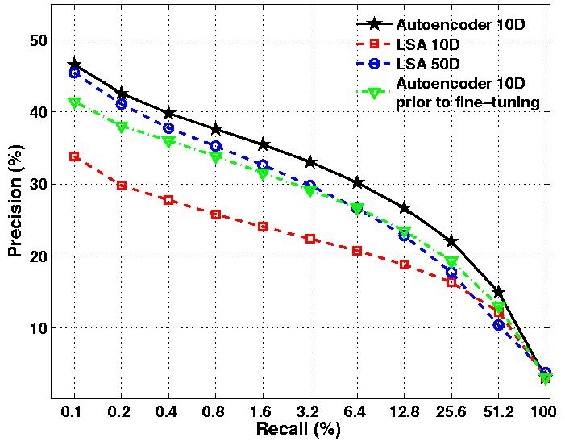
Proportion of retrieved documents in same class as query
Number of documents retrieved

