Slide 1
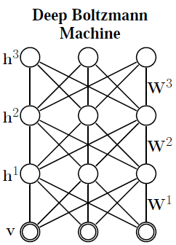
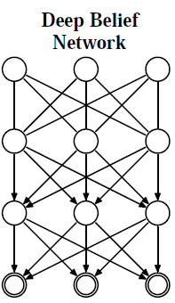
3 Deep Boltzmann Machine

Slide 2


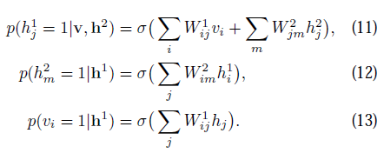
3 Deep Boltzmann Machine

Slide 3
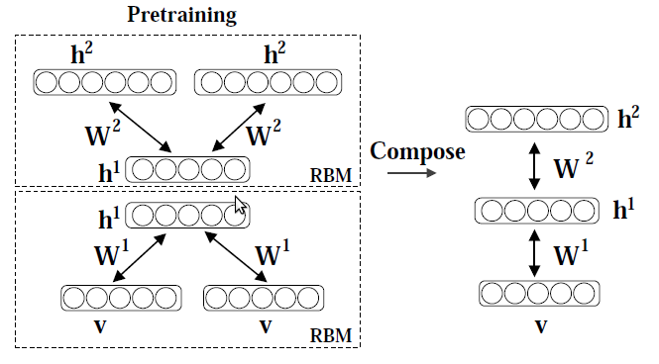

Slide 4
3.1 Greedy Layerwise
Pretraining of DBM

Slide 5

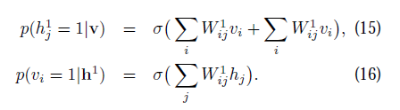
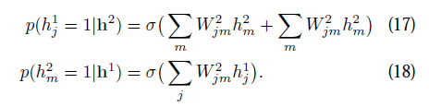

3.1 Greedy Layerwise
Pretraining of DBM

Slide 6
3.2 Evaluating DBM's
Annealesd Importance Sampling (AIS)
Inverse temperature
Markov chain transition operator
Inter mediate probability distributions
and

Slide 7
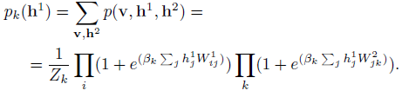
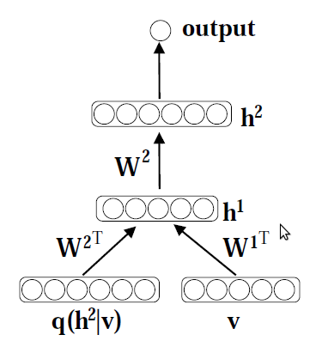
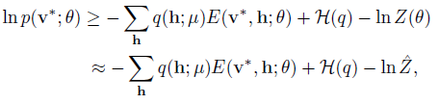
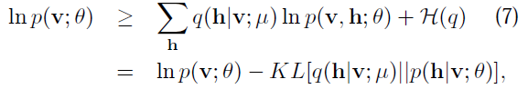
3.2 Evaluating DBM's

Slide 8
3.3 Discriminative
Fine-tuning of DBM's

Slide 9
AIS
BMの分配関数を評価

