Slide 1
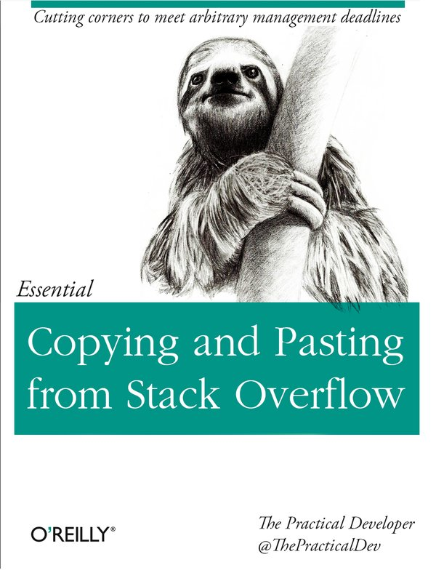
typescript

Slide 2
tsd
typescript definition manager
tsd init
  tsd.json
  tsd.d.ts
tsd query
tsd install

Slide 3
Importing AngularJS Into Typescript as AMD
Your /typings/tsd.d.ts file needs to contain references to all your dependencies:
  /// <reference path="./jquery/jquery.d.ts"/>
  /// <reference path="./angular/angular.d.ts"/>
Try with the old syntax for import with
  import $ = require("jquery");
  export export = A;
Many .d.ts files are not ready to work with the ES6 syntax maybe that is the problem
http://stackoverflow.com/questions/32770119/importing-angularjs-into-typescript-as-amd

Slide 4
typings
tsd が非推奨
typingsが代替として薦められている
From TSD to Typings
  typings --ambient
  /// <reference path=”./typings/tsd.d.ts” />
  /// <reference path=”./typings/main.d.ts” />
TSD doesn't support new syntax
Try with the old syntax for import with
  import $ = require(“jquery”);
https://github.com/DefinitelyTyped/tsd/issues/269

Slide 5
typings
install from jspm
some library contain .d.ts in their repository
typings install rx=file:jspm_package/...

Slide 6
Remove `browser.d.ts` #151
General issues
Everytime there is a typings install it will overwrite browser.d.ts / main.d.ts anyways and that puts them back in step one.
It is unclear how the user would organize his codebase to effectively use main and browser side-by-side. And for the user that does manage that they can probably generate the browser.d.ts and main.d.ts themselves.
@oliverjanik
If you use files in tsconfig.json, then just include either typings/main.d.ts or typings/browser.d.ts.
If you use exclude, then exclude typings/browser and typings/browser.d.ts if you use main, or vice versa.
https://github.com/typings/typings/issues/151

Slide 7
Compile Options
-d generate correspoinding '.d.ts' file
-m specify module code generator
  commonjs
  system
  amd
  umd
-p Compile the project in the given directory
-w Run the compile in watch mode

Slide 8
Compile Options
--out Concatenate and emit output
--sourceMap Generates corresponding '.map' file
--newLine
  Use the specified end of line sequene to be used who emitting files 'CRLF' or 'LF'
--noImplicitAny
  Raise error on expressions and declaration with an implied 'any' type
--noLib
  Do not include the default library file (lib.d.ts)
--noResolve
  Do not add triple-slash references or module import target to the list of command file
--noImplicitUserStrict
  Do not emit “use strict” directives in module output

Slide 9
tsconfig.json
no "files" property is present in a tsconfig.json
  the compiler defaults to including all TypeScript (*.ts or *.tsx) files in the containing directory and subdirectories.
"files" property is present
  only the specified files are included.
"exclude" property is specified
  the compiler includes all TypeScript (*.ts or *.tsx) files in the containing directory
  and subdirectories except for those files or folders that are excluded.
The "files" property cannot be used in conjunction with the "exclude" property.
  If both are specified then the "files" property takes precedence.
http://www.typescriptlang.org/docs/handbook/tsconfig.json.html

Slide 10
tsconfig.json
tsc foo.ts
When input files are specified on the command line, tsconfig.json files are ignored.
“out”
  create file
“outDir”
  out directory
“rootDir”
  TypeScript RootDir
“sourceRoot”

Slide 11
tsconfig.json
error TS2300: Duplicate identifier
{
  “exclude”: [
    “typings/browser.d.ts”,
    “typings/browser”,
    “node_modules”
  ]
}

Slide 12
typescript getting error TS2304: cannot find name ' require'
declare var require: any
tsd install node --save
/// <reference path=”typings/tsd.d.ts” />
http://stackoverflow.com/questions/31173738/typescript-getting-error-ts2304-cannot-find-name-require

Slide 13
Modules
Global Module
  File Module
External moduels
  import foo = require('foo');
  Tells the TypeScript compiler to look for an external module declaration of the form:
  declare module "foo" {
  /// Some variable declarations
  export var bar:number; /*sample*/
  }
  import foo = require('./foo');
  Tells the TypeScript compiler to look for a TypeScript file
  at the relative location ./foo.ts or ./foo.d.ts with respect to the current file.
https://basarat.gitbooks.io/typescript/content/docs/project/modules.html

Slide 14
Compiler Module Option
import foo = require('foo');
will generate different JS based on the compiler module option
  --module commonjs
  --module amd
  --module system
Personal recommendation:
  --module commonjs
  frontend webpack

Slide 15
import
import foo = require('./foo');
  tell the typescript compiler to look for a typescript file at the relative location.
import foo = require('foo');
  Compiler module option
  Import type only the following statement
dive into typescript

Slide 16
Typescript error TS1110 & TS1005
TypeScript error: typings/node/node.d.ts(83,23): Error TS1110: Type expected. TypeScript error: typings/node/node.d.ts(1830,52): Error TS1005: '=' expected.
TypeScript compilation breaks on node.d.ts, I have tried reinstalling node.d.ts to no avail.
I had this same error when I was using typescript version 1.7.3 with node 5.0.0
I upgraded to the latest typescript, 1.8.9, and the above errors disappeared.
The hint was in node.d.ts#17:
// compat for TypeScript 1.8

Slide 17
lib.d.ts

Slide 18
Typescript, confusing “duplicate identifier” error message
ode_modules/typescript/bin/lib.core.d.ts(83,5): error TS2300: Duplicate identifier 'configurable'.
node_modules/typescript/bin/lib.core.d.ts(84,5): error TS2300: Duplicate identifier 'enumerable'.
node_modules/typescript/bin/lib.core.d.ts(85,5): error TS2300: Duplicate identifier 'value'.
node_modules/typescript/bin/lib.core.d.ts(86,5): error TS2300: Duplicate identifier 'writable'.

