Slide 1
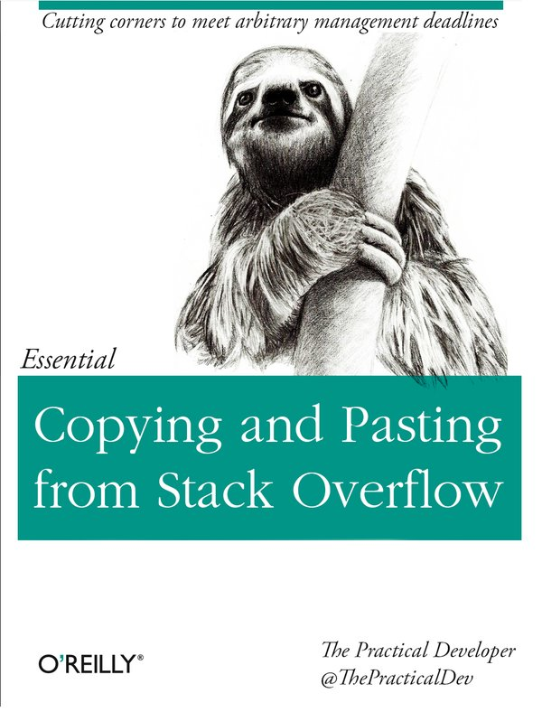
node.js入門

Slide 2
n
  node version management
npm cache clean
npm update -g
npm --save
npm --save-dev

Slide 3
npm install
  global install
    {prefix}/lib/node_modules
    {prefix}/bin
    usually {prefix} = /usr/local
    man page {prefix}/share/man
  local install
How to check for global install directory?
  npm config get prefix
  npm bin -g

Slide 4
Error: EACCESS, mkdir '/usr/lib/...'
sudo npm install -g
chown -R `whoami` /usr/local
npm config set prefix '~/.npm-package'
.bashrc
  export PATH=”$PATH:$HOME/.npm-packages/bin”

Slide 5
optionalDependencies
  if a dependency can be used,
  but you would like npm to proceed
  if it cannot be found or fails to install,
  then you may put it in the optionalDependencies object
peerDependencies
  In some cases, you want to express the compatibility of your package with a host tool or library, while not necessarity referred to as a plugin.
  Notably, your module may be exposing a specific interface,
  expected and specified by the host documentation.
log message
  supported/needed
  platform/cpu-arch

Slide 6
package manager
npm
  nested dependency tree
  node_modules/
  package.json
bower
  flat dependency tree
  bower_components/
  bower.json
JSPM
  flat dependency tree,
  which allows you to install multiple versions
  jspm_packages/
  config.js

Slide 7
module loader
CommonJS
  require('package');
  module.exports;
RequireJS
ES6 modules
global scripts

Slide 8
karma
karma.conf.js
if you omit the plugins property, it'll try to load all the plugins that are:
  Prefixed with karma-
  A sibling to the karma npm module
plugin
  karma-webpack

Slide 9
karma
karma-webpack
It doesn't load karma-webpack automatically.
Need to add 'plugins' property by myself
In addtion,
  require("karma-webpack"),
  require("karma-jasmine"),
  require("karma-phantomjs-launcher"),
Do Not Forget “,” after plugins: [] property

Slide 10
karma
Some question ask yourself
  Are you using a local version of karma or global version?
  Is everything up to date?
  If not try
    npm update
    npm uninstall && npm install
  Do you have global version of karma-x
  that are overriding the local ones?

Slide 11
karma
karma.conf.js
module.exports = function(config){
  config.set{
    files: [
      'node_modules/angular.js',
      'node_modules/angular-mocks/angular-mocks.js',
      //'src/*.js' should not include. remove it.
    ]
  })
}
angular-mocks.js

Slide 12
webpack.config.js
karma.conf.js
tsconfig.json

Slide 13
babel
  default = CommonJS
  Object.defineProperty(exports, “ esModule”, {
    value = true;
  });
  Not support on browser.
  Need to use Webpack or Browserify
.babelrc
  is shared between all tools which can't set their own configuration.
babel-loader
babel-preset-es2015

Slide 14
typescript
tsconfig.json
typings.json
tsd
  typescript definition manager for Definitely typed
  .d.ts

Slide 15
isparta
  Isparta is a code coverage tool for ES6 using babel.
istanbul
  a JS code coverage tool written in JS

Slide 16
webpack
webpack-dev-server

