Slide 1

How
we
will
rise

Slide 2

Overview
Background
About us
Our algorithm
Attack strategy
Other options
Needs
Simulation

Slide 3
Current situation
- Our goal: to be the first
- Google, Facebook etc. are beyond us
- How to tackle with this?

Slide 4

About us
- Cybersecurity
- Usually defensive
- Recent foundings in our lab allow another way of
thinking

Slide 5


Our algorithm
- A brand new formula :
- What can we achieve with this?

Slide 6

Attack strategy
- Algorithm deployment
- Sneaking it in the right place
- Legal concerns

Slide 7

Other options
- Worm-based attack (Stuxnet…)
- Hacking mercenary
- Physical attack

Slide 8
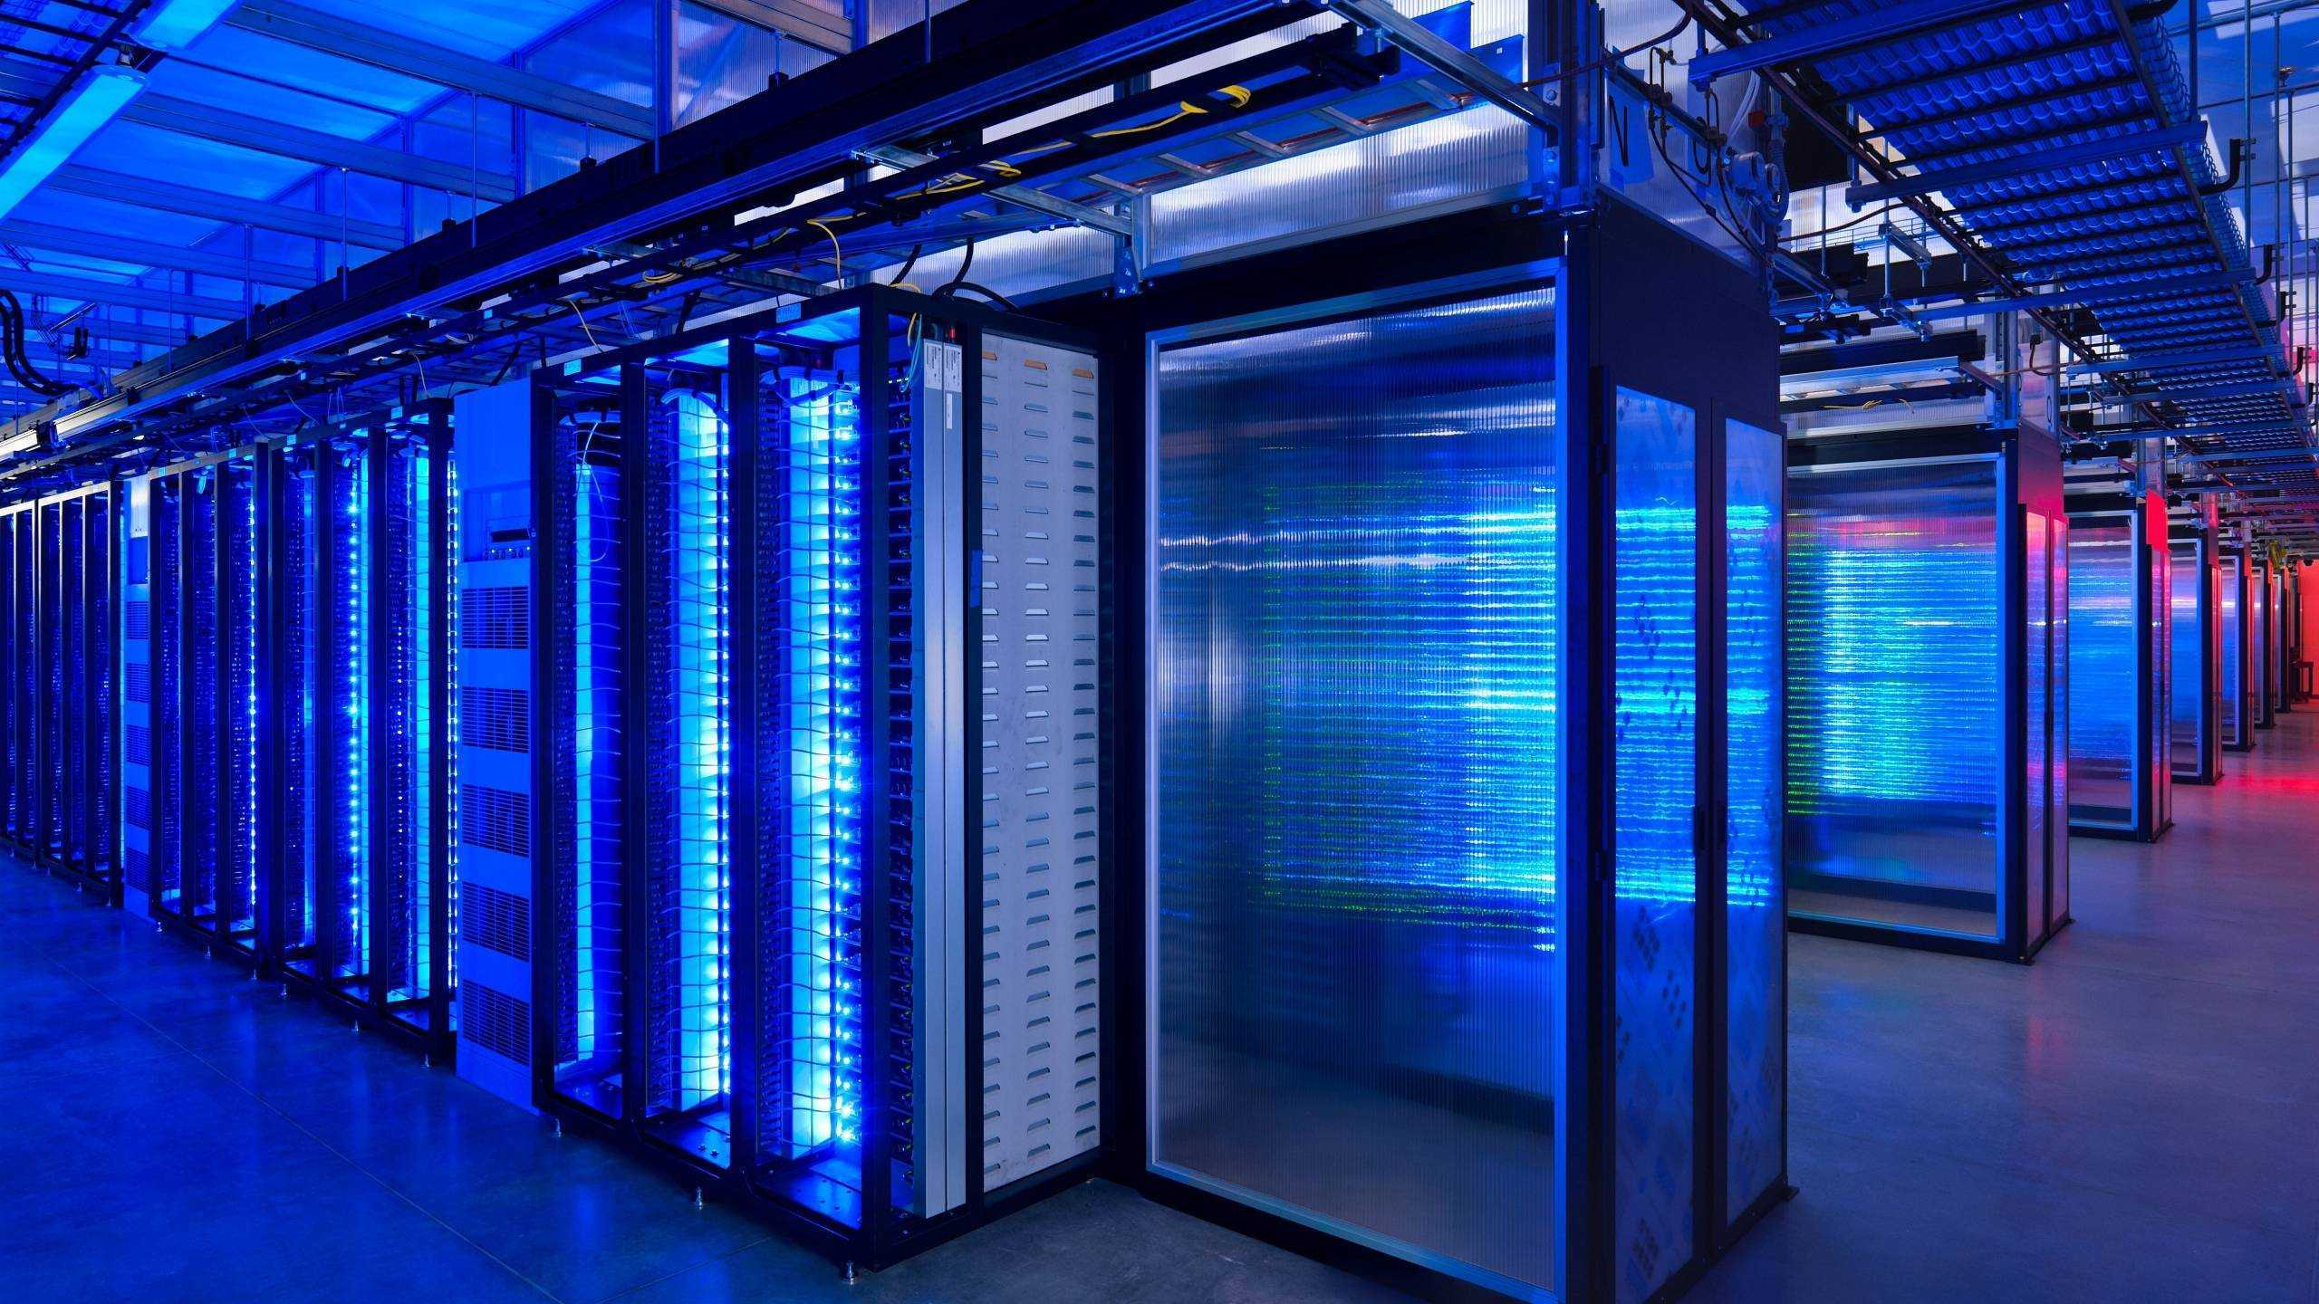
What we need
- Funds
- Development team
- Security

Slide 9

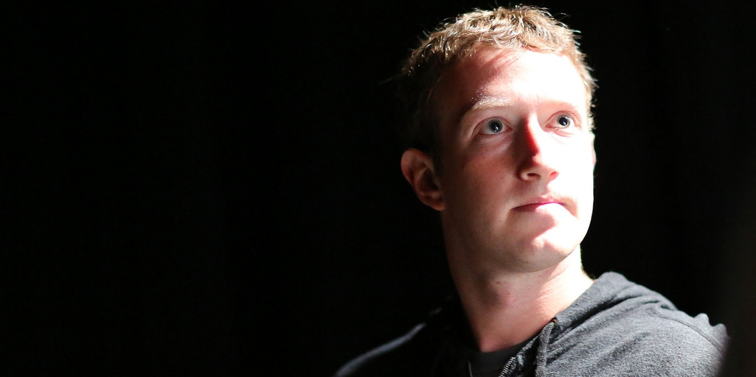
Simulation
Success
Blimey!
Time

