Slide 1

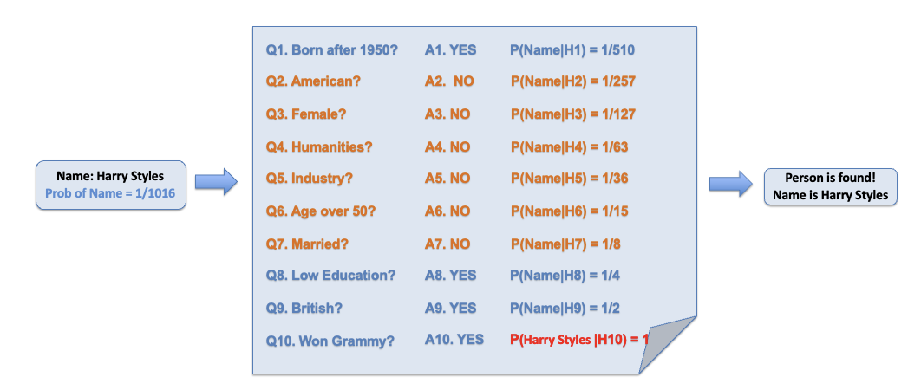
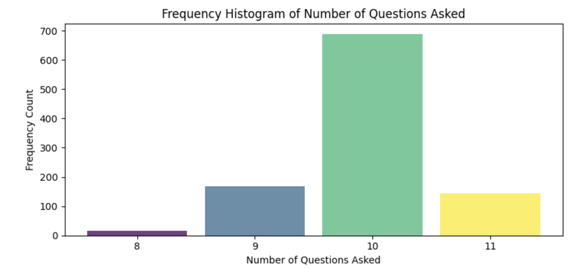
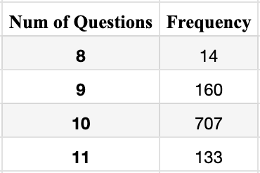
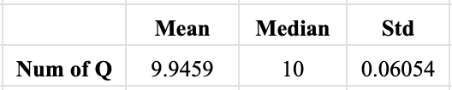
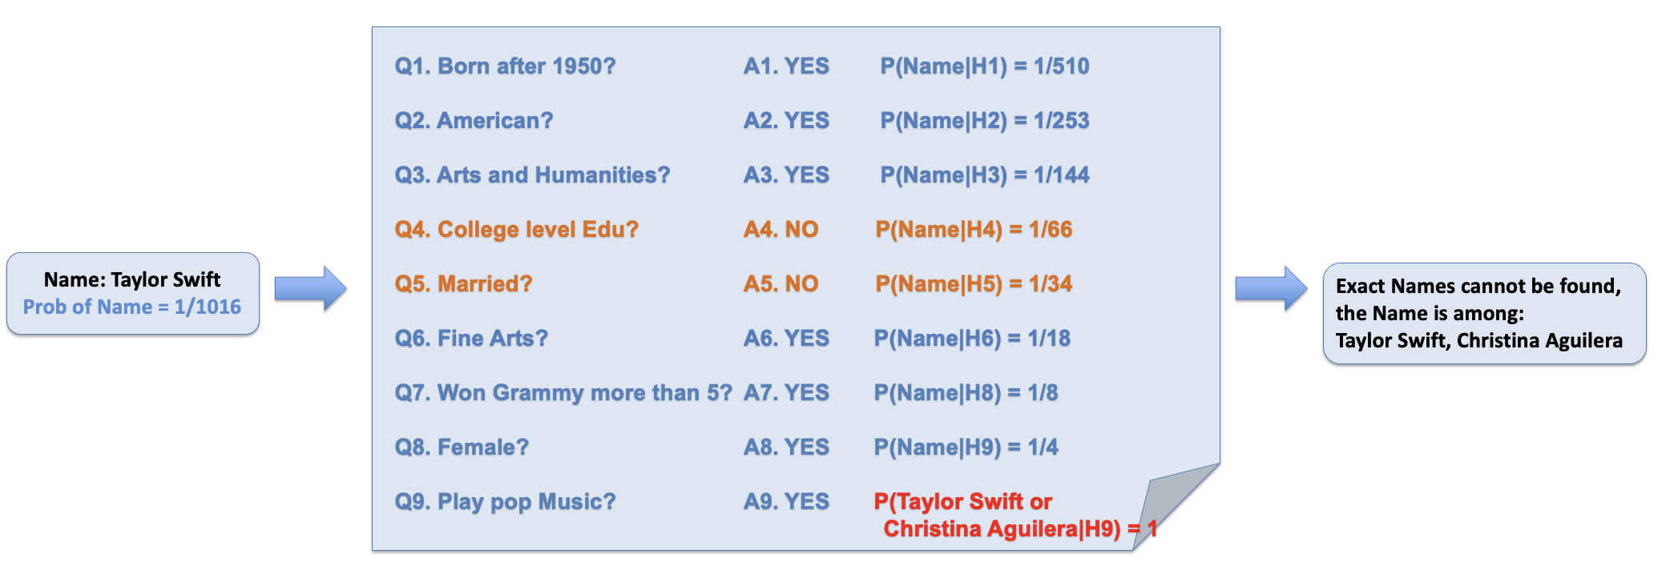
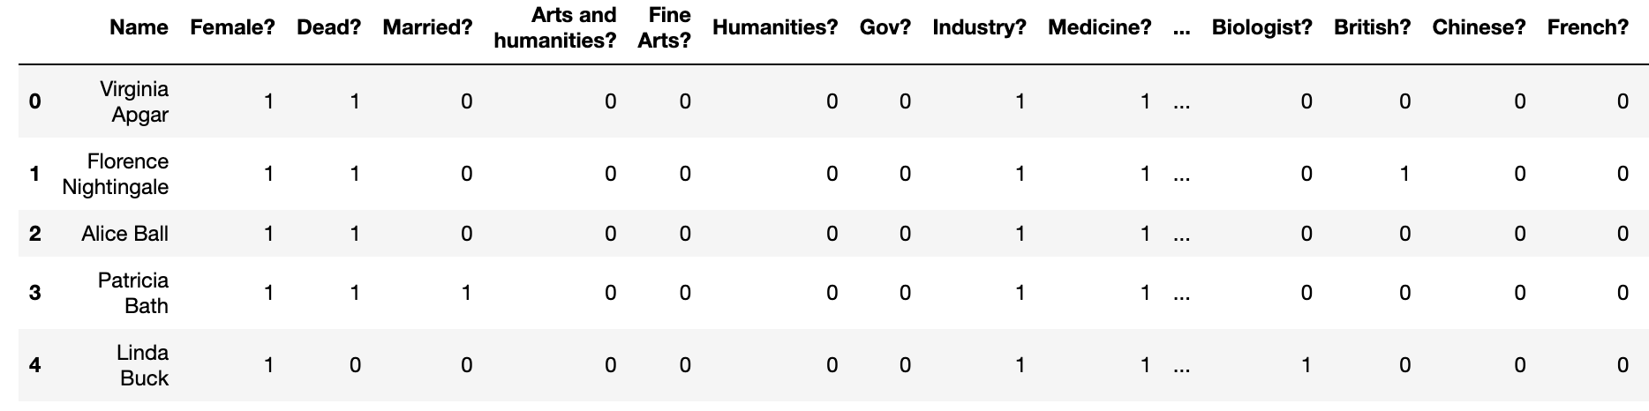
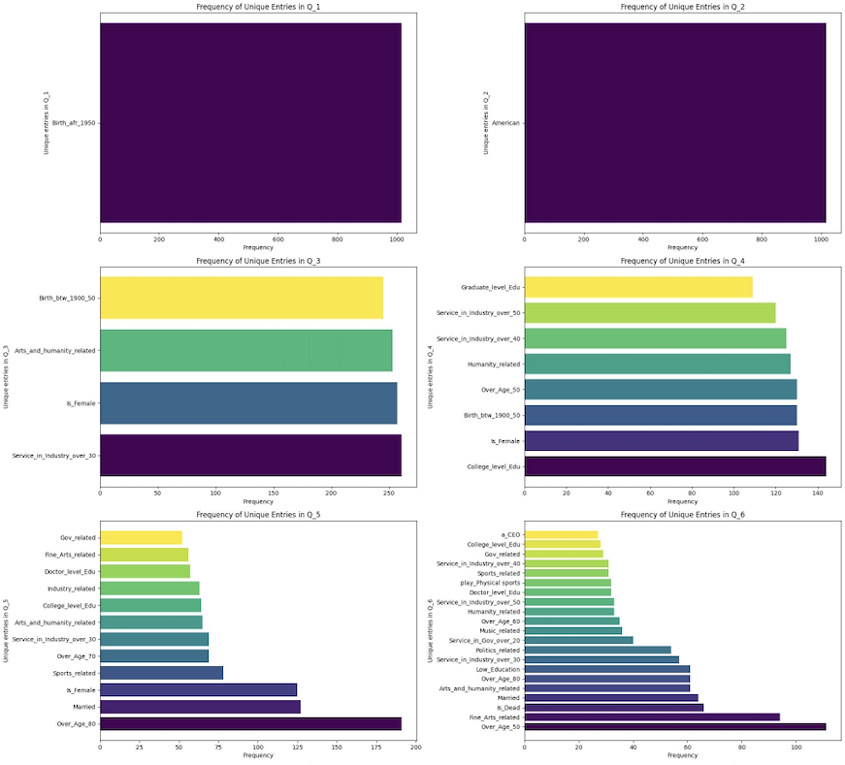
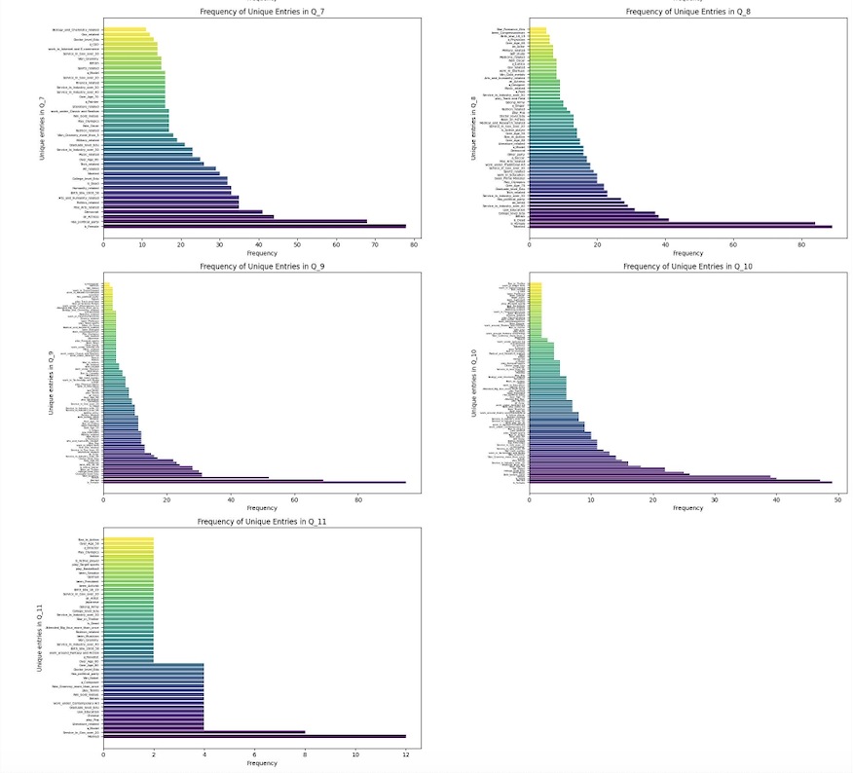
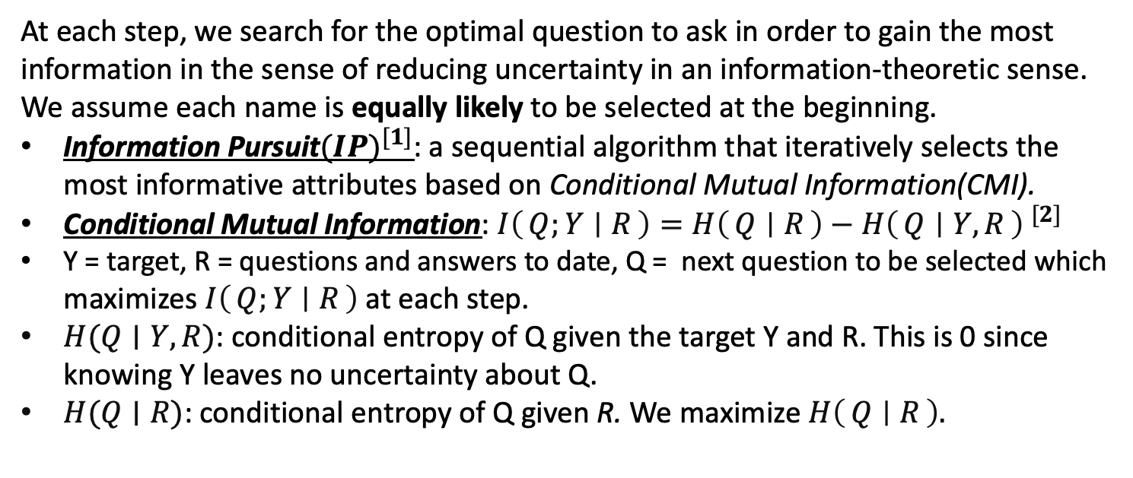
Optimal Search Strategies for the Parlor Game “20 Questions”
Jialin Guo Instructor: Prof. Donald Geman
Johns Hopkins University | Whiting School of Engineering | Baltimore, MD
Introduction
Results
“20 Questions” is a classical parlor game that is enjoyed by people of all ages. It is simple but very engaging. It is a guessing game between two players where one of them thinks of an object (which could be a person, a place, a concept) and the other player tries to guess the object by posing a series of “yes-no” questions to which the first player responds accurately.
In this project, the objects are names of “famous” people. The target person could be from any profession, dead or alive, etc., and is considered to be a well-known historical figure or celebrity. For example, Taylor Swift is a famous American singer. The series of “yes-no” questions are attributes of a person. For example: “Dead?”, “Female?”, “American?”, “Singer?” etc…
Objectives
Figure 3 – Number of QA Asked vs. Frequencies
Figure 4 – General Info of Number of QA
Create a strategy using as few questions as possible to identify the person that first player has in mind.
Build a representation of a question history to keep track of the narrowing process.
Develop a webpage for playing the game interactively, allowing players to play against each other.
Figure 2 – Sample Run Case 1
Discussion and Conclusion
All names and attributes collected by GPT4 are up to date as of 2022.
About 10% of the names have identical attribute entries; therefore, the model is not able to find the chosen name in these cases.
The use of IP Algorithm ensures that the strategy is efficient and dynamic. The population is always updated based on previous responses and selected next question\attributes accordingly.
The best questions are the ones that can partition the remaining populations into two almost even parts.(eg. Born after 1950?, Female?).
For about 67% of population, it takes about 10 questions to identify the names; and for about 16%, it takes 9 or 11 questions; for very few cases(about 1.6%), it takes only 8 questions.
Over 84% population use fewer than 10 questions.
Data Collections
Utilize recent Large Language Models GPT4 to generate a large list of famous people (1016 in our case) within 12 different categories (e.g., Music, Tech, Politics, Literature..) and collect the basic attributes (e.g., Gender, nationality, education) and specific descriptors (e.g., Profession, prize winning).
Represent the data as a large binary matrix with the rows indexed by Names (1016 rows), the columns indexed by attributes (146 cols), with entry “1” indicating that a person has the attribute, and “0” otherwise.
……
……
……
Figure 3 – Sample Run Case 2: Multiple Names
Future Direction
In this project, a uniform distribution was assumed over all names. As for future research, we can assign different weights to people due to their popularity based on frequencies of searches online.
Apply some generative models of neural networks in the process of finding optimal questions and compare the results with what we have now.
Figure 1 – Dataset(1016 rows × 146 columns)
Methods
At each step, we search for the optimal question to ask in order to gain the most information in the sense of reducing uncertainty in an information-theoretic sense. We assume each name is equally likely to be selected at the beginning.
Information Pursuit${(IP)}^{[1]}$: a sequential algorithm that iteratively selects the most informative attributes based on Conditional Mutual Information(CMI).
Conditional Mutual Information: ${I\left(Q;Y ∣ R\right)=H\left(Q ∣ R\right)−H\left(Q ∣ Y,R\right) }^{[2]}$
Y = target, R = questions and answers to date, Q = next question to be selected which maximizes $I\left(Q;Y ∣ R\right)$at each step.
$H(Q∣Y,R)$: conditional entropy of Q given the target Y and R. This is 0 since knowing Y leaves no uncertainty about Q.
$H(Q∣R)$: conditional entropy of Q given R. We maximize $H\left(Q ∣ R\right).$
Acknowledgment and Reference
Huge thanks to Prof. Geman for guiding the project and providing support during the entire Capstone experience. Thanks also to Aditya Chattopadhyay for providing help with codes and concepts, and to An Wang for providing suggestions to data collections.
[1] arXiv:2302.02876v2 [cs.LG]
[2] arXiv:2207.00938v2 [cs.CV]
Figure 5 – Distribution of Selected Attributes for Each Question

Slide 2
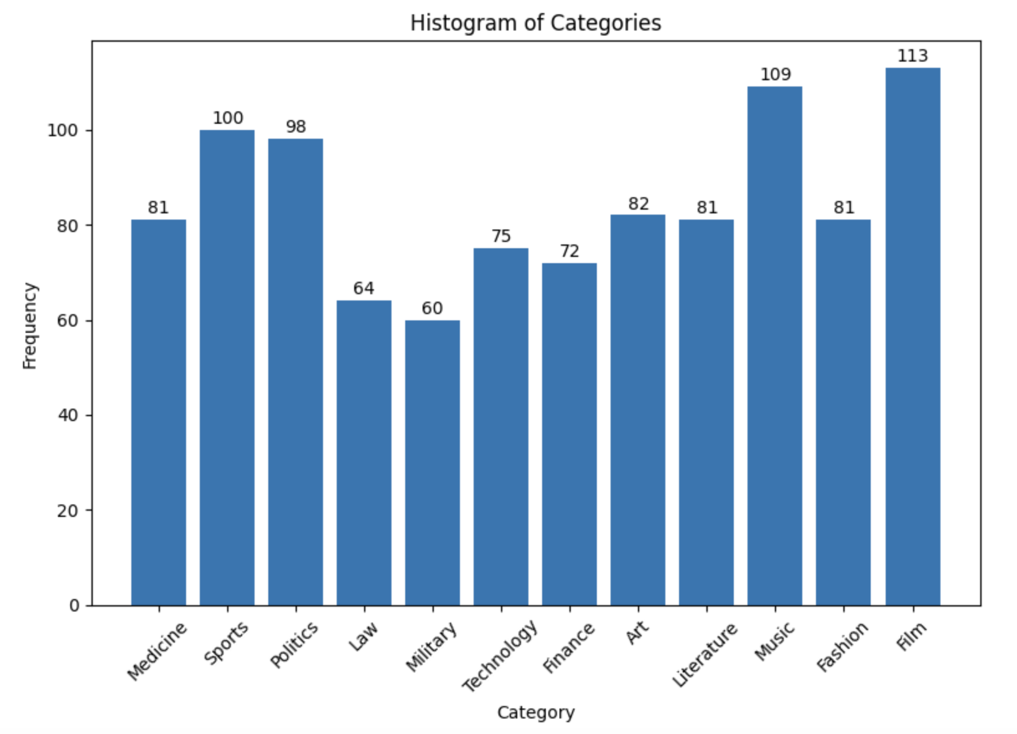
Category | Frequency
Medicine | 81
Sports | 100
Politics | 98
Law | 64
Military | 60
Technology | 75
Finance | 72
Art | 81
Literature | 82
Music | 109
Fashion | 81
Film | 113

Slide 3
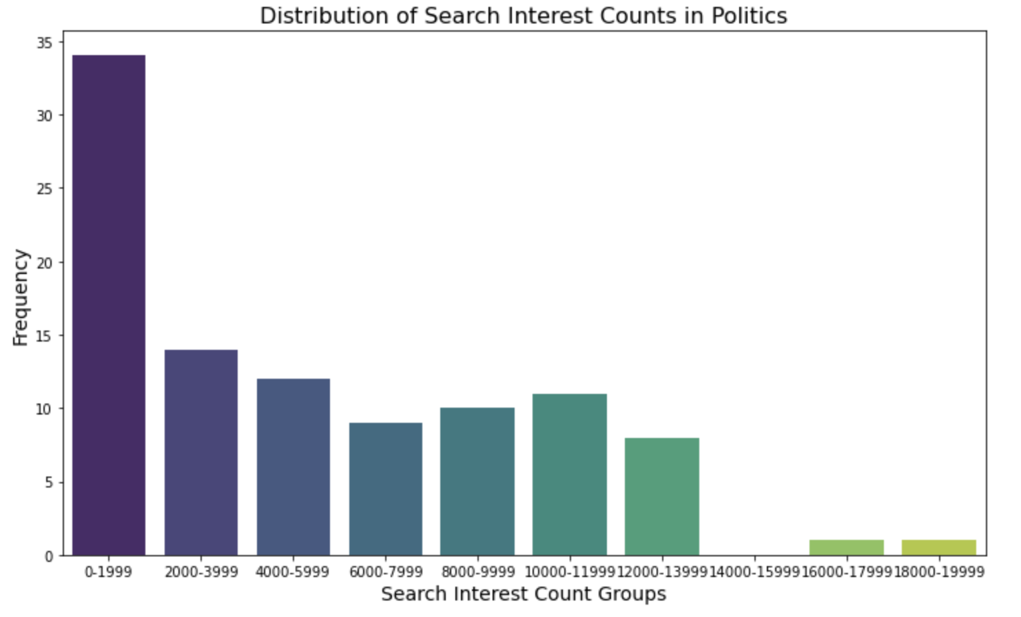
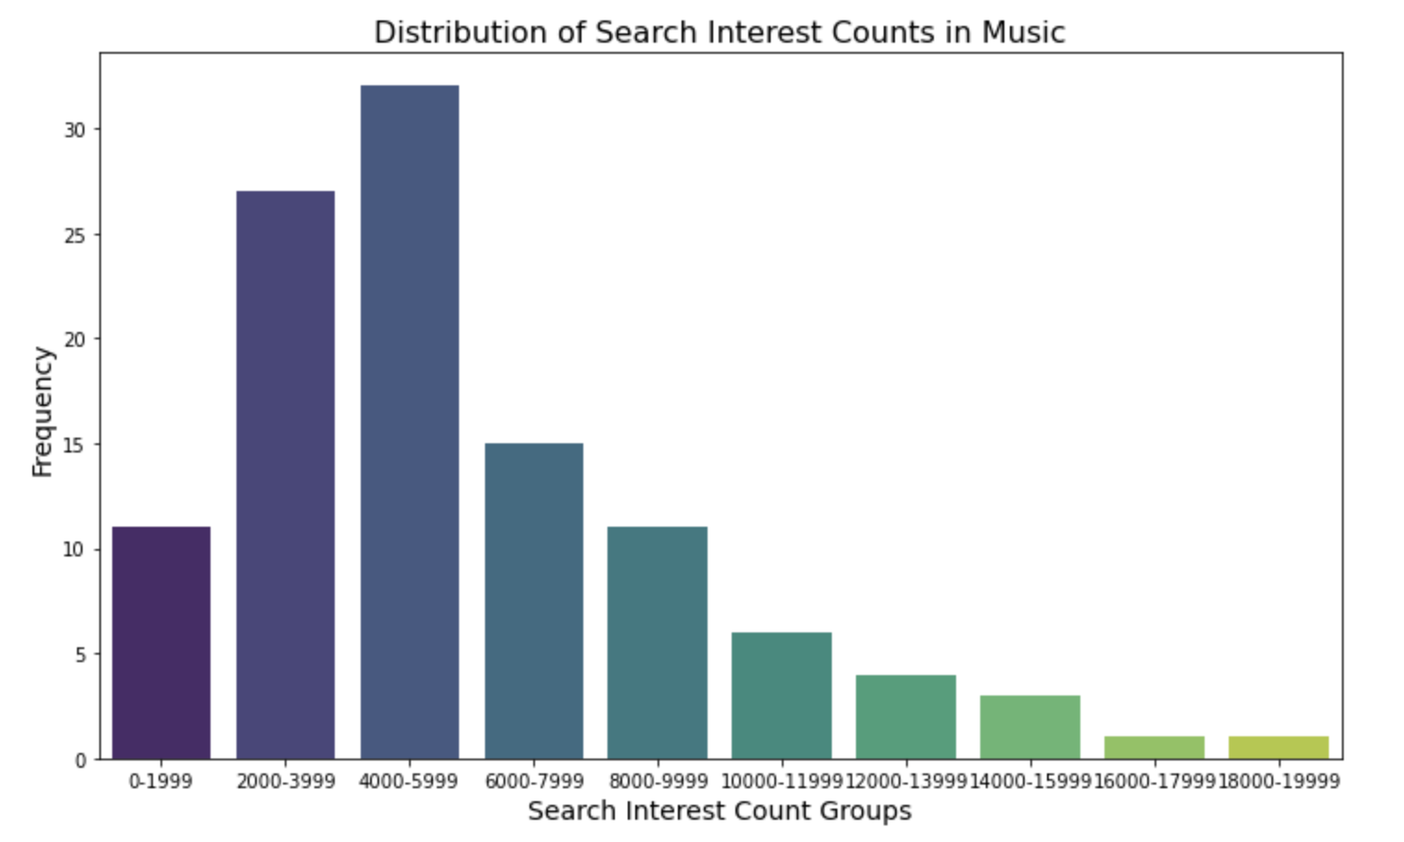

Slide 4
Profession
Tennis
Soccer
Wrestling
Racing
Beach Volleyball
Gymnastics
Track and Field
Basketball
Diving
Golf
Figure Skating
Badminton
Racquet sports
Profession
Racquet sports
Team sports
Physical sports
Physical sports
Team sports
Physical sports
Physical sports
Team sports
Target sports
Target sports
Physical sports
Racquet sports
Team sports
Physical sports
Target sports
Profession
Racquet sports
Team sports
Physical sports
Physical sports
Team sports
Physical sports
Physical sports
Team sports
Target sports
Target sports
Physical sports
Racquet sports
Racquet sports?
1
0
0
0
0
0
0
0
0
0
0
1
Team sports?
0
1
0
0
1
0
0
1
0
0
0
0
Physical sports?
0
0
1
1
0
1
1
0
0
0
1
0
Target sports?
0
0
0
0
0
0
0
0
1
1
0
0

Slide 5
Attribute
Born After 1950?
Female?
American?
Dead?
Singer?
Arts and Humanities?
Music?
Fine Arts?
CMI
0.99
0.99
0.99
0.25
0.56
0.47
0.12
0.05
Best Question
Q1
Born After 1950?
A Name
A1
Yes
……
……
History
R
H1:(Q1,A1)
Q1
Born After 1950?
Continue Until
Attribute
Female?
American?
Dead?
Singer?
Arts and Humanities?
Music?
Fine Arts?
CMI
0.56
0.99
0
0.13
0.30
0
0
One Name
Or
No more Information
A1
Yes
……
……
……

