Slide 1
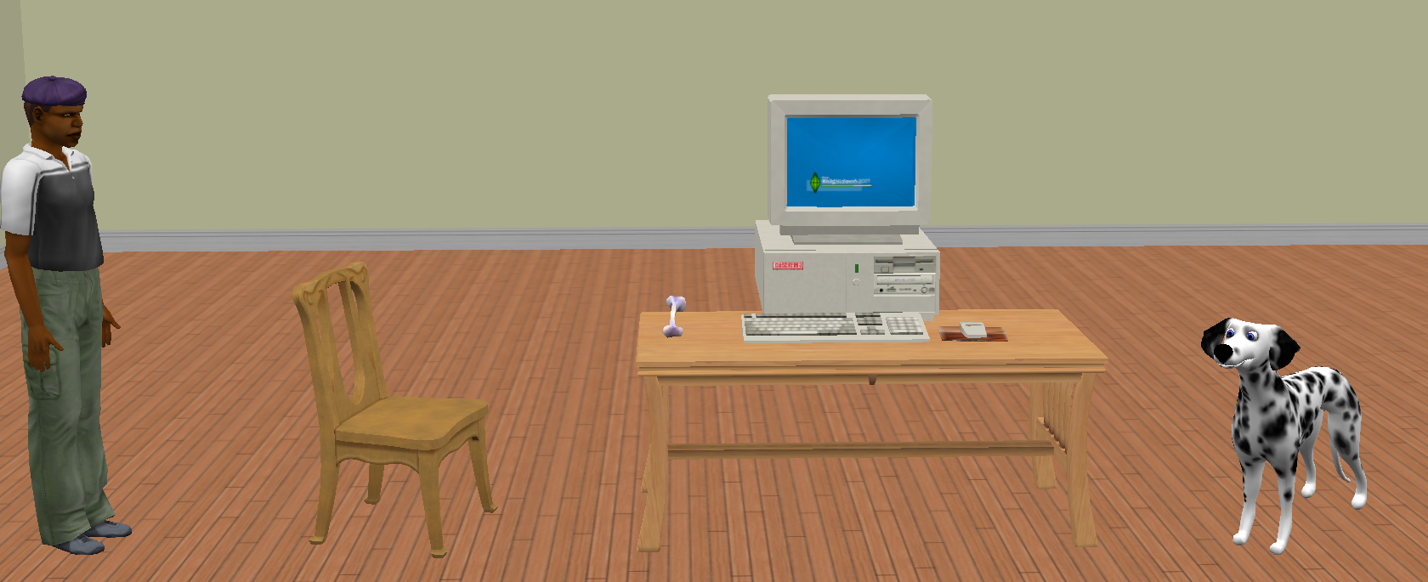
Lab2
Man turns to bone
Bone goes to man’s finger
Man moves to chair
Man calls the dog
Dog moves to the man
Dog turns around the man

