Slide 1
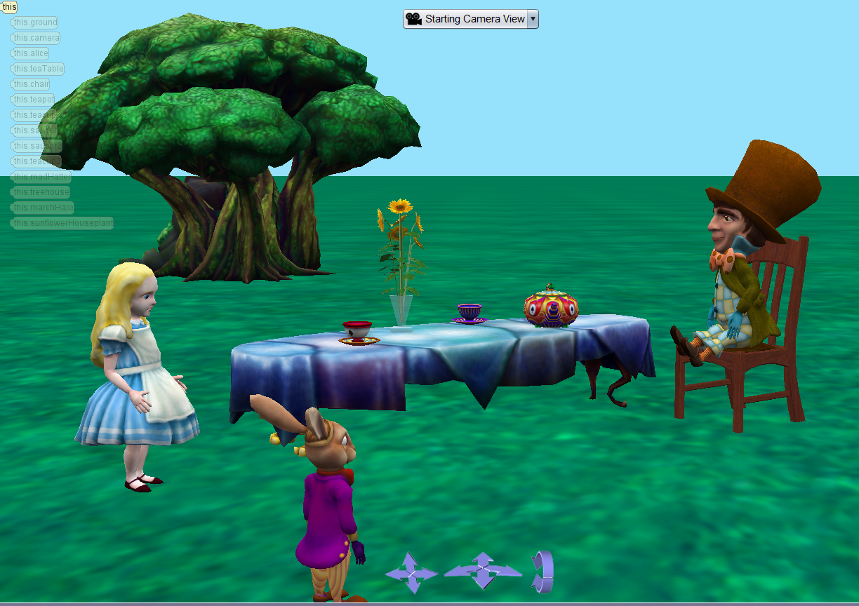
lab1
Alice turn to the table
There are flower, teapot, tea cups and saucers, on the table
There are big tree behind the table
The madHatter sits on the chair
marchHare stare the tea pot.
User the four screen views(top, side, front)

