Slide 1
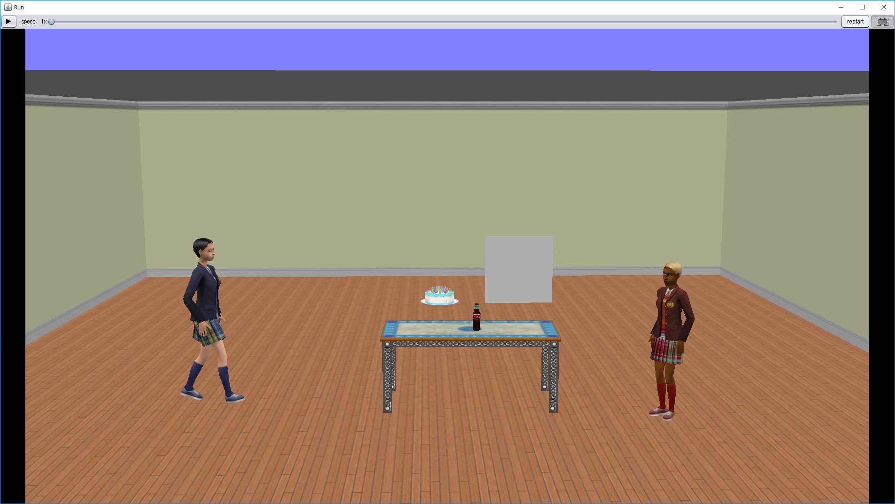
1.There are two person
2.One person walks to another person at this time one person keeps cookies
3.Suddenly, one person gives another person cookies
4. Compare two person’s height
5. Smaller person says “YOU are tall”
6. Smaller person grows tall
7. Compare two persons’ height again
8. Smaller person says “YOU are tall”
9. Smaller person turns around the table three times

