Slide 1
Histories and Futures of Technology
Explore Infinite Possibilities with Digital Me 2.0
Sally Bai

Slide 2
Contents
Theory Why I want to do it?
Research How can I do it?
Practice What did I create?

Slide 3


Part 1 – What if I get married with this guy?

Slide 4
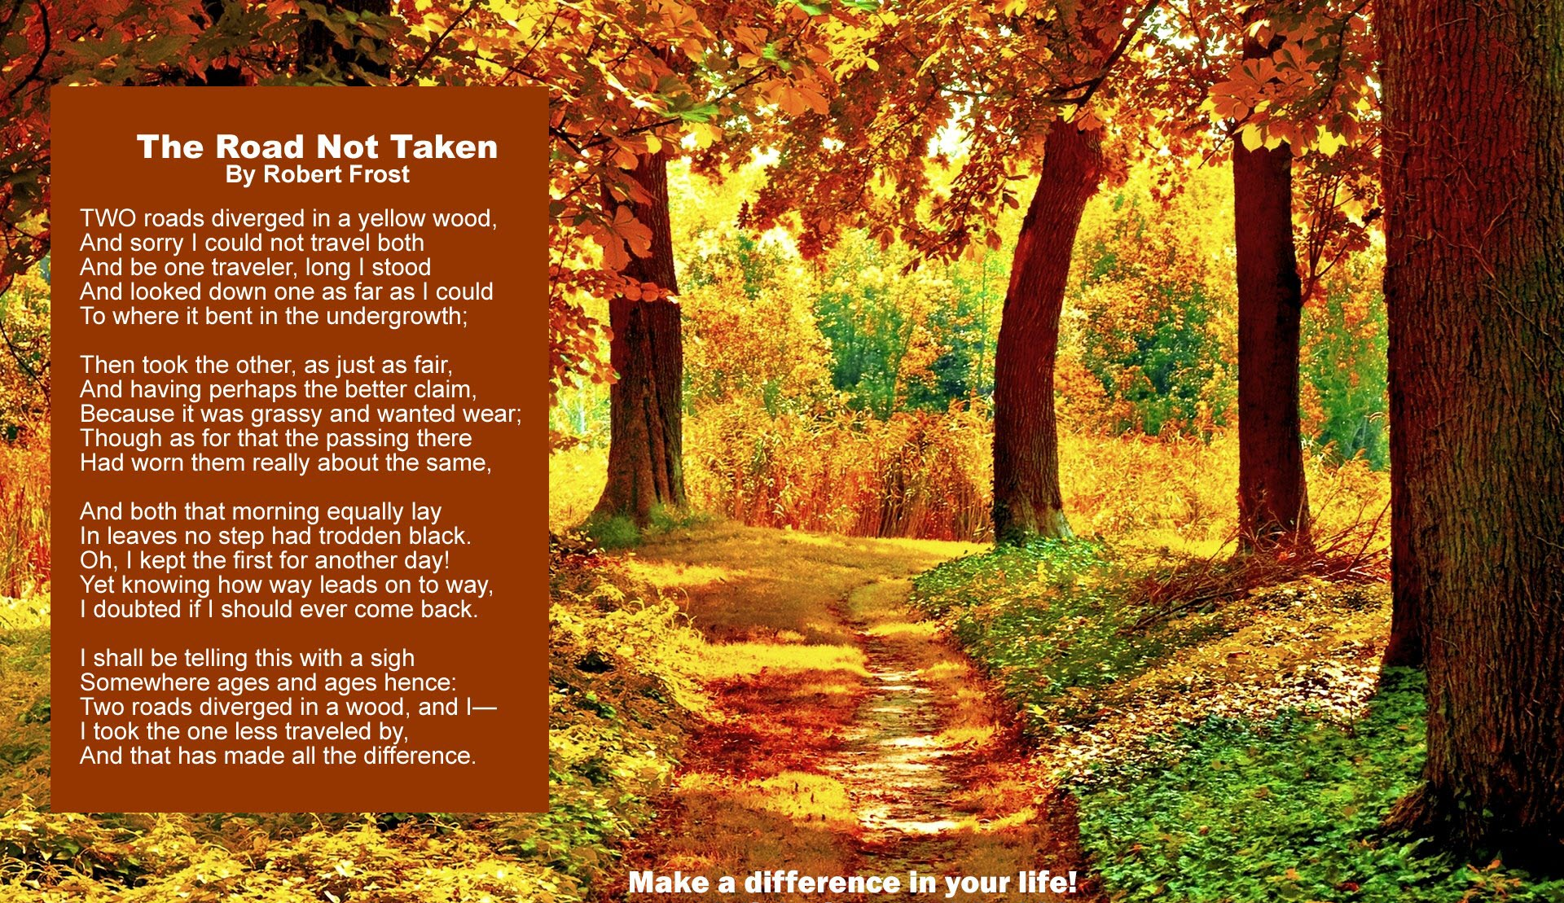
Part 1 – The Road Not Taken

Slide 5

Part 1 - Infinite Possibilities VS Limited Spacetime
Time
Space
Value Chain
Notes:
We construct time & underlying principles
Time constructed the framework which we can organize material resources
Where to go? What time to get there? How much it worth?
When they get there, how long it should take? What they should take for? Where they should start taking?

