Slide 1
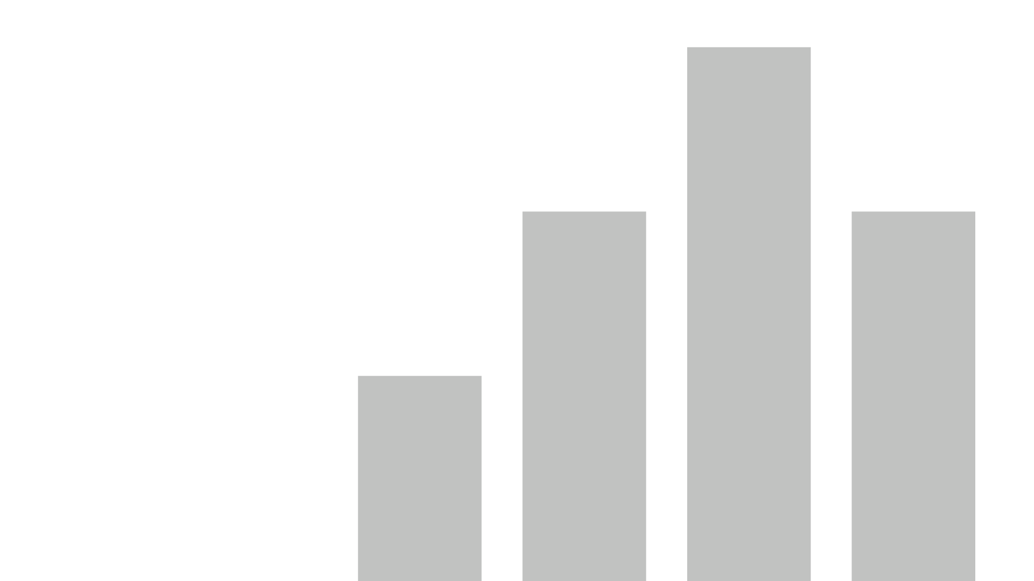


Introducing the Product Dashboard
View in Power BI
Last data refresh:
3/22/2021 7:56:10 AM Central Standard Time
Downloaded at:
3/22/2021 7:57:59 AM Central Standard Time

Slide 2
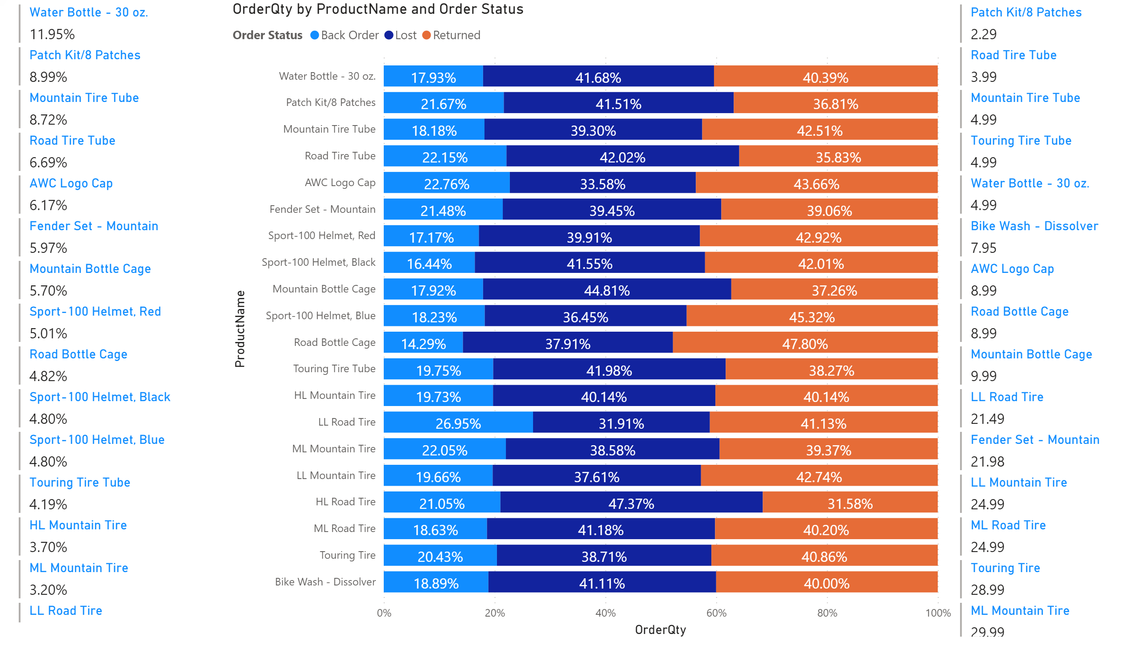
FirstDraftProducts

Slide 3
FirstDraftProducts
This shows qty ordered and this grand total % of what’s been ordered over time. It is sorted by highest to lowest gt%.

Slide 4
FirstDraftProducts
This shows the list price of each product and is sorted lowest to highest price

Slide 5
FirstDraftProducts
This stacked bar shows only items that are back ordered, lost or returned. It shows the % of each product and its status.

