Slide 1
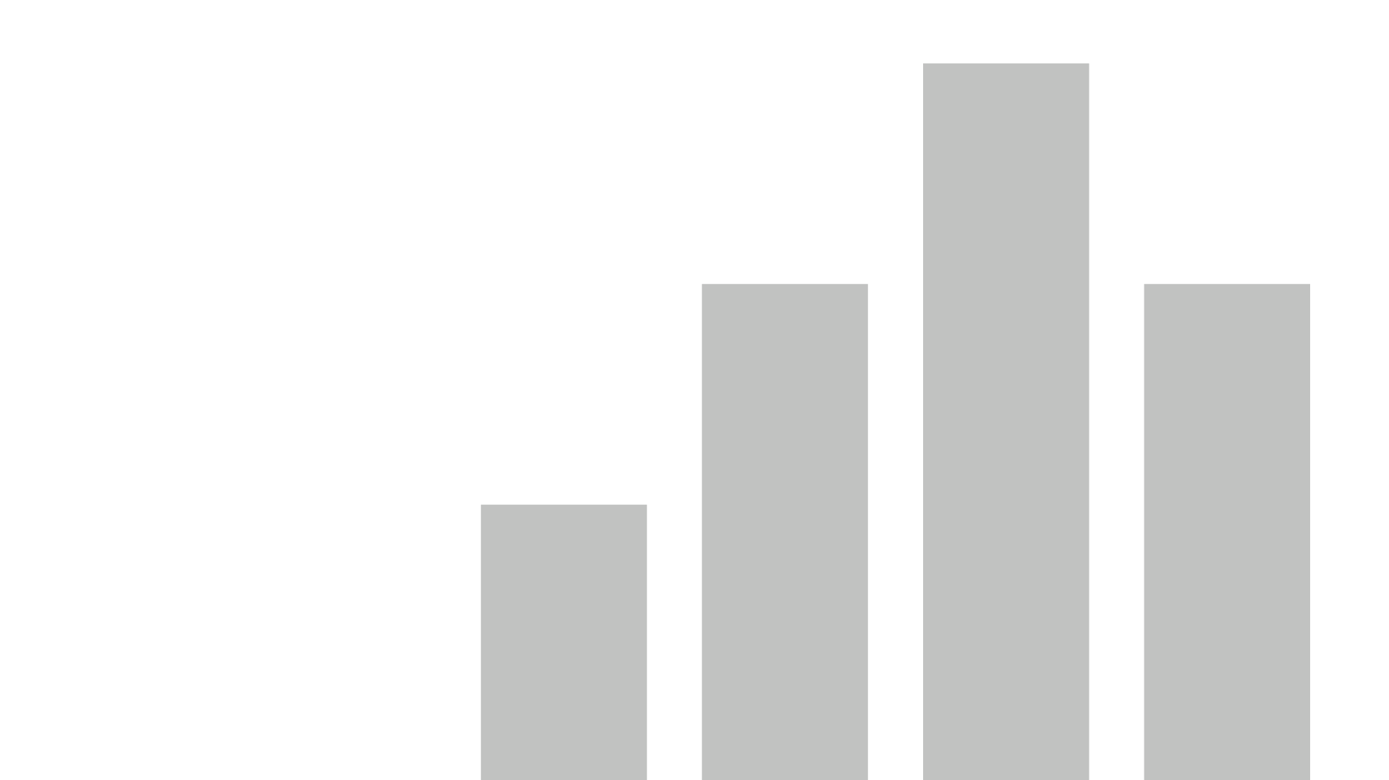

SalesDashboard_Production

Slide 2
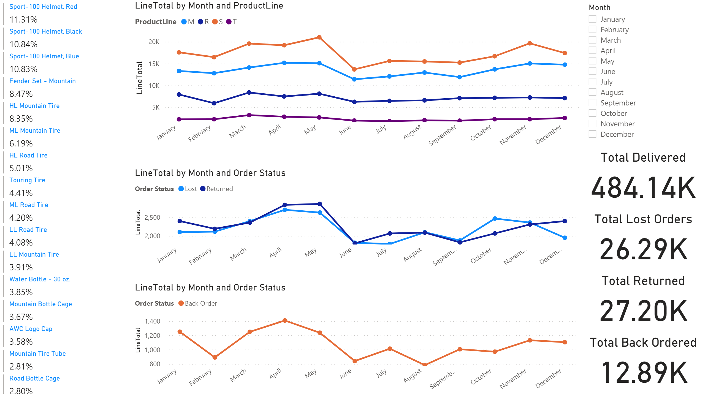
Sales Dashboard

Slide 3
Sales Dashboard
You can filter for each month, or hold ctrl for multiple months

Slide 4
Sales Dashboard
This will sort to the highest number based on filters applied.

Slide 5
Sales Dashboard

