Slide 1



sally fields
281 896 7540
my portfolio
about me
my skillset
6.5”

Slide 2


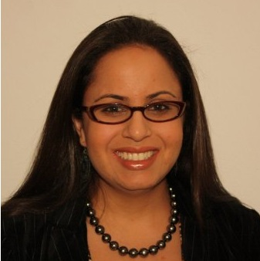
About Me /
Contact Me
Sally.nasr@gmail.com
[m](281)896-7540
Houston, TX
*
Sally Fields is currently employed as a Supply Chain IT SAP Developer. She graduated from University of Houston with a Bachelors in Business Administration, majoring in Management Information Systems.
Working as a Developer in the Supply Chain has given her years of experience analyzing requirements and designing, developing ,
Major Technologies
SAP ECC/SCM APO
React
Node.js
HTML
CSS
JavaScript
Jquery
AJAX
Firebase
APIs
Express
MySQL
deploying and supporting solutions all within the time constraints of SDLC phased project.
Wanting to expand her skillset and expose herself to new & exciting opportunities, she signed up and completed the UT Coding Bootcamp and is now eager to apply her newfound skills in a professional environment.
Major Roles
SAP Developer * Planning Lead * Batch Scheduling Lead *
Testing Lead * Infrastructure Co-Ordinator * Change Requestor
* More of my work can be found at gitHub

Slide 3


