Slide 1
Radar Trade Study Analysis
Nicholas Sally
EEE5557
4/20/2026

Slide 2
Final Inputs

Slide 3
Meta Analysis: Parameter Independence
Independence Matrix
Choice \ Compliance | Min Graze | Max PRF | Tfa | Min Spin | Warn Time | del-R | delAz | Pd | Dopp Prec | Swath Width | Independence Score
Radar Freq | 1 | 1 | 1 | 1 | 1 | 1 | 1 | 1 | 1 | 1 | 10
UAV Altitude | 0 | 1 | 1 | 1 | 1 | 0 | 1 | 1 | 1 | 1 | 8
Ant. Boresight Grazing Angle | 1 | 1 | 1 | 1 | 1 | 1 | 1 | 1 | 1 | 1 | 10
Ant dia- elevation | 1 | 1 | 1 | 1 | 1 | 1 | 1 | 1 | 1 | 1 | 10
Ant dia- azimuth | 0 | 0 | 0 | 0 | 0 | 0 | 1 | 1 | 1 | 0 | 3
Ant Azimuth +/- from fore-look | 0 | 0 | 0 | 0 | 1 | 0 | 0 | 0 | 0 | 1 | 2
Xmtr Pwr | 0 | 0 | 0 | 0 | 0 | 0 | 0 | 1 | 1 | 0 | 2
Xmt Pulse Width | 0 | 1 | 0 | 0 | 0 | 1 | 0 | 1 | 1 | 0 | 4
Design capability: # scans on target = N | 0 | 0 | 1 | 1 | 0 | 0 | 0 | 1 | 1 | 0 | 4
Independence Score | 3 | 5 | 5 | 5 | 5 | 4 | 5 | 8 | 8 | 5
 | Design Goal
 | 1 | Impacts
 | 0 | No Impact

Slide 4
Meta Analysis: Parameter Independence
All variables are interlinked, but some are more independent
The least independent parameters will be the first to be adjusted and then fixed when valid numbers are found
The more independent parameters will be adjusted to optimize the goals and ensure compliance as necessary
Based on the matrix, the most dependent parameters (Pd, Doppler Precision) are all a function of the Signal to Noise Ratio (SNR)
The design will initially optimize for SNR, then adjust parameters to maximize the goals

Slide 5
SNR vs. Boresight Grazing Angle
Fixed
Xmt Tau = 0.095us
Xmt Pwr = 650W
Ant El = 0.1m
Ant Az = 0.25m
Freq = 90GHz
The SNR of the system flattens between 15 and 50 degrees. Any values in this range would be acceptable with a slight SNR edge to higher grazing angles

Slide 6
Path Loss vs. Grazing Angle
Fixed
N/A as path loss is effectively a function of grazing angle and altitude
The path loss will always be smaller for lower altitudes, since there less atmosphere to cross through
The path loss also tapers off for high grazing angles, regardless of altitude
Once again, this appears to give the edge to high grazing angles to optimize SNR
Acceptable angles are greater than 16 deg

Slide 7
Swath Width vs. Grazing Angle
Fixed
Swath Beta = 80 deg
Despite initial victories for high grazing angles, they simply do not produce enough swath width for the radar to be compliant
The swath width rewards lower grazing angles with exponential results
To ensure the design is compliant and minimize SNR degradation, a grazing angle of 19 degs was chosen with an altitude of 3.5km
Any degradation will be offset with high transmit power or antenna gain

Slide 8
Ant Dia El vs. Ant Footprint Length
Fixed
Bore Ang = 19
Alt = 3.5km
An antenna elevation diameter of 0.1m was chosen
Despite worse SNR, the smaller diameter improves 2 additional goals: slower antenna speed and more scans. By proxy, this also increase Pd by increasing POT and TOT
Based on the independence matrix, both azimuth diameter length and transmit power can offset the diminished SNR

Slide 9
Ant Dia Az vs Pd (2 of 3)
Fixed
Graze Ang = 19 deg
Xmt Pwr = 400 W
El Dia = 0.1m
Xmt Tau = 0.095us
Alt = 3.5km
For a fix input power, the frequency with the smallest diameter azimuth dimension is 90GHz

Slide 10
Xmt Pwr vs Pd (2 of 3)
Fixed
Graze Ang = 19 deg
Xmt Pwr = 400 W
El Dia = 0.1m
Az Dia = 0.25m
Xmt Tau = 0.095us
Alt = 3.5km
Once again, 90GHz is the first (and only) frequency to become complaint for the previously established inputs
Using the plots as a baseline and trial-and-error for refinement, a transmit power of 650W and azimuth diameter of 0.25m appeared to be the optimal combination
Additionally, a frequency of 90GHz was chosen, since reach compliance while optimizing for goals

Slide 11
Az Beta and Twarn vs. S
The last chosen variable is the fore look beta angle, as it is mostly independent of the other variables
The variables are inversely related
Since both goals are equally weighted, an azimuth beta that achieved 100% of Twarn was chosen at the cost of 12% reduction in my Swath Width goal
The final azimuth beta value was 55 degrees to guarantee 100% of the goal and to offset minor changes to other variables

Slide 12
Additional Input Consideration
Antenna spin rate was chosen to be 5% above the absolute minimum spin rate
Low spin rate is always good for Pd and Dopper and help reach the goal
PRF was chosen to be 5% less than the absolute maximum
Similar to antenna spin, more PRF is always good for Pd and Doppler, but has hardware and single pulse limits that must be accounted for
Pulse compression and 2 stage doppler were not considered, since the design was compliant and the goal percentages were acceptable without them
Xmt Pulse Width was set to 0.095us to maximize doppler precision goal
The number of scans started at 3 and was gradually increased until the design fell out of compliance.
Final # of scan was 7

Slide 13
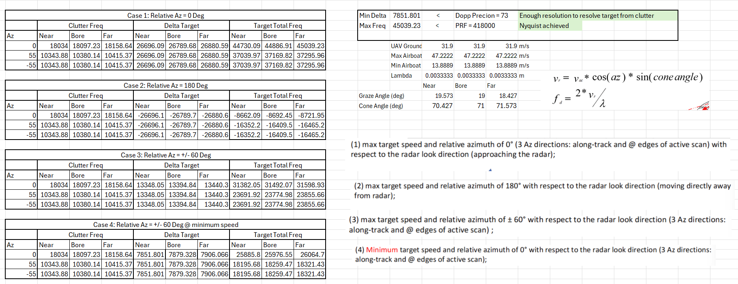
Doppler Analysis

Slide 14
Additional Radar Performance Results

Slide 15
Specification Compliance Matrix
All margins for compliance specs are positive (green), so design is compliant

Slide 16
Summary
To find optimal radar design parameters, an independence matrix was created to find the variables that needed to be optimized first
In this case, Pd and Doppler precision, which are functions SNR
Plots of the variables and their effect of SNR were shown
Values were chosen to maximize SNR
If SNR was not maximized, a different justification, usually pertaining to other goals, was provided
Doppler analysis showed all cases would be satisfied by the doppler precision and PRF of the design
The compliance matrix showed that the design is fully compliant
The final goal percentage was ~75% of all goals accomplished

