Slide 1

WHY PATIENTS TEND TO MISS THEIR APPOINTMENTS AND IF THERE IS ADEQUATE STAFF

Slide 2

Background
The NHS a National Health Service publicly funded in England has been facing a lot of patients missing their appointments, and the reason for this is yet to be better understood. Missed appointments can lead to worse care for patients, inefficient use of staff, increased waiting times and financial impact. The NHS wants to have a better understanding of the reason for missed appointments and the following questions answered, has there been adequate staff and capacity in the networks? And What was the actual utilisation of resources? As part of the Data analyst team contracted by the NHS, I am going to help in analysing and finding if there are any trends or similarities of patterns for missed appointments.

Slide 3
Techniques used to complete the analyses
1.DataPreparation: The first step in the process is to prepare the data. It entails cleaning the data to remove unnecessary and redundant values, converting it to the appropriate format, and preparing it for analysis.
2. Data Exploration: After the data was cleaned, it was explored using various data visualisation techniques to uncover previously unseen trends in the data, such as datatypes of the dataset's columns, stats, and metadata.
3. Data visualisations: After exploring the data, visualisations were carried out to simplify complex data and make it easier for our target audience to understand and extract insights.
4. Result interpretation: The final step in the analysis process is to generate meaningful results and determine whether the output matches the expected results.

Slide 4
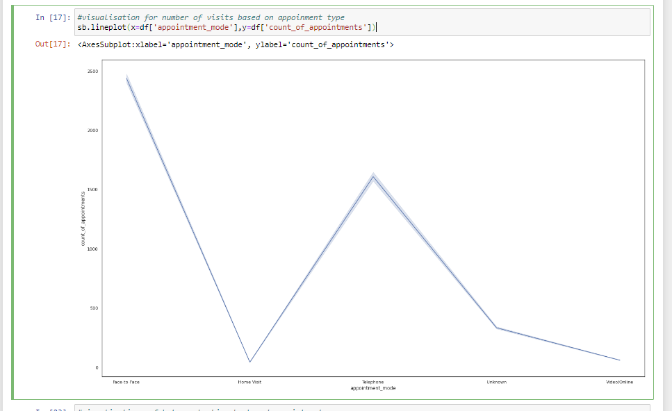
The visualisations used in this data analysis translate findings into a visual context, such as graphs and bar charts, to make data easier for our target audience to understand and pull insights from. The goal of the visualisations is to make it easier to identify patterns, and trends in the data set. The following charts were used as visualisations, line and bar charts. First, a line chart was selected to compare the appointment modes count of appointments; from the visualisations on the graph on the right , the highest mode of appointment is face-to-face. If investigated further, it will likely entail a higher probability of people missing their appointments as it has a higher count of appointments. To name a few, this could be due to a few reasons such as someone being in isolation or having difficulty with travelling. The time of the season, such as spring to summer, can also affect appointment attendees. In addition, another line graph was used to display the count of appointments by month. From this visualisation, the highest count of appointments was found in March, with a total count of 27,170002. Around this time, many people tend to feel sick due to season change sickness, which makes a lot of people book appointments they would not attend after feeling better before their appointment date. In addition, another line chart was used to analyse the highest count of utilisation per month. It can be seen that this occurred between October 2021 and November 2021. This could be due to being in lockdown and many patients suffering from long-term covid symptoms. The higher the number of appointments booked, the higher the number of unattended.

Slide 5
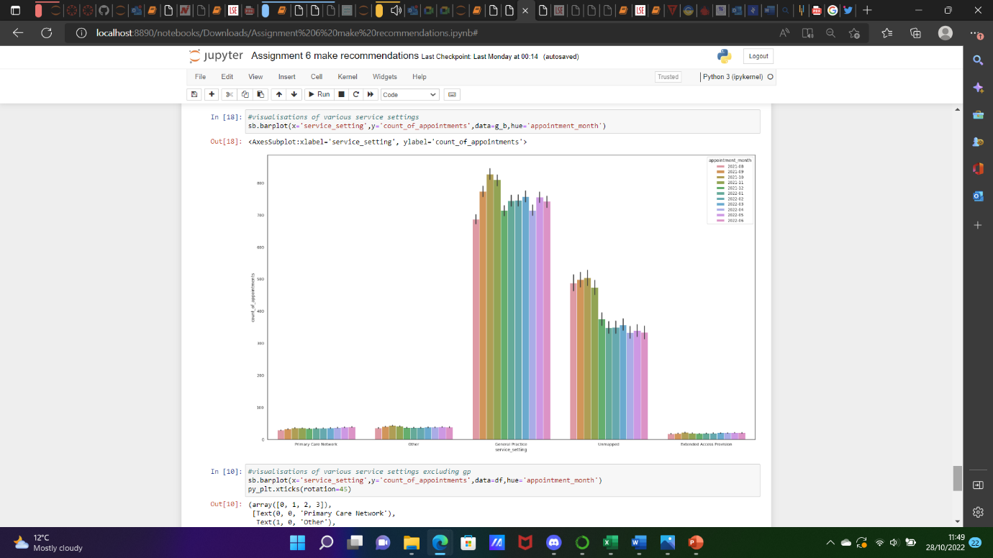
A bar chart was also used to compare the quantitative data from the service setting. The highest type of service setting is GP meaning many patients tend to have this form of appointment, the bar chart can be seen below. This visualisation helps direct the focus on the most used form of appointment and investigate how many people attend their appointments. Good data visualisation should communicate a data set clearly and effectively using graphics. These visualisations make it easy to comprehend the service settings, counts of appointments and service utilisation data at a glance. Complex information has been broken down in a way that makes it simple for the target audience to understand and on which to base their decisions.

Slide 6
the visualisations are interesting in showing how GP face-to-face appointments are higher than any other mode of appointments and number of face-to-face appointments were likely to increased after a telephone appointment. Another interesting finding is the count of appointments reducing around spring and summer time.
For future analysis, I recommend using a longitudinal study across the UK to collect more extensive data on patient demographics, surveys of possible reasons why patients miss their appointments and social media data that correlates to why people would miss their appointments. This will provide the pattern of reasons patients miss their appointments. This could also show if patients are satisfied with NHS service and feel safe. In addition, providing the total number of staff working in service settings and the amount of absence of staff will also help determine if there has been adequate staff.

