Slide 1

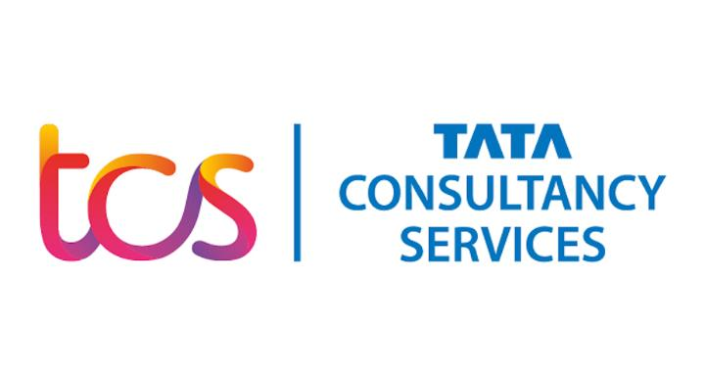
NAME: N.SALMA FATHIMA
DT NUMBER: DT20207480096
MAIL ID: saofflfa@gmail.com
DOMAIN: AUTONOMOUS IT

Slide 2
PROBLEM STATEMENT:
One of the Retail customer is looking to automate various phases of Infrastructure Lifecycle i.e., Design, Build, Operate & Optimize.
Overall objectives of the Autonomous Infrastructure are to improve agility of the business requirement and reduce manual intervention while managing the overall lifecycle of application

Slide 3
INTRODUCTION:
AUTONOMOUS:
The definition of autonomous is a person or entity that is self-controlling and not governed by outside forces.
PROJECT DESCRIPTION:
Here we are supposed to provide a web application that is supposed to perform various operations like design, build, operate and optimize of an infrastructure lifecycle.
Also we are improving the flexibility of the business and reducing the manual work .

Slide 4
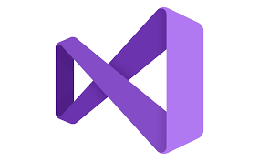
TECHNOLOGIES USED:
FRONTEND:
VISUAL STUDIO 2015 :
Microsoft Visual Studio is an integrated development environment (IDE) from Microsoft.
It is used to develop computer programs, websites, web apps, web services and mobile apps.
We are using various languages like : HTML, CSS, C Sharp, dotnet , Java script.

Slide 5
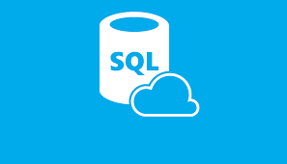
BACKEND:
SQL SERVER:
SQL Server is a database server by Microsoft which is a special-purpose programming language designed to handle data in a relational database management system.
A database server is a computer program that provides database services to other programs or computers that is defined by the client-server model.

Slide 6

PHP:
Stands for "Hypertext Preprocessor.“
PHP is an HTML-embedded Web scripting language. This means PHP code can be inserted into the HTML of a Web page.
It is a widely used open source scripting language used for web development.

Slide 7
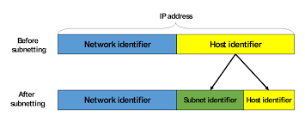
SUBNET:
A subnet or subnetwork is a segmented piece of a larger network.
subnets are a logical partition of an IP network into multiple, smaller network segments.
One goal of a subnet is to split a large network into a grouping of smaller, interconnected networks to help minimize traffic.

Slide 8
Here we are using a network with two subnets :
One public subnet which is an internet facing subnet , the instances should be able to access the internet and should be accessible from the internet over public IP address.
One private subnet which is the internal subnet that should not be accessible by the internet but it should contain the necessary cloud components to provide appropriate access.

Slide 9
PROJECT WORKFLOW:
In this project, we are firstly going to develop a web application using visual studio 2015.
Then we are creating a storage account in azure to store data files, SQL SERVER acts as the cloud.
Our primary motive is to extend the CPU utilization limit when the load exceeds 70%.
TPA:
The TPA (THIRD PARTY ATMINISTRATION) Works as the load balancer which monitors the load periodically on the flow.
As the number of users increase , the load also increases.
It functions similar to an auditor that periodically checks how many files were created or deleted or that have been modified.

Slide 10
The web application is connected to the SQL server’s database through PHP.
We can purchase free compute plans from azure.
One compute plan is assigned to our web application and two more compute plans are purchasedif in case we have to extend the cpu utilisation limit.
Now we are going to establish a network between all the computes which are connected to the load balancer.
If the load increases by 70%, it includes the second compute .

Slide 11
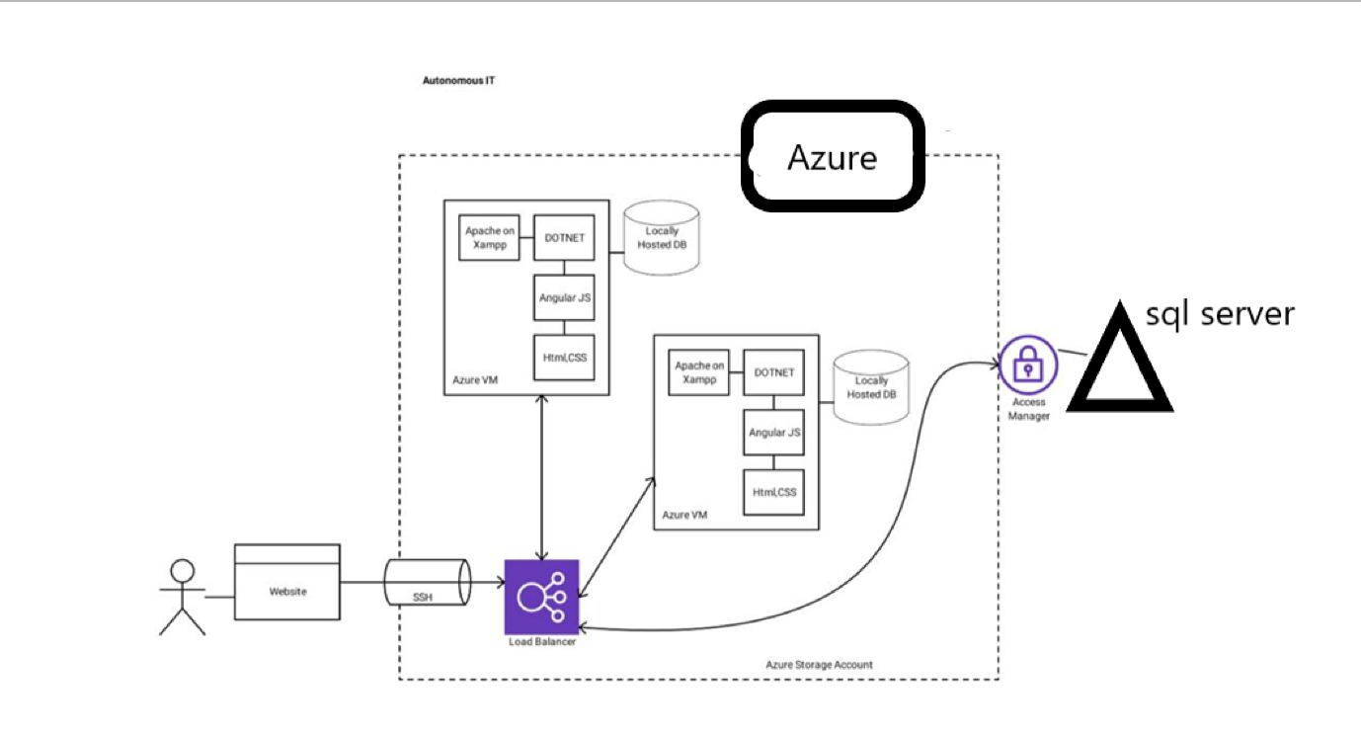
FLOWCHART:

Slide 12
Flowchart explanation :
A user is accessing the web application through a web site.
This is connected to the SSH also known as secure call which is a network communication protocol that enables communication between two computers.
Then this SSH is connected to the load balancer tp which azure virtual machines are connected.
AZURE VIRTUAL MACHINES are a tightly isolated software container with an OS and an application inside.
Load balancer provides high availability by distributing incoming traffic among the active VM’s.
Then the whole set is connected to the access manager.
The access manager defends against unauthorised login attempts and safegaurds information with risk-based access controls
Then this access manager is connected to the sql server.

Slide 13

THANK YOU FOR WATCHING !!!

