Slide 1

THE
WEDDING
PLANNER
◆
A beautiful guide for
planning your best day
♥
Created with love for the bride-to-be

Slide 2

◆
WELCOME TO YOUR
WEDDING
PLANNER
◆
A beautiful place to organize your big day
BRIDE
:
PARTNER
:
WEDDING DATE
:
CEREMONY VENUE
:
RECEPTION VENUE
:
WEDDING THEME
:
PLANNER BELONGS TO
:
PHONE / EMAIL
:
EMERGENCY CONTACT
:
EMERGENCY CONTACT NUMBER
:
A FEW WORDS ABOUT OUR BIG DAY
♥

Slide 3
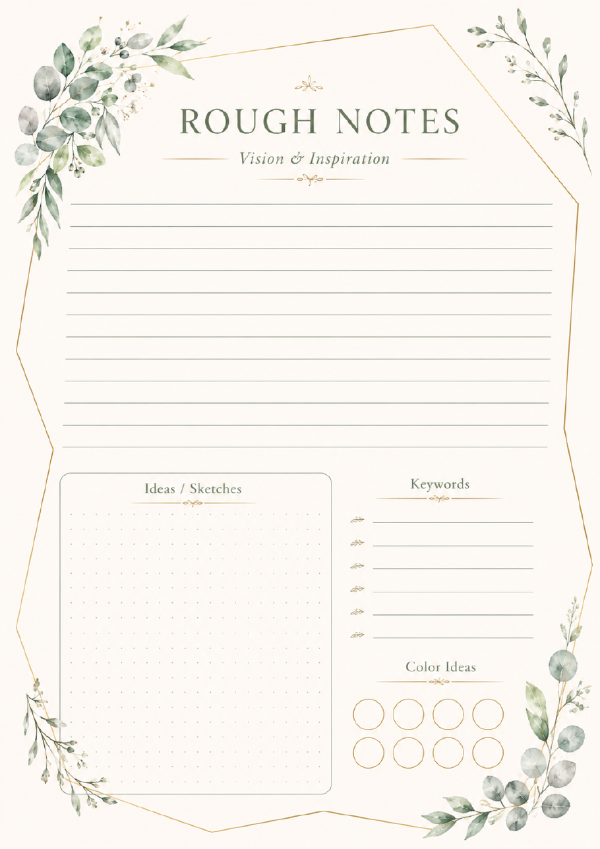
◆
ROUGH NOTES
Vision & Inspiration
◆
Ideas / Sketches
Keywords
Color Ideas

Slide 4

◆
WEDDING
VISION & MOOD BOARD
◆
THEME
WEDDING STYLE
VENUE VIBE
MUST-HAVE MOMENTS
FLORAL DIRECTION
FASHION
FLOWERS
DÉCOR
CAKE
COLOR PALETTE

Slide 5

◆
ROUGH NOTES
Planning & Budget
♥
TO REMEMBER
QUESTIONS TO ASK

Slide 6
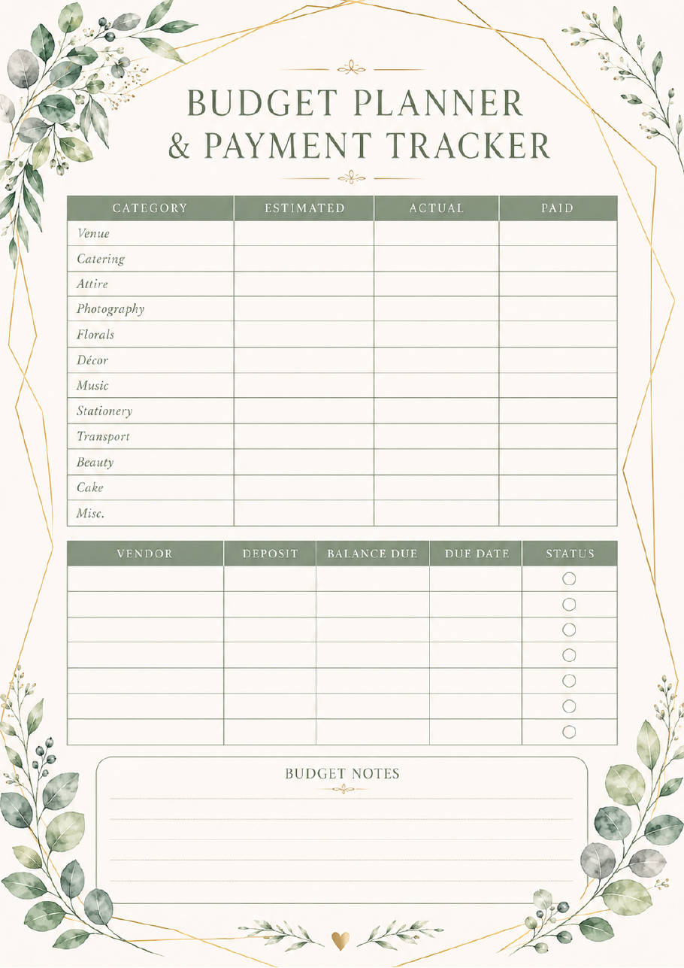
◆
BUDGET PLANNER
& PAYMENT TRACKER
◆
CATEGORY
ESTIMATED
ACTUAL
PAID
Venue
Catering
Attire
Photography
Florals
Décor
Music
Stationery
Transport
Beauty
Cake
Misc.
VENDOR
DEPOSIT
BALANCE DUE
DUE DATE
STATUS
BUDGET NOTES

Slide 7
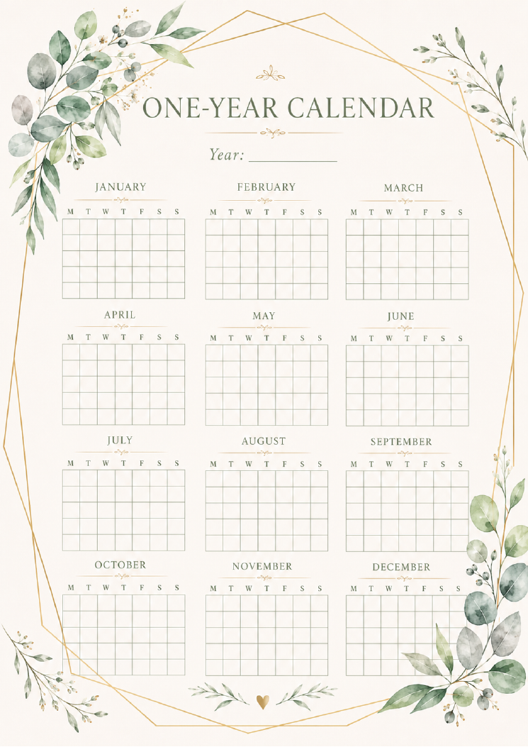
◆
ONE-YEAR CALENDAR
Year:
JANUARY
FEBRUARY
MARCH
M T W T F S S
M T W T F S S
M T W T F S S
APRIL
MAY
JUNE
M T W T F S S
M T W T F S S
M T W T F S S
JULY
AUGUST
SEPTEMBER
M T W T F S S
M T W T F S S
M T W T F S S
OCTOBER
NOVEMBER
DECEMBER
M T W T F S S
M T W T F S S
M T W T F S S

Slide 8

◆
ROUGH NOTES
Guests & Vendors
♥
NAMES TO REMEMBER
VENDOR QUESTIONS

Slide 9
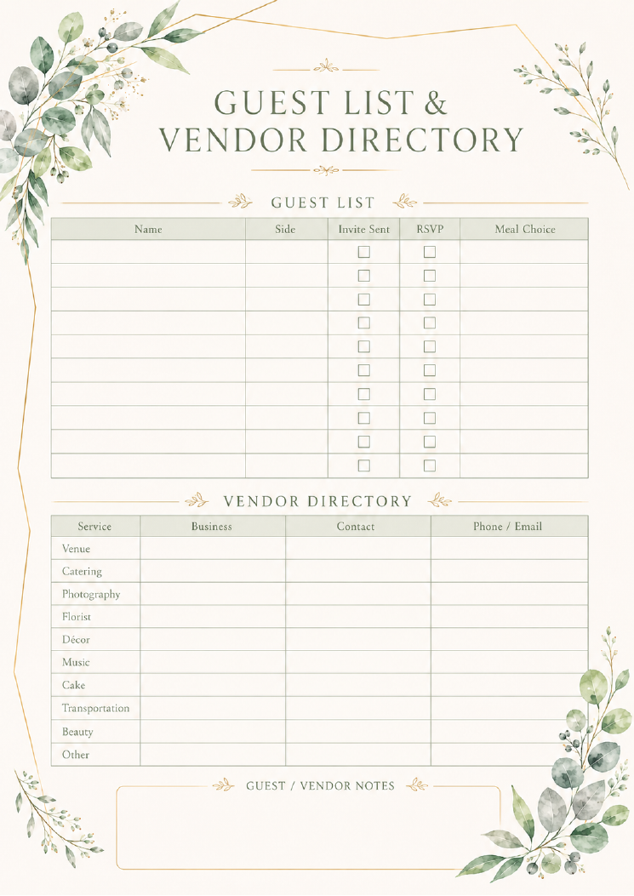
◆
GUEST LIST &
VENDOR DIRECTORY
◆
GUEST LIST
Name
Side
Invite Sent
RSVP
Meal Choice
VENDOR DIRECTORY
Service
Business
Contact
Phone / Email
Venue
Catering
Photography
Florist
Décor
Music
Cake
Transportation
Beauty
Other
GUEST / VENDOR NOTES

Slide 10
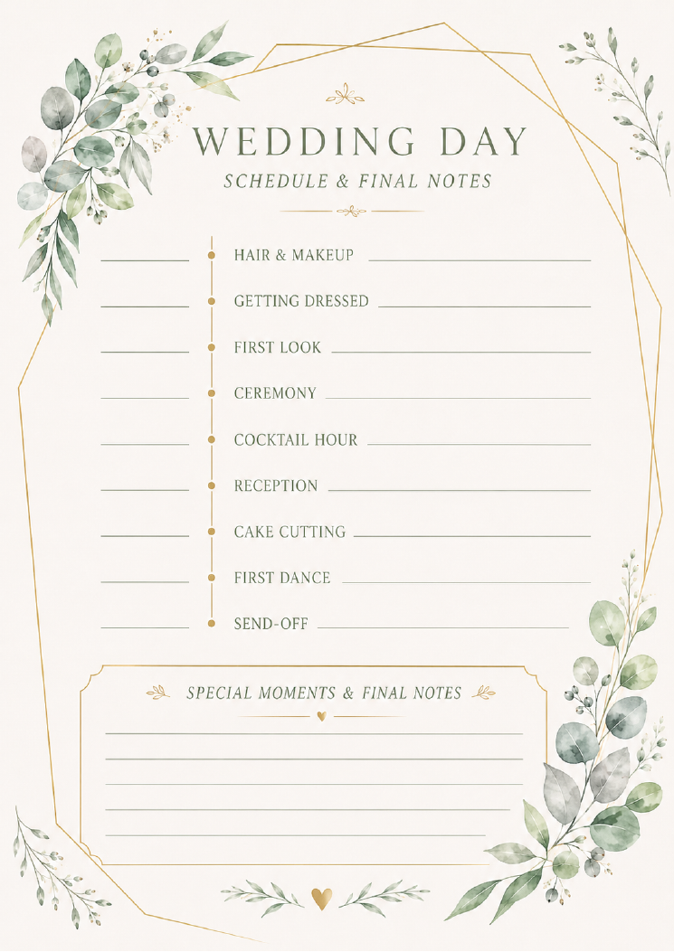
◆
WEDDING DAY
SCHEDULE & FINAL NOTES
◆
HAIR & MAKEUP
GETTING DRESSED
FIRST LOOK
CEREMONY
COCKTAIL HOUR
RECEPTION
CAKE CUTTING
FIRST DANCE
SEND-OFF
SPECIAL MOMENTS & FINAL NOTES
♥

