Slide 1


ML project

Slide 2
Team members
Salma sameh ID 21-01548
Ahmed ali ID 21-00360
Lubna ahmed ID 21-00897
Doha Ibrahim ID 21-00602
Jana hatem ID 21-00816
Mariam hany ID 21-00983

Slide 3

Project idea
breast cancer prediction model

Slide 4

Description
Our ML model is trained on (wiseonsin )breast cancer dataset that include 33 feature and 569 row that predict whether the tumor is malignant or benign

Slide 5

Project imported library
Numpy as np to make mathematical operations on arrays
Pandas as pd used to work with dataset and load into dataframes
Seaborn as sns to make statistical graphics to help in understanding and visualization of data
matplotlib.pyplot as plt is used to create interactive visualization of data which help in data analysis and data resentation

Slide 6

Dataset features
The features given are the characteristics of the cell nuclei computed from the fine needle aspirate(FNA) of a breast mass

Slide 7
Main features
radius (mean of distances from center to points on the perimeter)
texture (standard deviation of gray-scale values)
Perimeter
Area
smoothness (local variation in radius lengths)
compactness (perimeter^2 / area - 1.0)
concavity (severity of concave portions of the contour)
concave points (number of concave portions of the contour)
Symmetry
fractal dimension ("coastline approximation" - 1)
Ten real-valued features are computed for each cell nucleus as follows :

Slide 8

Main features
Mean, standard error and "worst" or largest (mean of the three largest values) of these features were computed for each image, resulting in 30 features.

Slide 9
Data cleaning and processing
We dropped 2 column (id , unnamed ) because they were not useful for analysis now we have 30 features and 1 label
We use random forest to choose the best features from dataset by (RFECV)recursive feature elimination with cross validation and random forest classification
We used label encoder to transform non-numerical label (diagnosis ) to numerical labels
we use correlation analysis is used to calculate the correlation between the numerical columns in data-frame , can be used to make predictions , when we know a score of one measure (feature) to make more accurate prediction of another measure that is highly related to it the stronger the relationship among variables the more accurate the prediction
We use stander-scaler to make all data in same range

Slide 10
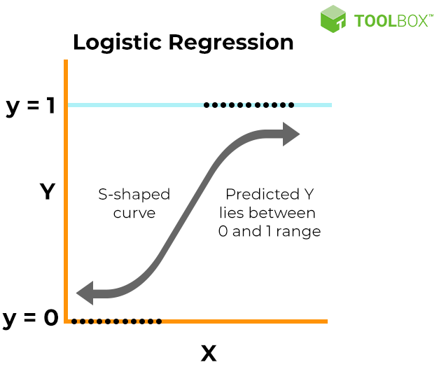
Used model (logistic model)
We use this model because It’s a classification algorithm, that is used where the response variable is categorical. The idea of Logistic Regression is to find a relationship between features and probability of particular outcome.

Slide 11
Training and testing accuracy
Our model give training accuracy : accuracy score of the training data :
0.98
Our model give testing accuracy :accuracy score of the test data :
0.96

Slide 12
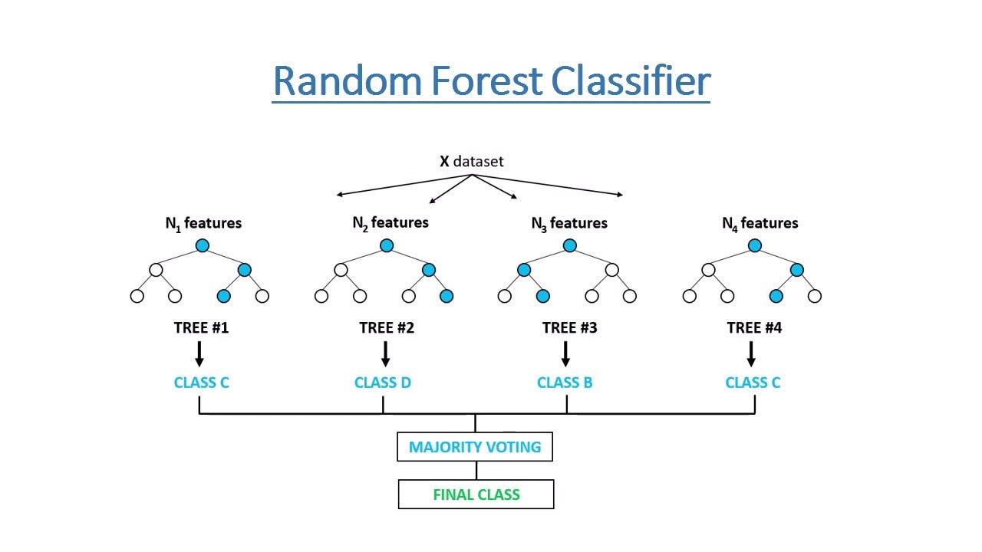
Another model (Random-Forest-Classifier)
we use this model because the random forest classifier can be used to solve for regression or classification problems. The random forest is a collective of decision trees , to classify a new object based on its attributes each tree is classified and tree “votes” for that class , the forest chooses the classification having the most votes

Slide 13
Training and testing accuracy
Our model give training accuracy : accuracy score of the training data :
1.0
Our model give testing accuracy : accuracy score of the test data :
0.94

Slide 14
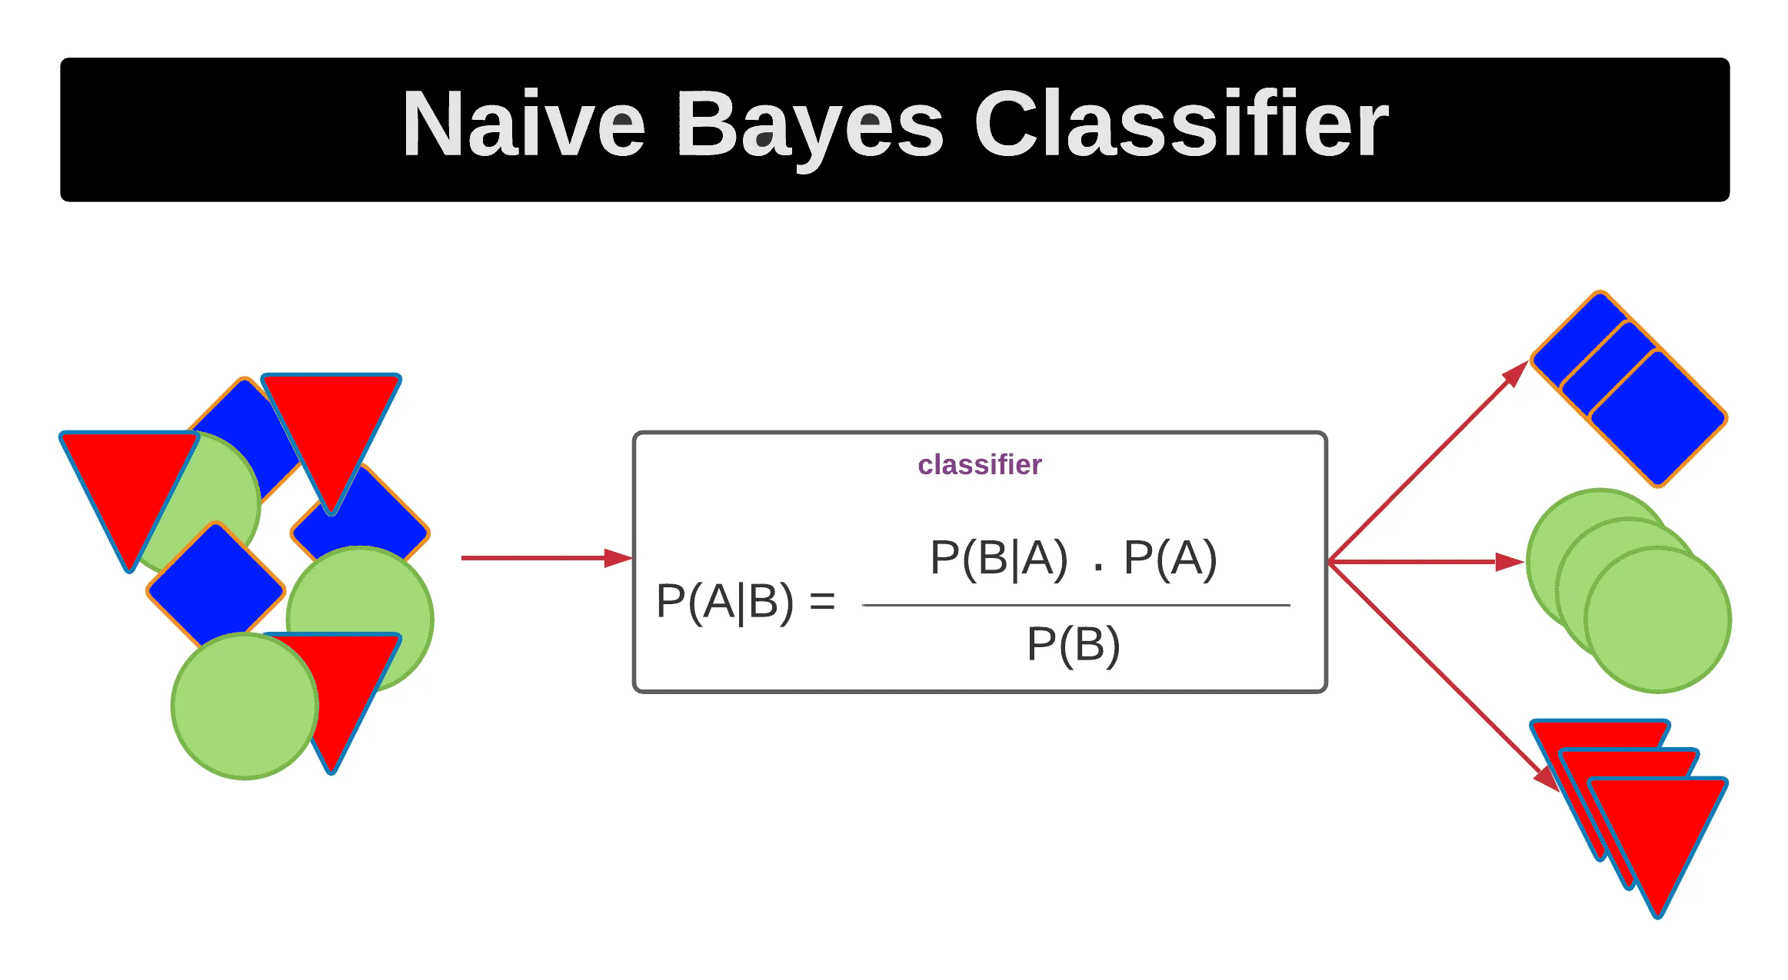
Another model (naïve bayes)
We use this model because is a supervised machine learning algorithm, which is used for classification tasks, like text classification. It is also part of a family of generative learning algorithms (instead of predicting a label given to some features they try to predict features given a certain label ), meaning that it seeks to model the distribution of inputs of a given class or category , Naive Bayes classifiers are a collection of classification algorithms based on Bayes’ Theorem. It is not a single algorithm but a family of algorithms where all of them share a common principle , every pair of features being classified is independent of each other when calculating the probability of particular outcome , it is easy to build and useful for massive datasets

Slide 15
Training and testing accuracy
Our model give training accuracy : accuracy score of the training data :
1.0
Our model give testing accuracy : accuracy score of the test data :
0.92

Slide 16
Performance measures
Precision : the number of correct outputs provided by the model or out of all positive classes that have predicted correctly by the model
Recall : out of total positive classes , how our model predicted correctly
F-score : it help us evaluate the recall and precision at the same time , the f-score is max if recall equal to precision

Slide 17
Thank you

