Slide 1
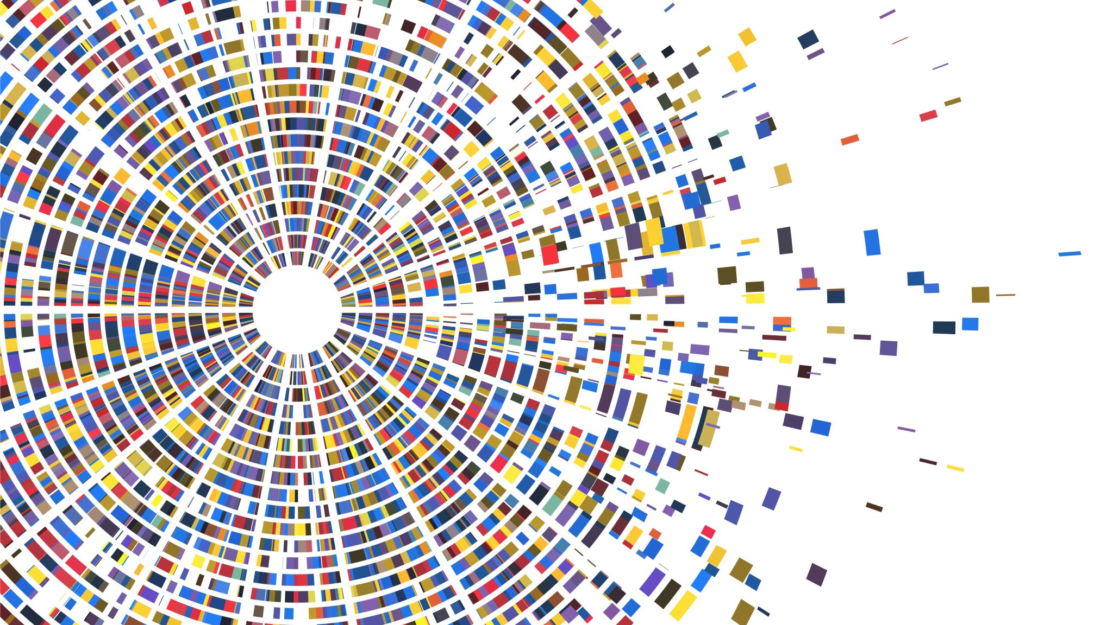
Pattern recognition

Slide 2
Team members
Salma sameh ID 21-01548
Ahmed ali ID 21-00360
Lubna ahmed ID 21-00897
Doha ahmed ID 21-00602
Ahmed Mahmoud ID 21-00396
Mohamed helmy ID 21-01146

Slide 3

Project idea
Heart disease prediction model

Slide 4

Project description
our machine learning model is trained on heart disease dataset that include 13 feature and 250 row that predict whether the person have heart disease or not

Slide 5
project imported library
Numpy as np to make mathematical operations on arrays
Pandas as pd used to work with dataset and load into dataframes
matplotlib.pyplot as plt is used to create interactive visualization of data which help in data analysis and data representation
Seaborn as sns to make statistical graphics to help in understanding and visualization of data

Slide 6

Dataset features
Our dataset contain features that describe the human medical information , that will be used to train our model to determine whether that person can get heart disease

Slide 7
Data cleaning and preprocessing
in our dataset we use preprocessing methods that help the model to train giving the highest and best accuracy
we use some diagrams like histplot , swarm to explain the features well
Data standardization a preprocessing step in machine learning where the mean of each feature is subtracted from the data and then divided by the standard deviation of that feature. This is done to centre the data around 0 and scale it.
Features correlation to exclude the similar features

Slide 8
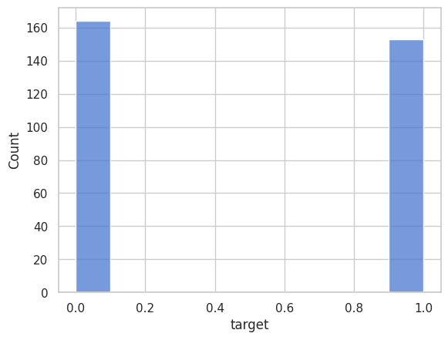
Bata balance
We use smote library to make over sampling that help to balance our data and help increase accuracy by balance the target feature

Slide 9

Grid search
We use the grid search to help select the best hyperparameters values that affect the model accuracy by control the learning process

Slide 10

Model processing

Slide 11
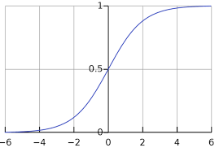
Used model
logistic regression : a supervised machine learning algorithm that accomplishes binary classification tasks by predicting the probability of an outcome, event, or observation. The model delivers a binary or dichotomous outcome limited to two possible outcomes: yes/no

Slide 12
Training and testing accuracy
Training accuracy 86 .84%
Testing accuracy 80.0%

Slide 13
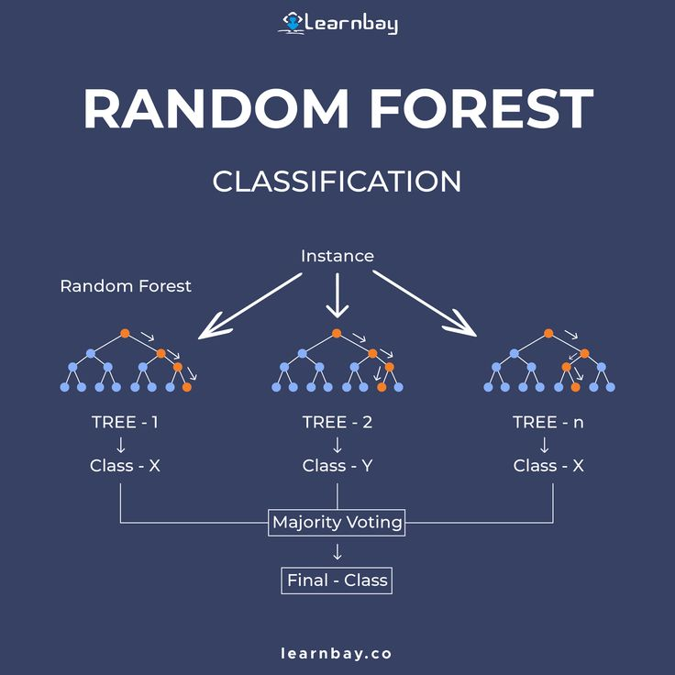
Used model
random forest classifier : In a random forest classification, multiple decision trees are created using different random subsets of the data and features. Each decision tree is like an expert, providing its opinion on how to classify the data

Slide 14
Training and testing accuracy
training accuracy 100.0%
Testing accuracy 92.0 %

Slide 15
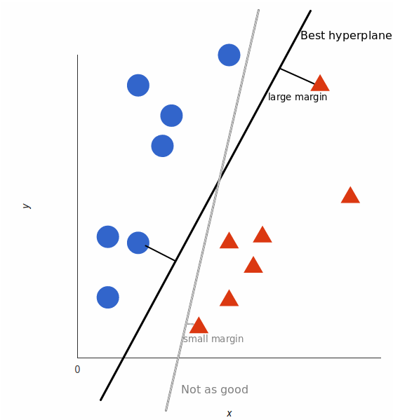
Used model
Support vector machine : a supervised machine learning algorithm that classifies data by finding an optimal line or hyperplane that maximizes the distance between each class in an N-dimensional space to get the least classification error

Slide 16
Training and testing accuracy
training accuracy 87.5 %
Testing accuracy 80.0 %

Slide 17
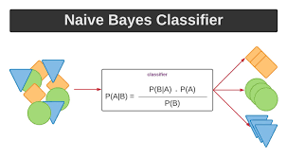
Used model
Naïve bayes : is part of a family of generative learning algorithms, meaning that it seeks to model the distribution of inputs of a given class or category. Unlike discriminative classifiers, like logistic regression, it does not learn which features are most important to differentiate between classes.

Slide 18
Training and testing accuracy
training accuracy 92.5 %
Testing accuracy 88.0 %

Slide 19
Performance measures
Precision : the number of correct outputs provided by the model or out of all positive classes that have predicted correctly by the model
Recall : out of total positive classes , how our model predicted correctly
F-score : it help us evaluate the recall and precision at the same time , the f-score is max if recall equal to precision

Slide 20

Project drive link
https://drive.google.com/drive/folders/1Dxp2zqtWgAJHspDQx6qdKdJ4teCTPuhw?usp=sharing

Slide 21

thank you

