Slide 1
Evaluating Recommender system
Presented by: Salma Elshahawy
DATA 612 Summer 2020
June, 23, 2020

Slide 2
Outline
Why cross validation
Different evaluation metrics
Which one should I pick?

Slide 3
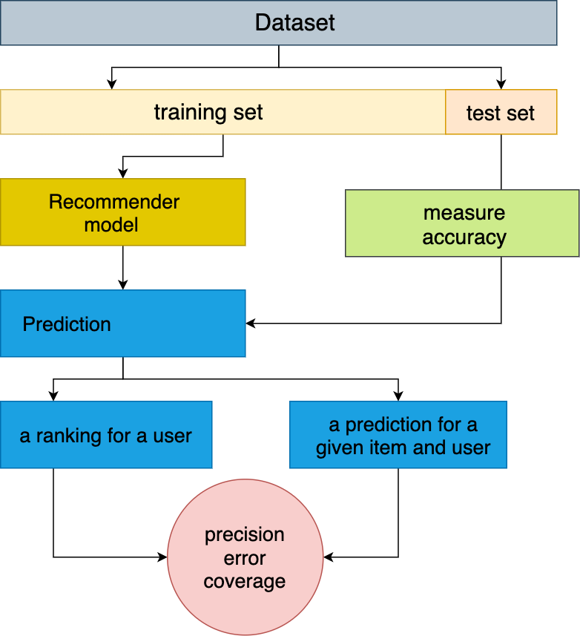
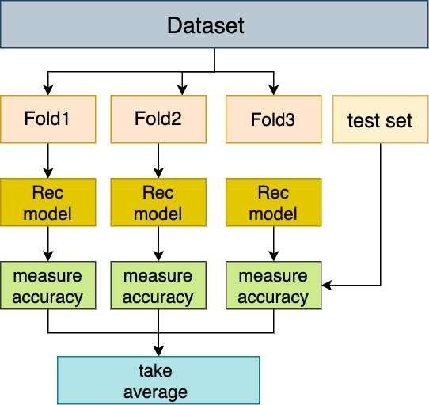
Why cross validation

Slide 4
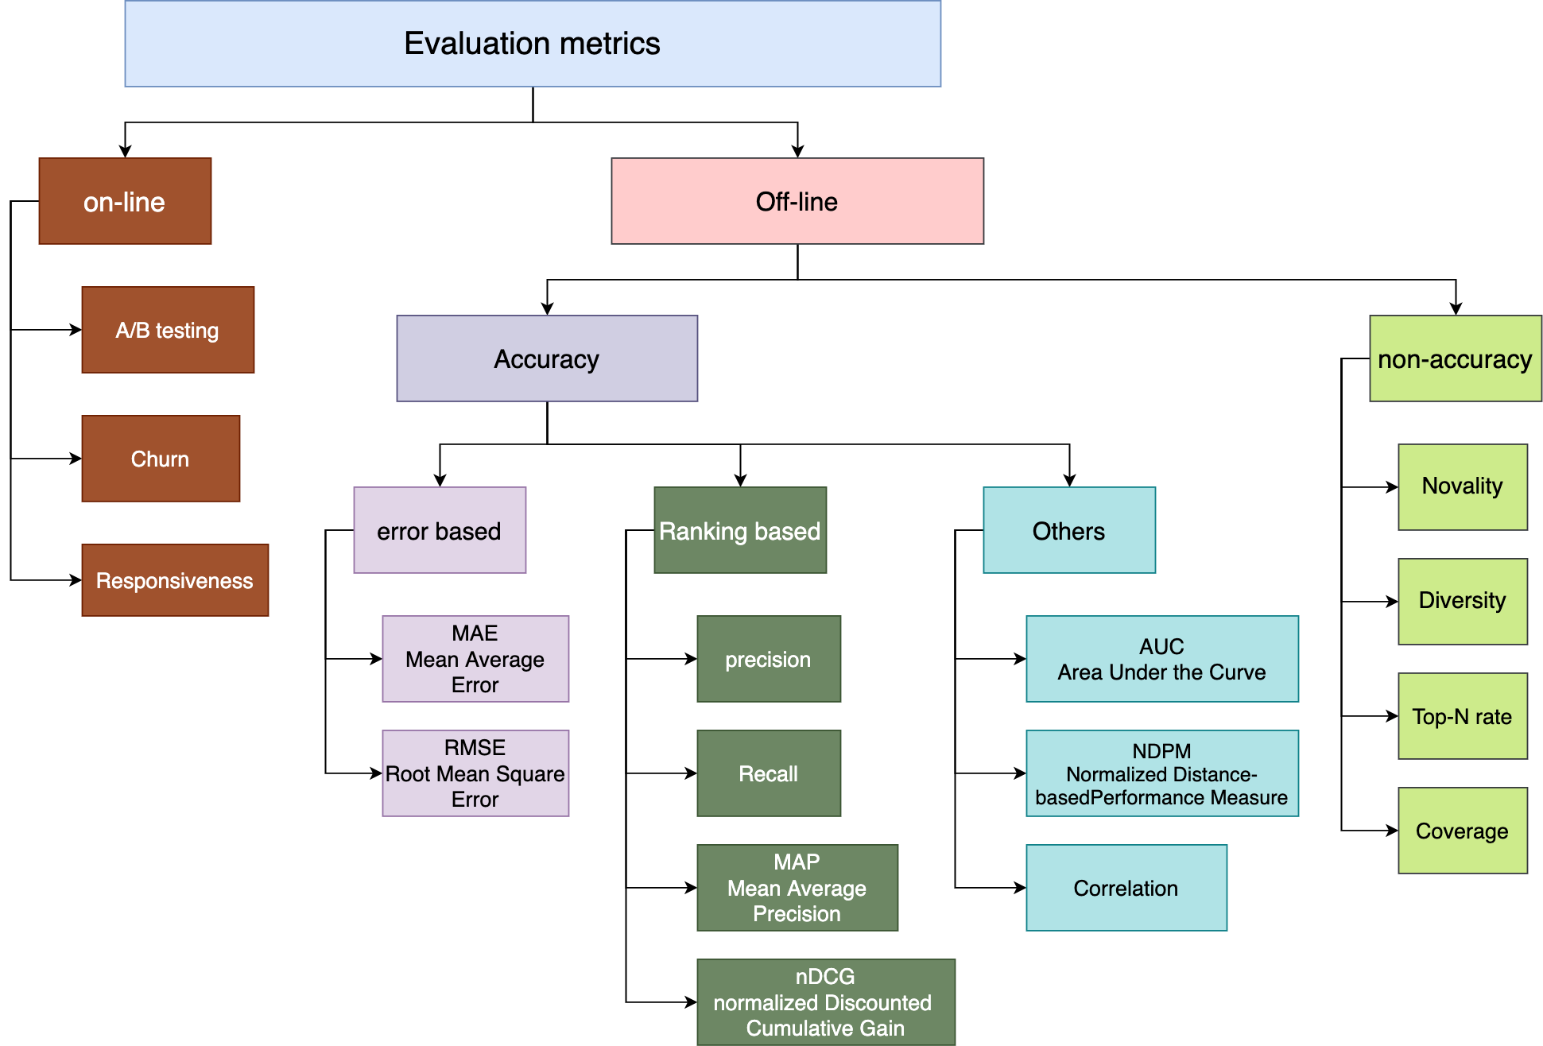

Slide 5
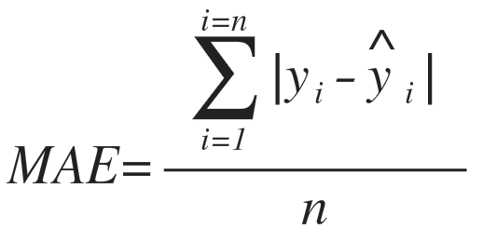
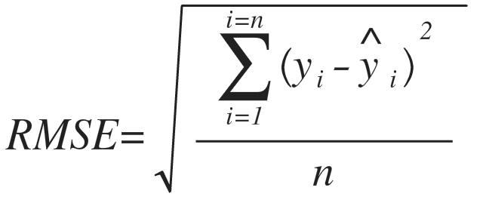
MAE vs. RMSE
predicted | actual | error
5 | 3 | 2
4 | 1 | 3
5 | 4 | 1
1 | 1 | 0
MAE |  | (2+3+1+0)/4 = 1.5
predicted | actual | error²
5 | 3 | 4
4 | 1 | 9
5 | 4 | 1
1 | 1 | 0
RMSE |  | √(14/4) = 1.87

Slide 6
Which one RMSE or MAE?
“Use RMSE if being off by 10 is more than twice as bad as being off by 5.
But if being off by 10 is just twice as bad as being off by 5, then MAE is more appropriate.”
If RMSE is close to MAE, then the model makes many relatively small errors.
If RMSE is close to MAE², then the model makes few but large errors.

Slide 7
Thanks!

