Slide 1
Evaluating Recommender system
Presented by: Salma Elshahawy
DATA 612 Summer 2020
June, 23, 2020

Slide 2
Outline
Testing methodology
Different evaluation metrics
RMSE vs. MAE?
Limitations

Slide 3
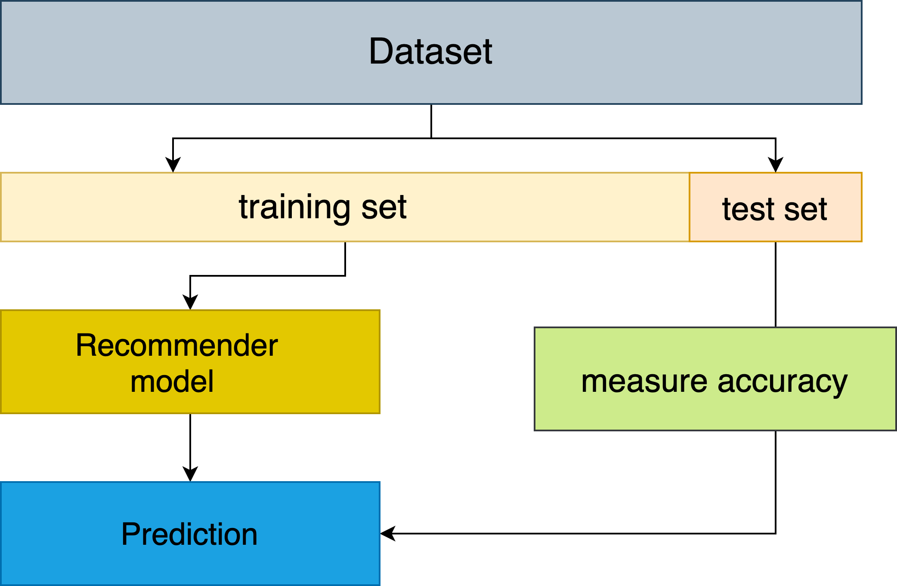
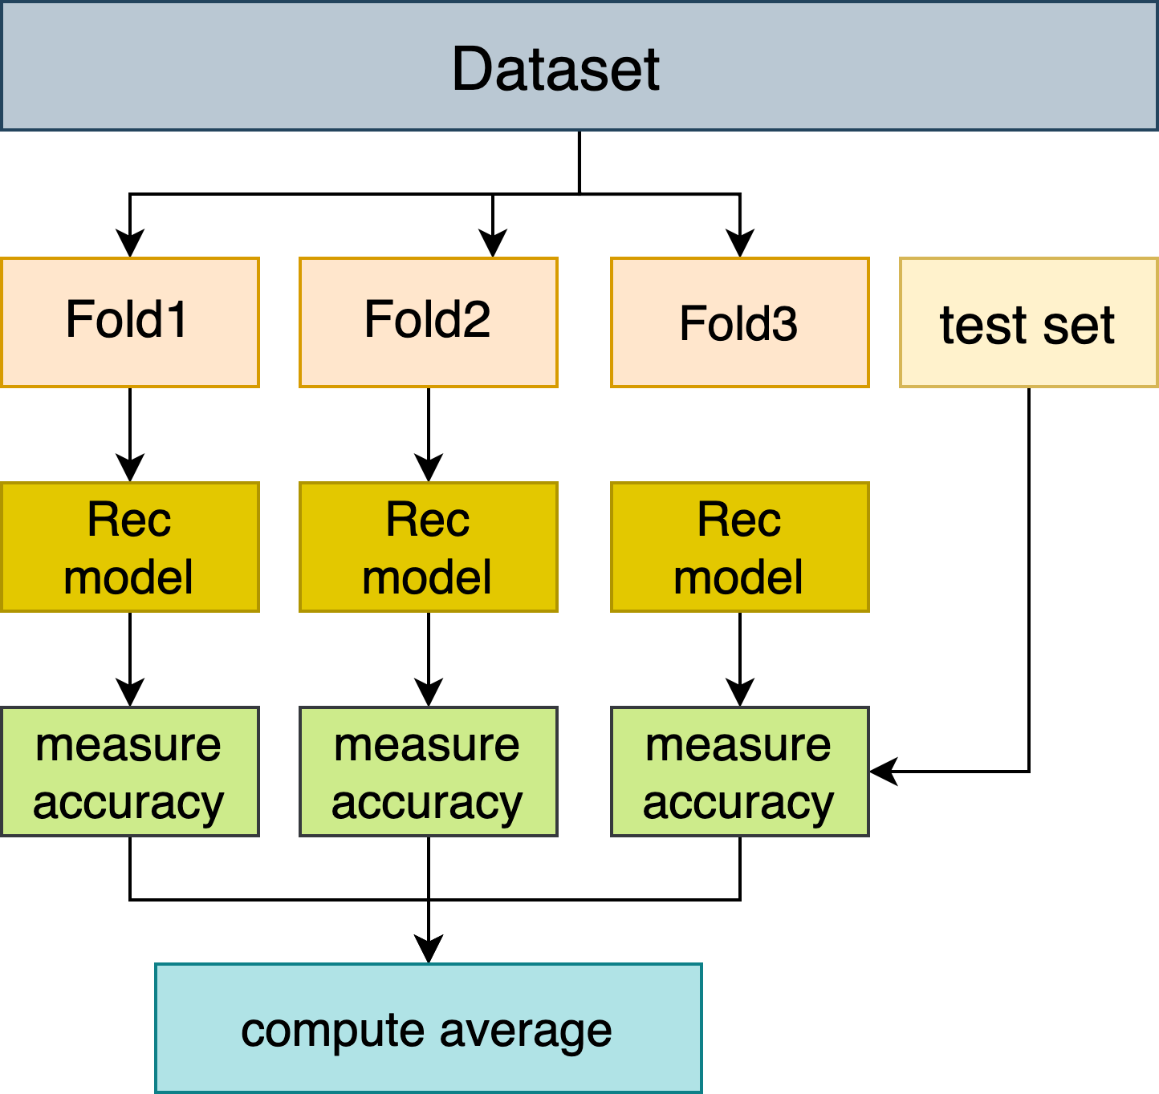
Testing methodologies

Slide 4
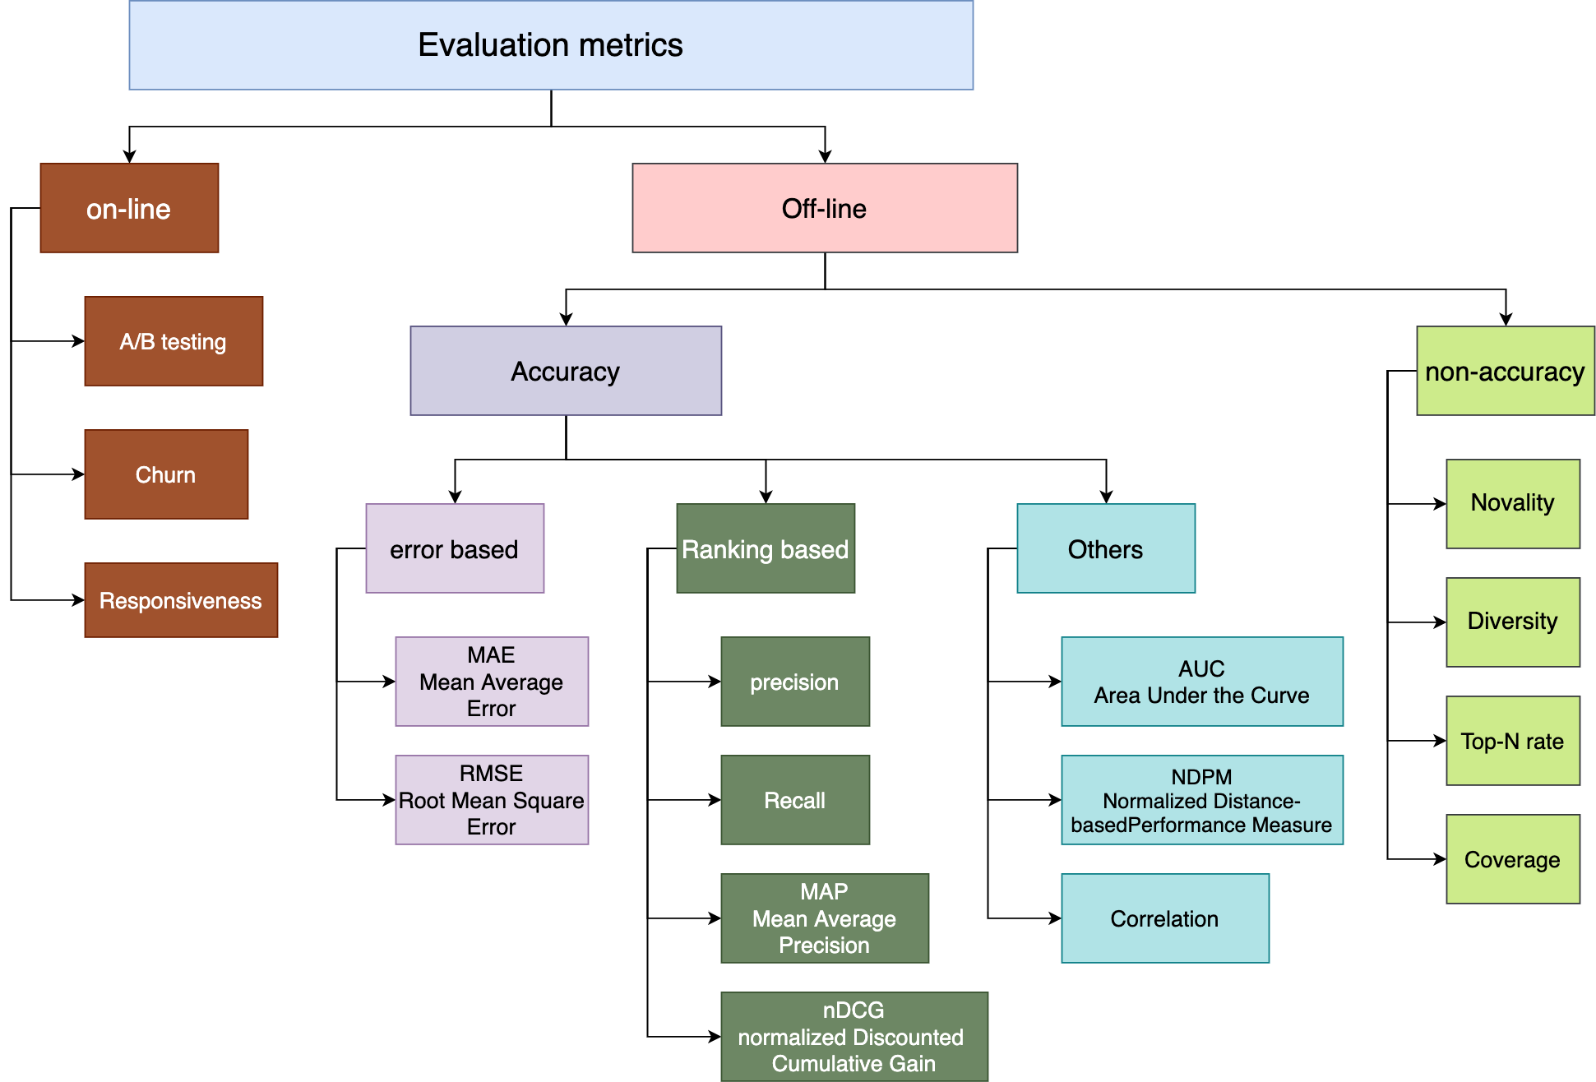

Slide 5
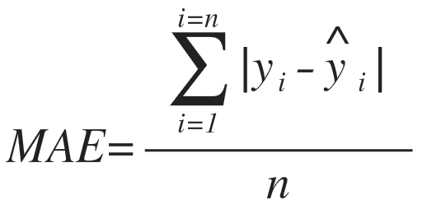
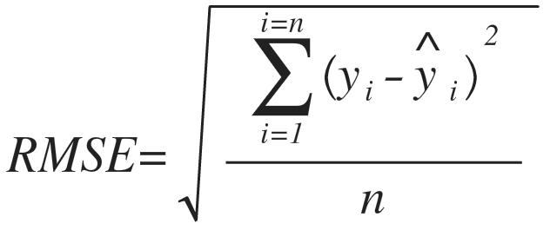
MAE vs. RMSE
Predicted | Actual | Error
5 | 3 | 2
4 | 1 | 3
5 | 4 | 1
1 | 1 | 0
MAE |  | (2+3+1+0)/4 = 1.5
Predicted | Actual | Error²
5 | 3 | 4
4 | 1 | 9
5 | 4 | 1
1 | 1 | 0
RMSE |  | √(14/4) = 1.87

Slide 6
RMSE or MAE?
“Use RMSE if being off by 10 is more than twice as bad as being off by 5.
But if being off by 10 is just twice as bad as being off by 5, then MAE is more appropriate.”
If RMSE is close to MAE², then the model makes few but large errors.
If RMSE is close to MAE, then the model makes many relatively small errors.

Slide 7
Limitations
Depend on the ratings range (unless normalized)
Depend on the recommender output’s range
Not Valid for recommenders that produce a score(not rating)
probability ,
similarity..etc

Slide 8
Thanks!

