Slide 1
Online Shopping Data Analysis

Slide 2
Team Members
Member Name | Member ID
Salma Ramy Mahmoud | 20201700348
Zainab Salama Ahmed | 20201700325
Alaa Salah Fahmy | 20201700135
Mariam Ahmed Tawfik | 20201700801
Omnia Khaled Abd-Elmeged | 20201700143

Slide 3
About Dataset
This data is for exploring online shopping trends and patterns
Data Attributes:
- Gender.
- Location: Location or address information of the customer.
- Tenure_Months: Number of months the customer has been associated with the platform.
- Transaction_Date. - Offline_Spend: Amount spent offline by the customer.
- Product_Category. - Online_Spend: Amount spent online by the customer.
- Quantity: Quantity of the product purchased in the transaction.
- Avg_Price. - Month: Month of the transaction.
- Delivery_Charges. - Discount_pct: Percentage of discount applied to the transaction.
- Coupon_Status: Status of the coupon associated with the transaction.
- GST: Goods and Services Tax associated with the transaction.

Slide 4
Preprocessing & Statistics

Slide 5
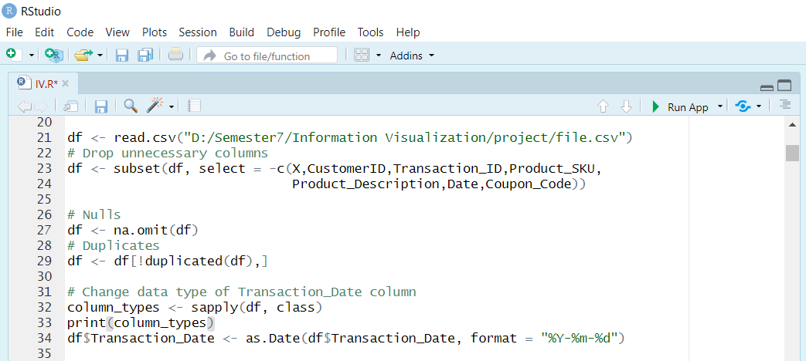
Preprocessing
Remove Unnecessary Attributes.
Remove Null Values.
Remove Duplicated Rows.
Check Attributes’ Data Types and Fix it.

Slide 6
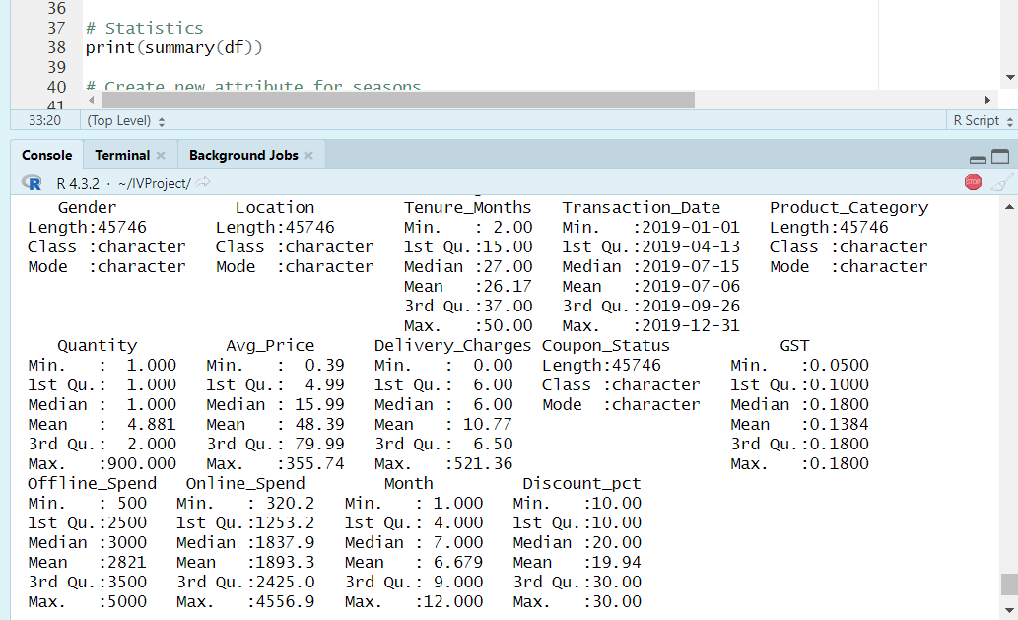
Statistics

Slide 7
Dashboard

Slide 8
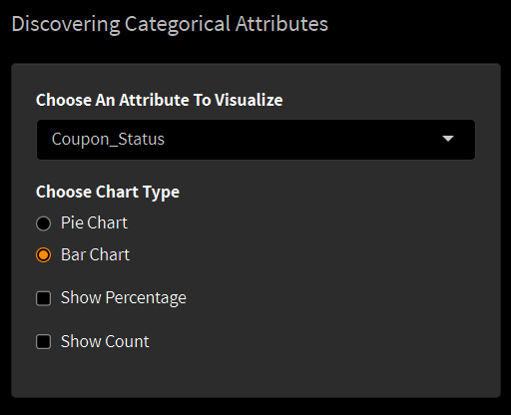
1) Discovering Categorical Attributes
Visualizing data’s categorical attributes ( Gender, Location, Product_Category, Coupon_Status) using both Bar chart and Pie chart .
We added drop down menu to allow switching between different categorical attributes to visualize also radio buttons to switch between pie chart and bar chart.
For pie chart we added check boxes to allow adding percentage or category count to the chart.

Slide 9
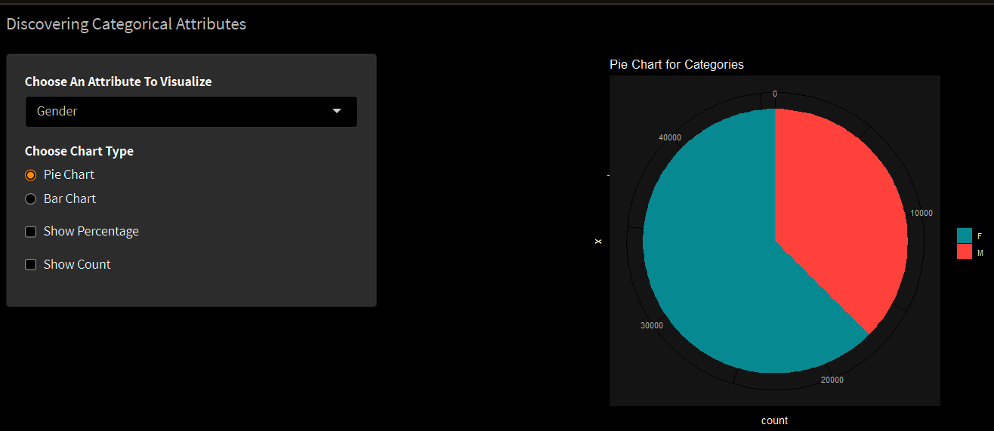
Results (1)

Slide 10
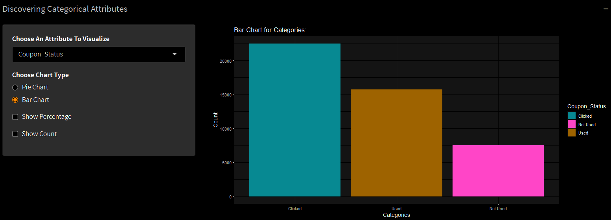
Results (2)

Slide 11
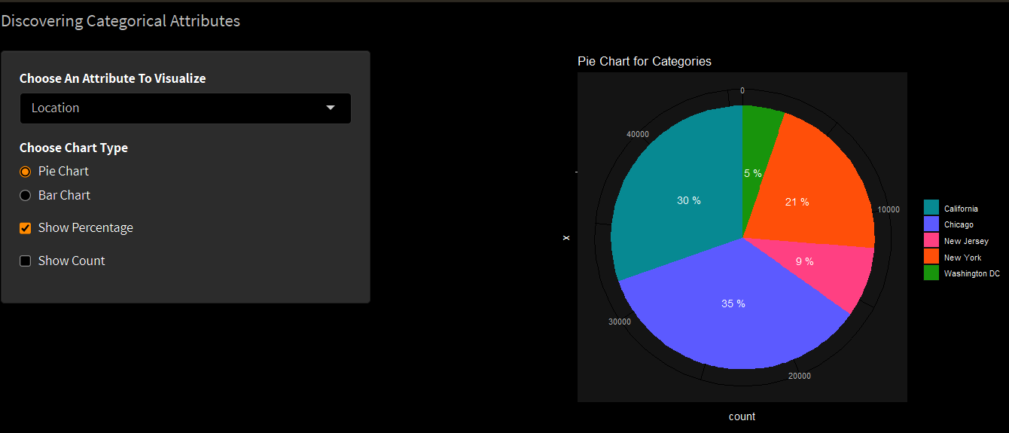
Results (3)

Slide 12
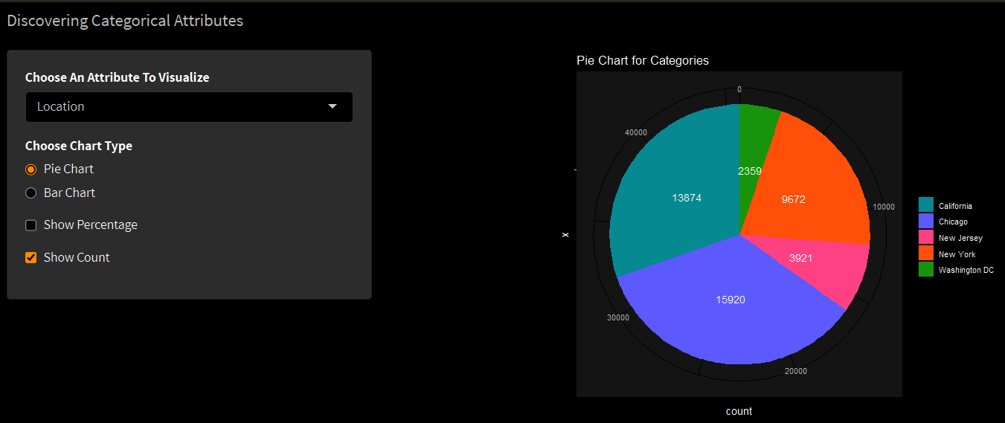
Results (4)

Slide 13
Observations
For Gender attribute → Most customers are woman.
For Location attribute → Most sales are in Chicago.
For Product_Category attribute → Best seller products are from Apparel category.
For Coupon_Status attribute → Most Coupons are Clicked.

Slide 14
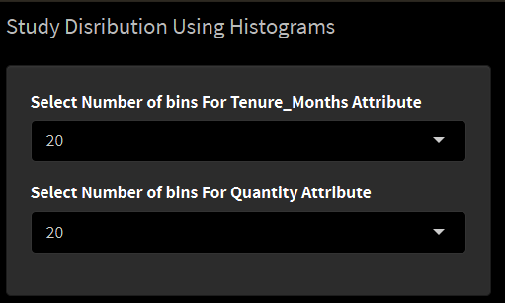
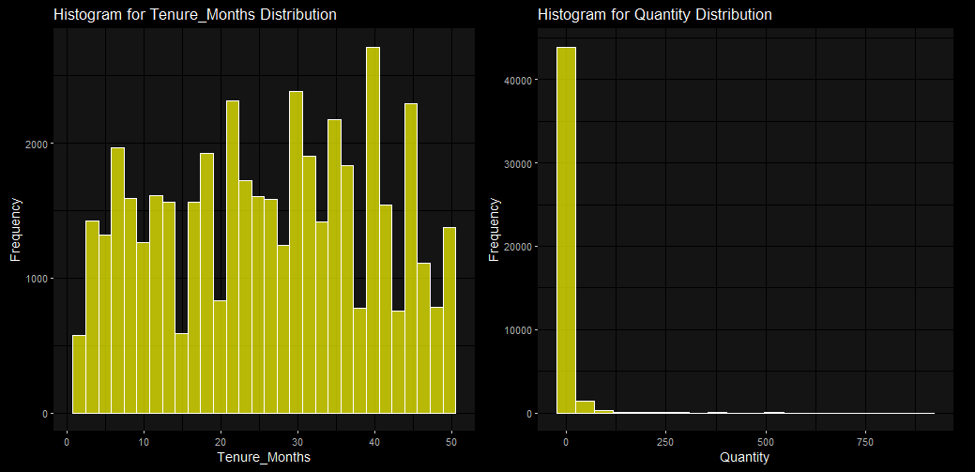
2) Study Some Attributes Using Histograms
Visualize 2 numerical attributes (Tenure_Months, Quantity) using histograms.
We added drop down menus to enable customize the plots by changing number od bins.
Results and Observations
most users have more than 40-month association with the platform.
one product is purchased in bulk.

Slide 15
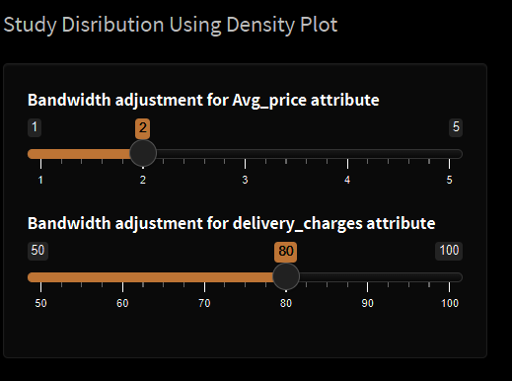
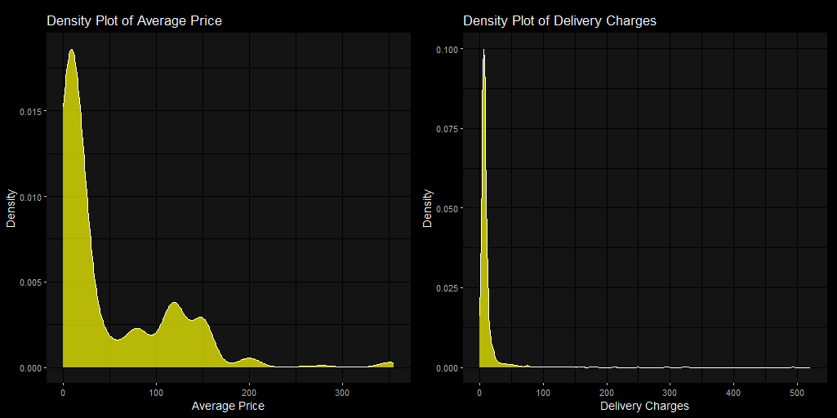
3) Study Distribution Using Density Plot
Visualize Distribution of 2 numerical attributes (Avg_price, delivery_charges) using density plot.
We added sliders to enable customize the plots by adjust the bandwidth of the plot.
Results and Observation
Avg price plot shows skewedness to the right.
The Delivery charge plot show that most of the charges are between 0 & 50

Slide 16
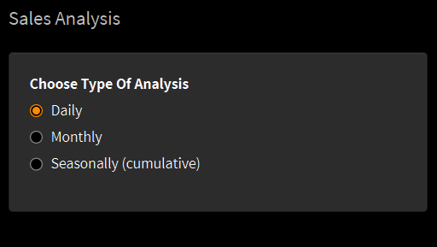
4) Sales Analysis
We created new attribute for sales to analyze it using bar chart daily and cumulative ( monthly and seasonally –for which we also created a new attribute-).
We added radio buttons to allow filtering sales Daily – Monthly – Seasonally.

Slide 17
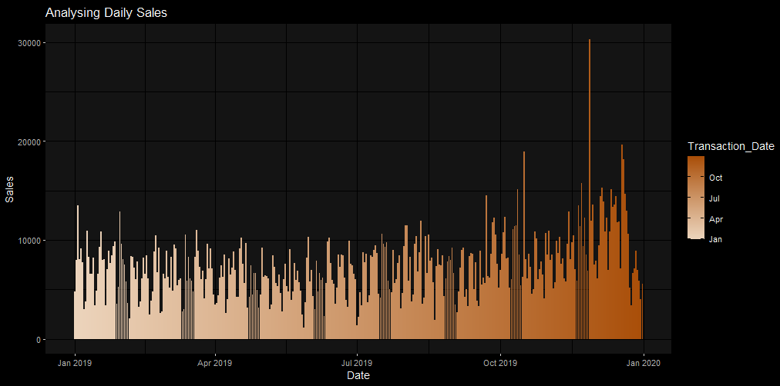
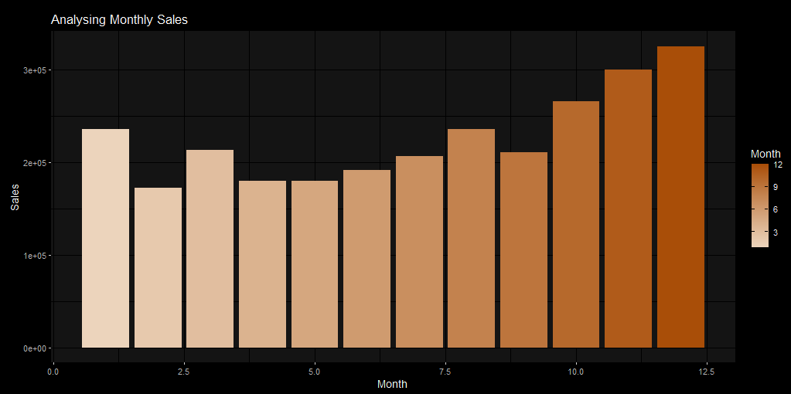
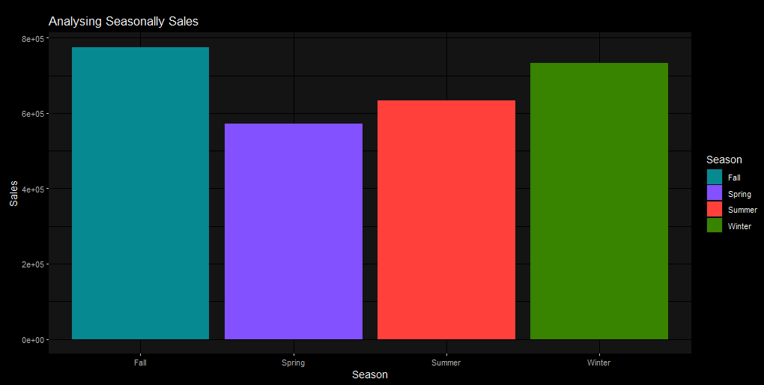
Results and Observations
Sales seems to increase gradually especially on months that have celebration like December.
Fall & winter have the highest sales.

Slide 18
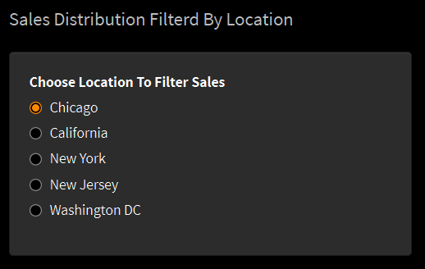
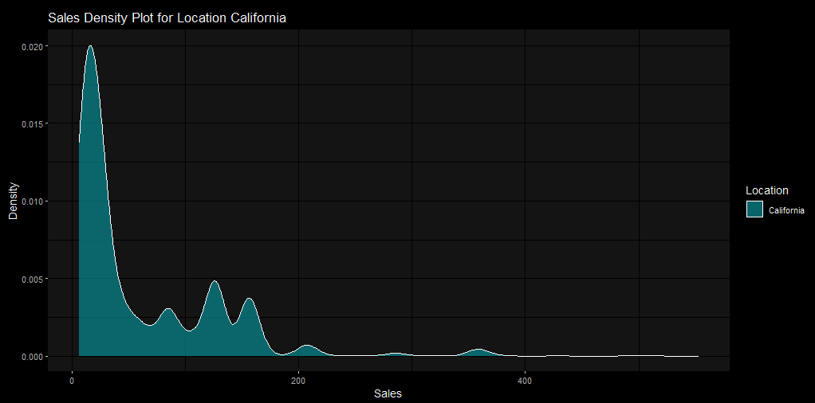
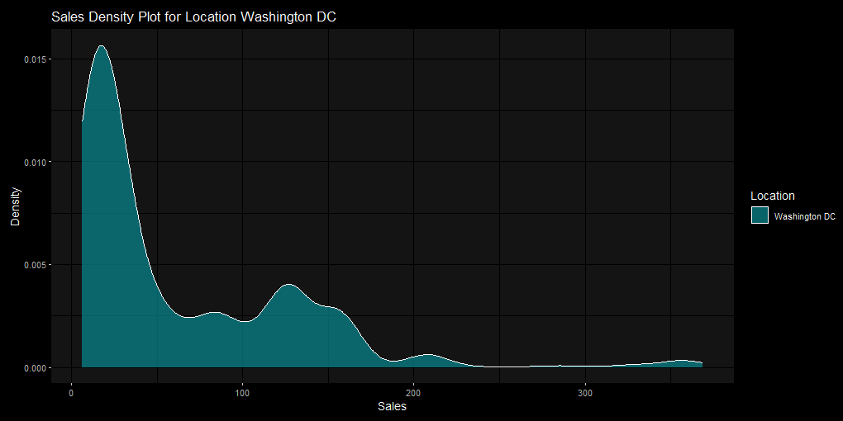
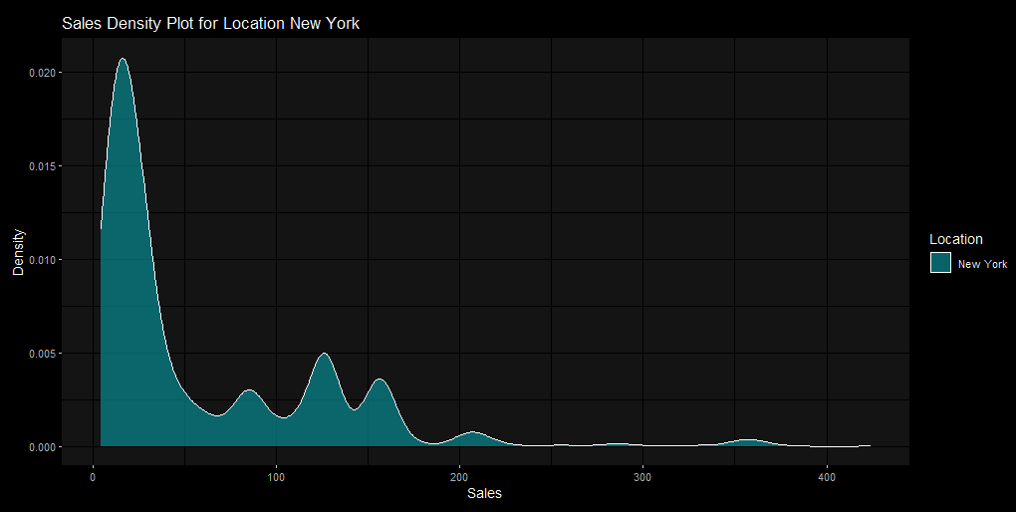
5) Sales Distribution Filtered By Location
Visualize Distribution sales attribute using density plot and filter it by location.
We added radio buttons to allow filtering sales different locations (Chicago, California, New York, New Jersey, Washington DC).
Results

Slide 19
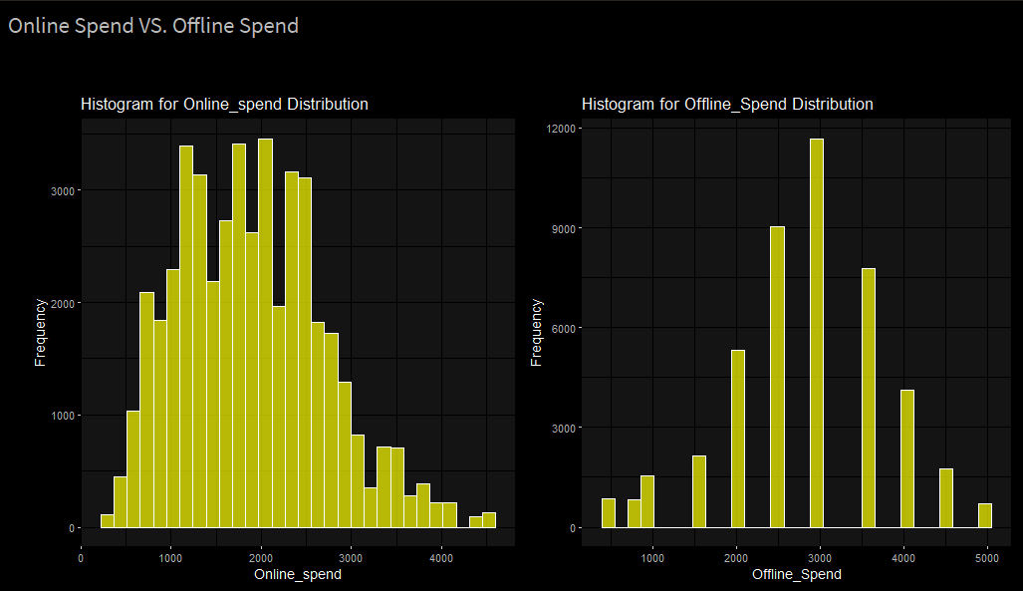
6)Online Spend VS. Offline Spend
Compare between amounts customers spend online and offline using histogram.
Offline Spenders Seem to spend more money per purchase.
Most customers prefer online shopping.

Slide 20
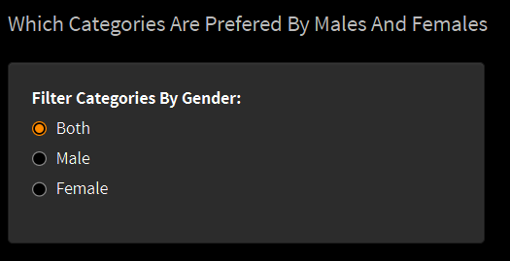
7) Product Categories Analysis
By this analysis we are trying to answer this question: Which Categories Are Preferred By Males And Females?
Visualize product categories using count plot and we added radio buttons to allow filter visualization by males, females or both.

Slide 21
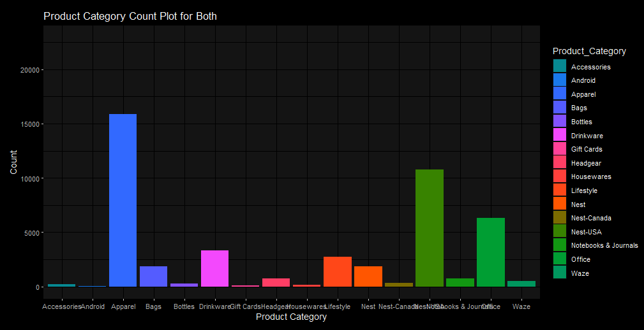
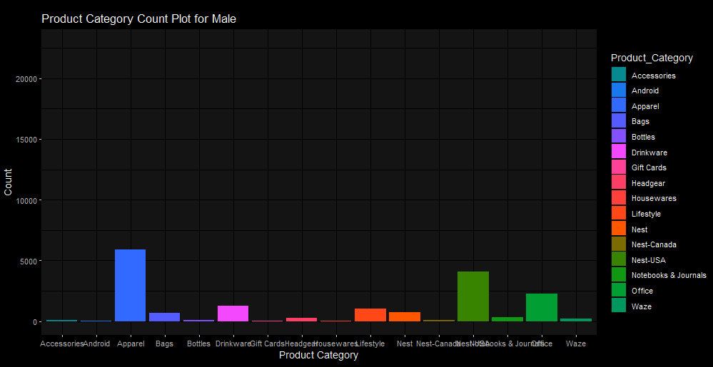
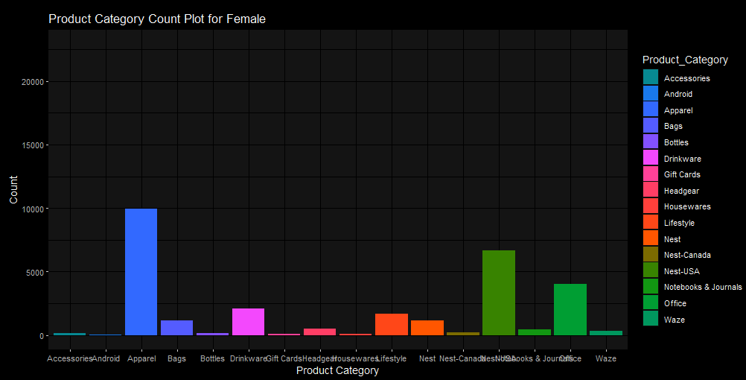
Results and Observations
Both female and male users prefer Apparel & Nest-USA categories.
Female Users have higher products overall.

Slide 22
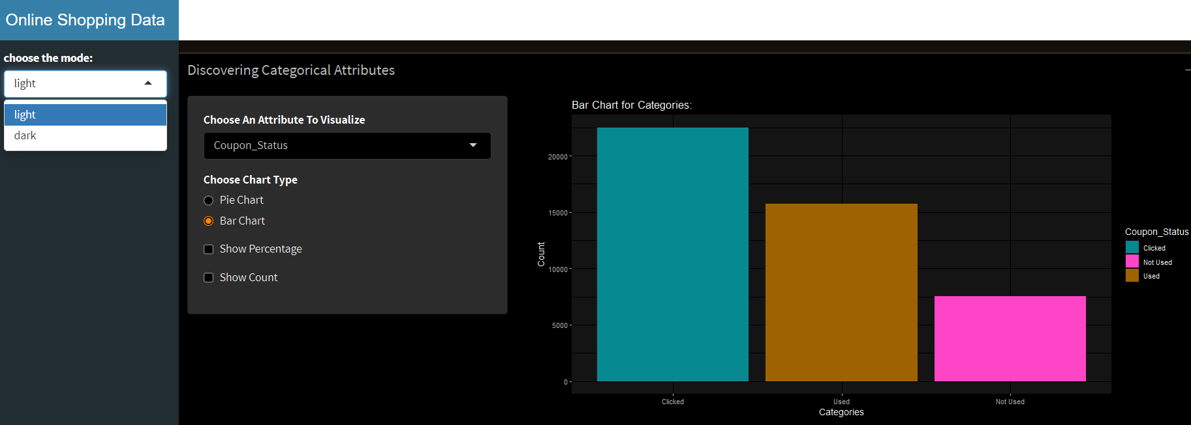
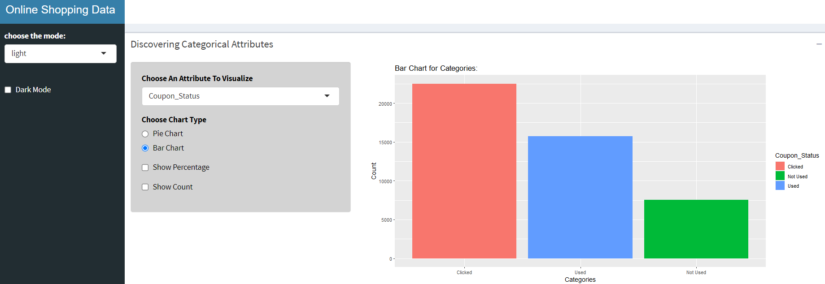
General Features Added to the Dashboard
Dark/Light mode toggle.
clear and concise tooltips.
Ability to show/hide visualizations.
Dark/Light Modes

Slide 23
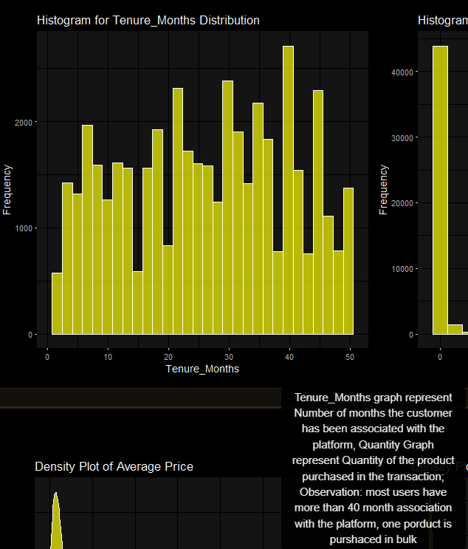
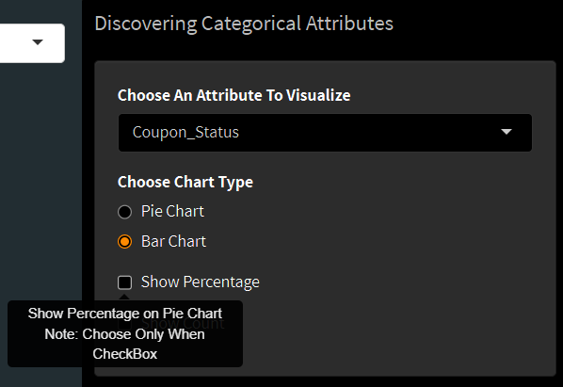
Observations
Tool Tips

Slide 24
THANK YOU

