Slide 1

Medical Insurance Claim Analysis
Salma Abdallah
Sp26 STAT 311-50 Regression Analysis
04/27/26

Slide 2

Research Question
Healthcare costs vary widely across individuals
Understanding key drivers helps:
Insurance pricing
Risk assessment
Research Question:
Which variables significantly affect claim amounts?
Which predictors are most important?

Slide 3

Dataset Overview
Source: Kaggle (Real U.S. Insurance Data)
4,000 observations
Observational dataset (real-world data)
No experimental control
Reflects real variation in individuals

Slide 4

Variables
what we predict
Claim Amount (continuous)
what we test
Age → affects health risk
BMI → relates to obesity/health
Gender → possible cost differences
Smoking → major health risk
Diabetes → chronic condition
Claim Status → claim category
Categorical variables converted into numeric indicators

Slide 5

Method Overview
Multiple Linear Regression:
Measures relationship between variables
Stepwise Regression:
Removes unimportant variables
Evaluation metrics:
R² → how much variation is explained
p-values → significance
Goal: build the best possible predictive model

Slide 6

Model Improvements
Tested nonlinear effects:
Age², BMI²
Tested interactions:
BMI × Smoking
Log transformation:
Fix skewed data
Trying to capture complex relationships

Slide 7

Regression Results
Model NOT significant
R² ≈ 0.002
Explains <1% of variation
Model fails to capture real patterns

Slide 8

Significant Variable
Only significant predictor:
Diabetes (p ≈ 0.01)
Final Model: Claim Amount = 2936 − 71.92(Diabetes)
Effect is small
Not practically meaningful

Slide 9
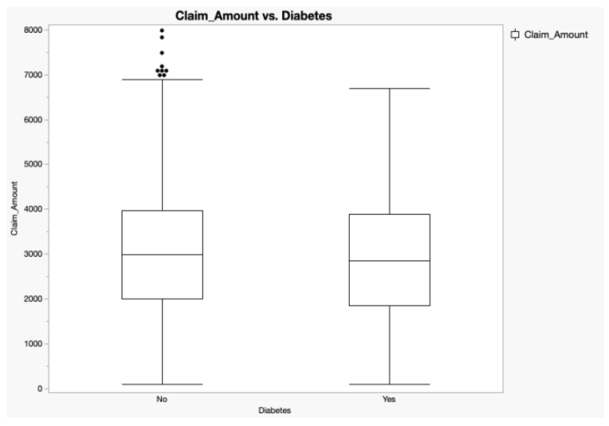
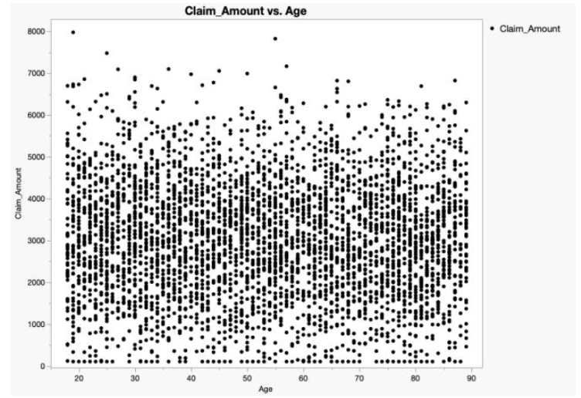
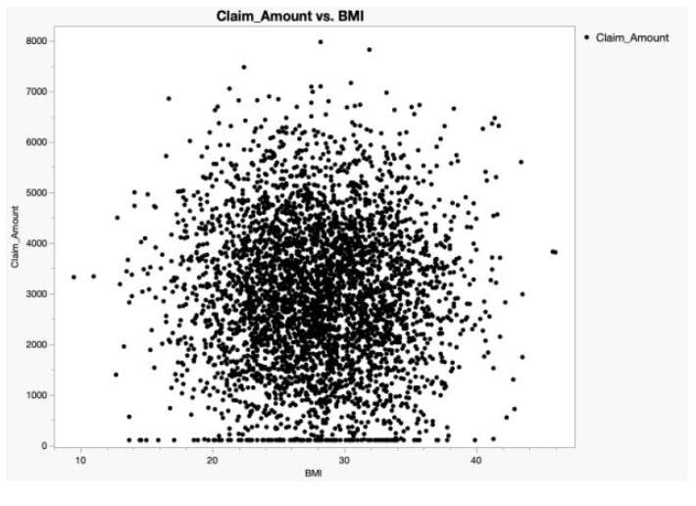
Visual Results
Age vs Claim → no pattern
BMI vs Claim → no pattern
Diabetes → slight difference
High variability across all data points

Slide 10
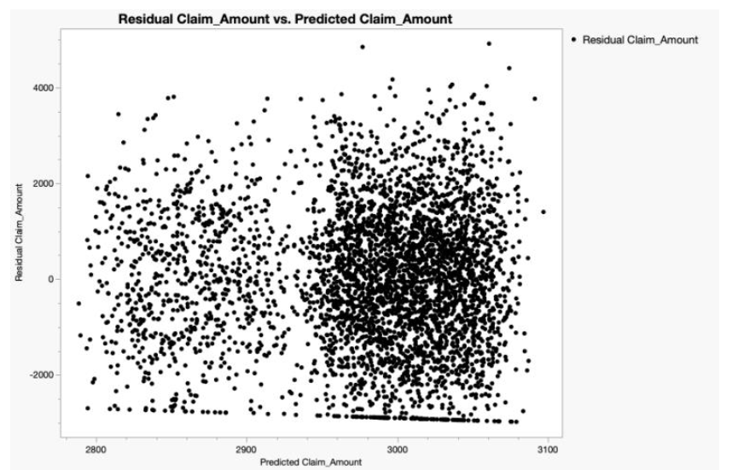
Residual Plot
Residuals centered around zero
No clear pattern → linearity OK
Large spread → poor predictions
Model cannot accurately predict outcomes

Slide 11
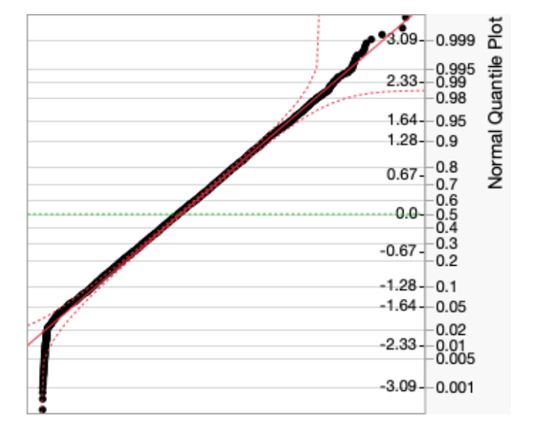
Q-Q Plot
Points follow line → mostly normal
Slight deviation → extreme values
Assumption acceptable

Slide 12

Key Findings
Most variables are NOT significant
Diabetes is the only significant predictor
Model explains almost nothing
Weak relationships overall

Slide 13

Why Model Failed
Missing important variables:
Medical history
Severity of illness
Income
Insurance type
Key drivers are not included

Slide 14

Real-World Meaning
Cannot predict costs with simple variables
Healthcare costs are complex
Requires more detailed data

Slide 15

Model is weak
Data is insufficient
Better data needed
Data quality determines success

